Slide 1
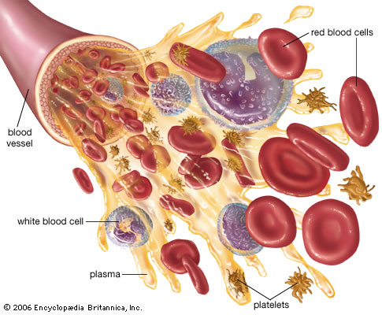
BLOOD CONTENT PREDICTION USING DEEP LEARNING TECHNIQUES
Presented by,
Moulya CP (16tucs121)
Narmatha Shree R (16tucs126)
Rumana Parveen A(16tucs157)
Guided by,
Ms. NRP Nivetha
Assistant Professor
CSE Department

Slide 2
OUTLINE
Base Paper Details
Abstract
Introduction
Literature survey
Problem definition
Existing System and its drawbacks
Proposed system/methodology
Block diagram
Modules
Platform & Tools
Conclusion

Slide 3
Base Paper Details
Title:
Visualizing Interactions of Circulating Tumor Cell and Dendritic Cell in the Blood Circulation Using In Vivo Imaging Flow Cytometry
Journal name:
IEEE
Transactions on Biomedical Engineering
Method used:
Artificial Neural Network
Year:
2018
Authors:
Dan Wei, Xuejiao Zeng

Slide 4
ABSTRACT
Visualizing cell interactions in blood circulation is of great importance in studies of blood disease immunotherapy or drugs.
However, the lack of a suitable imaging system hampers progress in this field.
Deep Learning Has Recently Been Used In Image Recognition
Deep learning is a collective term for algorithm shaving a deep architecture that solves complex problems

Slide 5
Introduction
Blood cells play a remarkable role in the human immune system.
To diagnose blood-related diseases, pathologists need to consider the characteristics of blood cells.
The diagnosis of blood-based diseases often involves identifying and characterizing patient blood samples.
Automated methods to detect and classify blood cell subtypes have important medical applications.
Object recognition is an integral part of computer vision that identifies an object in the given image irrespective of backgrounds, occlusion, the angle of view, lighting.

Slide 6
Survey
Name of paper | Authors | Year/ publisher | Algorithms used
An Automatic Nucleus Segmentation and CNN Model based Classification Method of White Blood Cell | Partha Pratim Banik Rappy Saha | 2020/ Expert Systems with Applications | convolutional neural network (CNN)
An automated method for segmentation and quantification of blood vessels in histology images | Faiza Bukenya, Culi Nerissa | Microvascular research, 2020 - Elsevier | Vessel Segmentation-Matlab

Slide 7
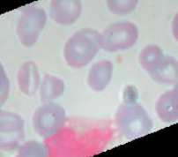
Block diagram → proposed flow
DATA (IMAGES)
Feature extraction
Selection of algorithms
Fitting parameters
Object detection
Analysis of images
Object classification
Object prediction

Slide 8
Area→ Deep learning
Deep learning is a type of machine learning in which a model learns to perform classification tasks directly from images, text or sound.
Deep learning is usually implemented using neural network architecture.
The term deep refers to the number of layers in the network—the more the layers, the deeper the network.
The layers are interconnected via nodes, or neurons, with each hidden layer using the output of the previous layer as its input.

Slide 9
TOOL→ DEEP LEARNING
Colaboratory is a free Jupyter notebook environment provided by Google where you can use free GPUs and TPUs which can solve all these issues
All major Python libraries, like TensorFlow, Scikit-learn, Matplotlib, etc. are pre-installed.
Keras is a powerful easy-to-use Python library for developing and evaluating deep learning models.

Slide 10
Modules
Data set collection
Pre-processing
Training the data –selecting DL algorithm
Sitting weights and parameters
Final output and results

Slide 11
DATASET COLLECTION & DESCRIPTION
This dataset contains 12,500 augmented images of blood cells (JPEG) with accompanying cell type labels (CSV).
There are approximately 3,000 images for each of 4 different cell types grouped into 4 different folders (according to cell type).
The cell types are Eosinophil, Lymphocyte, Monocyte, and Neutrophil.

Slide 12
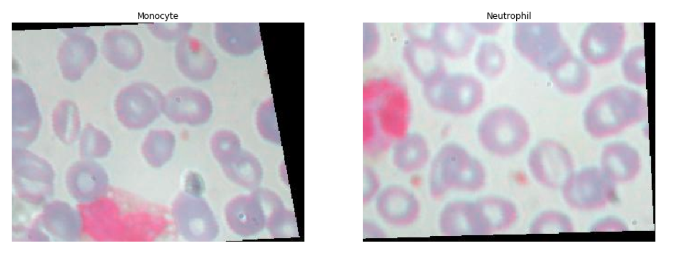
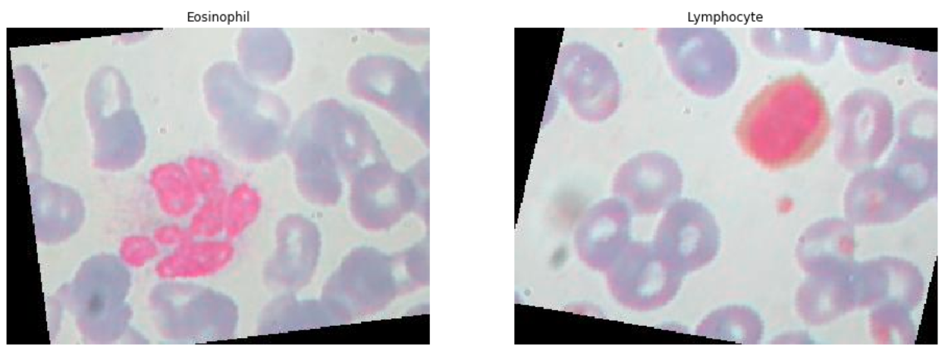
Viewing random samples from all four categories
Eosinophil, Lymphocyte, Monocyte, and Neutrophil

Slide 13
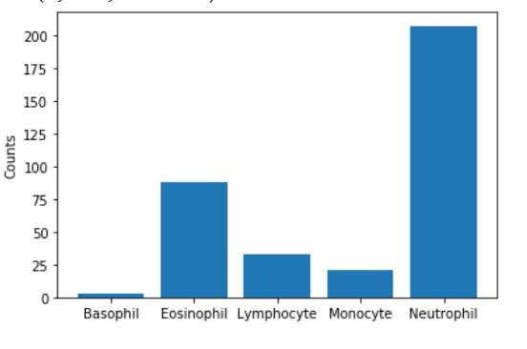
DATA IMAGES DISTRIBUTION

Slide 14
Model designing- CNN
Convolutional neural networks (CNN) is one of the variants of neural networks used heavily in the field of computer vision.
The hidden layers of a CNN typically consist of convolutional layers, pooling layers, fully connected layers etc.
A CNN model can be thought as a combination of two components: feature extraction part and the classification part.
The convolution + pooling layers perform feature extraction.
The fully connected layers then act as a classifier on top of these features, and assign a probability to provide final output

Slide 15
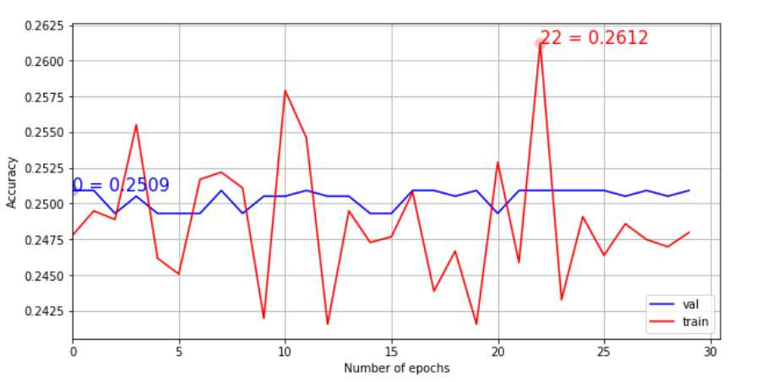
Accuracy
Accuracy : 25%

Slide 16
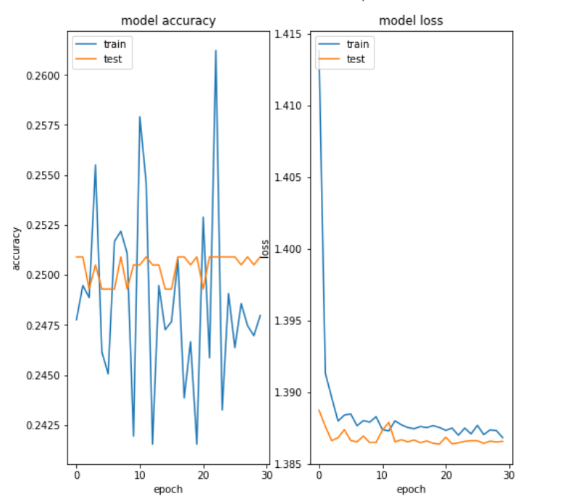
ACCURACY VS LOSS GRAPH

Slide 17
Conclusion
The diagnosis of blood-based diseases often involves identifying and characterizing patient blood samples.
Automated methods to detect and classify blood cell subtypes have important medical applications.
Deep learning can be a very good help in deciding the line of treatment to be followed by extracting knowledge from such suitable databases.
Our project can assist in proper treatment methods for a patient diagnosed with Blood related disease

