Slide 1
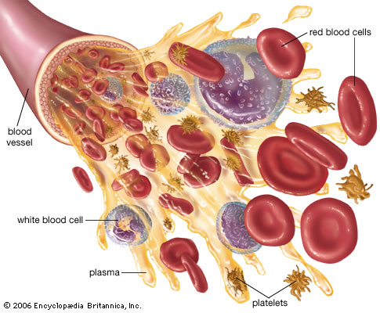
BLOOD CONTENT PREDICTION USING DEEP LEARNING TECHNIQUES
Presented by,
Moulya CP (16tucs121)
Narmatha Shree R (16tucs126)
Rumana Parveen A (16tucs157)
Guided by,
Ms.NRP Nivetha
Assistant Professor
CSE Department

Slide 2
OUTLINE
Base Paper Details
Abstract
Introduction
Literature survey
Problem definition
Existing System and its drawbacks
Proposed system/methodology
Block diagram
Modules
Platform & Tools
Conclusion

Slide 3
Base Paper Details
Title:
Visualizing Interactions of Circulating Tumor Cell and Dendritic Cell in the Blood Circulation Using In Vivo Imaging Flow Cytometry
Journal name:
IEEE
Transactions on Biomedical Engineering
Method used:
Artificial Neural Network
Year:
2018
Authors:
Dan Wei, Xuejiao Zeng

Slide 4
ABSTRACT
Visualizing cell interactions in blood circulation is of great importance in studies of blood disease immunotherapy or drugs.
However, the lack of a suitable imaging system hampers progress in this field.
Deep Learning Has Recently Been Used In Image Recognition
Deep learning is a collective term for algorithm shaving a deep architecture that solves complex problems

Slide 5
Introduction
Blood cells play a remarkable role in the human immune system.
To diagnose blood-related diseases, pathologists need to consider the characteristics of blood cells.
The diagnosis of blood-based diseases often involves identifying and characterizing patient blood samples.
Automated methods to detect and classify blood cell subtypes have important medical applications.
Object recognition is an integral part of computer vision that identifies an object in the given image irrespective of backgrounds, occlusion, the angle of view, lighting.

Slide 6
Survey
Name of paper | Authors | Year/ publisher | Algorithms used
An Automatic Nucleus Segmentation and CNN Model based Classification Method of White Blood Cell | Partha Pratim Banik Rappy Saha | 2020/ Expert Systems with Applications | convolutional neural network (CNN)
An automated method for segmentation and quantification of blood vessels in histology images | Faiza Bukenya, Culi Nerissa | Microvascular research, 2020 - Elsevier | Vessel Segmentation-Matlab

Slide 7
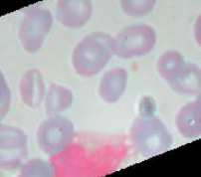
Block diagram → proposed flow
DATA (IMAGES)
Feature extraction
Selection of algorithms
Fitting parameters
Object detection
Analysis of images
Object classification
Object prediction

Slide 8
Area→ Deep learning
Deep learning is a type of machine learning in which a model learns to perform classification tasks directly from images, text or sound.
Deep learning is usually implemented using neural network architecture.
The term deep refers to the number of layers in the network—the more the layers, the deeper the network.
The layers are interconnected via nodes, or neurons, with each hidden layer using the output of the previous layer as its input.

Slide 9
TOOL→ DEEP LEARNING
Colaboratory is a free Jupyter notebook environment provided by Google where you can use free GPUs and TPUs which can solve all these issues
All major Python libraries, like TensorFlow, Scikit-learn, Matplotlib, etc. are pre-installed.
Keras is a powerful easy-to-use Python library for developing and evaluating deep learning models.

Slide 10
Modules
Data set collection
Pre-processing
Training the data –selecting DL algorithm
Sitting weights and parameters
Final output and results

Slide 11
DATASET COLLECTION & DESCRIPTION
This dataset contains 12,500 augmented images of blood cells (JPEG) with accompanying cell type labels (CSV).
There are approximately 3,000 images for each of 4 different cell types grouped into 4 different folders (according to cell type).
The cell types are Eosinophil, Lymphocyte, Monocyte, and Neutrophil.

Slide 12
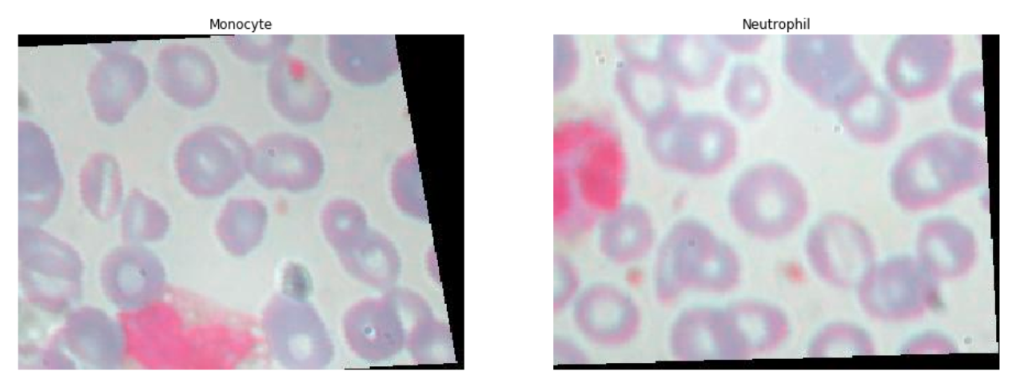
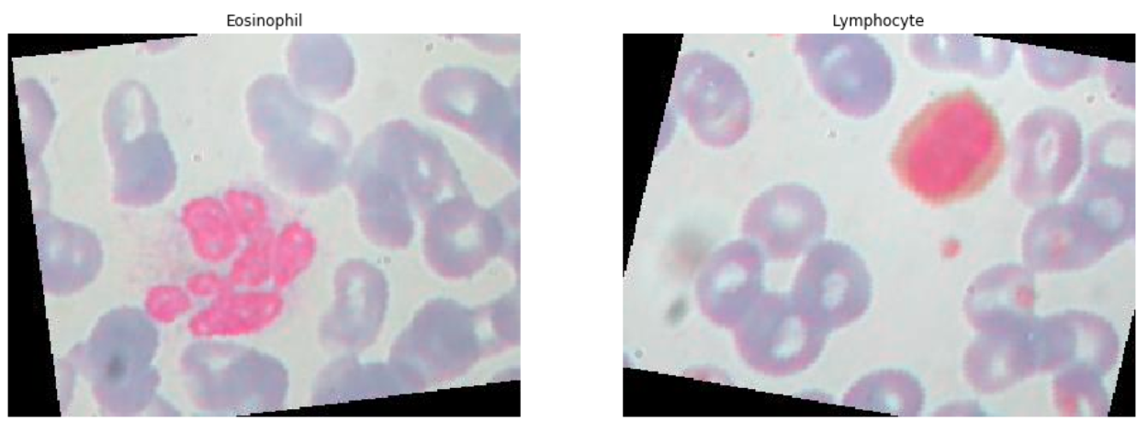
Viewing random samples from all four categories
Eosinophil, Lymphocyte, Monocyte, and Neutrophil

Slide 13
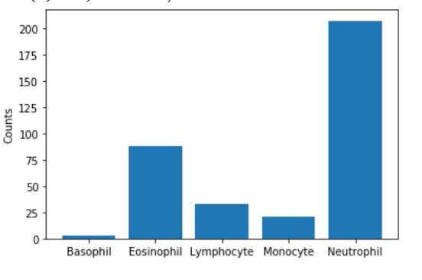
DATA IMAGES DISTRIBUTION

Slide 14
LAYERS USED IN THIS WORK
Convolution Layer :
Features Of The Image Are Get Extracted Within This Layer.
Max Polling Layer:
Used To Reduce The Spatial Volume Of Input Image
Batch Normalization Layer:
Improving The Speed, Performance, And Stability
Dense Layer:
Feeds All Outputs From The Previous Layer
Drop Out Layer:
Helps To Reduce Overfitting.

Slide 15
Model designing- CNN
Convolutional neural networks (CNN) is one of the variants of neural networks used heavily in the field of computer vision.
The hidden layers of a CNN typically consist of convolutional layers, pooling layers, fully connected layers etc.
A CNN model can be thought as a combination of two components: feature extraction part and the classification part.
The convolution + pooling layers perform feature extraction.
The fully connected layers then act as a classifier on top of these features, and assign a probability to provide final output

Slide 16
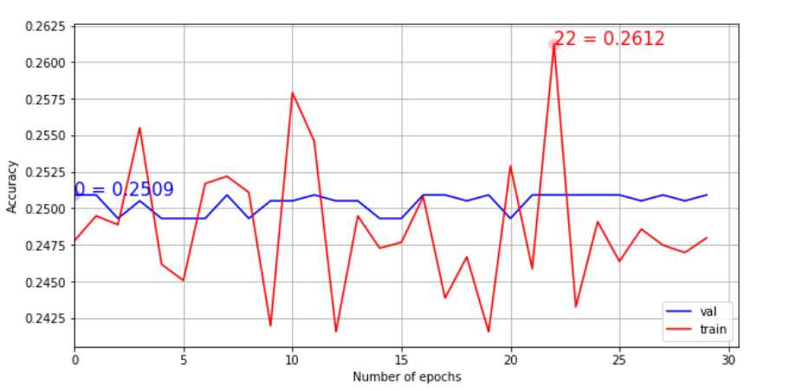
Accuracy
Accuracy : 25%

Slide 17
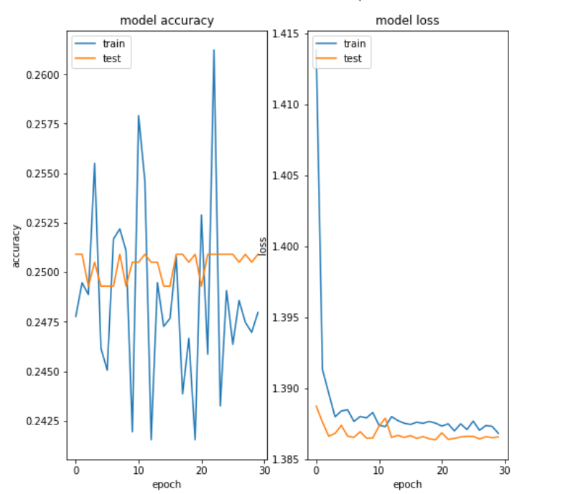
ACCURACY VS LOSS GRAPH

Slide 18
INCEPTION
Inception V3 by Google is the 3rd version in a series of Deep Learning Convolutional Architectures.
Inception v3 is a widely-used image recognition model that has been shown to attain greater than 78.1% accuracy on the ImageNet dataset.
The model is the culmination of many ideas developed by multiple researchers over the years
The image recognition model called Inception-v3 consists of two parts:
Feature extraction part with a convolutional neural network.
Classification part with fully-connected and softmax layers.

Slide 19
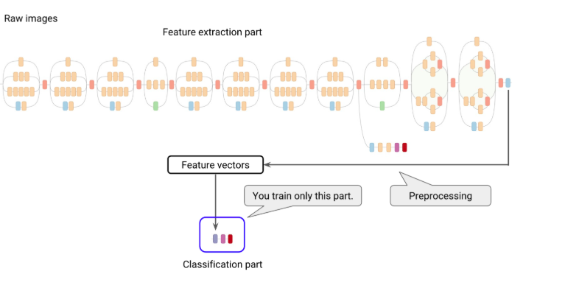
INCEPTION PROCESS
IMPROVED PERFORMANCE
Accuracy : 86%

Slide 20
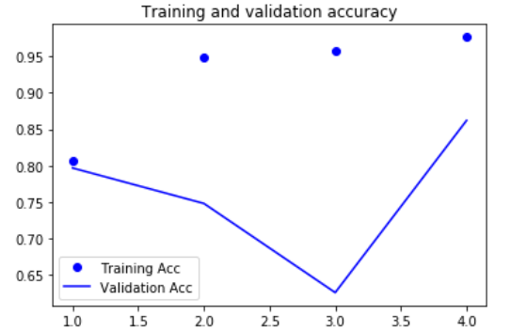
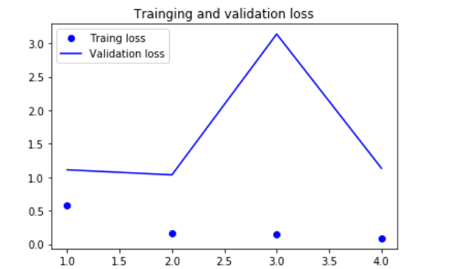
ACCURACY VS LOSS- INCEPTION

Slide 21
VGG 16
It makes the improvement over AlexNet by replacing large kernel-sized filters(11 and 5 in the first and second convolutional layer, respectively) with multiple 3X3 kernel-sized filters one after another.
With a given receptive field(the effective area size of input image on which output depends), multiple stacked smaller size kernel is better than the one with a larger size kernel because multiple non-linear layers increases the depth of the network which enables it to learn more complex features, and that too at a lower cost.
IMPROVED PERFORMANCE
Accuracy : 98%

Slide 22
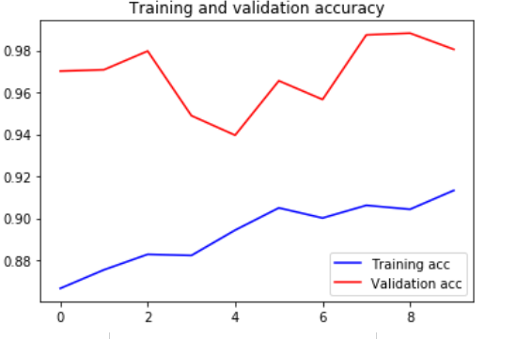
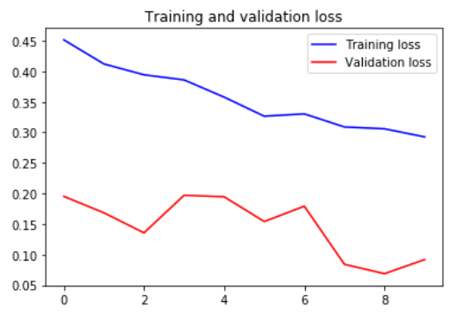
ACCURACY VS LOSS –VGG16

Slide 23
Conclusion
The diagnosis of blood-based diseases often involves identifying and characterizing patient blood samples.
Automated methods to detect and classify blood cell subtypes have important medical applications.
Deep learning can be a very good help in deciding the line of treatment to be followed by extracting knowledge from such suitable databases.
Our project can assist in proper treatment methods for a patient diagnosed with Blood related disease

