Slide 1
Activity-3

Slide 2
Prepare a presentation on 5 networking protocols being used in your smart phone.
Protocol
A set of rules or procedures for transmitting data between electronic devices, such as computers.
Communication protocol
A communication protocol is a system of rules that allows two or more entities of a communications system to transmit information via any variation of a physical quantity.
Wireless communication Protocol
Wireless communication is a standard set of rules about which various electronic devices communicate with each other wirelessly.

Slide 3
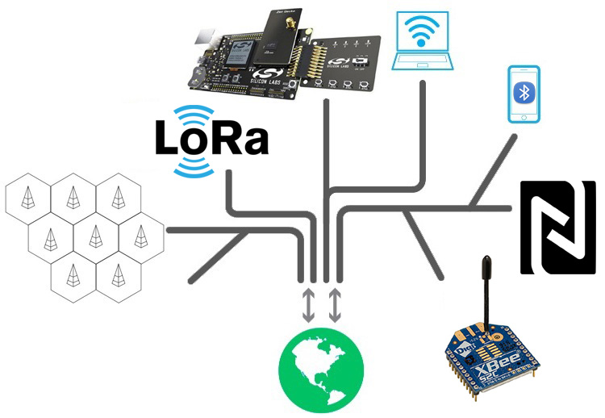
There are many wireless communication protocols available to use for your product, it becomes difficult for the product designers to choose the correct one but once the scope of IoT application is decided it would become easier to select the right protocol.

Slide 4
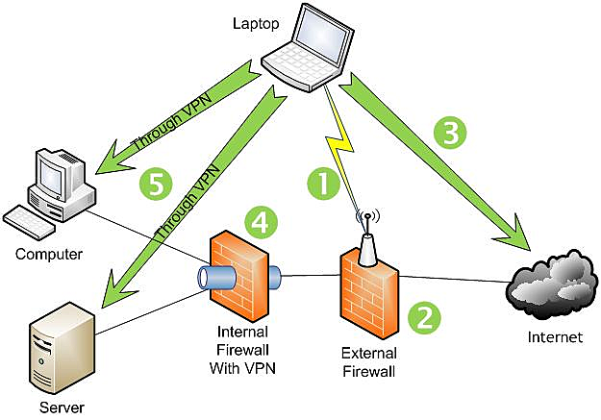
1.Wi-fi
Wi-Fi (Wireless Fidelity) is the most popular IOT communication protocols for wireless local area network (WLAN) that utilizes the IEEE 802.11 standard through 2.4 GHz UHF and 5 GHz ISM frequencies.
Indoor Wi-Fi provides Internet access to devices that are within the range of about 20 - 40 meters from the source.
In outdoor Wi-Fi provides Internet access to devices that are within the range of about 100m meters from the source.
Wifi data ranges from 2Mbps t0 2.4Gbps for different modules, depending on channel frequency used and the number of antennas.

Slide 5
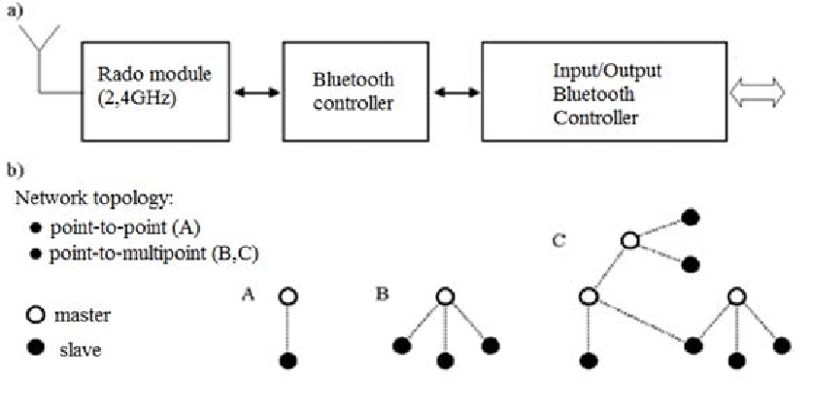
2. Bluetooth
Bluetooth is a technology used for exchanging data wirelessly over short distances.
It uses short-wavelength UHF radio waves of frequency ranging from 2.4 to 2.485 GHz in the ISM band.
Bluetooth technology has 3 different versions based on its applications:

