Slide 1
Soil Monitoring for Improved Crop Yield in IoT
TEAM NAME :- STRICKERS
1. M.Archana
2. J.Moulya
3. V.Aasha

Slide 2
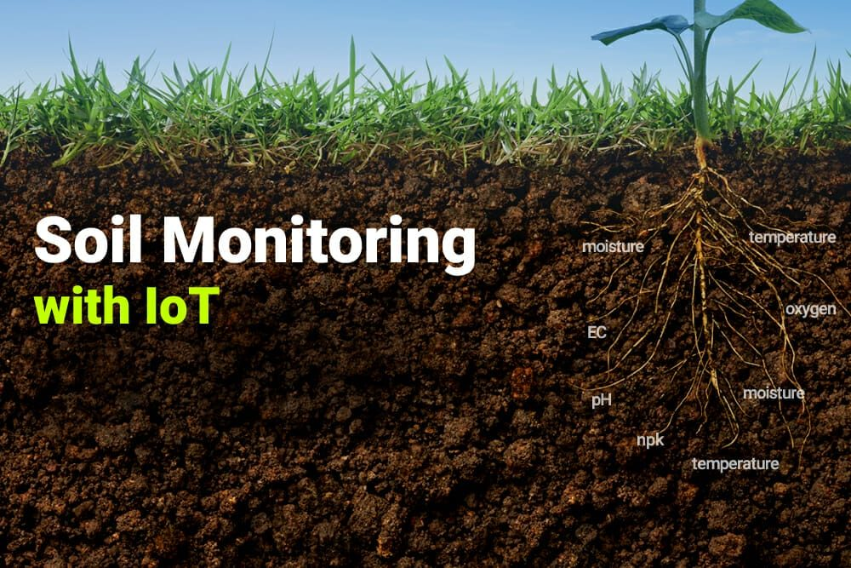

Slide 3
Summary
Traditional agriculture relies heavily on intuition and experience.
Modern agriculture leverages data-driven techniques for improved decision-making.
Soil health is a critical factor influencing crop growth and yield.
IoT sensors provide real-time data on various soil parameters, enabling precise monitoring and management.

Slide 4
Overview of Smart Agriculture
Smart agriculture leverages IoT, AI, and machine learning to transform traditional farming into a more efficient and data-driven process.
Components:
Sensors: Measure soil moisture, temperature, and nutrient levels, providing critical real-time data.
IoT Connectivity: Facilitates seamless communication between devices and central systems for synchronized operations.
Automation: Implements precision farming techniques, such as automated irrigation and fertilization.

Slide 5
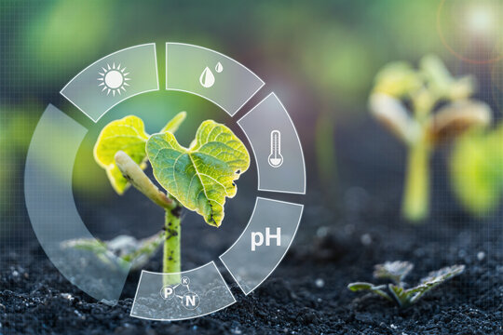
Key Focus Areas
Soil Quality:
Moisture content
Mineral content
Nutrient levels (NPK)
pH balance
Crop Yield:
Crop health
Growth rate
Yield prediction

Slide 6
Smart Agriculture with IoT
Benefits:
Optimized resource use (water, fertilizer)
Reduced environmental impact
Increased crop yield and quality
Enhanced decision-making

Slide 7
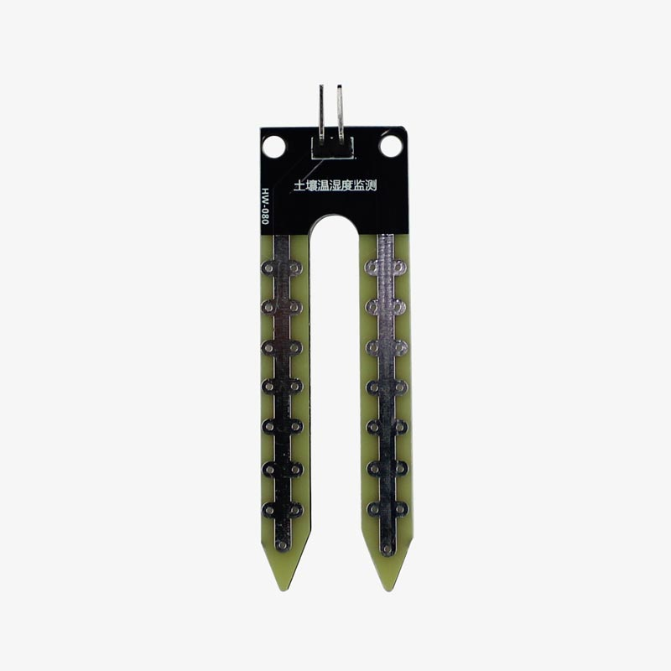
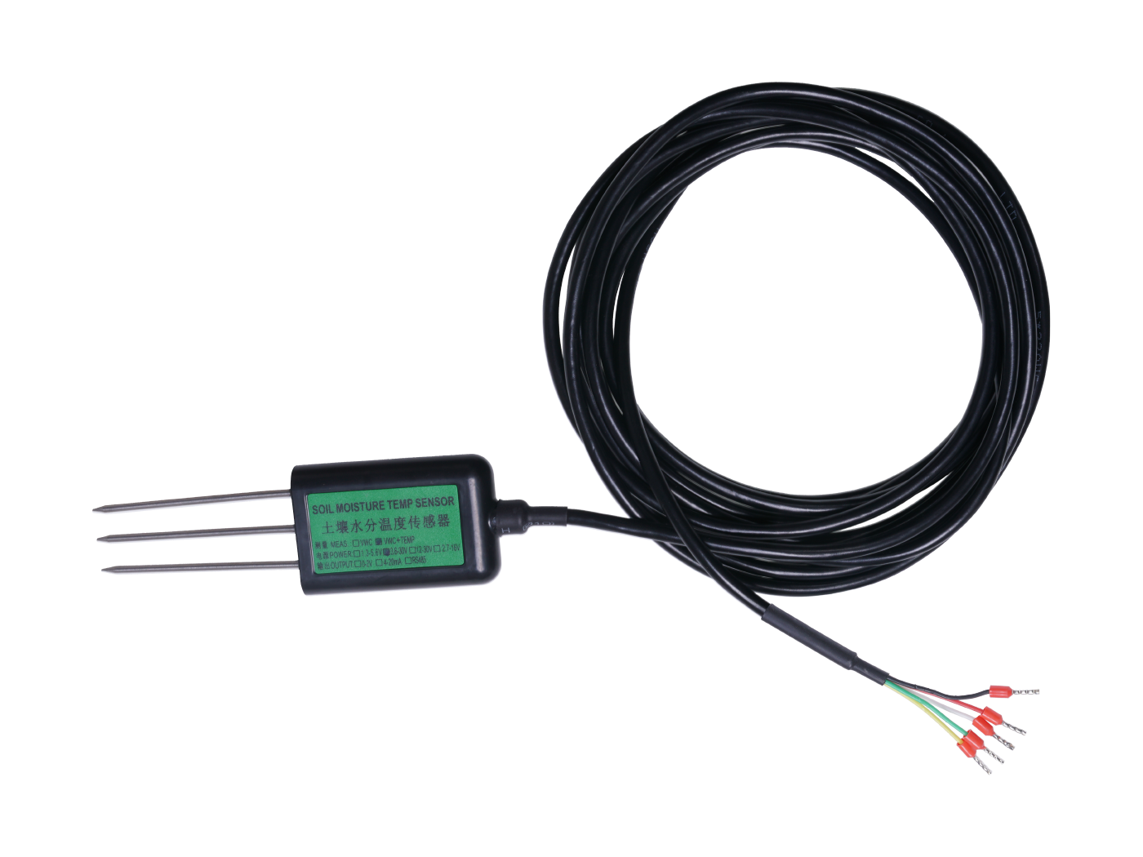
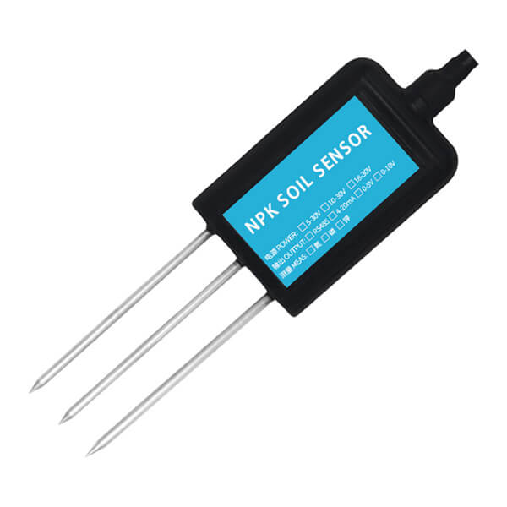
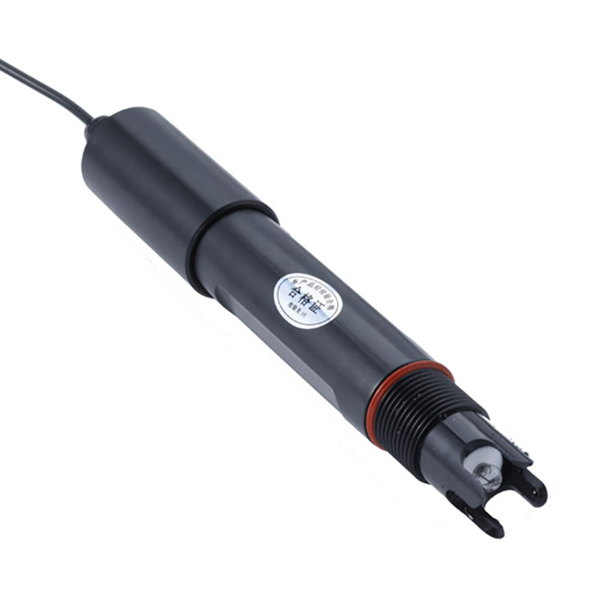
IoT Sensors for Soil Monitoring
Types of Sensors:
Temperature sensors
Moisture sensors
NPK sensors
pH sensors
Oxygen sensors

Slide 8
Data Analysis and Action
Process:
Real-time data collection and transmission
Cloud-based data storage and analysis
Identification of trends and potential issues
Generation of actionable insights and recommendations

Slide 9
Benefits of IoT-Based Soil Monitoring
Benefits:
Improved crop yield
Reduced water usage
Enhanced fertilizer application
Early detection of plant stress
Increased farm productivity

Slide 10
Conclusion
Key Takeaways:
IoT-based soil monitoring is a transformative technology for agriculture.
Empowers farmers to make data-driven decisions for improved outcomes.
Contributes to sustainable agricultural practices by optimizing resource use.
Ensures food security for a growing global population.

