Slide 1
DESIGN ARCHITECTURE for Soil Monitoring for Improved Crop Yield

Slide 2
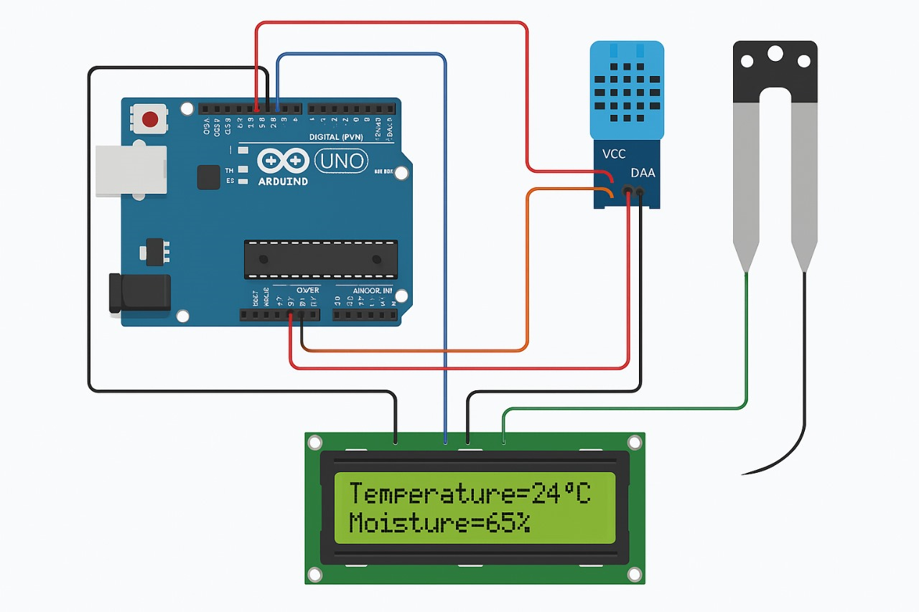
Circuit Diagram:

Slide 3
Aurdino uno
Connections between the sensors and Aurdino
sensors
Write the code
Upload the code into Aurdino IDE
Compile the code
Implementation
Run the code
stop

Slide 4
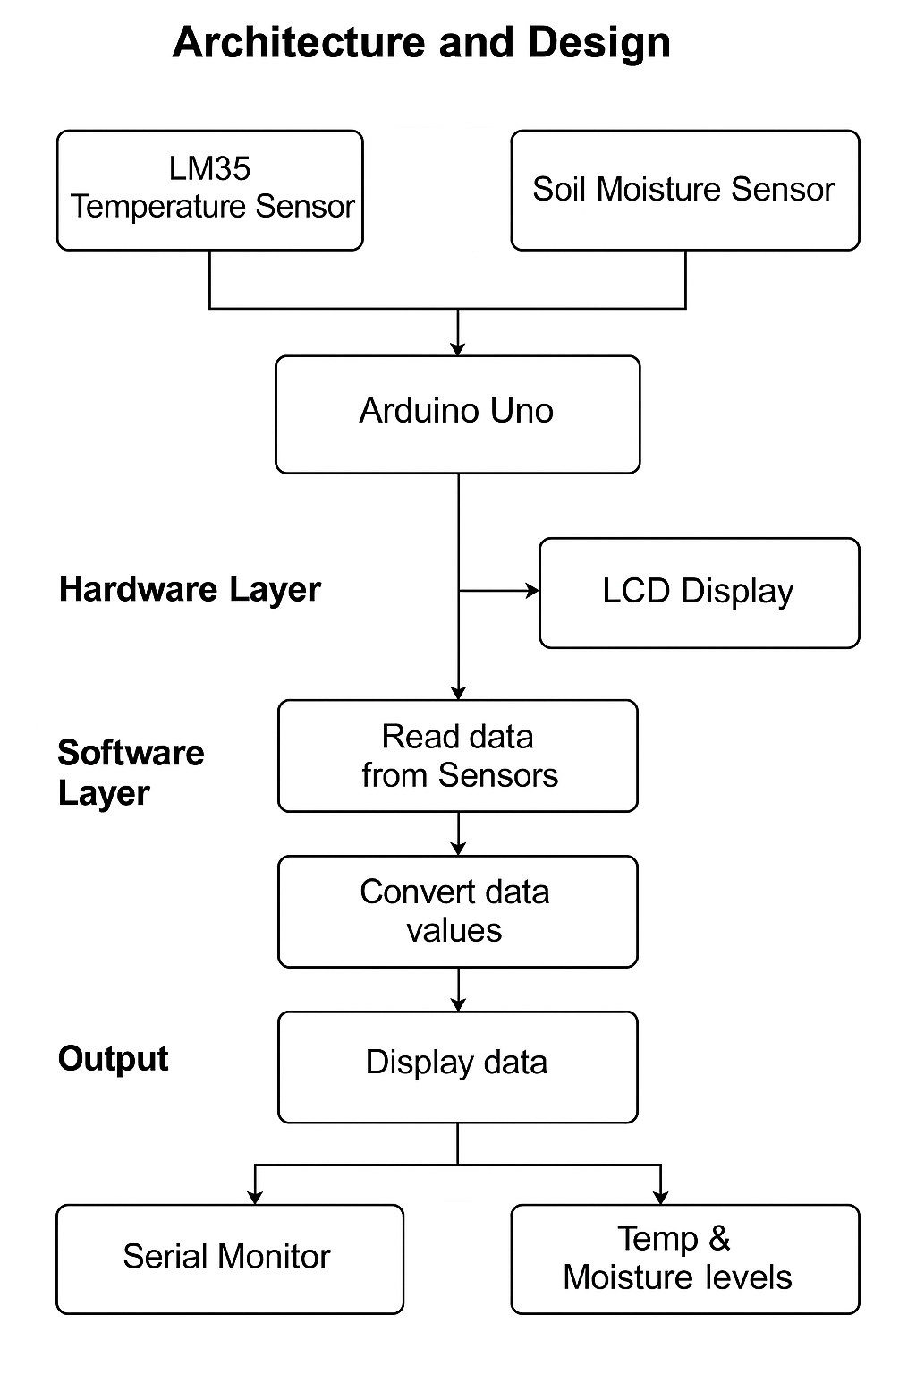

Slide 5
Summary:
Soil monitoring helps improve crop yield by providing insights into key parameters like moisture, temperature, which are crucial for optimal plant growth and nutrient uptake. By understanding these factors, farmers can make informed decisions about irrigation, fertilization, and other management practices, ultimately leading to healthier crops and higher yields.
soil monitoring empowers farmers to manage their crops more effectively, leading to increased yields, reduced input costs, and more sustainable farming practices.

Slide 6
Connections:
Power and Ground
Connect the Arduino’s 5V pin to the VCC pins of the Soil Moisture Sensor, LM35 Temperature Sensor, and the 16x2 I2C LCD module.
Connect the Arduino’s GND pin to the GND pins of all sensors and the LCD to ensure a common ground reference.
Soil Moisture Sensor
Connect the sensor’s analog output pin to Arduino’s analog input pin A1.
The sensor’s power (VCC) and ground pins go to 5V and GND respectively.
LM35 Temperature Sensor
Connect the LM35’s analog output pin to Arduino’s analog input pin A0.
Power the LM35 by connecting its VCC to 5V and GND to Arduino’s GND.

Slide 7
16x2 LCD with I2C Module
Connect the LCD module’s VCC to Arduino’s 5V.
Connect the LCD module’s GND to Arduino’s GND.
Connect the SDA pin of the LCD module to Arduino’s A4 pin (SDA).
Connect the SCL pin of the LCD module to Arduino’s A5 pin (SCL).

Slide 8
Software Layer:
This is the logic running on the Arduino:
Analog Read: Gets raw sensor values from A0 (temperature) and A1 (moisture)
Data Conversion:
LM35: Converts voltage to Celsius
Moisture: Optionally maps to percentage
Output:
Displays temperature and moisture on LCD
Prints readings to the serial monitor
Looping:
Updates every second using delay(1000)

