Slide 1



Edge Inference
EdgeScale Conf 2026
Berlin · 29 Oct 2026 · Systems Track
Conference talk · 40 min
at Scale
Serving sub-80 ms language models from 184 cities without blowing the power budget.
MO
Maya Oduya
Staff Engineer, Inference Platform · Lattice Edge
184PoPs
2.4Mreq/s
78ms
12kW
Cities in 61 countries
Peak global throughput
Median time-to-first-token
Power cap per PoP rack

Slide 2

Six stops between the user and the silicon
Agenda
A 40-minute walk through serving 2.4M req/s from 184 PoPs: the numbers, the config, the scars.
No.
Segment
Time
The latency budget
Who this is for
Intermediate
01
05 min
Platform engineers running inference in production
Why a 254 ms round trip no longer fits an interactive product
02
Fleet and architecture
SREs who own a latency SLO
Anycast PoPs, request routing and the control plane
08 min
Architects weighing edge against regional GPUs
03
Efficiency
Quantization, silicon choice and joules per inference
07 min
Trade-offs
Method note
30 days
04
05 min
All figures are production medians to 30 Sep 2026: 7B-class decoder, AWQ INT4, 256-token prompts, unless a slide says otherwise.
Where central, regional, edge and on-device each win
05
Behaviour under load
Adaptive batching, prefix caching and the p99 tail
08 min
06
Operating it
Rollout config, field notes and what we would redo
07 min
Edge Inference at Scale · EdgeScale Conf 2026
02 / 12

Slide 3
The round trip no longer fits the budget
The problem
Interactive AI features promise an answer before the user notices a wait: roughly 150 ms to the first token.
Physics sets the floor. A 9,000 km round trip costs about 90 ms in fibre before a single FLOP runs.
Latency budget, one request (ms)
3.3x faster
Queues amplify it. Centralised GPU pools run at 70-85% utilisation, so p99 queueing adds 40-120 ms.
Central region
254 ms
Jitter is visible. Users notice variance in time-to-first-token long before they notice the mean.
Edge PoP
78 ms
Egress is the hidden bill. Shipping prompts, images and embeddings to a few regions was 31% of serving cost.
Stage
Central
Edge
Network round trip
96
9
Residency rules tighten. Eleven of our top 30 markets now require in-country processing for some inputs.
TLS and connect
24
3
Queue and batch wait
38
11
Power is the real cap. A PoP rack gives us 12 kW; every watt per inference is a trade against capacity.
Prefill
74
41
First decode step
22
14
Time to first token
254
78
First token in under 150 ms at the median and under 300 ms at p99, from any of 61 countries.
Target
Edge Inference at Scale · EdgeScale Conf 2026
03 / 12

Slide 4






184 cities, 2.4 million requests a second
Fleet
Production medians over the 30 days to 30 Sep 2026; 7B-class decoder, AWQ INT4 unless noted.
Points of presence
Peak throughput
Median time-to-first-token
184
2.4M req/s
78ms
Cities in 61 countries, each running inference inside a 12 kW rack envelope.
Global 30-day high, served across all tiers and 14 production models.
At the edge, against 254 ms on the central-region path.
+37 this year
3.1x year on year
-69% vs. central
Energy per 1k inferences
90-day availability
Network egress spend
−71%
99.97%
−34%
Fleet-weighted, against the FP16 datacenter-GPU baseline.
Requests answered inside SLO; the target is 99.95%.
Prompts and embeddings now stay in-region instead of crossing oceans.
4.8 to 1.4 Wh
0 Sev-1 incidents
$1.9M saved / yr
Edge Inference at Scale · EdgeScale Conf 2026
04 / 12

Slide 5
One request, five hops, under 80 ms
Architecture
Anycast steers the user to the nearest PoP; everything after that is a local decision.
1
Anycast landing
BGP anycast lands the connection at the nearest healthy PoP and TLS 0-RTT resumes the session. 9 ms median.
Request path
p50 78 ms
Hop 2
Hop 4
2
Admission and routing
User
Hop 1
Router
INT4 runtime
The router reads tenant, model and priority, then picks a replica by queue delay, not round-robin.
Client
Anycast PoP
Tenant, model, priority; queue-aware
App or browser, 9 ms away
Nearest healthy site, 0-RTT TLS
Continuous batching, paged KV
3
Prefix and semantic cache
KV-prefix reuse and an embedding cache answer or shorten 18% of prompts before an accelerator is touched.
4
Quantized runtime
Hop 3
Hop 5 · spill
AWQ INT4 7B model on NPU or GPU, with continuous batching and paged KV memory.
Prefix cache
Regional GPU pool
Hot path, served locally
18% of prompts shortened
Queue delay over 12 ms
5
Overflow and fallback
Overflow path, spill to region
When queue delay passes 12 ms, the router spills to the regional GPU pool and tags the request for replay.
Model registry
Rollout controller
Telemetry
Control plane
Signed artifacts, per-PoP pinning
Canary gates, auto-revert
SLO guard, queue-delay export
Edge Inference at Scale · EdgeScale Conf 2026
05 / 12

Slide 6
The right silicon plus INT4 cuts energy 12×
Efficiency
Energy per 1,000 inferences in Wh: 7B-class decoder, 256-token prompts, steady state at 60% load.
Wh per 1,000 inferences (lower is better)
Datacenter
Edge PoP
On-device
12.6×
6
less energy per inference from FP16 datacenter GPUs to INT4 on a mobile SoC: 4.80 to 0.38 Wh.
4.80
4
8.7×
2.90
more inferences from the same 12 kW rack: about 6,100 a second on INT4 NPUs against 700 on FP16 GPUs.
2
1.60
0.90
0.55
0.38
−0.6 pt
0
quality cost of AWQ INT4 on our 40-task eval suite. Tail-sensitive models stay on INT8.
GPU, FP16
GPU, INT8
GPU, INT8
NPU, INT8
NPU, INT4
SoC, INT4
Datacenter
Datacenter
Edge PoP
Edge PoP
Edge PoP
On-device
Edge Inference at Scale · EdgeScale Conf 2026
06 / 12

Slide 7
Edge wins on latency and residency, not size
Trade-offs
Four ways to serve the same assistant workload, measured from real end-user networks over 30 days.
Dimension | Central cloud | Regional GPU | Edge PoP | On-device
Median network RTT | 96 ms | 38 ms | 9 ms | 0 ms
Median time-to-first-token | 254 ms | 171 ms | 78 ms | 112 ms
p99 time-to-first-token | 610 ms | 340 ms | 142 ms | 480 ms
Largest practical model | 70B+ | 70B | 13B INT4 | 3B INT4
Cost per 1M tokens | $0.60 | $0.71 | $0.94 | $0.00 user's battery
Data residency | Region-locked | Per country, limited | In-country default | Never leaves device
Operational burden | Low | Medium | High, automated | Very high, fragmented
Choose edge when
Choose regional when
Choose on-device when
p99 time-to-first-token must stay under 150 ms, or inputs must be processed in-country.
the model is larger than 13B, or traffic is global, spiky and tolerant of 300 ms.
inputs are private by nature and a 3B model is good enough for the task.
Edge Inference at Scale · EdgeScale Conf 2026
07 / 12

Slide 8
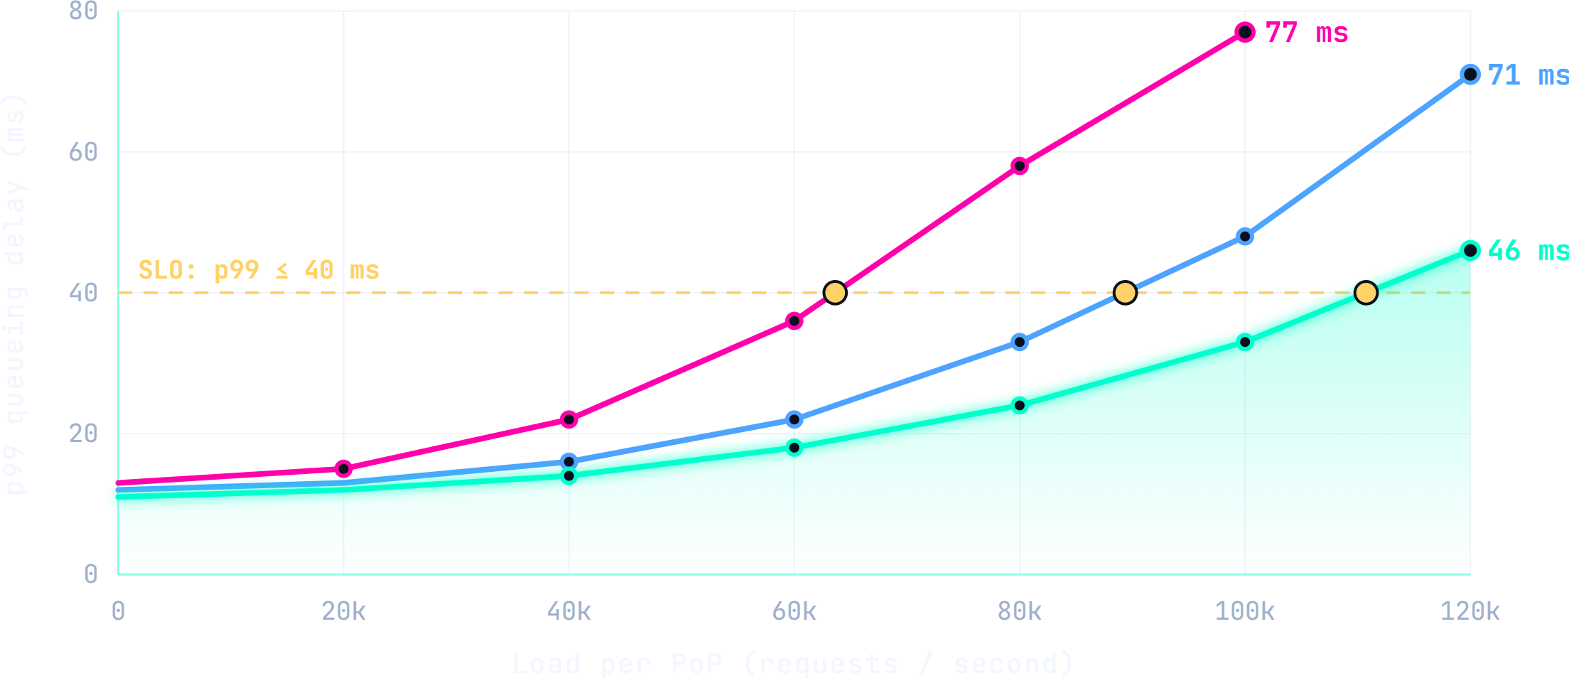
Batching and caching lift SLO capacity by 73%
Load behaviour
p99 queueing delay per PoP as load rises: same hardware, same model, same 40 ms SLO.
p99 queueing delay vs. load per PoP
Static batching
Adaptive
Adaptive + prefix cache
−57%p99 queue delay
at 100k req/s per PoP: 77 ms down to 33 ms with adaptive batching and the prefix cache switched on.
111kreq/s per PoP
before the 40 ms SLO breaks, up from 64k with static batching. Adaptive batching alone reaches 89k.
0extra accelerators
The gain is scheduling and cache hits on 18% of prompts. No hardware was added to any PoP.
Edge Inference at Scale · EdgeScale Conf 2026
08 / 12

Slide 9
The whole rollout fits in one manifest
Config
Every model ships as a declarative manifest; the controller does the rest, PoP by PoP.
edge-deploy.yaml
YAML
L8
Quantization
AWQ INT4, group size 128. Costs 0.6 pt on the eval suite and cuts weight memory about 3.8x.
1
2
3
4
5
6
7
8
9
10
11
12
13
14
15
16
17
18
# edge-deploy.yaml: one manifest per model, rolled out per PoP cohort
apiVersion: edge.lattice.example/v2
kind: ModelDeployment
metadata:
name: assist-7b-int4
spec:
artifact: registry.lattice.example/assist/7b@sha256:9f2c...e41a
quantization: { scheme: awq-int4, group_size: 128 }
placement:
tier: pop
min_replicas: 2
fallback: regional-gpu
batching: { mode: adaptive, max_wait_ms: 6, max_batch: 32 }
autoscale:
signal: queue_ms_p95
target: 12
cooldown_s: 45
rollout: { strategy: canary, steps: [1, 5, 25, 100], bake_min: 20 }
L13
Adaptive batching
Waits at most 6 ms to fill a batch of 32. This is the setting behind the knee on the previous slide.
L15-17
Autoscale on queue delay
Scale on p95 queue time, not CPU. Target 12 ms with a 45 s cooldown to avoid flapping.
L18
Canary rollout
1, 5, 25, 100% of PoPs with a 20 min bake per step. The SLO guard auto-reverts on breach.
Edge Inference at Scale · EdgeScale Conf 2026
09 / 12

Slide 10
“
Field note
We stopped asking which region is closest and started asking which milliseconds we can afford. The edge turned that into a config change instead of a migration.
PE
Head of Platform Engineering
Tier-1 retail customer · Q3 2026 rollout retrospective
support tickets saying the assistant feels slow
p99 time-to-first-token, down from 610 ms on the central path
to launch in a new country, down from two quarters
−41%
142 ms
6 wks
Edge Inference at Scale · EdgeScale Conf 2026
10 / 12

Slide 11
What we would redo, and what comes next
Lessons
Three years of running inference at the edge, compressed into six regrets and four milestones.
Treat PoPs as cattle on day one. Hand-tuned sites cost us 14 incident-hours before provisioning was automated.
Roadmap, next 12 months
Planned
Measure queue delay, not utilisation. GPU utilisation sat at 90% while p99 was fine, and the reverse.
Q4 2026
Speculative decoding on NPUs
Draft-model decoding with a target of 25% lower median time-to-first-token.
Ship the fallback first. Overflow to regional GPUs turned three Sev-1s into non-events.
Q1 2027
Multi-model co-residency
Version models and runtimes together. Mismatched kernels caused 60% of our canary rollbacks.
Three models per node sharing one KV pool to lift accelerator utilisation.
Q2 2027
Budget watts like milliseconds. Rack power, not rack space, is the scarce resource at a PoP.
Federated quality telemetry
Privacy-preserving eval signals from live traffic; no prompts leave the PoP.
Keep evals at the edge. Quality drift only showed up on real traffic, never on the offline suite.
Q3 2027
250 PoPs, same 12 kW cap
66 new cities, with power per inference falling another 30%.
Edge Inference at Scale · EdgeScale Conf 2026
11 / 12

Slide 12

Four things to take back to your own fleet
Takeaways
The playbook on one slide, with the numbers that justify each line.
01
02
Budget in milliseconds
Quantize, then pick silicon
Write the latency budget first. 254 to 78 ms came from removing hops, not from tuning kernels.
INT4 on edge NPUs gives 8.7x more inferences from each 12 kW rack for a 0.6 pt quality cost.
Questions?
Slides, raw benchmark data and the full manifest are open.
03
04
Email
maya@lattice-edge.example
Schedule for the tail
Automate the fleet
Slides
lattice-edge.example/edgescale26
Adaptive batching plus a prefix cache lifts SLO capacity by 73% on the same hardware.
One manifest, canary gates and auto-revert run 184 PoPs without a pager storm.
Room
Systems Track · Hall B
Edge Inference at Scale · EdgeScale Conf 2026
12 / 12

