Slide 1
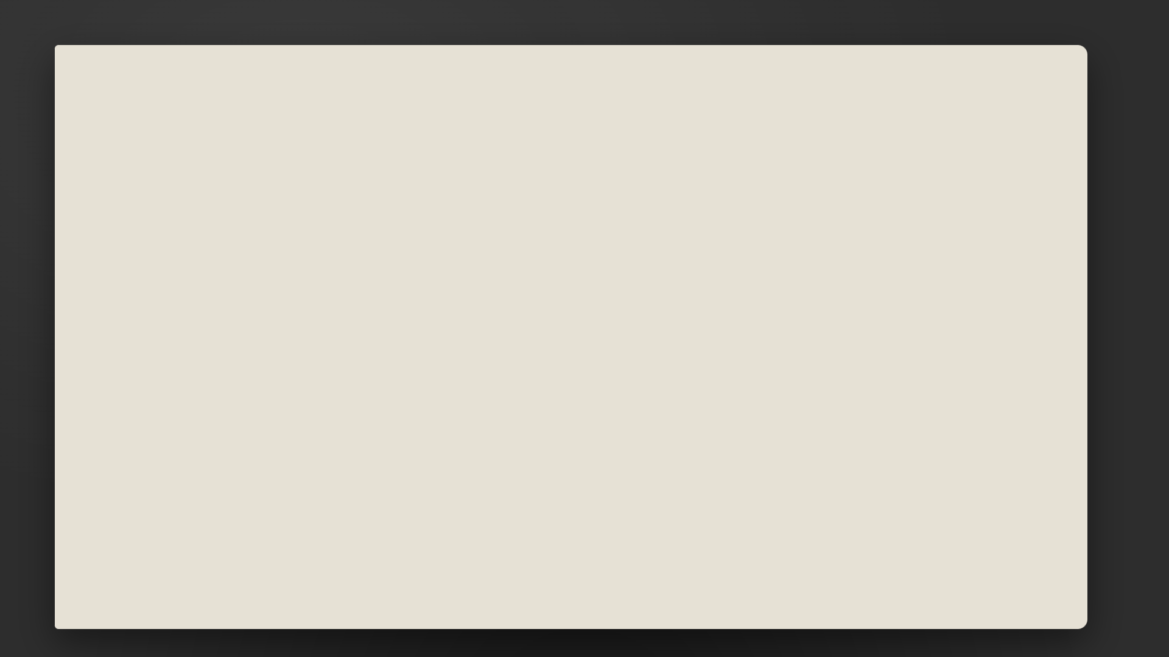
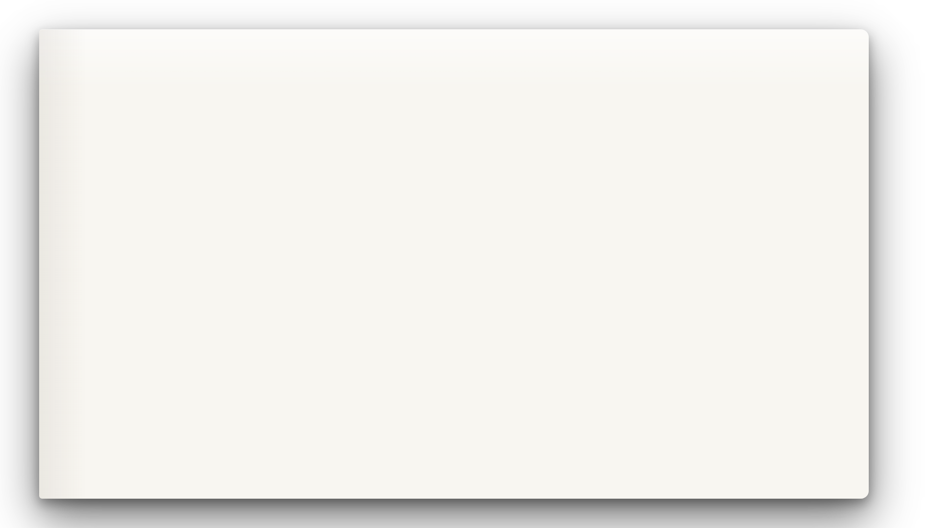

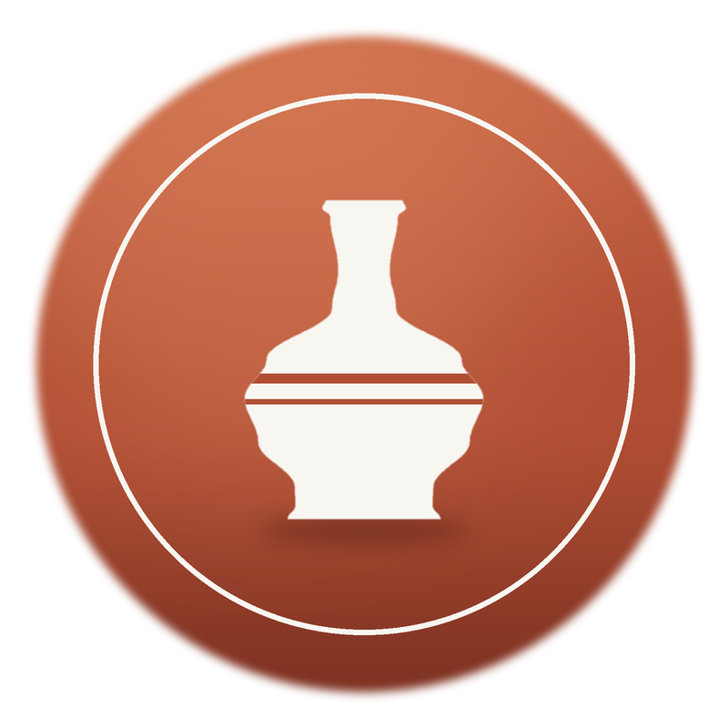
Saltkiln
Ceramics
Hello
A studio pitch · Autumn 2026
Our story
Craft
Join
Hand-thrown pottery for everyday rituals, salt-fired in Maine and signed by the person who made it.
Visit
Rockport, Maine
Est. 2019
9 potters, 2 kilns

Slide 2
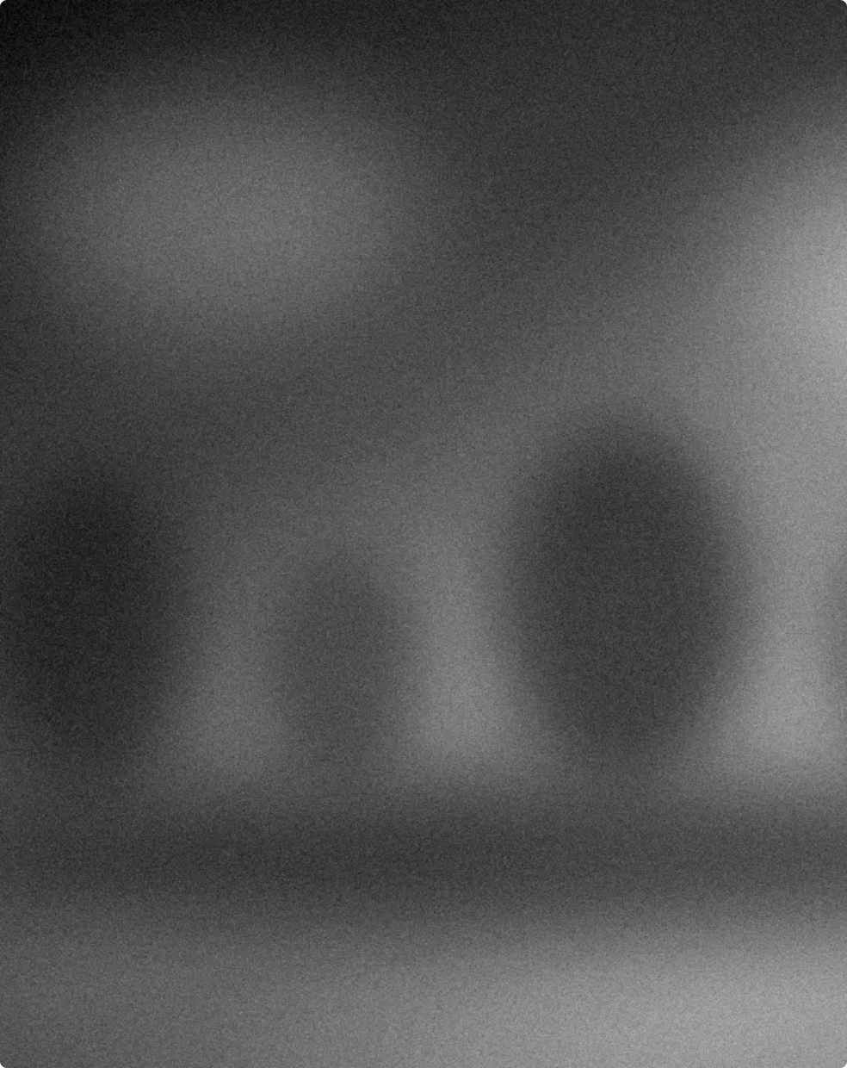
Most mugs are made by machines for no one in particular.
Hello
The idea
Our story
Craft
Join
We make the other kind: one pot, one person, one morning at a time.
Visit
Machine-made, 2019: identical, anonymous, forgotten.
Saltkiln Ceramics · Studio pitch 2026
02

Slide 3

From a borrowed wheel to a working studio
Hello
Our story
Our story
aya Okafor threw her first hundred mugs on a
borrowed wheel in 2019, in a garage that smelled permanently of wet clay. She fired them in a second-
Craft
M
hand kiln, gave most away, then sold her first thousand to a café down the road. People kept asking where the cups came from, so we opened the door, added a second wheel, and never quite closed it again.
Join
Visit
9
potters
2
salt kilns
40
working members
The garage kiln, first firing, March 2019.
Saltkiln Ceramics · Studio pitch 2026
03

Slide 4
Seven years in the fire
Hello
The timeline
Our story
Craft
2019
2021
2023
2025
2026
Join
The garage
First 50 members
Tidewater Mill
Wholesale
A second kiln
One borrowed wheel and a second-hand kiln.
Word of mouth fills every Saturday class.
We move into a brick mill with room to grow.
Fourteen cafés now serve on our plates.
A founding cohort of forty makers joins.
Visit
Saltkiln Ceramics · Studio pitch 2026
04

Slide 5

From mud to mug, in five steps.
The craft
Hello
Our story
Wedge
Knead out every air bubble, or the kiln will find it.
Craft
Throw
Centre the clay and pull the walls up on the wheel.
Join
Trim
Turn it leather-hard and carve a clean foot ring.
Glaze
Visit
Dip in slip and oxide; the kiln finishes the sentence.
Fire
Thirteen hours to 1,280 °C, salt thrown in at the peak.
Saltkiln Ceramics · Studio pitch 2026
05

Slide 6




Four promises on every pot
Hello
What we promise
Our story
Craft
01
02
03
04
Dug nearby
Fired clean
Made to last
Signed by hand
Join
Our clay comes from a river bank thirty miles from the kiln.
Lead-free, food-safe glazes, tested on every batch.
Dishwasher, oven, microwave. If it chips, we repair it free.
Each piece carries its maker’s mark on the foot.
Visit
Saltkiln Ceramics · Studio pitch 2026
06

Slide 7

Thirteen hours in the fire.
Hello
Our story
The firing
Craft
Join
Visit
Salt goes in at 1,280 °C, and the glaze we get is never quite the same twice.
Kiln No. 2 · Tidewater Mill · 1:40 a.m.
07

Slide 8
Hello
In their words
Our story
“
Guests ask about the cups before they ask about the coffee.”
Craft
Join
Elena Marsh
Owner, Lantern Café · stockist since 2024
Visit
Saltkiln Ceramics · Studio pitch 2026
08

Slide 9
Pick your place at the wheel
Hello
Membership
Our story
Most popular
Drop-in
Member
Resident
$28
$185
$420
Craft
/ session
/ month
/ month
Try the wheel with a teacher beside you.
Your own key, your own shelf, your own pace.
A private wheel and a place in our shop.
Join
Two-hour wheel session
Unlimited open-studio hours
Reserved wheel & 6 ft shelf
Clay & tools provided
25 lb of clay each month
Unlimited clay & firings
Visit
Firing billed per piece
Two firings included
Sell through our shop
Book any weekday
15% off classes & shop
Name on the kiln wall
Saltkiln Ceramics · Studio pitch 2026
09

Slide 10
Forty seats at the wheel, locked in for life.
Hello
Founding cohort · opens Nov 1
Our story
40
Craft
Reserve before 30 November and your member rate never goes up.
Join
Reserve a seat → hello@saltkiln.example
founding seats
Visit
Saltkiln Ceramics · Studio pitch 2026
10

Slide 11
Come make something with us.
Hello
Thank you
Our story
Visit
Craft
Tidewater Mill, Unit 4
18 Quarry Lane, Rockport
Join
Write
hello@saltkiln.example
Visit
Hours
Tuesday to Sunday, 10 to 6
Saltkiln Ceramics · Studio pitch 2026
11

