Slide 1



credit_card_lead_analysi
View in Power BI
Last data refresh:
10/20/2021 1:22:42 PM UTC
Downloaded at:
10/20/2021 1:25:01 PM UTC

Slide 2
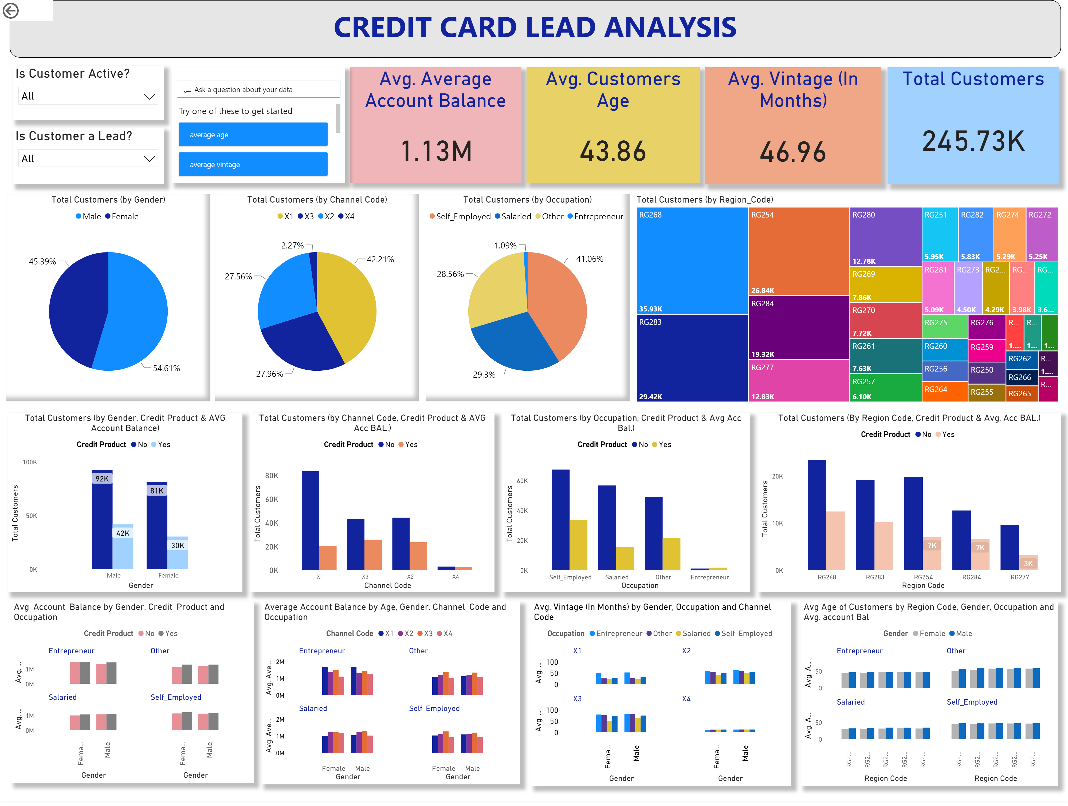
Page 2
Notes:
Is Customer Active?
- To select : Yes (If customer is active since last 3 months), No (If customer is inactive since last 3 months)
Is Customer a Lead?
- To select : Yes (If customer is interested in Credit Card), No (If customer is NOT interested in Credit Card)
qnaVisual
- To as any question related to the dashboard. A few sample questions are mentioned as examples.
actionButton
Press Enter Button to search
Total Customers (by Gender)
- Total customer count, gender-wise.
Total Customers
Avg. Customers Age
- Average age of customers.
Total Customers (by Channel Code)
- Total customer count, acquired through various Channels.
Total Customers (by Occupation)
- Total customer count, Occupation-wise.
Avg. Vintage (In Months)
- Average vintage months of a customer.
Avg. Average Account Balance
Average account balance maintained by the customer.
Total Customers (by Region Code)
- Total customer count, region-wise.
Total Customers (by Gender, Credit Product & AVG Account Balance)
- Gender & Credit Product wise: customer bifurcation such as total customer count, average account balance maintained by the customer.
Avg_Account_Balance by Gender, Credit Product and Occupation
- Showing Customer bifurcation using Gender, Credit product & Average Account Balance.
Total Customers (by Occupation, Credit Product & Avg. Account Balance.)
- Showing Customer bifurcation using Occupation, Credit Product & Average Account Balance.
Avg. Vintage (In Months) by Gender, Occupation and Channel Code
- Showing Average Vintage of the customer based on Gender, Occupation & Channel code.
Total Customers (by Channel Code, Credit Product & AVG Acc BAL.)
Showing Customer bifurcation using Channel Code, Credit Product & Average Account Balance.
Average Account Balance by Age, Gender, Channel_Code and Occupation
- Showing Average Account Balance of the customers based on Gender, Channel code, Occupation & Average age.
Total Customers (By Region Code, Credit Product & Avg. Acc BAL.)
- Showing customers based on Region, with/without Credit product, average of Average Account Balance of the customers.
Avg Age of Customers by Region Code, Gender, Occupation and Avg. account Bal
- Showing Average age of the customers based on Region code, Gender, Occupation and their average Account balance.

