Slide 1

Heart Disease Risk Analysis
Presented By:-
Radhika Gupta
Moumita Majumder
SHABNAM IKRAM

Slide 2
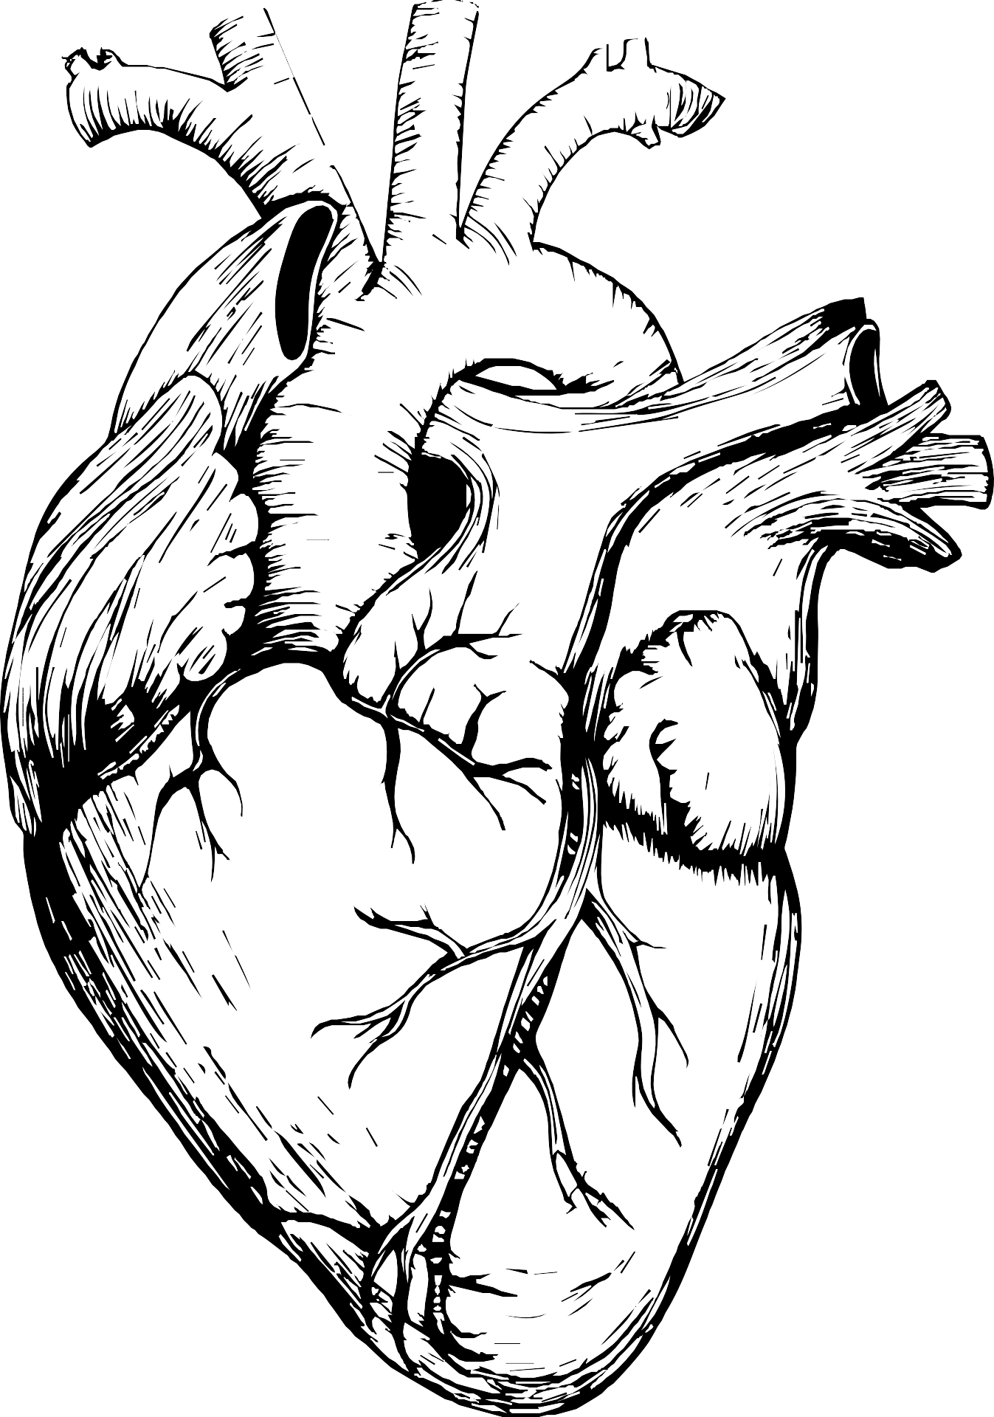
Introduction
Heart disease is a leading global health concern, making early detection and risk factor analysis essential. This project analyzes patient health records to identify patterns and associations related to heart disease presence.
Using subgroup analysis and visual exploration, we examine how factors like age, gender, chest pain type, cholesterol, and exercise response impact disease risk. The study employs SQL and Python tools to uncover meaningful insights that support improved screening and prevention strategies.

Slide 3






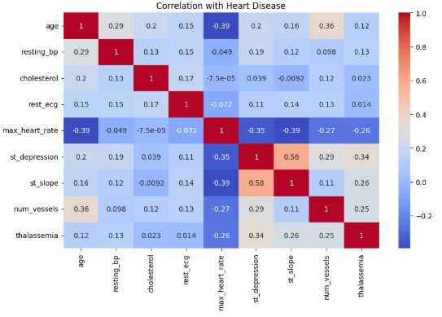















Key Insight:
Age: Most heart disease cases occur between ages 40–60, with a peak at 50–55, highlighting increased risk in middle age.
Gender: Males have a higher incidence of heart disease, indicating greater vulnerability or detection rates.
Cholesterol: Cholesterol alone shows weak correlation with heart disease and should be assessed alongside other factors.

Slide 4

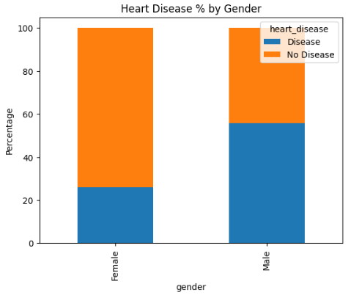
Key Insight:
Visual analysis shows that males have a higher rate of heart disease than females in this dataset.
It aligns with broader epidemiological data suggesting men are at greater cardiovascular risk, especially before menopause in women. This difference is important for gender-specific screening and preventive strategies.

Slide 5
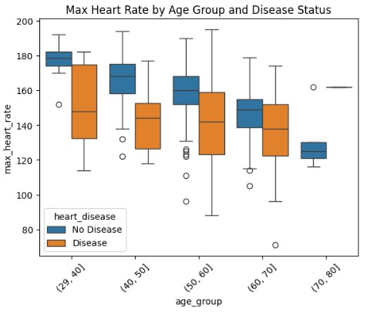
Key Insight:
Patients with heart disease tend to have lower maximum heart rates, indicating reduced cardiac function and exercise capacity.
This metric helps in evaluating exercise tolerance and cardiovascular efficiency, especially when analyzed along with age.

Slide 6
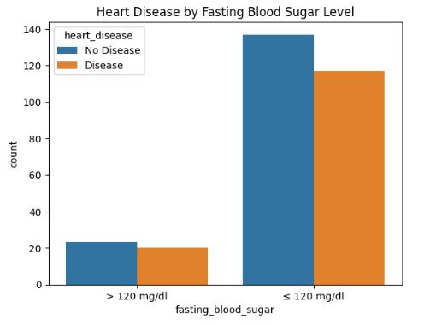


Key Insight:
Fasting blood sugar >120 mg/dL shows no significant difference in heart disease rates.
It is not a strong standalone predictor in this dataset.

Slide 7
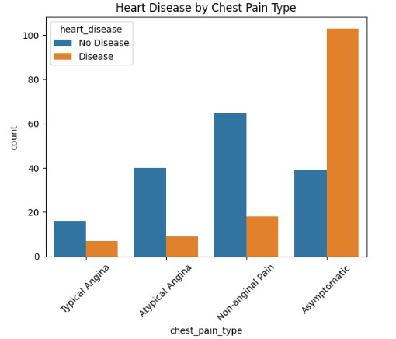
Key Insight:
Chest pain type strongly correlates with heart disease.
Asymptomatic (Type 3) pain is most linked to disease despite lack of symptoms.
Typical Angina (Type 0) is less predictive, highlighting the need for broader screening.

Slide 8


Conclusion
This analysis highlights key factors associated with heart disease, including age, gender, chest pain type, exercise- induced angina, and ECG findings. Middle-aged males, especially those with asymptomatic chest pain or exercise- triggered angina, show a higher risk. While traditional markers like cholesterol and fasting blood sugar appear less predictive on their own, combining multiple indicators provides more accurate insights.
By leveraging data analysis techniques, we gain a deeper understanding of heart disease patterns—supporting early detection, targeted screening, and better preventive strategies.

Slide 9
Thank You

