Slide 1




Busy doing nothing !
Missing in-person movie nights? Bored of being bored on weekends?
NetFlix Party to the rescue
Watch movies with your friends and chat together at the same time with this free Chrome extension from Netflix

Slide 2
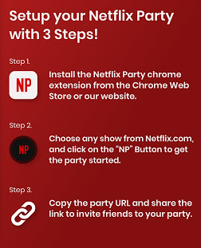

Slide 3
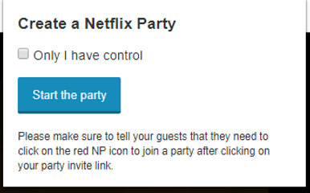
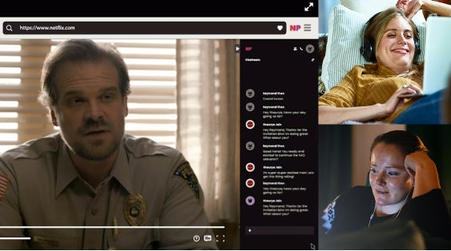
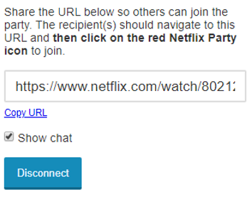
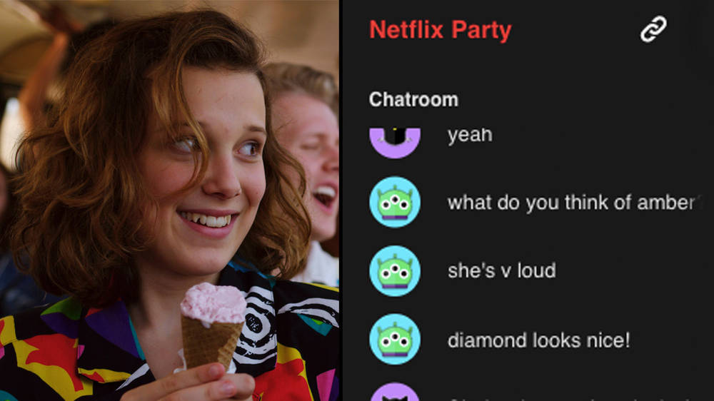
Laugh, cry and howl with your family and friends, and feel a little less on your own

Slide 4

