Slide 1

Exploratory Data Analysis

Slide 2
INTRODUCTION
Zomato.csv
The data contains information about Restaurants tied up with Zomato worldwide and comprises of several aspects of restaurants cost , rating etc.
Data Set Characteristics: | Multivariate | Number of Instances: | 9551
Attribute Characteristics: | Categorical, Continuous | Number of Attributes: | 21
Period of data: | N/A | Missing Values? | Yes
Country-Code.xlsx
The data contains information about Country and Country Code

Slide 3
Attribute Information
Zomato.csv
-Restaurant ID : Identification Number
-Restaurant Name : Name Of the Restaurant
-Country Code : Unique Code for Country
-City : City Name of the Restaurant
-Address
-Locality : Shot Address Of the Restaurant
-Locality Verbose : Long Address of the Restaurant
-Longitude : Longitude
-Latitude : Latitude
-Cuisines : Types Of Cuisines Served
-Average Cost for two : Average Cost if two people visit the Restaurant
-Currency : Dollars
-Has Table booking : Can we book tables in Restaurant? Yes/No
-Has Online delivery : Can we have online delivery ? Yes/No
-Is delivering now : Is the Restaurant delivering food now? Yes/No
-Switch to order menu : Switch to order menu ? Yes/ No
-Price range : Categorized price between 1 -4
-Aggregate rating : Categorizing ratings between 1-5
-Rating color : Different colors representing Customer Rating
-Rating text : Different Rating like Excellent, Very Good ,Good, Avg., Poor, Not Rated
-Votes : No.Of Votes received by restaurant from customers.
Country-Code.xlsx
-Country Code
-Country

Slide 4
Aim of the Project/
Business Questions
1. Country where Zomato has major Presence.
2. City where Zomato has major Presence.
3. Most Popular Cuisine.
4. City wise Average Cost for Two people.
5. Impact of online Delivery on Restaurant Rating.
6. City wise Best and worst Restaurants.

Slide 5

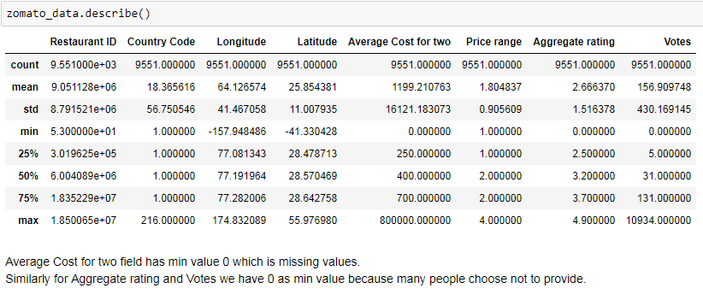
Loading,Understanding
and Cleaning Data
Load both the Datasets
Merge the Dataset to know Country for respective Country Code.
3. Understanding the Dataset using pandas Describe function

Slide 6
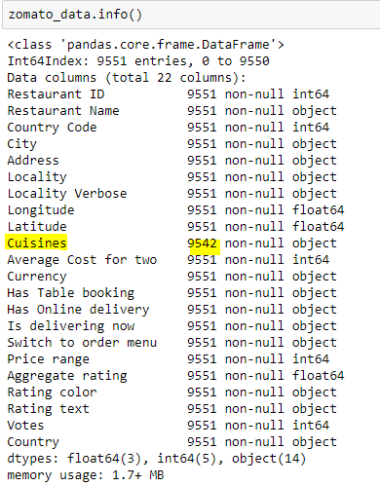
Continued….
4. Data Type of Different Columns using pandas info function
5. Missing Values
From above Snippet its observed that:
Cuisine has 9 missing values and all are from Country United States

Slide 7
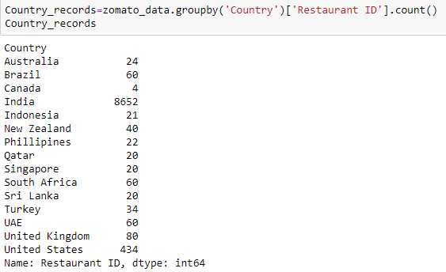
Q1. Country where Zomato Has
Major Presence
Approach: To Group By Country and Counting Restaurant ID.
Snippet:
Findings: There are 15 countries Zomato is operating in out of which it's major
operation is in India followed by United States.

Slide 8

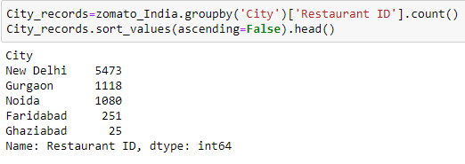
Q2. City Where Zomato has Major
Presence
Approach: 1.Create a new Data for Country India
2. To Group By City and Counting Restaurant ID.
Snippet:
Findings: Among the Indian Cities Zomato has major presence in New Delhi
followed by Gurgaon, Noida and Faridabad.

Slide 9
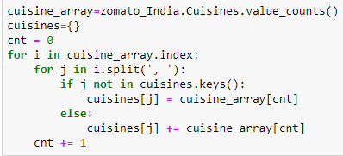
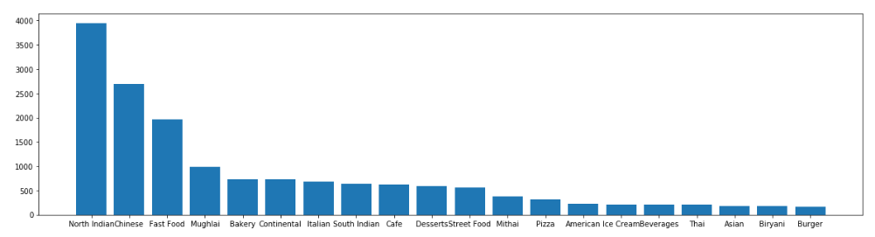
Q3. Most Popular Cuisine
Approach: 1.Split the Cuisine column value using ‘,’ Separator.
2. Store the unique Cuisine in an Array and Sort in Descending Order
Snippet:
Findings: North Indian is the most popular cuisine. Reason being majority dataset is
concentrated towards North Indian region.

Slide 10
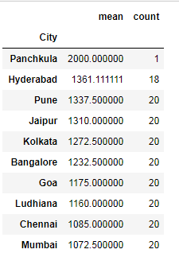
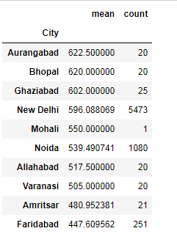
Q4. City Wise Average Cost for
Two People
Approach: 1. To Group By City and Average ,Counting Average Cost for Two
Snippet: 1. Top 10 Average Cost for Two Cities
->
2. Bottom 10 Average Cost for Two Cities
Findings: 1. The highest Average for two cost is Rs 2000. But it is for only one record in the city Panchkula.
2. The lowest Average for two cost is around Rs 448 which is in Faridabad.

Slide 11
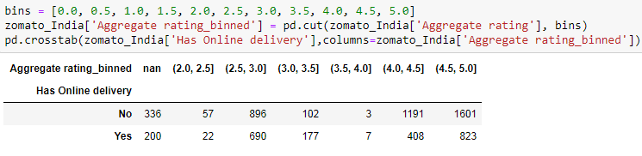
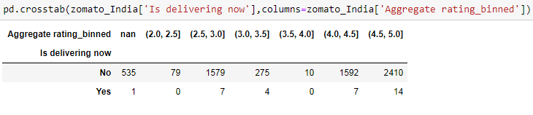
Q5. Impact Of Online Delivery on
Restaurant Rating
Approach: 1. To Bin the Aggregate Rating Column.
2. To apply pandas Crosstab on Has Online Delivery and Aggregate Rating Binned.
3. To apply pandas Crosstab on Is Delivering Now and Aggregate Rating Binned.
Snippet:
Findings: We can see that online delivery does not have significance impact on the Restaurant rating.

Slide 12
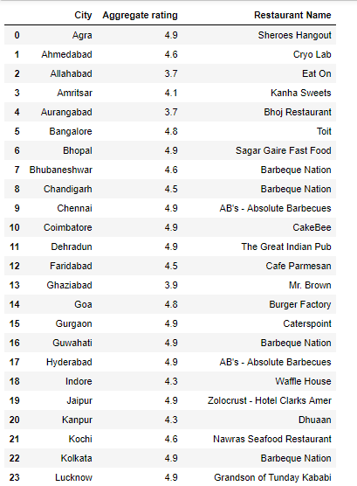
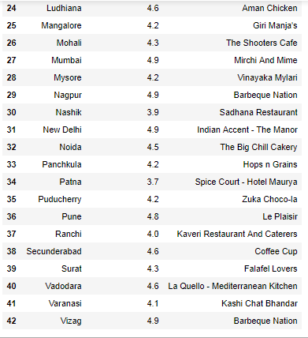
Q6. City Wise Best and Worst Restaurants
Best Restaurant City Wise:
Approach: 1. To Group By city and get First Row, Sort Values for Aggregate Rating in Descending Order
Snippet:

Slide 13
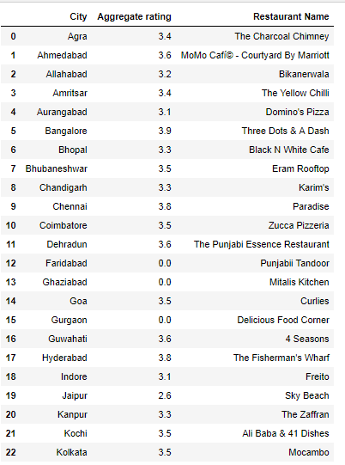
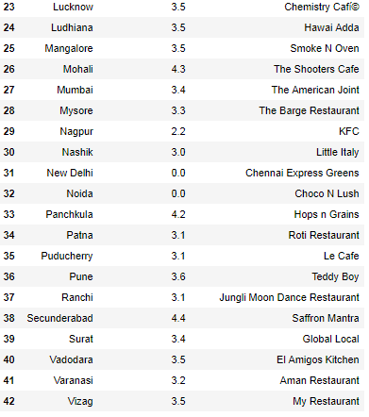
Continued….
Worst Restaurant City Wise:
Approach: 1. To Group By city and get First Row, Sort Values for Aggregate Rating in Ascending Order
Snippet:

Slide 14
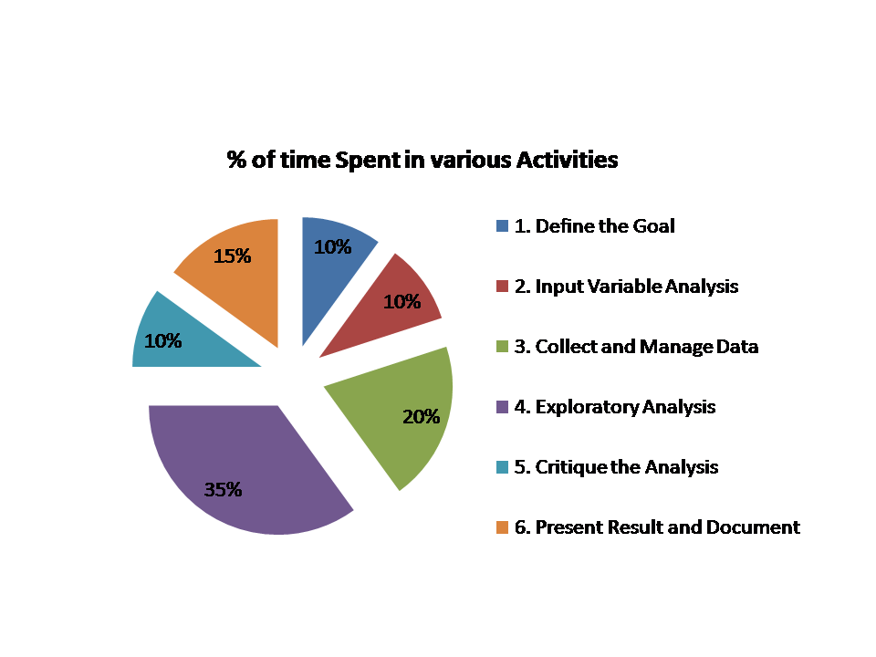
Appendix

Slide 15
Thank You….

