Slide 1

Presented By Moumita Samaddar
Bank Analytical CRM
Customer Retention Analysis Using CRM & Data Analytics

Slide 2

Agenda
Introduction
Project Aim
Problem Statement
Data Overview
Metrics and their Insights
Dashboards
Data Challenges in Churn Analysis
Recommendations
Conclusion

Slide 3

Introduction
This analysis focuses on understanding customer churn patterns within a retail bank. By examining key factors such as demographics, geography, financial behavior, and customer engagement, the study aims to:
Identify who is leaving and why.
Highlight high-risk customer segments.
Develop data-driven strategies to reduce churn, improve service quality, and enhance overall customer satisfaction.

Slide 4
Project Aim
The aim of this project is to analyze customer demographics, financial profiles, and behavioral patterns to identify the key factors driving customer churn. By uncovering these insights, the analysis seeks to:
Reduce customer attrition through targeted retention strategies
Improve service delivery efficiency across banking operations
Enhance overall customer satisfaction and loyalty

Slide 5
Problem Statement
You are an analytical CRM (Customer Relationship Management) specialist hired by a bank to extract meaningful insights from various customer-related datasets. The bank aims to reduce customer churn, improve service delivery, and enhance customer satisfaction. They have provided you with datasets including customer demographics, transaction details, customer exit information, and active customer profiles.

Slide 6
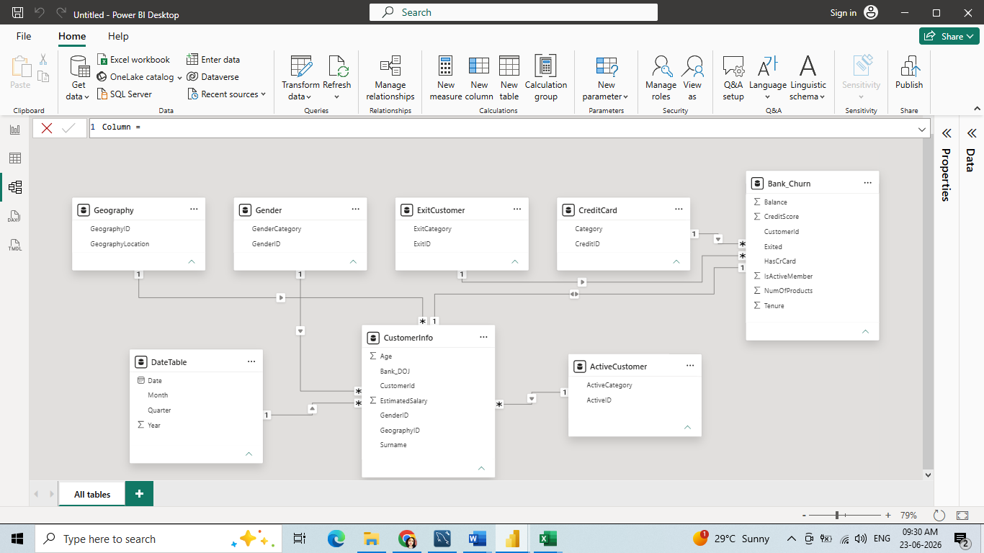
Data Overview

Slide 7
The image above displays details about Bank Customer data, including:
Customer ID: Unique identifier for each customer.
Credit Score: Measures creditworthiness.
Poor: 300–579
Fair: 580–669
Good: 670–739
Very Good: 740–799
Excellent: 800–850
Geography ID: Customer's country/region.
Gender ID: Customer gender.
Age: Customer age.
Tenure: Years with the bank.

Slide 8
Balance: Current account balance.
No. of Products: Number of bank products held by the customer.
Has Credit Card: Credit card ownership (1 = Yes, 0 = No).
Active Member: Customer activity status (1 = Active, 0 = Inactive).
Estimated Salary: Customer's estimated annual salary.
Exited: Customer churn status (1 = Exited, 0 = Retained).
Bank_DOJ: Customer's joining date with the bank.

Slide 9
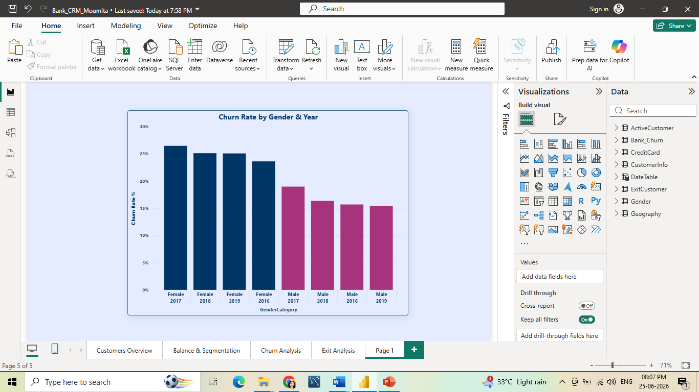
Churn Rate By Gender & Year
Key Insights
• Female customers have consistently higher churn.
• Male customer retention is improving.
Recommendations
• Strengthen female-focused retention programs.
• Identify causes of female customer churn.
Female customers consistently exhibit 8–10% higher churn than male customers.

Slide 10
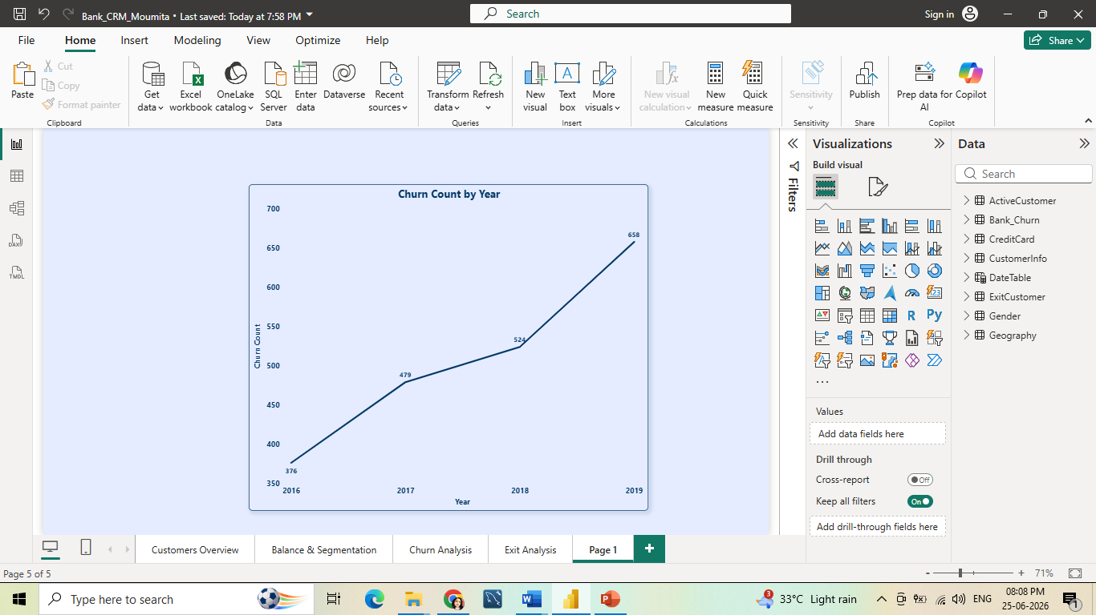
Churn Count By Year
Key Insights
• Churn rose consistently over time.
• 2019 recorded the highest churn.
Recommendations
• Analyze causes of rising churn.
• Improve retention strategies.
Customer churn increased consistently, reaching its highest level in 2019.

Slide 11
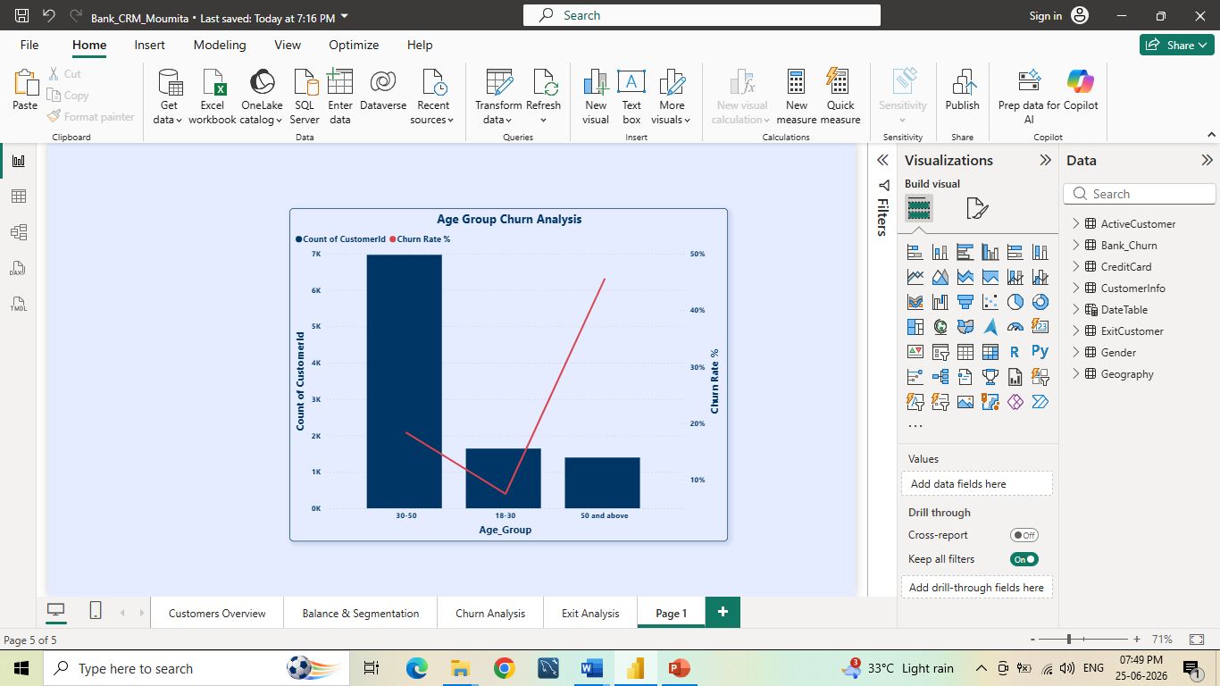
Customers & Churn Rate by Age Group
Key Insights
30–50 is the largest customer segment.
18–30 customers show the lowest churn.
50+ customers have the highest churn.
Recommendations
Focus retention on 50+ customers.
Strengthen loyalty for 30–50 customers.
Grow the 18–30 customer base.
Younger customers are more loyal, while churn risk rises significantly among customers aged 50+.

Slide 12
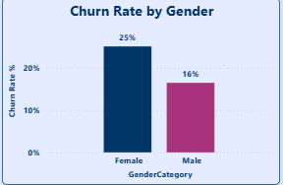
Churn Rate By Gender
Key Insights
Higher churn among females.
Lower female retention.
Stronger male loyalty.
Recommendations
Target female retention.
Resolve key pain points.
Replicate successful male strategies.
Female customers are more likely to churn, while male customers demonstrate stronger loyalty.

Slide 13

Churn Rate By Geography Location
Key Insights
• Germany records the highest churn. • France has the lowest churn rate.
Recommendations
• Improve retention in Germany. • Scale growth initiatives in Spain.
Germany requires immediate retention focus, while France remains the most stable market.

Slide 14
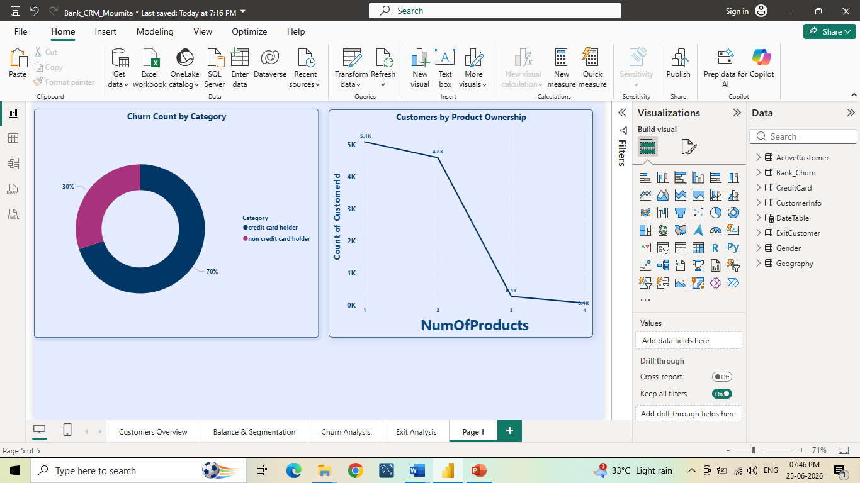
Churn Count By Credit Card Category
Key Insights
Non-card holders drive most churn.
Churn is higher among non-card holders.
Card holders show stronger retention.
Recommendations
Focus retention efforts on non-card holders.
Promote credit card adoption.
Offer card-based rewards and benefits.
Credit card ownership is associated with better customer retention and lower churn.

Slide 15
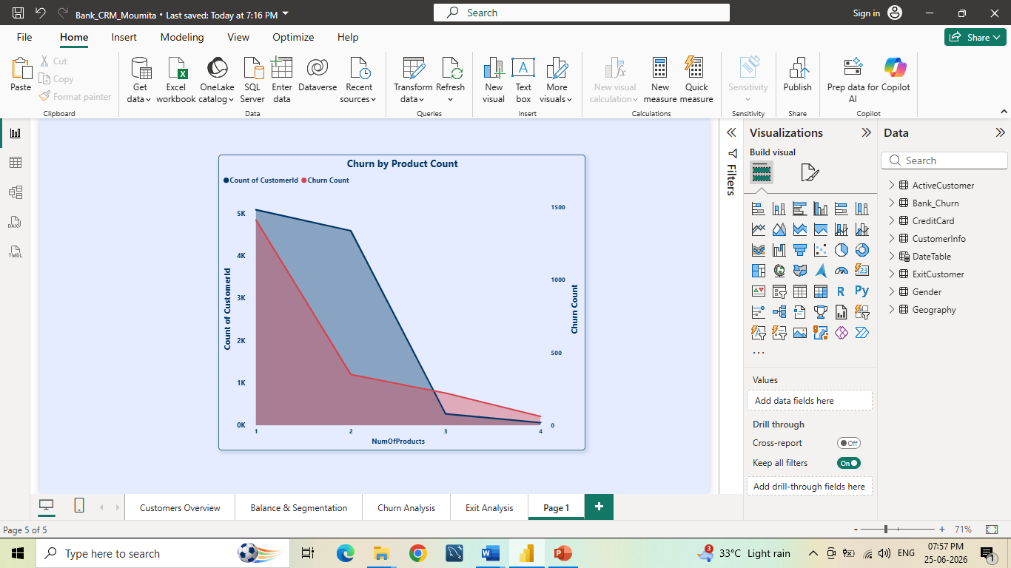
Customers & Churn Count By Products
Key Insights
Highest churn from single-product customers.
Multi-product customers are more loyal.
Recommendations
Target single-product customers.
Promote cross-selling.
Single-product customers are most likely to churn, while multi-product customers show stronger loyalty.

Slide 16
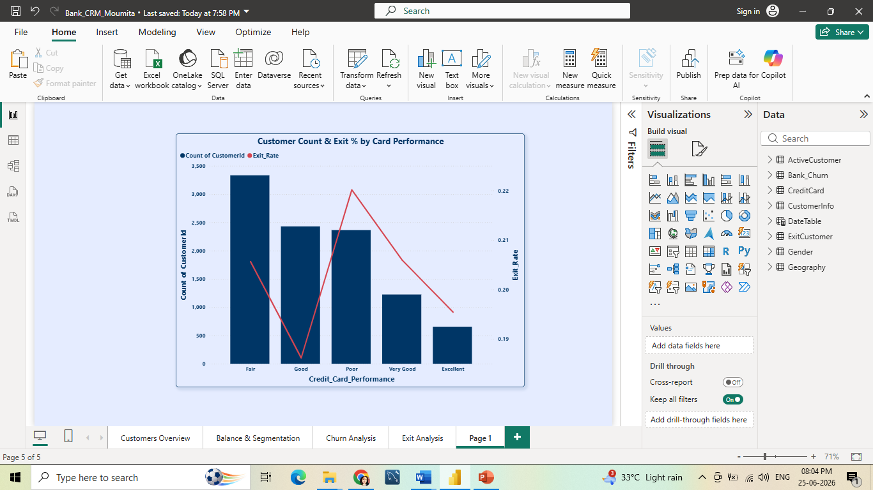
Exit Rate by Customers & Credit Card Performance
Key Insights
Highest churn in Poor & Very Good segments.
Good performers churn the least.
Excellent segment still shows some churn.
Recommendations
Focus retention on Poor & Very Good segments.
Maintain benefits for Good performers.
Monitor the Excellent segment.
Good card performers are the most loyal, while Poor and Very Good segments drive higher churn

Slide 17
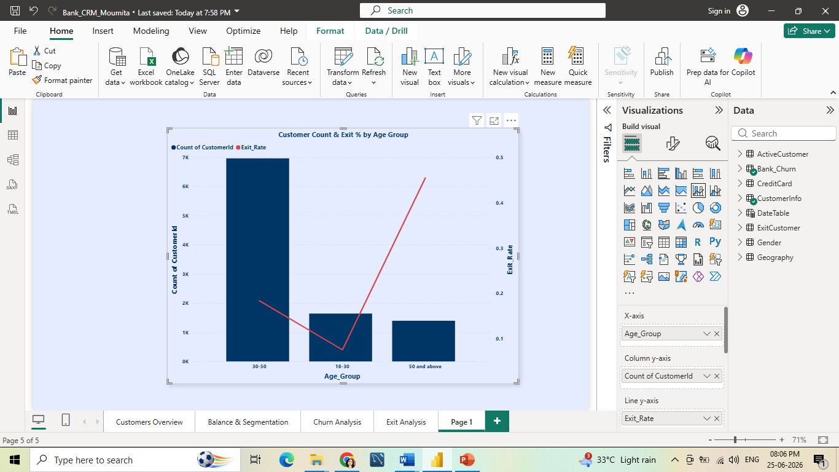
Exit Rate by Age Group
Key Insights
Highest churn in the 50+ segment.
Lowest churn among ages 18–30.
30–50 is the largest customer group.
Recommendations
Focus retention on 50+ customers.
Keep younger customers engaged.
Monitor the 30–50 segment.
Churn risk increases with age, making the 50+ segment a key retention priority.

Slide 18
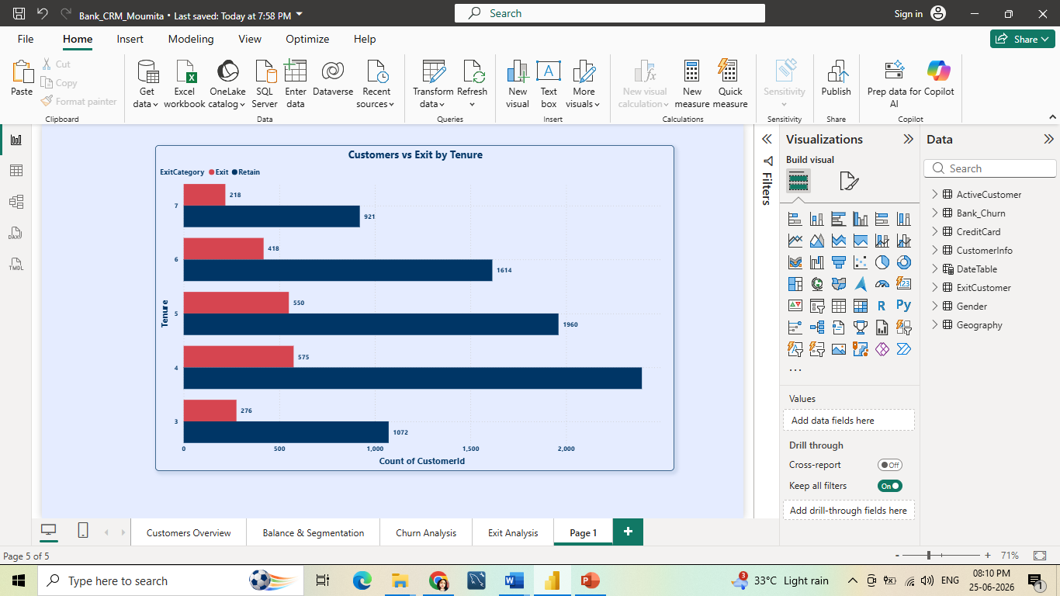
Customers Exit by Tenure
Key Insights
Churn peaks at 4–5 years of tenure.
Retention declines with longer tenure.
New and long-tenured customers churn less.
Recommendations
Focus on 4–5 year customers.
Improve mid-tenure engagement.
Introduce loyalty programs.
Churn peaks during the mid-tenure period, while new and long-tenured customers remain more loyal.

Slide 19
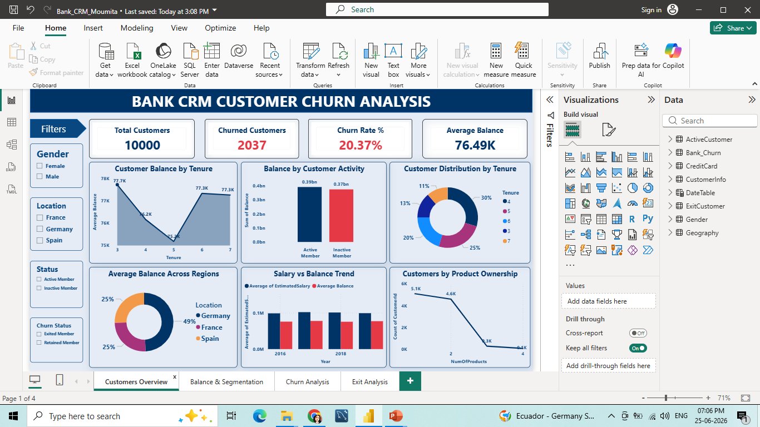
Dashboard

Slide 20
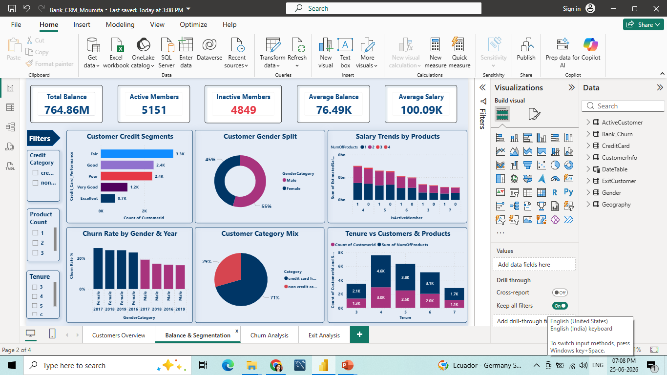

Slide 21
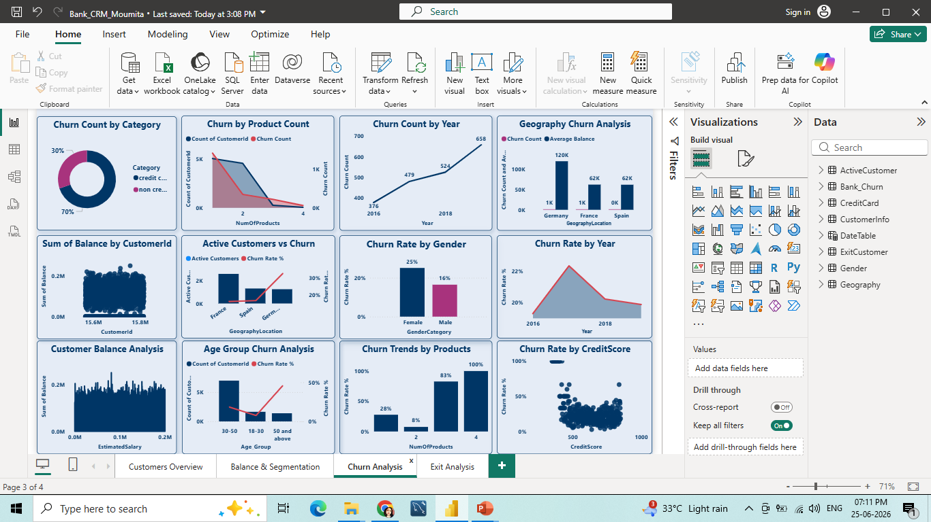

Slide 22
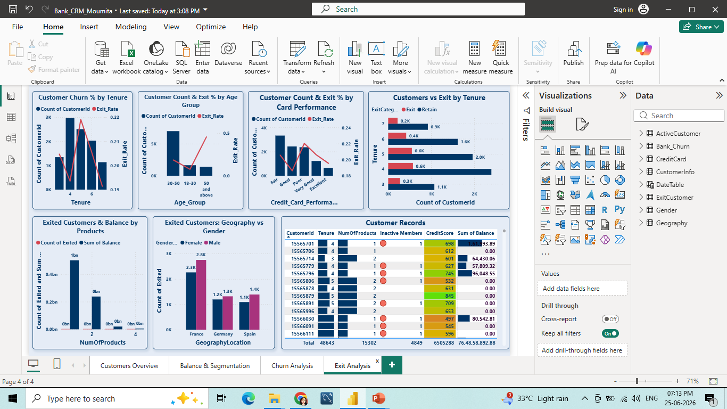

Slide 23
Data Challenges in Churn Analysis
Imbalanced customer churn data.
Missing financial and behavioral attributes.
Multiple factors influencing churn.
Regional variations in customer behavior.
Limited transaction and product usage data.
Data quality and missing value issues.
Difficulty identifying key churn drivers.
Limited historical data for trend analysis.

Slide 24
Recommendations
Target High-Risk Segments: Focus retention efforts on females aged 50+ and German customers.
Increase Product Adoption: Promote additional products and credit card usage through personalized offers.
Strengthen Loyalty Programs: Reward stable customer segments and retain mid-credit score customers.
Improve Customer Targeting: Avoid relying solely on salary for churn prediction and segmentation.
Optimize Geographic Strategy: Prioritize growth in France and Spain due to lower churn and larger customer bases.

Slide 25
Conclusion
High churn among females aged 50+ and German customers.
Young customers (18–30) and mid-credit score customers show stronger loyalty.
France has the largest customer base and lowest churn rate.
Most customers hold only one product, creating cross-sell opportunities.
Non-credit card holders present potential for product adoption.
Salary has minimal impact on churn and customer behavior.

Slide 26
Thank You

