Slide 1
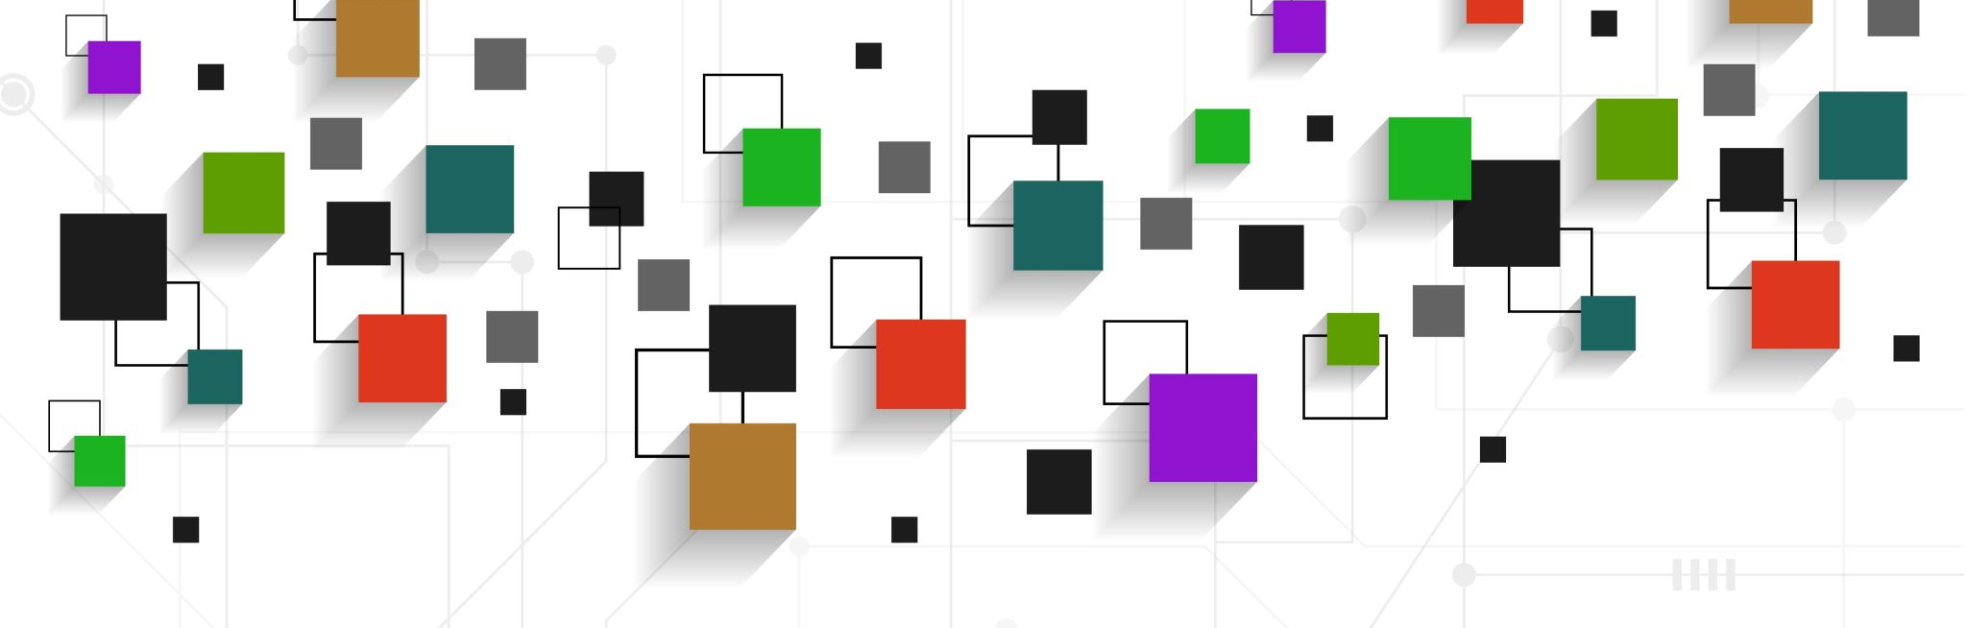
GRASP

Slide 2
WHY GRASP ?

Slide 3
1. Information Expert
2. Creator
3. Controller
4. Low Coupling
5. High Cohesion
6. Indirection
7. Polymorphism
8. Pure Fabrication
9. Protected Variations

Slide 4
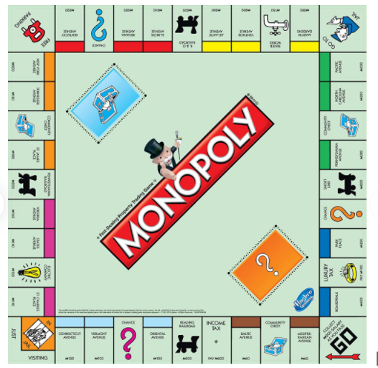
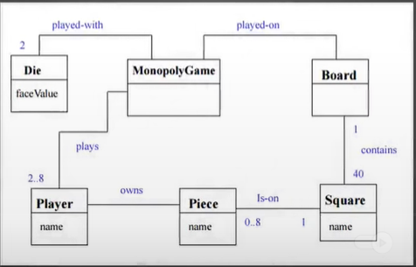

Slide 5
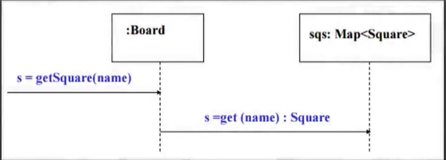
1. Information Expert (Ask The Expert)
Problem :
What is a basic principle by which to assign responsibilities to objects?
Solution:
Assign a responsibility to the information Expert , the class that has information necessary to fulfill the responsibility,

Slide 6
2. Creator
Problem :
Who creates the new instance of some class?
Solution:
Assign class A the responsibility to create an instance of class B if :
* A aggregates B objects,
* A contains B objects ,
* A records instances of B objects,
* A is closely uses this B objects , OR
* A has initializing data that is needed while creating b objects

Slide 7
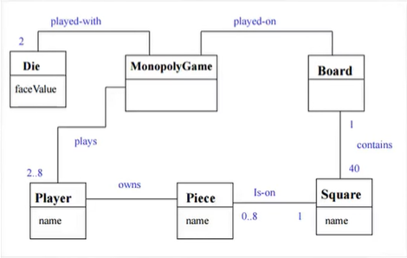

Slide 8
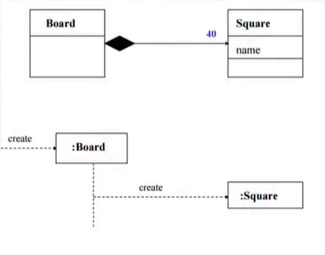

Slide 9
3. Controller
Problem :
Who should be responsible for handling a system event?
Solution:
Assign the responsibility for handling a system event message to a class representing one of the following :
1- A class that represents the overall system, root object, device that the software is running within, or a major subsystem (these are all variations of a facade controller)
2- A class Represents a use case scenario within which the system operation occurs (a use case or session controller)

Slide 10
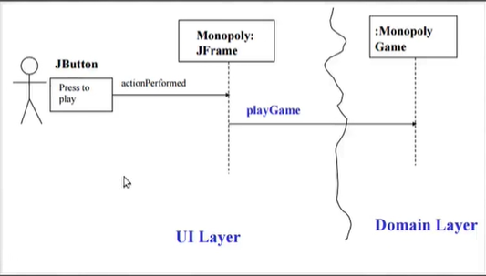

Slide 11
4. Low Coupling
Problem :
How to reduce the impact of change and encourage reuse?
Solution:
Assign responsibilities so that coupling remains low.

Slide 12
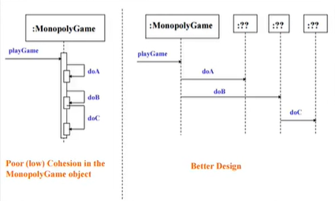
5. High Cohesion
Problem :
How to keep objects focused and manageable ?
Solution:
Assign a responsibility so that cohesion remains high.

Slide 13
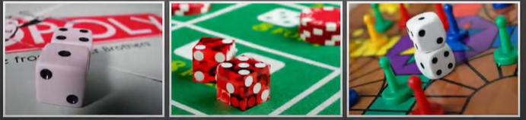
6. Indirection
Problem :
How to combine Low coupling and High potential for reuse ?
Solution:
Assign the responsibility to an intermediate object to mediate between other components or services so that they are not directly coupled

Slide 14
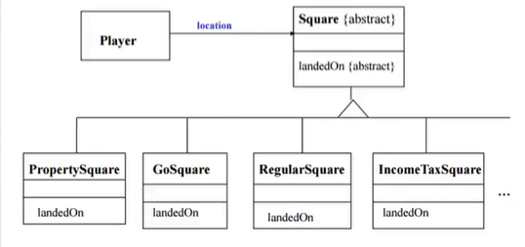
7. Polymorphism
Problem :
How to handle alternatives based on type?
How to create pluggable software components ?
Solution:
1- Identify classes/types which would have the behaviour changing slightly
2- Look for the methods which use conditional statements,
3- Assign a responsibility to a type for which the behaviour varies,

Slide 15
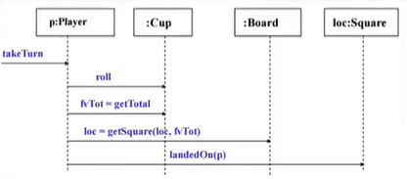
8. Pure Fabrication
Problem :
Who should be responsible when an expert violates High Cohesion and Low Coupling ?
Solution:
Assign the responsibility for handling a system event message to a class which is new, fictitious and doesn’t represent a concept in domain

Slide 16
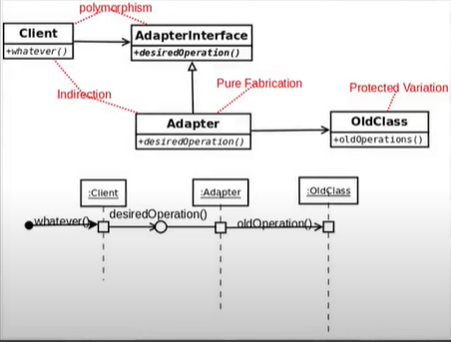
9. Protected Variations

Slide 17
9. Protected Variations
Problem:
How should responsibilities be assigned in such fashion that the current or future variations in the system do not cause major problems with system operation and/or revision?
Solution:
Assign responsibilities to create stable interfaces around current and future variations,

