Slide 1
Is the Tweet related to Hurricane? Topic Modelling using LDA
Mouna Kalidindi

Slide 2
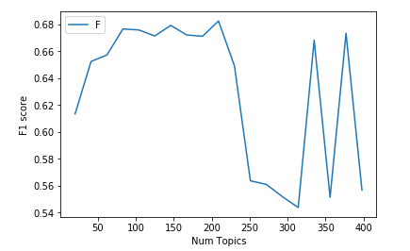
LDA model
Randomly selected 10000 records from new dataset and concatenated with exiting data.
Created lda model for number of topics ranging from 20 to 400.
Calculated F1 scores

Slide 3
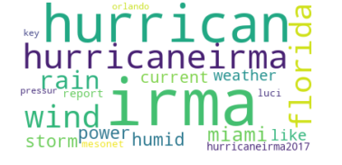
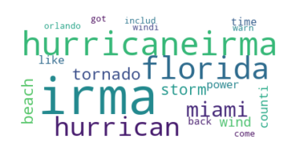
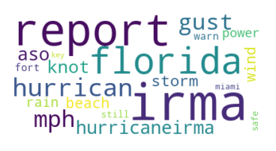
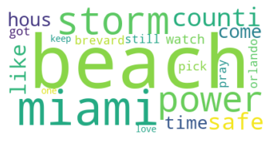
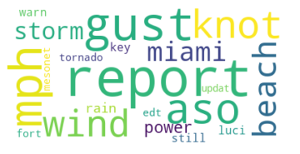
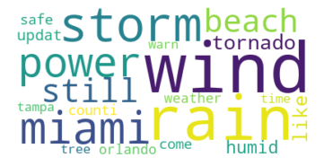
Community Detection

