Slide 1
HILTI Data Collection

Slide 2
Objective
Work Load Detection
Anomaly Detection

Slide 3
Sensors
A sensor is a device that is able to detect changes in an environment.
A sensor is able to measure a physical phenomenon (like temperature, pressure, and so on) and transform it into an electric signal

Slide 4
Characteristics:
It should be sensitive to the phenomenon that it measures
It should not be sensitive to other physical phenomena
It should not modify the measured phenomenon during the measurement process

Slide 5
Classification:
Passive sensors do not require an external power source to monitor an environment, while Active sensors require such a source in order to work.
Analog sensors produce an analog or continuous signal while digital sensors produce a discrete signal.

Slide 6
Properties:
Range: The maximum and minimum values of the phenomenon that the sensor can measure.
Sensitivity: The minimum change of the measured parameter that causes a detectable change in output signal.
Resolution: The minimum change in the phenomenon that the sensor can detect.

Slide 7
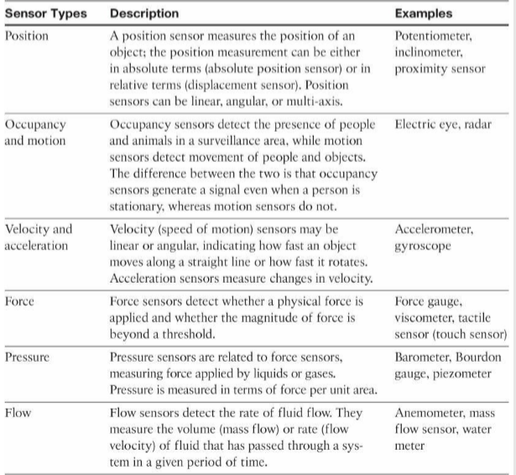
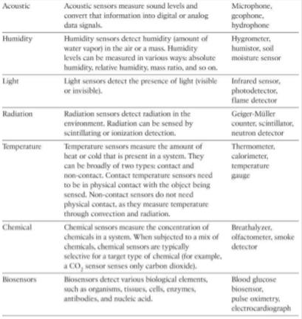
Types of sensors

Slide 8
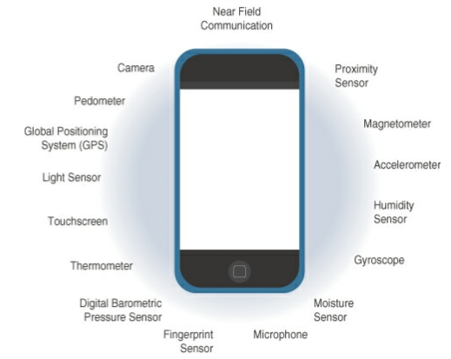
Sensors in a smart phone

Slide 9
How to use Sensors in IoT
Two most popular boards used for prototyping are
Arduino Uno
Microcontroller board based on an ATmega328P.
Provides 6 analog and 14 digital pins.
Can be used with analog and digital sensors.
Raspberry Pi
Small “Single Board Computer” (SBC) based on Broadcom BCM2837B0
Compatible with Operating Systems such as Linux, FreeBSD, NetBSD, OpenBSD, Plan 9, RiscOS and Windows 10 IoT Core
Built in Camera, SenseHat (has lots of built-in sensors), Gertboard, Official Display

Slide 10
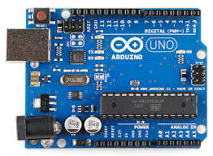
Arduino

Slide 11
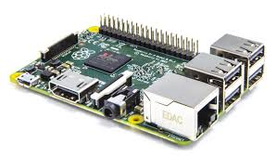
Raspberry Pi

Slide 12
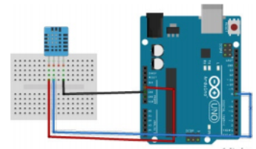
How to measure Temperature and Humidity using Arduino
// Arduino IDE
#include "DHT.h"
#define PIN 8
#define DHTTYPE DHT11 // sensor type
DHT dht(PIN, DHTTYPE);
void setup()
{
Serial.begin(9600);
}
void loop()
{
int temp = dht.readTemperature();
int hum = dht.readHumidity();
Serial.println("Temperature: " + String(temp));
Serial.println("Humidity: " + String(hum));
delay(5000);
}

Slide 13
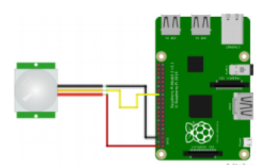
How to use Movement Sensors with Raspberry Pi
//python code
import RPi.GPIO as GPIO
import time
GPIO.setmode(GPIO.BCM)
sensorPin = 7
GPIO.setup(sensorPin, GPIO.IN)
while True:
if GPIO.input(sensorPIN) == GPIO.LOW:
print "Motion detected"
else:
print "No motion"
time.sleep(0.5)

Slide 14
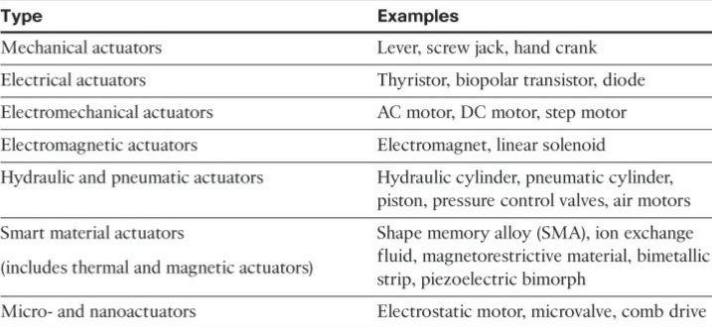
Actuator
An actuator is a mechanism for turning energy into motion
Actuators can be categorized by the energy source they require to generate motion

Slide 15
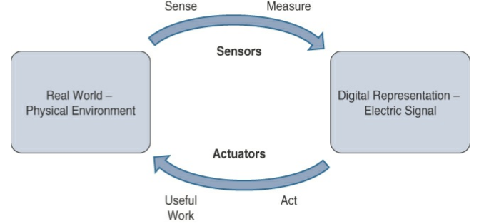
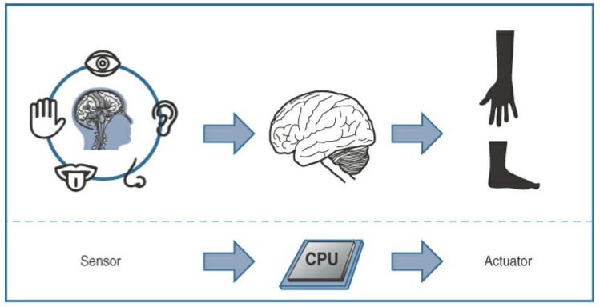
How Sensors and Actuators interact with the physical world

Slide 16
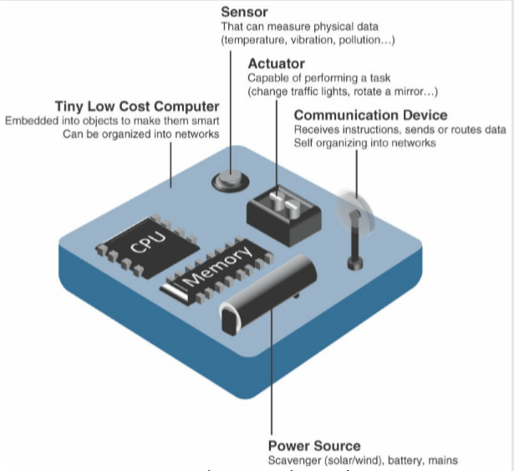
Smart object

Slide 17
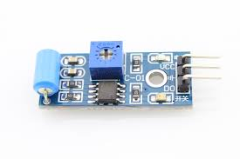
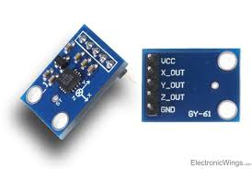
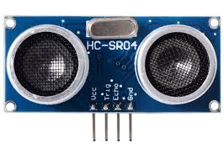
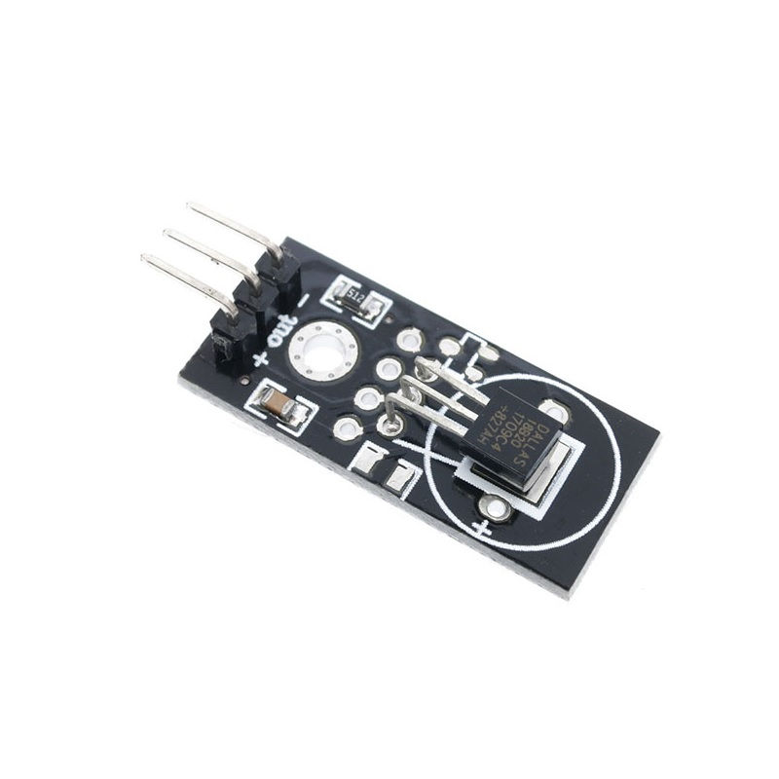
Vibration Sensor
Accelerometer Sensor
Ultrasonic Sensor
Temperature Sensor

Slide 18
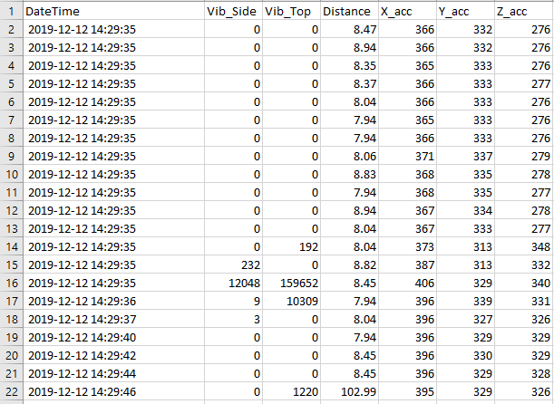
Sample Dataset

Slide 19
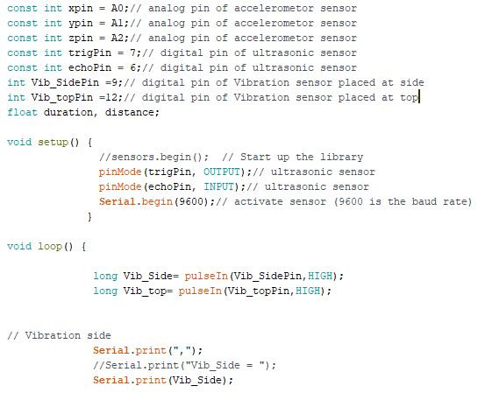
Sample arduino code

