Slide 1
Vibration Compensation of Display Contents in Smart Devices using Accelerometer Feedback
Alireza Mounesisohi and Saeid Bashash
Department of Mechanical Engineering
San Jose State University
1st IEEE Conference on Control Technology and Applications Kohala Coast, HI
August 2017

Slide 2
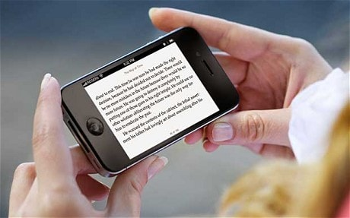
Smart Devices in Motion
Smart devices are an inseparable elements of the 21st century life.
Reading text on a moving can cause eye strain, discomfort, and headache.
In particular, this imposes a significant limitation on the life quality of people with Parkinson and hand tremor
WHO projects that 40 million people will be afflicted by PD.

Slide 3
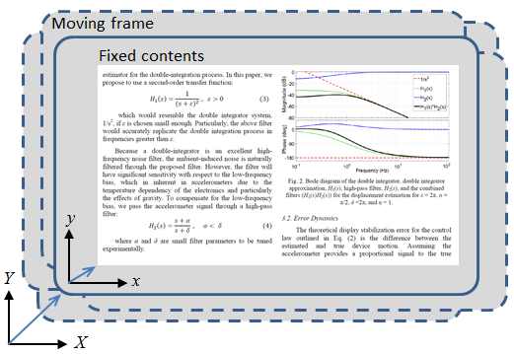
Display Content Control Method
Ideal control law:
$$x\left(t\right)=x_{0}−∆X\left(t\right), y\left(t\right)=y_{0}−∆X(t)$$
Practical control law:
$$x\left(t\right)=x_{0}−∆\hat{X}\left(t\right), y\left(t\right)=y_{0}−∆\hat{Y}(t)$$

Slide 4
Display Control Literature
B. Abali, H. Franke, and M. E. Giampapa, “Method and apparatus for image stabilization in display device,” US Patent 6317114, Nov. 2001.
T. Y. Lu, “Anti-vibration system for the display screen of an image display device,” US Patent 20090169127, July 2009.
A. Rahmati, C. Shepard and L. Zhong, “NoShake: Content stabilization for shaking screens of mobile devices,” Proceedings of the 2009 IEEE International Conference on Pervasive Computing and Communications, Galveston, Texas, Mar. 2009.
Display control literature suffers from a fundamental mistake, and lack of quantitative results.

Slide 5
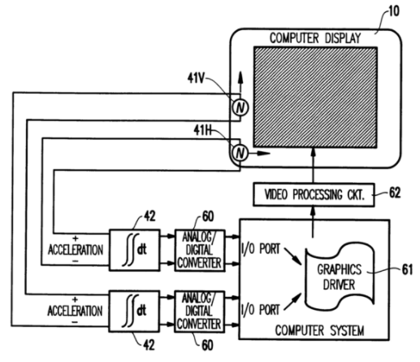
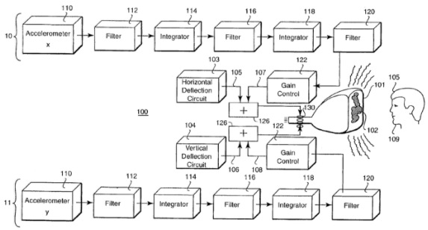
Display Control Literature
US 6317114 B1
US 6906754 B1

Slide 6

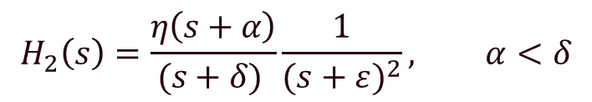
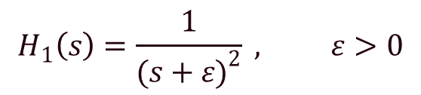
Filter Design
Accelerometer signal
?
Estimated position
$$H_{0}\left(s\right)=\frac{1}{s^{2}}$$
Candidate #0
$$H_{1}\left(s\right)=\frac{1}{{(s+ε)}^{2}} , ε>0$$
Candidate #1
$$H_{2}\left(s\right)=\frac{η\left(s+α\right)}{(s+δ) }\frac{1}{{(s+ε)}^{2}}, α<δ$$
Candidate #2
Stable double integrator approximate with a high-pass filter and a calibration gain

Slide 7
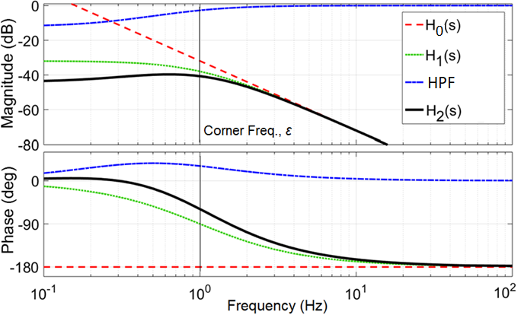
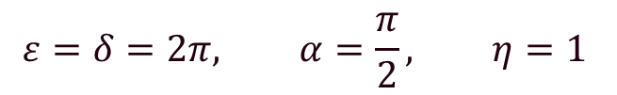
Sample Bode Diagram
$$ε=δ=2π, α=\frac{π}{2}, η=1$$

Slide 8
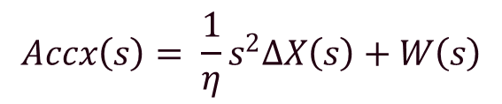
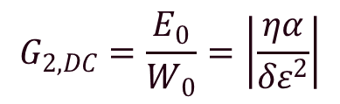
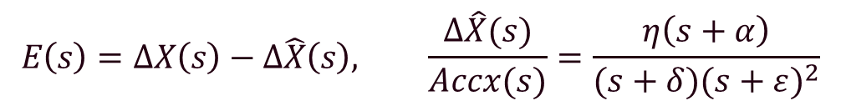
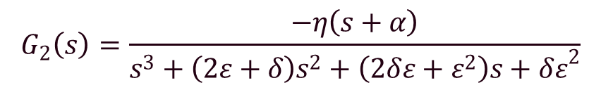
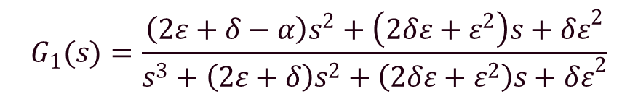

Error Dynamics
$$E\left(s\right)=∆X\left(s\right)−∆\hat{X}\left(s\right), \frac{∆\hat{X}(s)}{Accx(s)}=\frac{η\left(s+α\right)}{(s+δ){(s+ε)}^{2}}$$
Displ. error:
$$Accx\left(s\right)= \frac{1}{η}s^{2}∆X\left(s\right)+W\left(s\right)$$
Accelerometer Signal:
Bias/noise
$E\left(s\right)=G_{1}\left(s\right)∆X\left(s\right)+G_{2}\left(s\right)W\left(s\right)$
$$G_{1}(s)=\frac{\left(2ε+δ−α\right)s^{2}+\left(2δε+ε^{2}\right)s+{δε}^{2}}{s^{3}+\left(2ε+δ\right)s^{2}+\left(2δε+ε^{2}\right)s+{δε}^{2}}$$
where:
$$G_{2}\left(s\right)=\frac{−η\left(s+α\right)}{s^{3}+\left(2ε+δ\right)s^{2}+\left(2δε+ε^{2}\right)s+{δε}^{2}}$$
$$G_{2,DC}=\frac{E_{0}}{W_{0}}=\left|\frac{ηα}{δε^{2}}\right|$$
Sensitivity to sensor bias

Slide 9
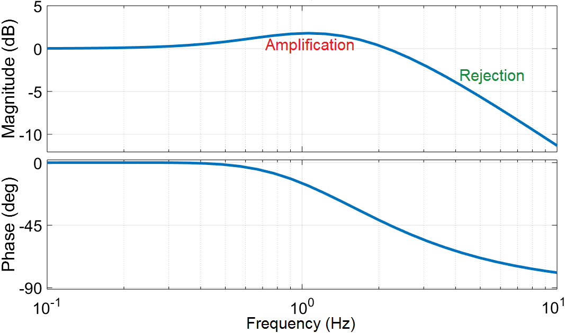

Error Transfer Function Bode Diagram
$$G_{1}(s)$$

Slide 10
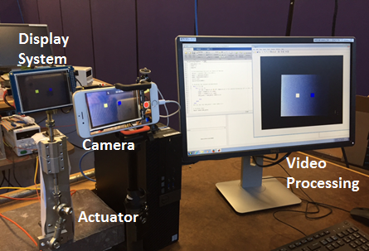
Experimental Setup
- Microcontroller: ATmega328P-based Arduino-Mega (Atmel)
- Accelerometer: ADXL335, 3-axis analog accelerometer (Analog Devices)
- LCD: TFT touchscreen board (KOOKYE)

Slide 11
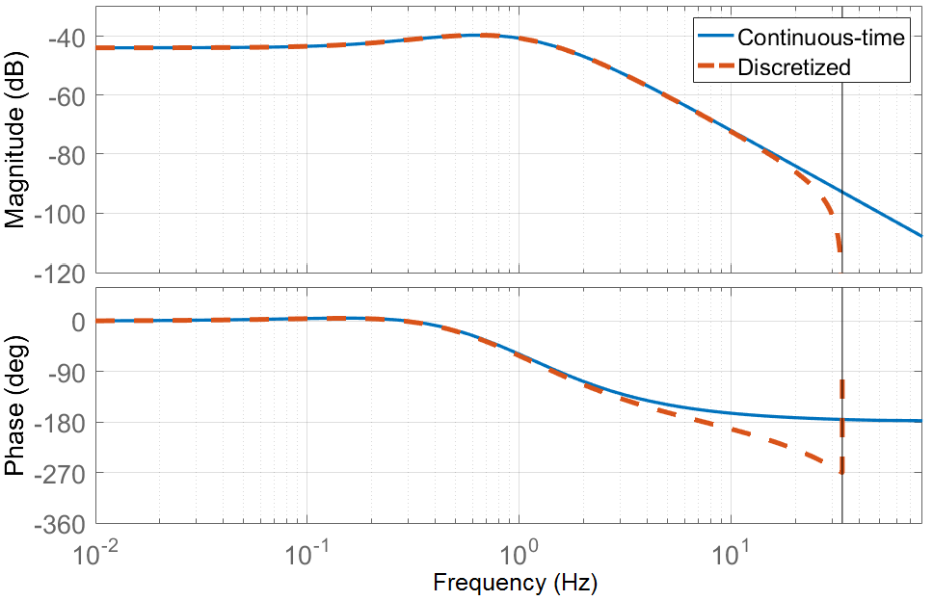
Filter Discretization
The filter is discretized using pole-zero matching with 15 ms sampling time.
It is converted to state-space form before hardware implementation

Slide 12
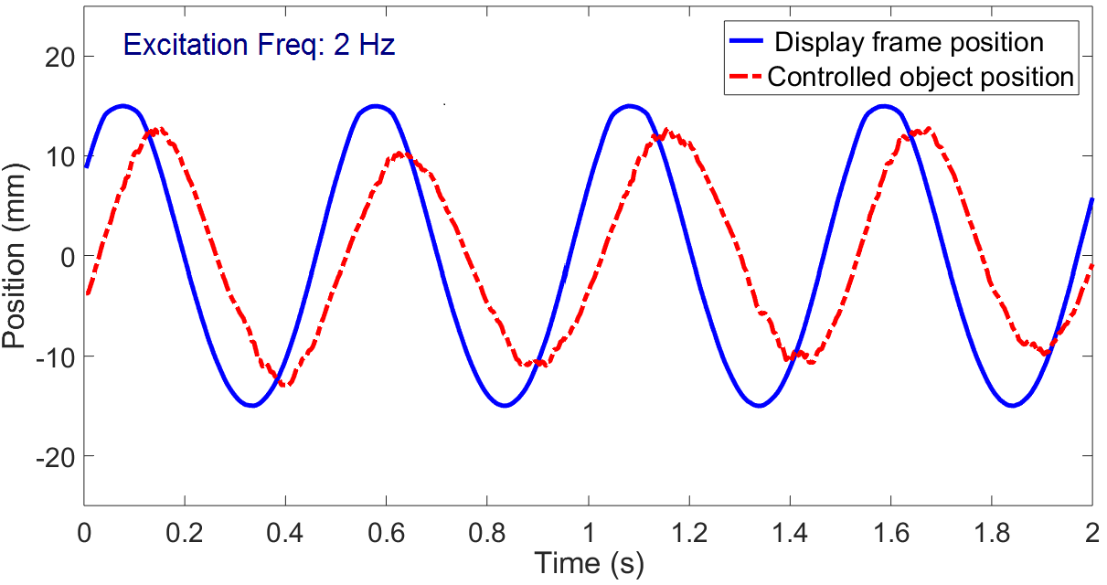
Implementation Results

Slide 13
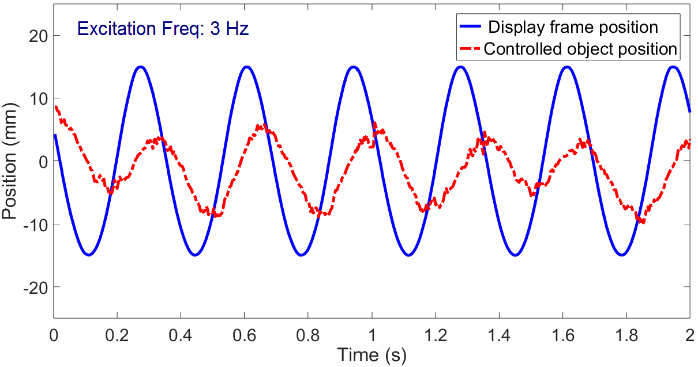
Implementation Results

Slide 14
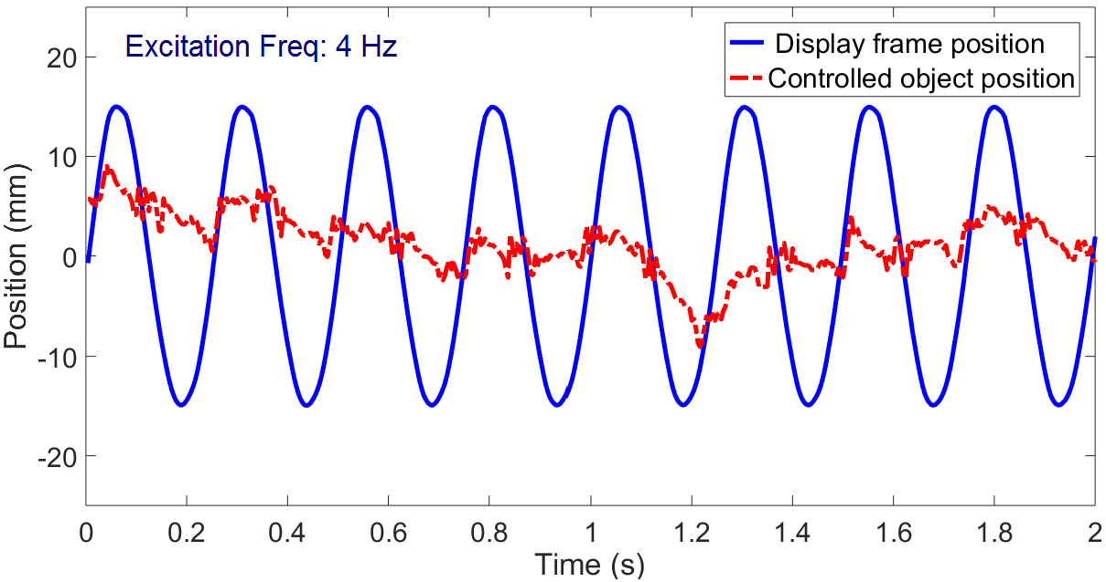
Implementation Results

Slide 15
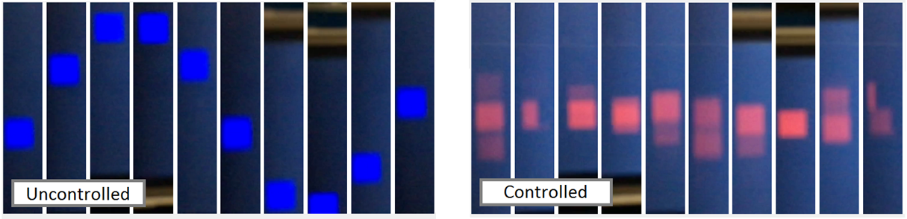
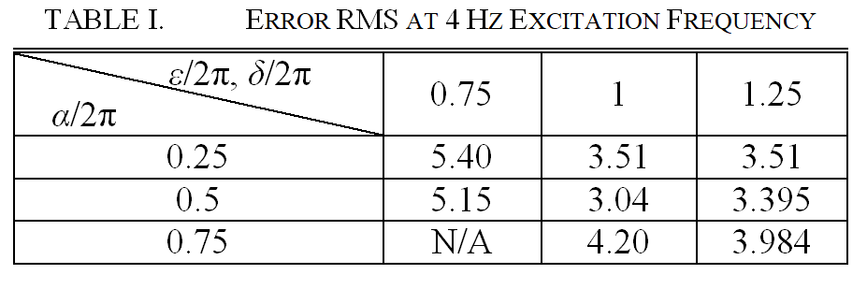
Sequential Snapshots of the Screen

Slide 16
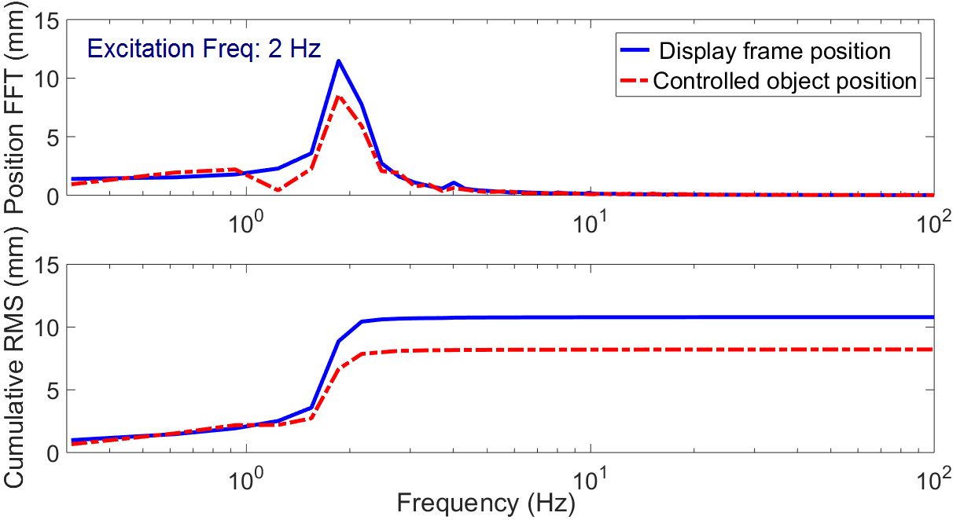
Frequency Domain Analysis (FFT)

Slide 17
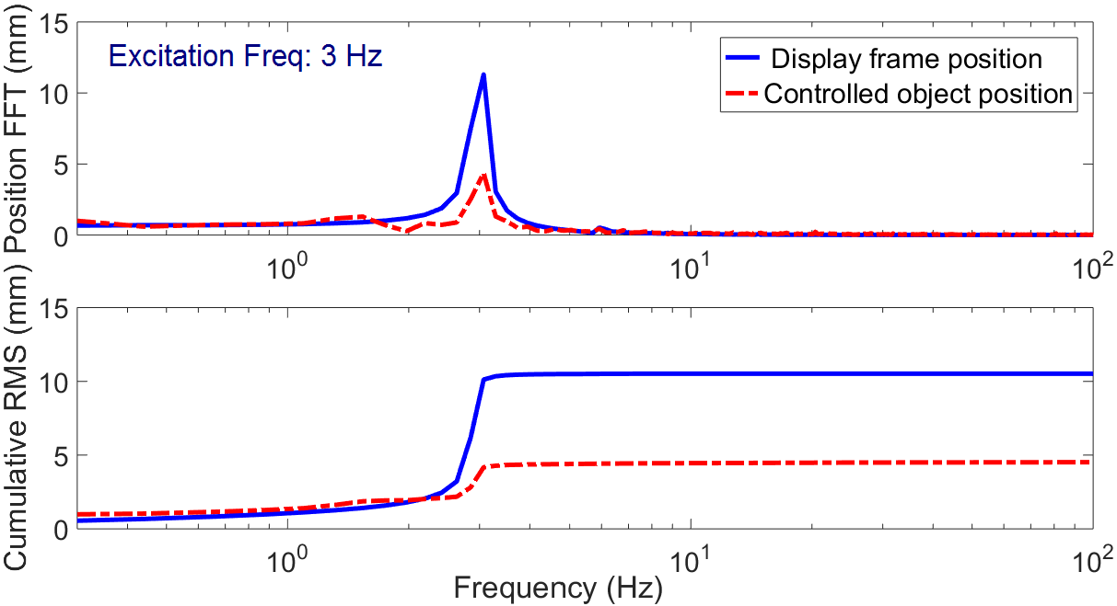
Frequency Domain Analysis (FFT)

Slide 18
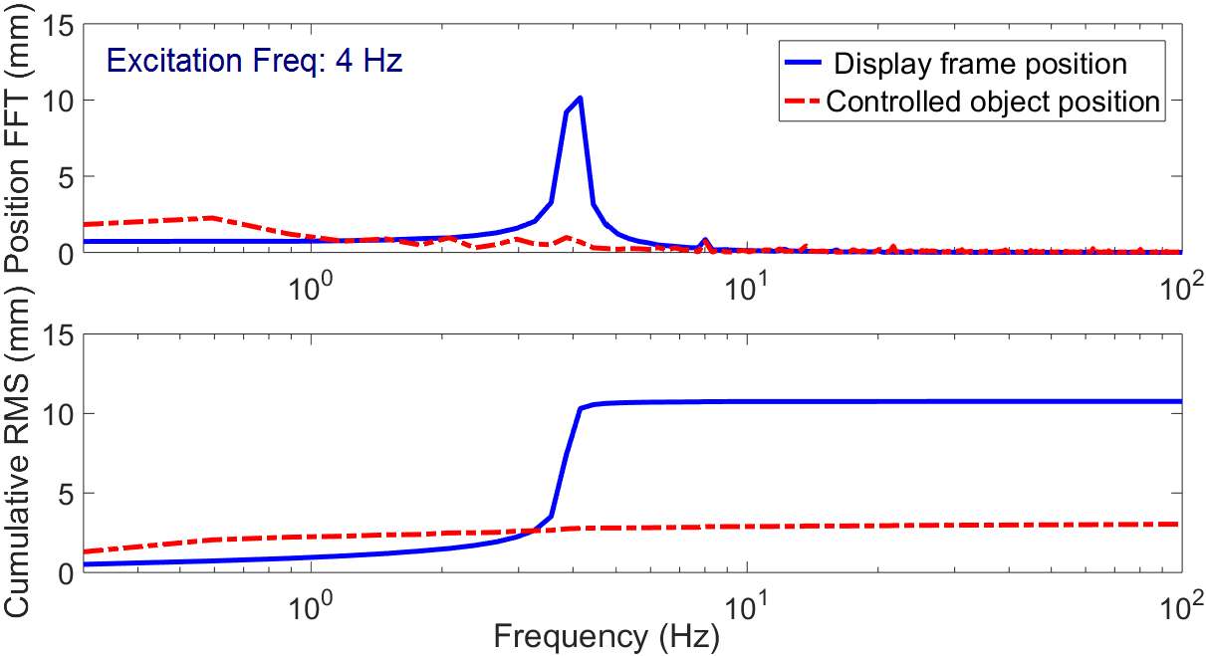
Frequency Domain Analysis (FFT)

Slide 19
Conclusions and Future Work
Screen content motion in smart electronic devices can be mitigated via accelerometer feedback
The accelerometer-based filters have limitations in rejecting disturbances at lower frequencies
An approximate double integrator with a high-pass filter for bias rejection is a promising solution for rejecting high-frequency components of the display motion.
Future Work
Optimizing the filter structure and parameters systematically
Extending to multi-axis configuration
Implementing in a real smart device

Slide 20
Thank You!

