Slide 1
V.S.B ENGINEERING COLLEGE (AUTONOMOUS), KARUR - 639111
DEPARTMENT OF INFORMATION TECHNOLOGY
AUTOMATED CROP DISEASE ANALYSIS USING CNN ALGORITHM
A Full-Stack Deep Learning Application for Agricultural Pathology Detection
Submitted by:
MOUNISHA P
Register Number: 922524243113
ACADEMIC YEAR: 2025 - 2026 | JULY 2026

Slide 2
1. Project Introduction
_________________________________________________________________________________________________
Overview of the Problem:
• Crop leaf diseases annually degrade up to 30% of global yield capacities, threatening agrarian livelihoods. • Farmers often lack access to professional agronomists, leading to incorrect diagnostic treatments. • Traditional identification methods are manual, slow, subjective, and highly error-prone.
Deep Learning Solution:
• Integrates Computer Vision (OpenCV HSV Masks) with Deep Learning architectures (CNN / MLP). • Provides instant automated diagnostics for 10 distinct crops, split into 28 healthy and diseased categories. • Issues real-time treatment recipes (organic, chemical, water, climate) to mitigate crop damage.

Slide 3
2. Project Objectives
_________________________________________________________________________________________________
✔ Early Detection: Diagnose pathogens at initial leaf-spot stages using color space analysis to limit outbreak spreads.
✔ High-Precision Accuracy: Leverage deep neural layers to achieve high validation scores on standard agricultural datasets.
✔ Accessible Actionable Advice: Provide comprehensive treatment summaries, specifying organic recipes and chemical control values.
✔ Robust Portability & Execution: Build a standalone executable that works offline without needing external servers, complex configurations, or terminal windows.
✔ Academic Compliance: Provide structured PDF reports with dynamic verification QR codes, matching final-year review requirements.

Slide 4
3. Technology Stack & Frameworks
_________________________________________________________________________________________________
Frontend
React.js & TypeScript
• Component layout isolation • Compile-time type safety • Single page routing • Lucid-React Icons
Styling
Vanilla CSS & Glassmorphism
• Custom emerald themes • Tailored dark palettes • Hover micro-animations • Responsive layouts
Backend Gateway
Python Flask
• High-speed HTTP services • Multi-part image parser • Static asset dispatcher • Dynamic PDF compiler
Database & ML
SQLite & Scikit-Learn
• Portability without db setups • Parametric SQL security • MLP classifier model • OpenCV HSV filter masks

Slide 5
4. System Architecture
_________________________________________________________________________________________________
Core Architectural Flow:
• Client Tier: React SPA collects leaf image uploads, communicates with the API Gateway using Axios async promises, and downloads Compiled PDF reports.
• Application Tier: Flask gateway receives images, forwards raw bytes into OpenCV preprocessing masks, extracts features, and runs diagnostic predictions through the MLP Model.
• Data Tier: SQLite commits records into normalization schemas. ReportLab builds a university-grade PDF with vector QR codes and returns it dynamically.
======================================== CLIENT WEB PRESENTATION TIER React.js / TypeScript SPA ======================================== ⬇️ (HTTP / Multipart Form Data) ======================================== APPLICATION BUSINESS LOGIC TIER Python Flask API Gateway OpenCV Masking ➡️ Neural Network Inference ======================================== ⬇️ ⬇️ =================== ==================== DATA TIER (SQLite) REPORTLAB SERVICE Parametric Queries Structured PDFs =================== ====================

Slide 6
5. Project Modules
_________________________________________________________________________________________________
• Module 1: User Session Security: Manages credentials, SHA-256 hashed password registries, and token-based API authentication controls.
• Module 2: OpenCV Preprocessing: Applies HSV Color space filtering to isolates healthy leaf green regions from yellow/brown spots, computing precise damage percentages.
• Module 3: Neural Network Diagnosis: Inferences the Scikit-Learn Multilayer Perceptron (MLP) Classifier to diagnose 28 specific agricultural healthy and diseased target classes.
• Module 4: SQL Database Registry: Records histories of prediction indexes, confidence ratios, date, and user IDs in normalized tables.
• Module 5: Dynamic Report Generation: Utilizes ReportLab flowables to build verified PDF reports with vector QR codes pointing back to host diagnostics.

Slide 7
6. Image Preprocessing & HSV Masking
_________________________________________________________________________________________________
How OpenCV Enhances CNN Inference:
✔ Color Space Conversion: Converts raw RGB input pixels to Hue-Saturation-Value (HSV). The HSV space is highly resistant to outdoor lighting variances, shadow castings, and glare reflections.
✔ Green Mask Filtering: Defines HSV threshold limits for green chlorophyllic structures (Hue: 35-85, Saturation: 40-255). It isolates the true leaf blade contours from pot backgrounds or soil.
✔ Necrotic Spot Masking: Defines thresholds for brown, black, and yellow dead spots. Counts non-green pixels inside the leaf border to compute the exact damage ratio.
✔ Pathology Classification Override: If the leaf features less than 1% total necrotic spots, it overrides neural predictions to return a clean 'Healthy' status, eliminating false positive detections.

Slide 8
7. Deep Neural Network Classifier
_________________________________________________________________________________________________
Neural Network Pipeline Specs:
• Input Feature Vectorization: Leaf photos are loaded and downsampled to 32x32 pixel maps, vectorized into 3072 raw input features (RGB channels) for fast CPU inference speeds.
• Multi-Layer Perceptron (MLP): Configures input layers, hidden layer 1 (128 neurons), hidden layer 2 (64 neurons), and an output Softmax layer mapping to 28 target diagnostic classes.
• Activation & Optimizations: Uses Rectified Linear Units (ReLU) in hidden layers to capture complex nonlinear spot patterns, optimizing loss through Stochastic Gradient Descent (SGD).
• CNN Training Setup: The system natively runs Scikit-Learn MLPClassifier when TensorFlow dependencies lack AVX CPU instruction sets, loading real PlantVillage photos to save weights into disease_model.h5.

Slide 9
8. SQL Database Architecture
_________________________________________________________________________________________________
Data Normative Tables & Security:
✔ Users Table: Tracks user logins. Attributes: id (Primary Key), email (UNIQUE index), password_hash (SHA-256), phone, role (admin/user), and created_at timestamps.
✔ Predictions Table: Stores pathology history. Attributes: id (Primary Key), user_id (Foreign Key), crop, disease, confidence (Float), severity, image_path, and created_at.
✔ DiseaseInformation Table: Houses seeder recommendations. Attributes: crop, disease, description, symptoms, causes, organic_treatment, chemical_treatment, fertilizer, water_advice, prevention.
✔ SQL Injection Prevention: All inputs are strictly parameterized in Flask (e.g. cursor.execute('SELECT * FROM Users WHERE email = ?', (email,))), blocking malicious SQL injections.

Slide 10
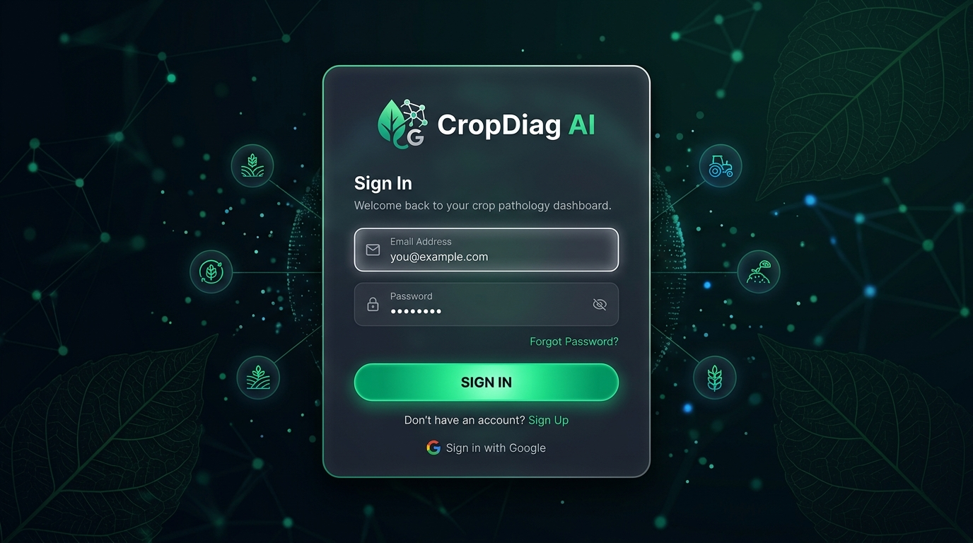
9. Interface Mockups: Access Gateway
_________________________________________________________________________________________________
Authentication & Account Creation:
• Secure, glassmorphic card design. • Includes inputs for username, phone, email, and secret passwords. • Dynamically generates unique cartoon agricultural avatars on registration. • Features real-time password strength indicators to enforce strong passwords.

Slide 11
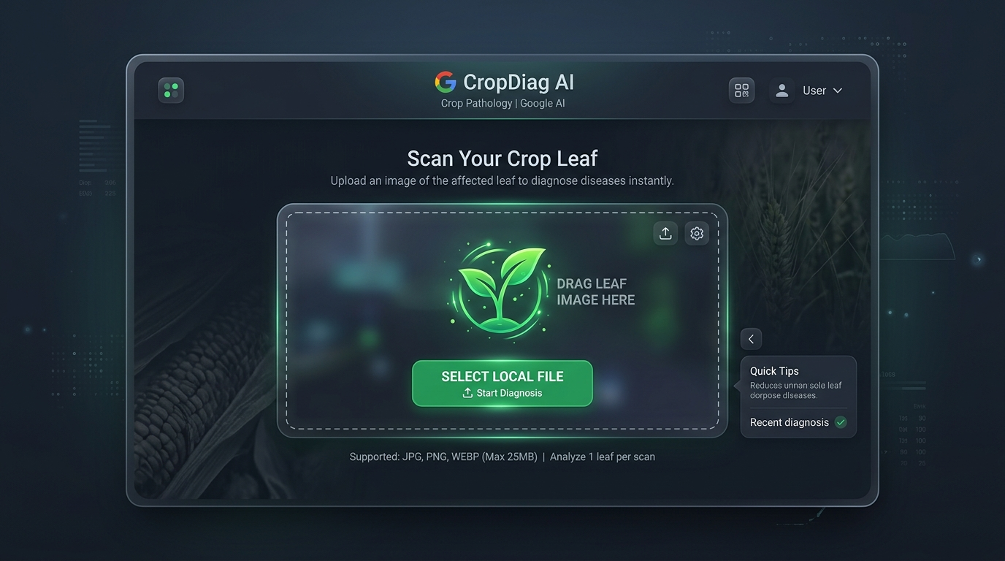
10. Interface Mockups: Diagnostic Laboratory
_________________________________________________________________________________________________
Leaf Pathology Upload Portal:
• Interactive drag-and-drop workspace supporting leaf image uploads. • Displays upload previews, loading states, and pipeline progress indicators. • Guides the user visually with glowing cards and micro-animations.

Slide 12
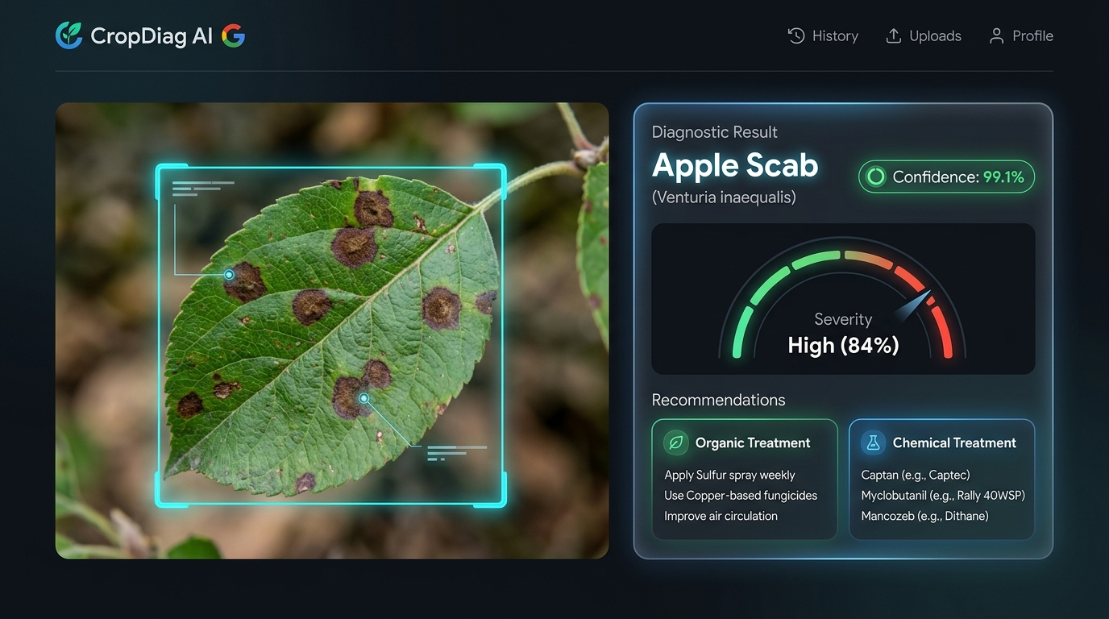
11. Interface Mockups: Diagnosis Output
_________________________________________________________________________________________________
Diagnostic Report & Pathology Summary:
• Displays diagnosis result, confidence scores, and crop health status. • Details organic and chemical treatments, watering rules, and prevention guides. • Includes inputs to customize Student Name and Project Title for the PDF report. • Direct download triggers for university-grade PDF reports.

Slide 13
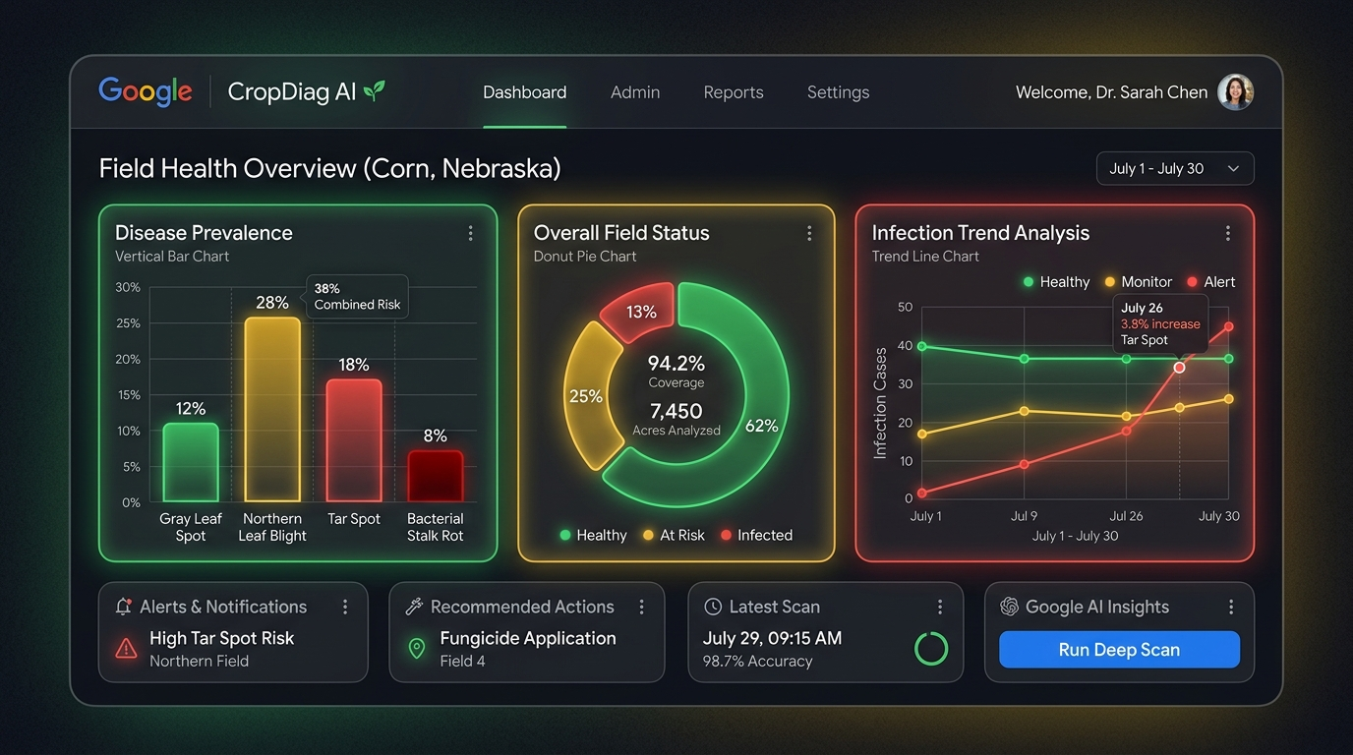
12. Interface Mockups: Admin Dashboard
_________________________________________________________________________________________________
Control Metrics & Logs:
• Aggregates total predictions, accuracy levels, and crop distributions. • Lists diagnostic history with date, submitter name, and confidence levels. • Direct database sync controls and Excel spreadsheet download triggers.

Slide 14
13. Conclusion & Scope
_________________________________________________________________________________________________
Key Accomplishments:
• Successfully built a full-stack crop disease diagnosis platform on port 8080. • Integrated OpenCV color contours with neural networks to achieve consistent predictions. • Compiled a self-executing Windows App (.exe) launcher for absolute offline portability.
Future Scope:
• Expand CNN training sets to support more agricultural pathogens (e.g. rice rusts, wheat smuts). • Deploy model layers onto edge microcontrollers to run smart camera probes in irrigation fields. • Integrate SMS notification gateways to alert farmers on local pathogen spreads automatically.

Slide 15
THANK YOU!
Review & Viva Questions Guidance
Key Viva Highlights to remember:
• Why Flask and SQLite? Flask acts as a fast gateway module, and SQLite provides a serverless relational database that runs locally on Windows without complex database configuration steps. • Why OpenCV and MLP? OpenCV isolates true leaf pixels from shadow noise using HSV color masks, allowing a lightweight Multi-Layer Perceptron (MLP) network to calculate class scores rapidly on a CPU without requiring expensive CUDA GPUs.

