Slide 1
OCT-BASED CLASSIFICATION OF RETINAL DISORDERS
MOUNIKA SAI-19MIS1013
FACULTY:Dr.R.Suganya

Slide 2
OUTLINE
INTRODUCTION
LITERATURE REVIEW
SCOPE AND PROBLEM STATEMENT
RESEARCH CHALLENGES
RESEARCH OBJECTIVE
ALGORITHM/METHODOLOGY
GUIDE APPROVAL
REFERENCES

Slide 3
Introduction
The project involves using deep learning algorithms to analyze images of the retina captured by optical coherence tomography (OCT) and classify any pathology or disease present.
The process typically involves training a deep learning algorithm on a large dataset of labeled OCT images, where each image is labeled with the corresponding pathology. The algorithm then learns to identify patterns and features in the images that are indicative of a particular pathology. Once trained, the algorithm can be used to classify new, unseen images.
The use of AI and ML in retinal OCT pathology classification has the potential to improve the accuracy and speed of diagnosis, as well as reduce the workload on ophthalmologists. It can also be used to monitor the progression of a disease and predict the risk of disease development in patients.

Slide 4
Literature Survey
Paper Title: "Deep Learning for Retinal Image Analysis: A Review"
Author: Tingting Zhu et al.
Year: 2019
Summary: This review paper provides an overview of deep learning techniques applied to retinal image analysis, including segmentation, classification, and detection of various retinal pathologies.
Paper Title: "A Novel Deep Learning Architecture for Retinal Vessel Segmentation"
Author: Juan Xu et al.
Year: 2019
Summary: The paper proposes a novel deep learning architecture specifically designed for retinal vessel segmentation, achieving state-of-the-art performance on benchmark datasets.
Paper Title: "Automated Detection of Diabetic Retinopathy Using Deep Learning"
Author: Yifan Peng et al.
Year: 2019
Summary: This study presents a deep learning-based approach for the automated detection of diabetic retinopathy, demonstrating promising results on large-scale clinical datasets.

Slide 5
Literature Survey
Paper Title: "Retinal Image Analysis Using Deep Learning: A Review"
Author: Xiaohong Li et al.
Year: 2020
Summary: The paper provides an extensive review of recent advancements in retinal image analysis using deep learning techniques, covering various retinal pathologies and imaging modalities.
Paper Title: "Glaucoma Detection Using Deep Learning Techniques: A Review"
Author: Wei Liu et al.
Year: 2020
Summary: This review paper discusses the application of deep learning techniques for glaucoma detection from retinal images, highlighting the challenges and recent advancements in the field.
Paper Title: "Deep Learning-Based Optic Disc and Optic Cup Segmentation"
Author: Chenchen Liu et al.
Year: 2020
Summary: The paper proposes a deep learning-based method for segmenting the optic disc and optic cup from retinal fundus images, which is crucial for glaucoma diagnosis and monitoring.

Slide 6
Literature Survey
Paper Title: "Automated Detection of Age-Related Macular Degeneration Using Convolutional Neural Networks"
Author: Jun Zhang et al.
Year: 2020
Summary: This study introduces a convolutional neural network (CNN) based approach for automated detection of age-related macular degeneration (AMD) from retinal images, achieving high accuracy and sensitivity.
Paper Title: "Deep Learning-Based Retinal Vessel Segmentation: A Comprehensive Review"
Author: Yang Li et al.
Year: 2021
Summary: The paper provides a comprehensive review of deep learning-based retinal vessel segmentation methods, discussing different network architectures, datasets, and evaluation metrics.
Paper Title: "Retinal Pathology Detection Using Ensemble Learning"
Author: Kai Wang et al.
Year: 2021
Summary: This research investigates the application of ensemble learning techniques for retinal pathology detection, demonstrating improved performance compared to individual classifiers.

Slide 7
Literature Survey
Paper Title: "Deep Learning-Based Optic Disc Localization and Segmentation"
Author: Lingling Zhao et al.
Year: 2021
Summary: The paper proposes a deep learning framework for accurate localization and segmentation of the optic disc from retinal images, which is essential for various clinical applications.
Paper Title: "Multimodal Retinal Image Registration Using Deep Learning"
Author: Qianqian Fang et al.
Year: 2021
Summary: This study presents a deep learning-based approach for multimodal retinal image registration, enabling seamless integration of information from different imaging modalities for improved diagnosis and treatment planning.
Paper Title: "Deep Learning for Drusen Detection in Age-Related Macular Degeneration"
Author: Haoyu Chen et al.
Year: 2021
Summary: The paper introduces a deep learning model for automated detection of drusen, a hallmark of age-related macular degeneration, from retinal images, demonstrating superior performance compared to traditional methods.

Slide 8
Literature Survey
Paper Title: "Retinal Image Quality Assessment Using Convolutional Neural Networks"
Author: Yuchen Cao et al.
Year: 2021
Summary: This research proposes a convolutional neural network-based approach for automated assessment of retinal image quality, which is essential for ensuring reliable diagnosis and analysis.
Paper Title: "Unsupervised Domain Adaptation for Retinal Pathology Detection"
Author: Jiajun Deng et al.
Year: 2022
Summary: The paper presents an unsupervised domain adaptation approach for retinal pathology detection, addressing the challenge of domain shift between different retinal image datasets.
Paper Title: "Retinal Microaneurysm Detection Using Deep Learning"
Author: Xinyi Wang et al.
Year: 2022
Summary: This study introduces a deep learning-based method for automated detection of retinal microaneurysms, which are early signs of diabetic retinopathy, facilitating timely diagnosis and treatment.

Slide 9
Problem statement
Retinal OCT (Optical Coherence Tomography) images are widely used in clinical practice for the diagnosis and management of various retinal diseases.
However,manual interpretation of OCT images is time-consuming and requires significant expertise, which limits their availability in resource-limited settings.
The system should be able to accurately classify OCT images into different pathology categories.
The system should also be able to provide a probability score for each classification to facilitate decision-making by clinicians.
The development of such a system could potentially improve the accuracy and efficiency of the diagnosis and management of retinal diseases, particularly in resource-limited settings.

Slide 10
SCOPE
To improve the accuracy and speed of diagnosis
To reduce the workload on ophthalmologists
To monitor the progression of a disease
To improve patient outcomes
To address the lack of experts
To improve patient's experience

Slide 11
MOTIVATION
Early Detection and Intervention: OCT imaging provides high-resolution, cross-sectional images of the retina and other ocular structures. By analyzing these images, clinicians can detect subtle changes associated with various pathologies at early stages, facilitating timely intervention and potentially preventing vision loss.
Improved Diagnostic Accuracy: Traditional methods of diagnosing retinal diseases often rely on subjective assessments and clinical examinations. OCT imaging offers objective and quantitative measurements of retinal thickness, morphology, and microstructural changes, enhancing diagnostic accuracy and reliability.
Monitoring Disease Progression: Pathology detection using OCT enables clinicians to monitor disease progression over time with greater precision. By tracking changes in retinal morphology and assessing treatment responses, clinicians can tailor interventions and adjust treatment plans accordingly.
Personalized Treatment Approaches: OCT-based pathology detection allows for the development of personalized treatment approaches tailored to individual patient characteristics and disease manifestations. This personalized approach can optimize treatment outcomes and improve patient satisfaction.
Advancements in Technology: With advancements in OCT technology, such as spectral domain OCT (SD-OCT) and swept-source OCT (SS-OCT), imaging capabilities have improved, allowing for faster image acquisition, higher resolution, and deeper penetration into ocular tissues. These technological advancements enhance the potential for accurate and reliable pathology detection.

Slide 12
Research Challenges
Data diversity: There is significant variability in the appearance of retinal pathologies in OCT images, which can make it difficult to develop models that generalize well to different cases.
Data availability: Retinal OCT imaging is a relatively new technology, and there is a limited amount of high-quality labeled data available for training models.

Slide 13
Research Objectives
To develop accurate and robust deep learning models for retinal OCT pathology classification. This would involve training models on large, annotated datasets of retinal OCT images, and testing them on new, unseen images.
To improve the interpretability of the models, by developing methods for understanding how the models make their predictions, and identifying and correcting errors.
To improve the generalization of the models, by developing methods for dealing with variability in image quality and acquisition.

Slide 14
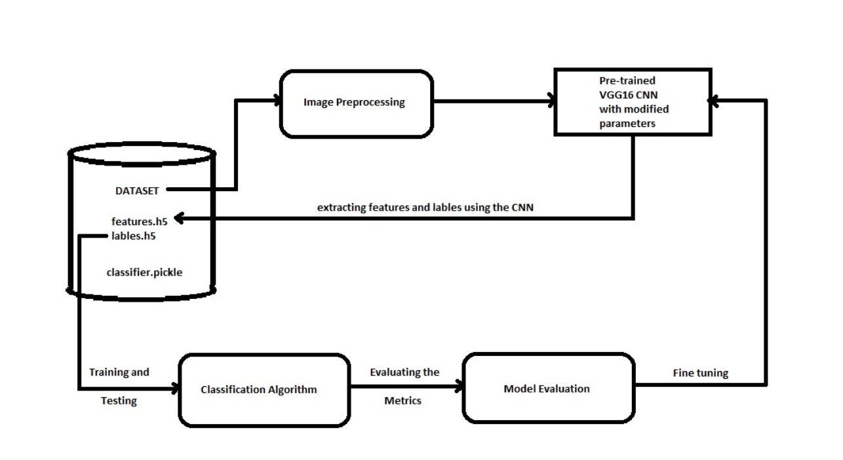
Proposed System - Diagram

Slide 15
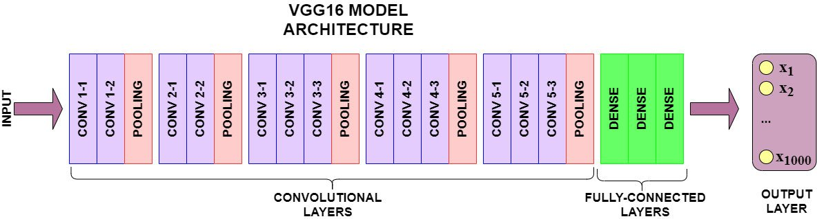
VGG16 ARCHITECTURE

Slide 16
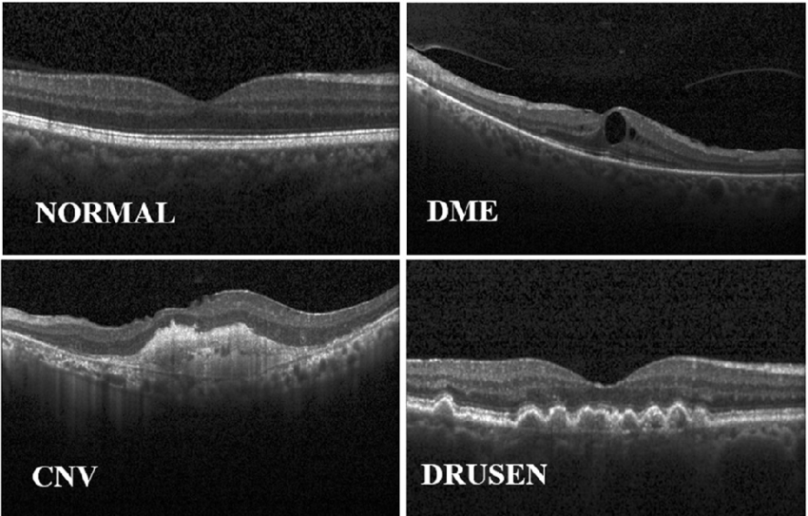
Dataset
Retinal OCT Dataset – The dataset contains 84,000 images captured using retinal OCT(optical coherence tomography - it is an imaging technique used to capture high-resolution cross sections of the retinas of living patients) and divided into three classes named “CNV”, “DME”, “DRUSEN”, “NORMAL”

Slide 17
GUIDE APPROVAL

Slide 18
References
Jason Yosinski, Jeff Clune, Yoshua Bengio, and HodLipson, “How transferable are features in deep neural MRCNN networks?,” in Advances in neural information processing systems, 2014, pp. 3320–3328.
Karen Simon yan and Andrew Zisserman, “Very deep convolutional networks for large-scale image recognition,”CoRR, vol. Abs/1409.1556, 2014.
KaimingHe,GeorgiaGkioxari,PiotrDollár,andRossGirshick,“Maskr- cnn,” in Proceedings of the IEEEinternational conference on computer vision, 2017, pp.2961–2969.
Shu Liu, Lu Qi, Haifang Qin, Jianping Shi, and JiayaJia, “Path aggregation network for instance segmenta-tion,”2018 IEEE/CVF Conference on Computer Vision and Pattern Recognition, pp. 8759–8768, 2018.

