Slide 1
CSE7302 - INTERNSHIP Review-3 Presentation FULL STACK DEVELOPMENT
Student Details
Name | Mounika A
Roll No | 20221CSE0329
Section | 8CSE11
Under the Supervision of,
Dr. Sudha P
Associate Professor
Presidency School of CSE
Presidency University
Name of the Program: Computer Science and Engineering
Name of the HoD: Dr. Asif Mohammed
Name of the Program Internship Coordinator: Mr. Sakthi S
Name of the School Internship Coordinator: Dr. Md Ziaur Rahman

Slide 2
Content
About Company or Organization
Working domain or the technology
About your team and reporting Manager
Challenges Faced in Internship
Objectives of the work
Literature Review
Proposed System
Problem Statement
System Requirements
Advantages of Proposed System/Work
System Design
System Implementation
Internship Roadmap
Github Link

Slide 3
About Company or Organization
Company Overview – Prola Tech
Prola Tech is a technology-driven software development and IT services company.
It provides end-to-end services from planning, developing, implementing, and managing.
It helps businesses perform in an efficient, faster, and profitable manner.
Headquartered in Bangalore , India, serving clients across multiple industry domains.
Vision: to deliver innovative, reliable, and scalable digital solutions.

Slide 4
Services and Products
Mobile Application Development :- Development of user-friendly and scalable mobile applications.
Web Application Development :- Design and implementation of secure, responsive web applications.
Internet of Things (IoT) :- Integration of smart devices and data-driven IoT solutions.
Web Services :- Development of APIs and backend services for application integration.
Cloud-based Services :- Deployment and management of applications on cloud platforms.

Slide 5
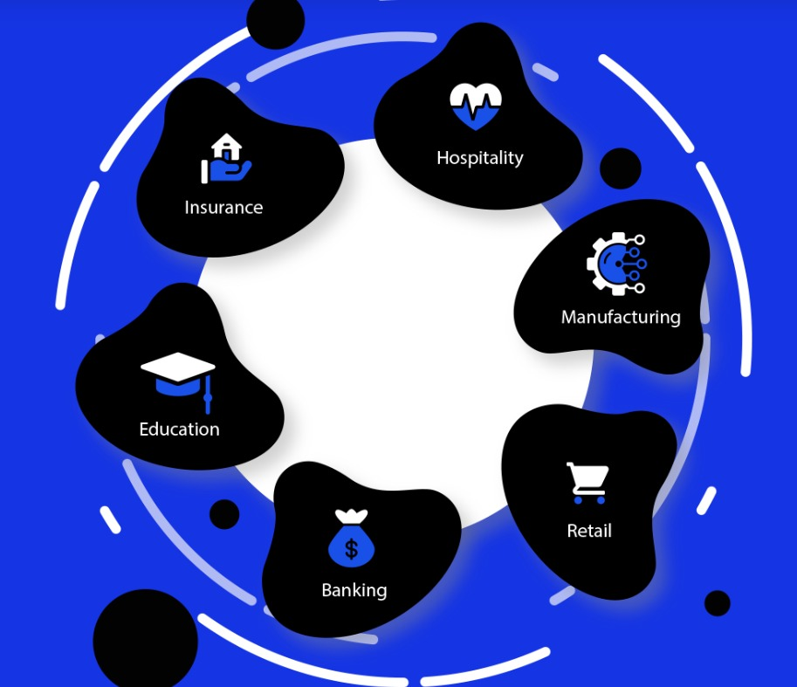
Clients and Industries
Banking
Insurance
Education
Hospitality
Manufacturing
Retail
Key Projects
Tally Integrated CRM
ERP Shipping Management System
Village Asset Tracking System

Slide 6
Working domain or the technology
Domain :- Full Stack Development
Features :-
Works on both Frontend and Backend technologies.
Handles Database Integration.
Enables creation of dynamic and interactive web applications.
Supports APIs and CRUD Operations for data handling.
Importance :-
Develops complete web applications.
Highly in-demand skill in IT industry.
Provides career growth opportunities.

Slide 7
About your team and reporting Manager
Working under the guidance of the Project Manager who provides over all direction and supervision.
The team consists of frontend , backend developers , testers and interns collaborating the project.
Team follows an Agile working approach for feature development, bug fixing, and system improvements.
Tasks planned, assigned, and reviewed systematically.
Regular communication was maintained through team meetings, discussions, and progress updates.

Slide 8
Challenges Faced in Internship
Finding the right internship opportunity aligned with my domain.
Preparing and the clearing the interview process.
Understanding project requirements, workflow, and coding standards in the initial phase.
Adjusting to team collaboration and professional work environment.
Managing time effectively while learning new technologies and completing assigned tasks.

Slide 9
Objectives of the work
To understand the project requirements and overall full stack application workflow.
To apply the web technologies in real-time development tasks.
To gain hands-on experience in frontend and backend development.
To learn and follow coding standards, version control, and best practices.
To assist in feature development, bug fixing, and system enhancement activities.
To improve technical skills, teamwork, and professional work practices.

Slide 10
Literature Review
Study of HTML5 semantic elements and page structuring standards followed in modern websites.
Study of CSS concepts including layout techniques, styling standards, and media queries.
Review of responsive web design principles used in modern websites and web development best practices.
Study of Bootstrap framework for responsive grid system, pre-built UI components, and layout consistency.
Analysis of existing websites to understand UI/UX design patterns and navigation flow.

Slide 11
Proposed System / Work
Design and develop a responsive company website.
Create structured web pages using HTML5 semantic elements for better readability and maintainability.
Apply CSS styling techniques to achieve consistent layout, typography, and visual design.
Ensure cross-device compatibility by testing layouts on multiple screen resolutions.
Use Bootstrap framework to implement responsive grid systems and reusable UI components.

Slide 12
Problem Statement
The internship involves the development of a professional company website for Prola Tech as an assigned industrial task.
The task requires implementation of frontend web development using HTML5, CSS, and Bootstrap
The website must follow industry-standard design principles, including structured layout, clear navigation, and visual consistency.
This work enables practical exposure to real-time web development practices.
The website is developed using standard web technologies while adhering to company guidelines.

Slide 13
System Requirements
Hardware Requirements
Laptop or Desktop
Minimum 4GB RAM
Stable Internet Connection
Software Requirements
Frontend Technologies: HTML5, CSS3, Bootstrap
Code Editor: Visual Studio Code
Web Browser: Google Chrome /Firefox
Version Control: GitHub

Slide 14
Advantages of Proposed System/Work
Practical application of frontend development skills.
Improved understanding of responsive web design.
Structured and maintainable UI development.
Exposure to industry-level development practices.
Scalable foundation for future enhancements.
Enhances knowledge of layout planning, navigation flow, visual hierarchy, and user-centric design
Enhanced learning through real-world project execution.

Slide 15
System Design
User Interface (UI) Architecture: Developed a modular UI design using a Mobile-First approach to ensure the websites adapt to all screen resolutions.
Navigation Flow: Designed a hierarchical navigation structure.
Component-Based Layout: Utilized the Bootstrap Grid System to design reusable UI components, ensuring layout consistency across different project types.
Component Mapping: Structured the design into reusable sections such as Hero headers, Service portfolios.

Slide 16
System Implementation
Frontend Development:
HTML5 & CSS3: Implemented semantic elements for better code maintainability and applied custom styling for professional typography and visual branding.
Bootstrap Integration: Leveraged pre-built UI components and responsive grids.
Development Workflow:
Environment: Conducted all coding and debugging within Visual Studio Code.
Built a responsive Company Website using the Frontend Technologies

Slide 17
Internship Road Map
Review 1
Onboarding & Fundamentals
Understanding the project requirements , development workflow and basic frontend concepts.
Review 2
Frontend Skill Enhancement
Improved frontend development skills through practical application and responsive design principles.
Review 3
Introduction to Dynamic Web Concepts
Learning dynamic web concepts and interactive user interfaces. Understanding application flow and improving UI consistency.
Review 4
Final Review
Backend Concepts & Integration
Understanding backend development fundamentals and basic data handling to support application functionality.
Project Completion and learning Outcomes
Demonstrating overall understanding of application workflow along with improvement in technical knowledge and professional skills.

Slide 18
Github Link
https://github.com/mouni0304/Full-Stack-Development-Internship

Slide 19
Q&A

Slide 20
Thank you !!

