Slide 1
CSE7302 - INTERNSHIP Review-4 Presentation FULL STACK DEVELOPMENT
Student Details
Name | Mounika A
Roll No | 20221CSE0329
Section | 8CSE11
Under the Supervision of,
Dr. Sudha P
Associate Professor
Presidency School of CSE
Presidency University
Name of the Program: Computer Science and Engineering
Name of the HoD: Dr. Asif Mohammed
Name of the Program Internship Coordinator: Mr. Sakthi S
Name of the School Internship Coordinator: Dr. Md Ziaur Rahman

Slide 2
Content
About Company or Organization
Working domain or the technology
About your team and reporting Manager
Challenges Faced in Internship
Objectives of the work
Literature Review
Proposed System
Problem Statement
System Requirements
Advantages of Proposed System/Work
System Design
System Implementation
System Testing
Conclusion
References
Github Link

Slide 3
About Company or Organization
Company Overview – Prola Tech
Prola Tech is a technology-driven software development and IT services company.
It provides end-to-end services from planning, developing, implementing, and managing.
It helps businesses perform in an efficient, faster, and profitable manner.
Headquartered in Bangalore , India, serving clients across multiple industry domains.
Vision: to deliver innovative, reliable, and scalable digital solutions.

Slide 4
Services and Products
Mobile Application Development :- Development of user-friendly and scalable mobile applications.
Web Application Development :- Design and implementation of secure, responsive web applications.
Internet of Things (IoT) :- Integration of smart devices and data-driven IoT solutions.
Web Services :- Development of APIs and backend services for application integration.
Cloud-based Services :- Deployment and management of applications on cloud platforms.

Slide 5
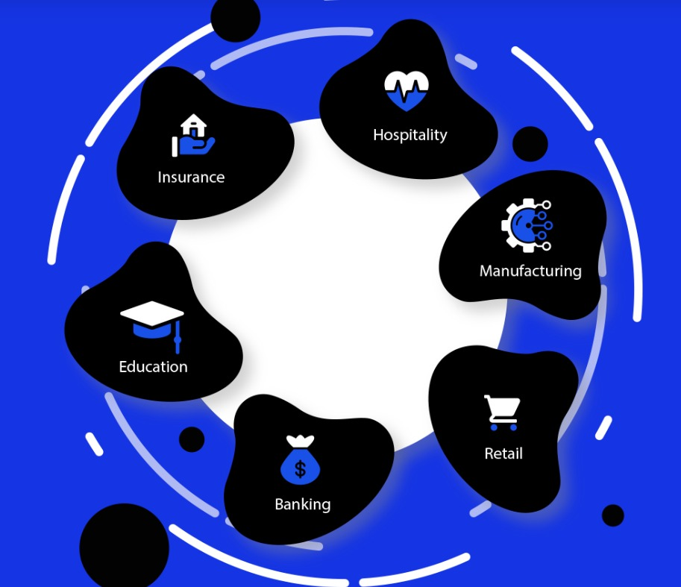
Clients and Industries
Banking
Insurance
Education
Hospitality
Manufacturing
Retail
Key Projects
Tally Integrated CRM
ERP Shipping Management System
Village Asset Tracking System

Slide 6
Working domain or the technology
Domain :- Full Stack Development
Features :-
Works on both Frontend and Backend technologies.
Handles Database Integration.
Enables creation of dynamic and interactive web applications.
Supports APIs and CRUD Operations for data handling.
Importance :-
Develops complete web applications.
Highly in-demand skill in IT industry.
Provides career growth opportunities.

Slide 7
About your team and reporting Manager
Working under the guidance of the Project Manager who provides over all direction and supervision.
The team consists of frontend , backend developers , testers and interns collaborating the project.
Team follows an Agile working approach for feature development, bug fixing, and system improvements.
Tasks planned, assigned, and reviewed systematically.
Regular communication was maintained through team meetings, discussions, and progress updates.

Slide 8
Challenges Faced in Internship
Finding the right internship opportunity aligned with my domain.
Preparing and the clearing the interview process.
Understanding project requirements, workflow, and coding standards in the initial phase.
Adjusting to team collaboration and professional work environment.
Managing time effectively while learning new technologies and completing assigned tasks.

Slide 9
Objectives of the work
To understand the project requirements and overall full stack application workflow.
To apply the web technologies in real-time development tasks.
To gain hands-on experience in frontend and backend development.
To learn and follow coding standards, version control, and best practices.
To assist in feature development, bug fixing, and system enhancement activities.
To improve technical skills, teamwork, and professional work practices.

Slide 10
Literature Review
Study of HTML5 semantic elements and page structuring standards followed in modern websites.
Study of CSS concepts including layout techniques, styling standards, and media queries.
Review of responsive web design principles used in modern websites and web development best practices.
Study of Bootstrap framework for responsive grid system, pre-built UI components, and layout consistency.
Analysis of existing websites to understand UI/UX design patterns and navigation flow.
Explored JavaScript to implement interactivity and dynamic behavior in web applications.

Slide 11
Proposed System / Work
Design and develop a responsive Prola Tech Company website.
Created structured web pages using HTML5 with proper layout and navigation.
Apply CSS styling techniques to achieve consistent layout and visual design.
Ensure cross-device compatibility by testing layouts on multiple screen resolutions.
Use Bootstrap framework to implement responsive grid systems and reusable UI components.
Developed an additional Construction Website with interactive features.
Integrated JavaScript to enhance user interaction and dynamic functionality.

Slide 12
Problem Statement
The internship involves the development of a professional company website for Prola Tech as an assigned industrial task.
The task requires implementation of frontend web development using HTML5, CSS, and Bootstrap
The website must follow industry-standard design principles, including structured layout, clear navigation, and visual consistency.
This work enables practical exposure to real-time web development practices.
To build a Construction website with interactive and dynamic features.
To Integrate JavaScript to enhance user interaction in Construction Website

Slide 13
System Requirements
Hardware Requirements
Laptop or Desktop
Minimum 4GB RAM
Stable Internet Connection
Software Requirements
Frontend Technologies: HTML5, CSS3, Bootstrap, JavaScript.
Code Editor: Visual Studio Code
Web Browser: Google Chrome /Firefox
Version Control: GitHub

Slide 14
Advantages of Proposed System/Work
Practical application of frontend development skills.
Improved understanding of responsive web design.
Structured and maintainable UI development.
Exposure to industry-level development practices.
Scalable foundation for future enhancements.
Enhances knowledge of layout planning, navigation flow, visual hierarchy, and user-centric design
Enhanced learning through real-world project execution.

Slide 15
System Design
User Interface (UI) Architecture: Developed a modular UI design using a Mobile-First approach to ensure the websites adapt to all screen resolutions.
Navigation Flow: Designed a hierarchical navigation structure to provide clear and easy access to different sections of the website.
Component-Based Layout: Utilized the Bootstrap Grid System to design reusable UI components, ensuring layout consistency across different project types.
Component Mapping: Structured the website into reusable sections such as Hero section, Services section, and Footer for better organization and scalability.

Slide 16
System Implementation
Frontend Development:
Used HTML5 to create structured and semantic web pages.
Applied CSS3 for styling, layout design, and visual presentation.
Utilized Bootstrap for responsive design and reusable UI components.
Project Development:
Developed Prola Tech Company Website with proper layout and navigation.
Built a Construction Website with interactive features and responsive design.

Slide 17
Functionality Implementation:
Implemented JavaScript for user interaction and dynamic behaviour.
Development Tools:
Used Visual Studio Code for coding and debugging.
Used GitHub for version control and project management

Slide 18
System Testing
Performed functional testing to verify correct loading of web pages and content.
Tested CSS styling for proper alignment, colors, and layout consistency.
Conducted navigation testing to ensure all links and pages work correctly.
Verified responsive design across mobile, tablet, and desktop devices using Bootstrap.
Implemented JavaScript validation to check user inputs and interactive features.
Performed cross-browser testing using Chrome.

Slide 19
Conclusion
Successfully developed responsive websites including Prola Tech company website and a construction website.
Applied HTML5, CSS3, Bootstrap, and JavaScript to build structured and interactive web pages.
Gained practical experience in real-time web development and industry practices.
Ensured websites are user-friendly, responsive, and visually consistent.
Enhanced understanding of professional workflow and Agile methodology.
The project provides a strong foundation for future full stack development.

Slide 20
References
[1] CodeWithTee, “15 HTML and CSS Good Practices,” Dev.to, 2026. [Online]. Available: https://dev.to/codewithtee/15-html-and-css-good-practices-4608
[2] W3Schools, “HTML Tutorial,” 2026. [Online]. Available: https://www.w3schools.com/html/
[3] W3Schools, “CSS Tutorial,” 2026. [Online]. Available: https://www.w3schools.com/css/default.asp
[4] W3Schools, “JavaScript Tutorial,” 2026. [Online]. Available: https://www.w3schools.com/js/default.asp
[5] Bootstrap, “Bootstrap 5 Documentation,” 2026. [Online]. Available: https://getbootstrap.com/docs/5.3/getting-started/introduction/

Slide 21
[6] Google Fonts, “Font Library,” 2026. [Online]. Available: https://fonts.google.com/
[7] Font Awesome, “Icons Library,” 2026. [Online]. Available: https://fontawesome.com/
[8] HTML Color Codes, “Color Reference,” 2026. [Online]. Available: https://htmlcolorcodes.com/
[9] CDNJS, “Content Delivery Network,” 2026. [Online]. Available: https://cdnjs.com/
[10] HTML.com, “HTML Reference Guide,” 2026. [Online]. Available: https://html.com/

Slide 22
Github Link
https://github.com/mouni0304/Full-Stack-Development-Internship

Slide 23
Q&A

Slide 24
Thank you !!

