Slide 1

PNEUMOTHORAX SEGMENTATION
Team SPAM

Slide 2

OBJECTIVE
Given a dataset of chest X-rays,an algorithm is devised to detect regions of pneumothorax.
Implemented using a U-net model built on a pre-trained Resnet-34 model

Slide 3
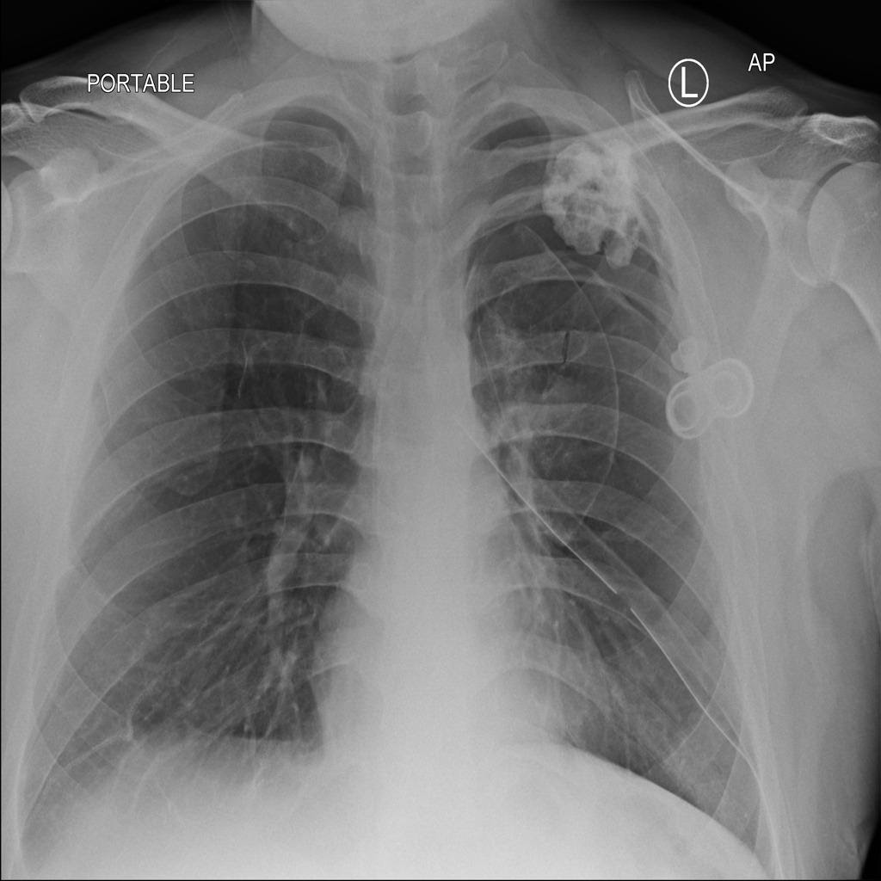

DATASET
A set of 12047 chest Xray-mask pairs with the white segment in the mask indicating pneumothorax
X-ray image
Mask image

Slide 4
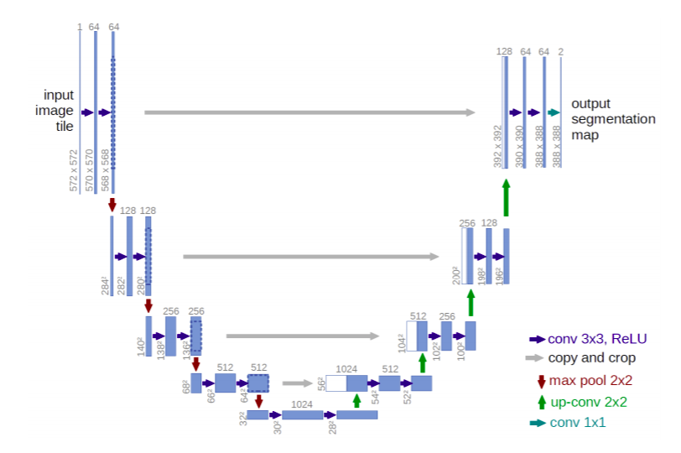
U-net architecture

Slide 5

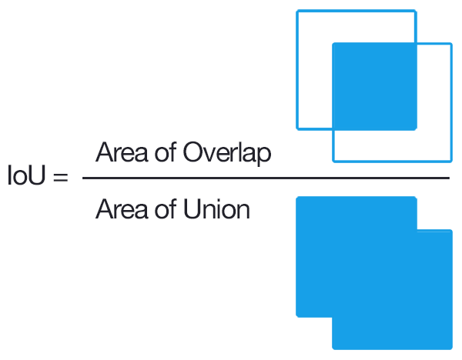
Metric used
Jaccard index
  Area of intersection over area of union is calculated between the predicted mask image and the ground truth mask image

Slide 6

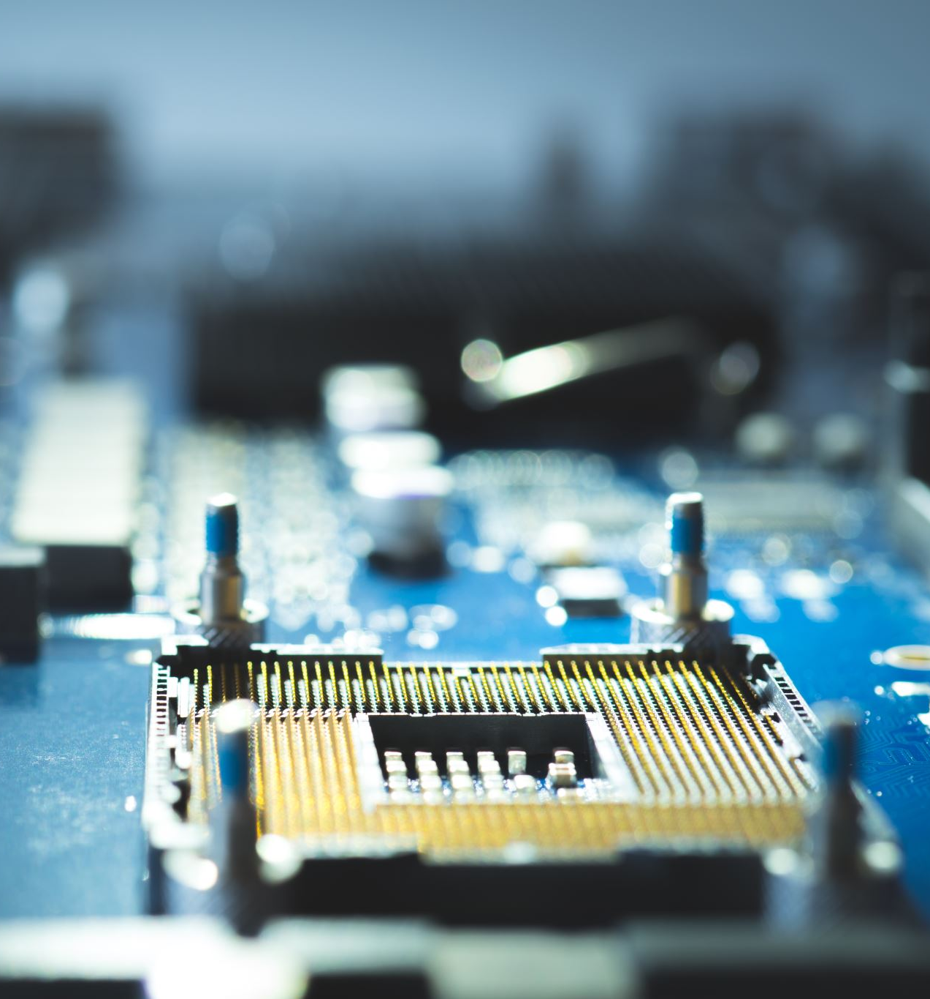
Further work
To add a preprocessing step and compare the accuracy of our system
The two methods are Multiscale Image Contrast Amplification(MUSICA) and CLAHE

