Slide 1
Project-1 Learnings

Slide 2
What is Docling?

Slide 3
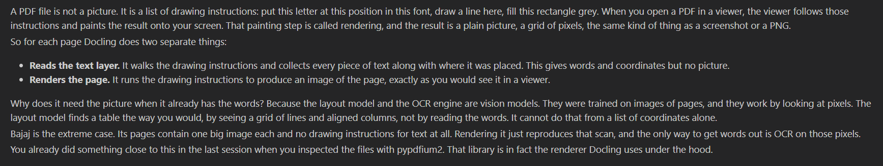

Slide 4
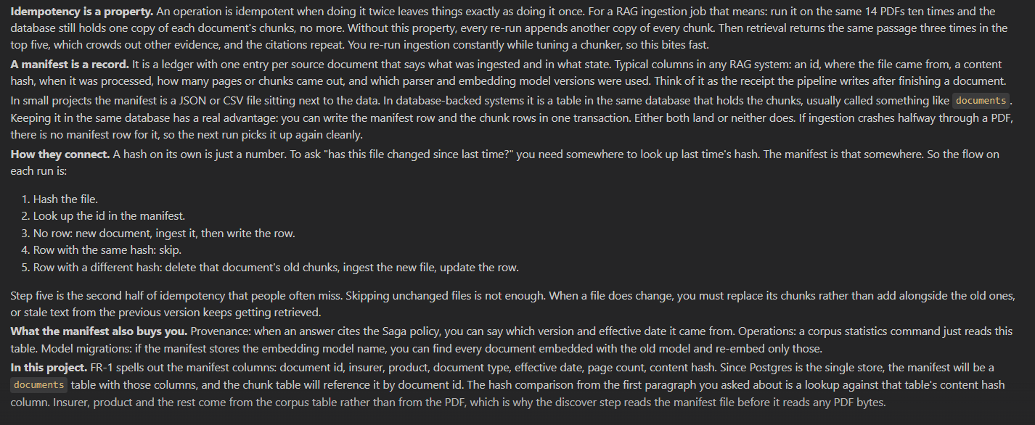

Slide 5
