Slide 1
PROJECT TITLE
CAPSTONE PROJECT
Presented By:
B Mouni Prakash Reddy- Amrita Vishwa Vidyapeetham -Computer and Communication Engineering
AICTE ID:STU682f195108cb21747917137

Slide 2
OUTLINE
Problem Statement (Should not include solution)
System Development Approach (Technology Used)
Algorithm & Deployment (Step by Step Procedure)
Result
Conclusion
Future Scope(Optonal)
References

Slide 3
Problem Statement
Our project focuses on developing an Employee Salary Prediction System using machine learning .This system aims to accurately estimate an individual's salary based on key professional attributes like experience, education, job role, and performance. By leveraging data-driven insights, the project seeks to help organizations establish fair and competitive compensation structures, thereby reducing employee turnover and attracting top talent. Ultimately, it promotes transparency in salary determination and supports equitable decision-making within the workplace.

Slide 4
System Approach
The "System Approach" section outlines the overall strategy and methodology for developing and implementing. Here's a suggested structure for this section:
System requirements
Operating System : A modern operating system capable of running Python environments (My Model is HP15s-FQ-2071tu)
Processor A multi-core processor Intel Core i5/i7 or AMD Ryzen 5/7 equivalent or higher(My Processor - Intel Iris core i5)
RAM: At least 8 GB of RAM is recommended(My Config 8gb dual core)
Python Environment: Python 3.8 or higher is required (My version -3.8)
Development Environment: An IDE like VS Code or Jupyter Notebook/Lab (My IDE -VS-Cod
Library required to build the model
Coding libraries:- pandas, numpy, matplotlib, seaborn, sklearn, xgboost, shap, joblib
Deployment Libraries:- streamlit, datetime, pyngrok, time, os, threading

Slide 5
Algorithm & Deployment
Data Collection
Exploratory Data Analysis
Data Preprocessing and Feature Engineering
Model Selection and Training
Model Evaluation
Model Interpretation
Model Deployment using ngrok and Streamlit

Slide 6
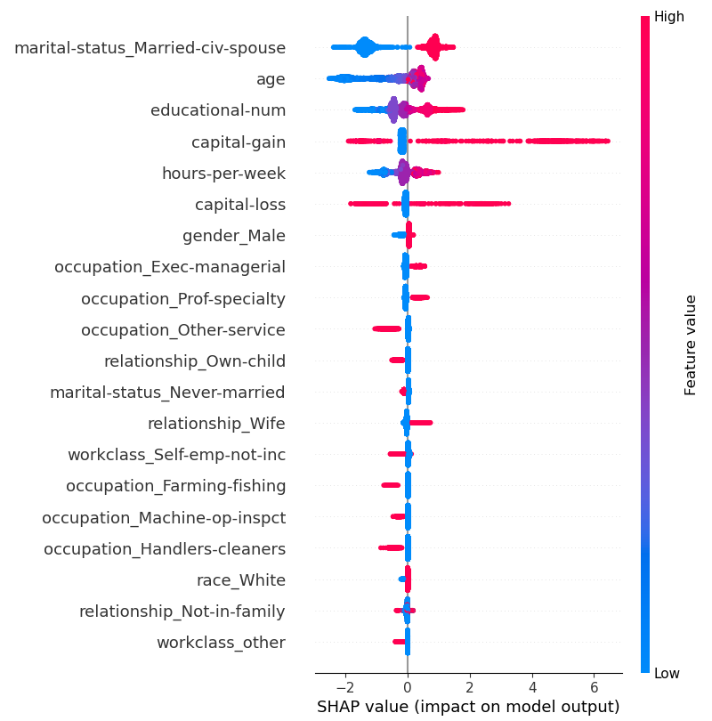
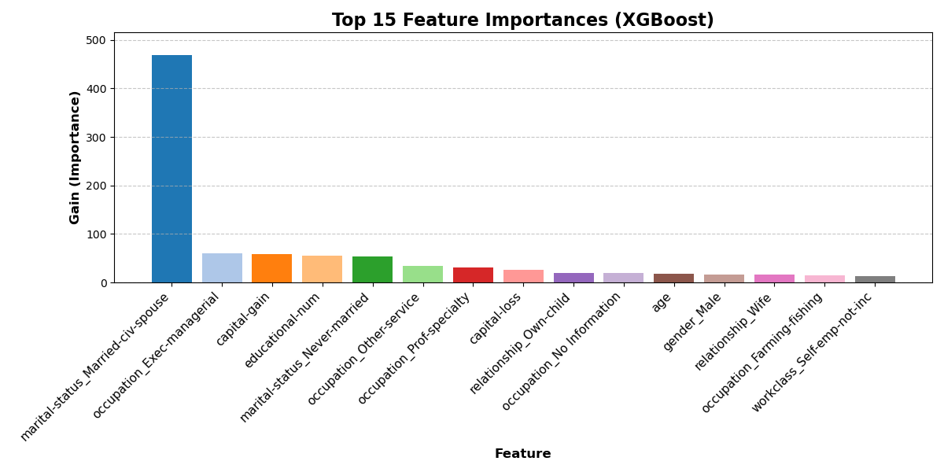
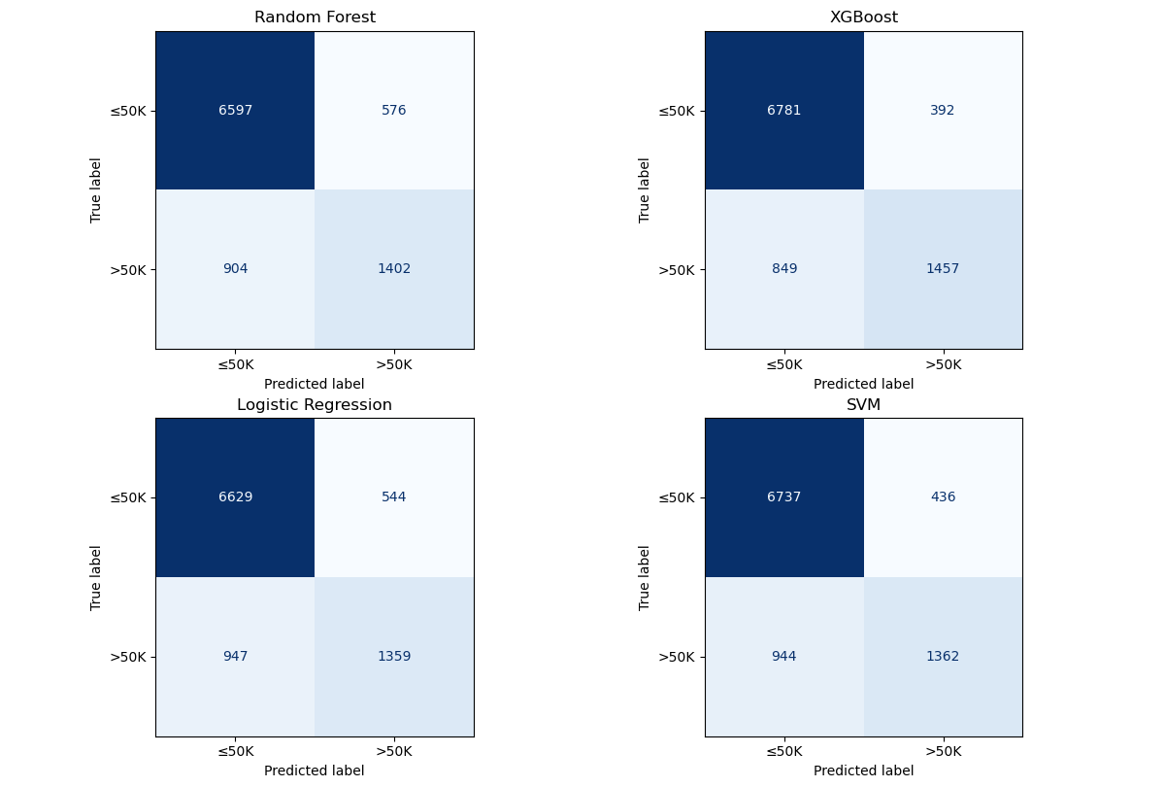
Result

Slide 7
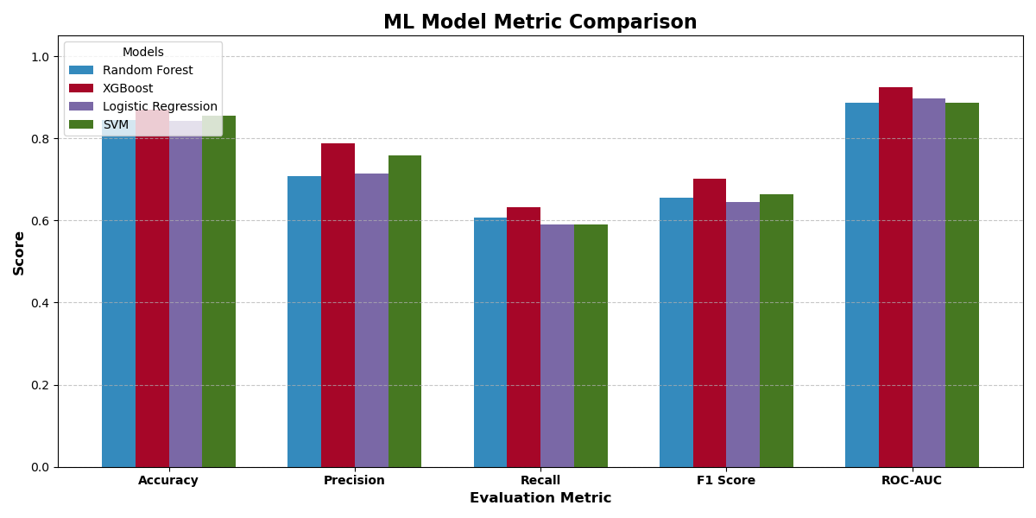
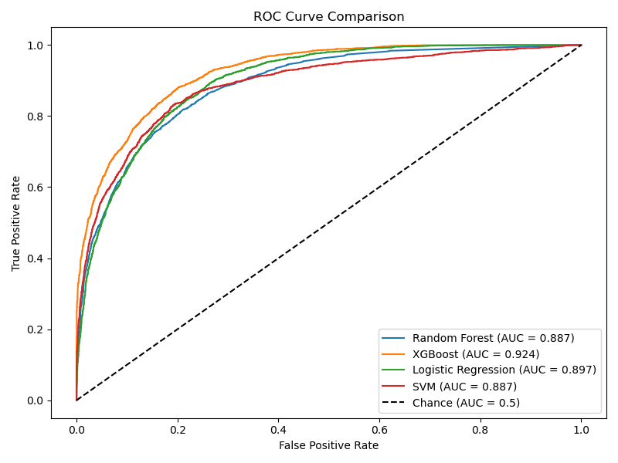
https://github.com/

Slide 8
Conclusion
Project Summary & Effectiveness :
Developed an Employe Salary Prediction model using XGBoost.
Achieved strong performance: 87-88% Accuracy
Model effectively distinguishes between <= 50k and > 50k income groups.
Challenges & Improvements :
Data Cleaning & Feature Engineering: Addressed missing values and encoded categorical variables for accurate model training.
Model Alignment & Deployment: Ensured user inputs matched trained model expectations for reliable predictions in the deployed app
Interpretability & UX: Delivered insight into model decisions and built an intuitive, user-friendly Streamlit application.

Slide 9
Future scope(Optional)
Apply ensemble techniques or model stacking to improve prediction accuracy.
Integrate advanced feature engineering and automated feature selection to boost model performance.
Expand to handle more granular income ranges or multiclass classification tasks.
Broaden data sources for richer context and increase generalizability across demographics.
Add continuous model monitoring and retraining mechanisms for adapting to new data trends

Slide 10
References
[1] V. Kumar, “Enhancing Salary Predictions with Ensemble Learning Techniques,” International Journal for Research in Applied Science and Engineering Technology, vol. 13, pp. 7075–7081, Apr. 2025, doi: 10.22214/ijraset.2025.70090.
[2] A. S. Antonini et al., “Machine Learning model interpretability using SHAP values: Application to Igneous Rock Classification task,” Applied Computing and Geosciences, vol. 23, p. 100178, Sep. 2024, doi: 10.1016/j.acags.2024.100178.
[3] “Income Prediction Using Machine Learning Techniques.”
https://dzone.com/articles/optimizing-machine-learning-deployment-tips-and-tr

Slide 11
THANK YOU

