Slide 1
CAPSTORE
ForgetPassword
Presented by: Mounica

Slide 2
ABOUT CAPSTORE :
CapStore is a web based e-commerce website that allows users to buy or sell products. Users can view products from different categories and buy them .The user will be able to see products of similar category, sort them, compare them etc .
This site gives a feel of already established e-commerce websites like Flipkart, Amazon, ebay etc.; with aim to enable employees buy goods online while sitting in office or from home i.e irrespective of their locations.

Slide 3
Contents:
Description
Software Requirements

Slide 4
Description:
An email containing the user's password (decrypted) will be sent to the user.

Slide 5
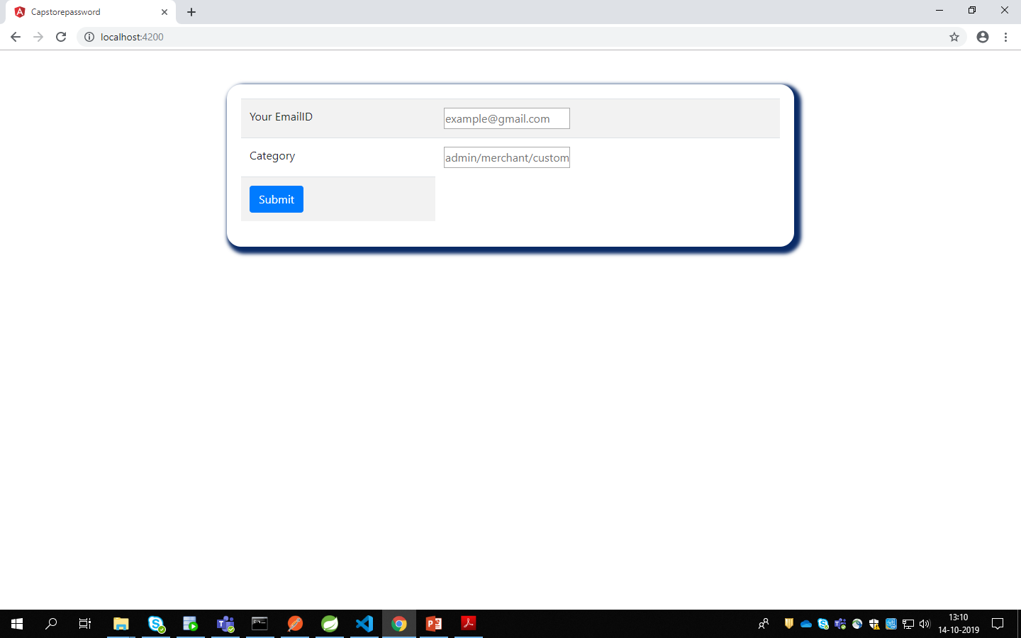

Slide 6
Software Requirements:
Spring Tools
Visual Code Studio
Oracle sql database

Slide 7
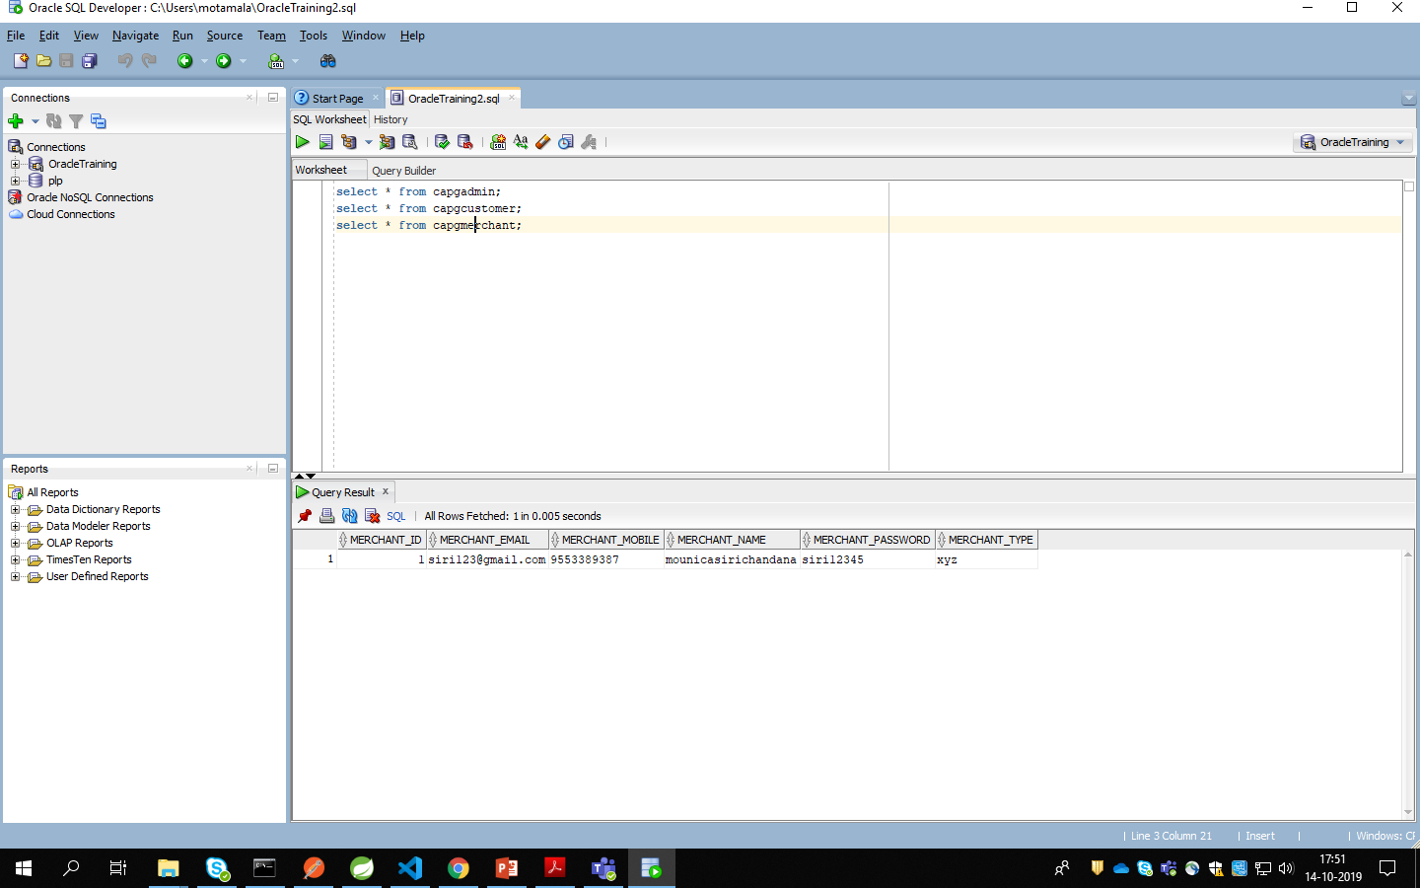

Slide 8
User Type
System
Database
Customer/admin/merchant
Forgot password request
Ask for email id and category
Enter email id and category
Verify email id and type and search from password
Return Password
Password will be displayed

Slide 9
