Slide 1
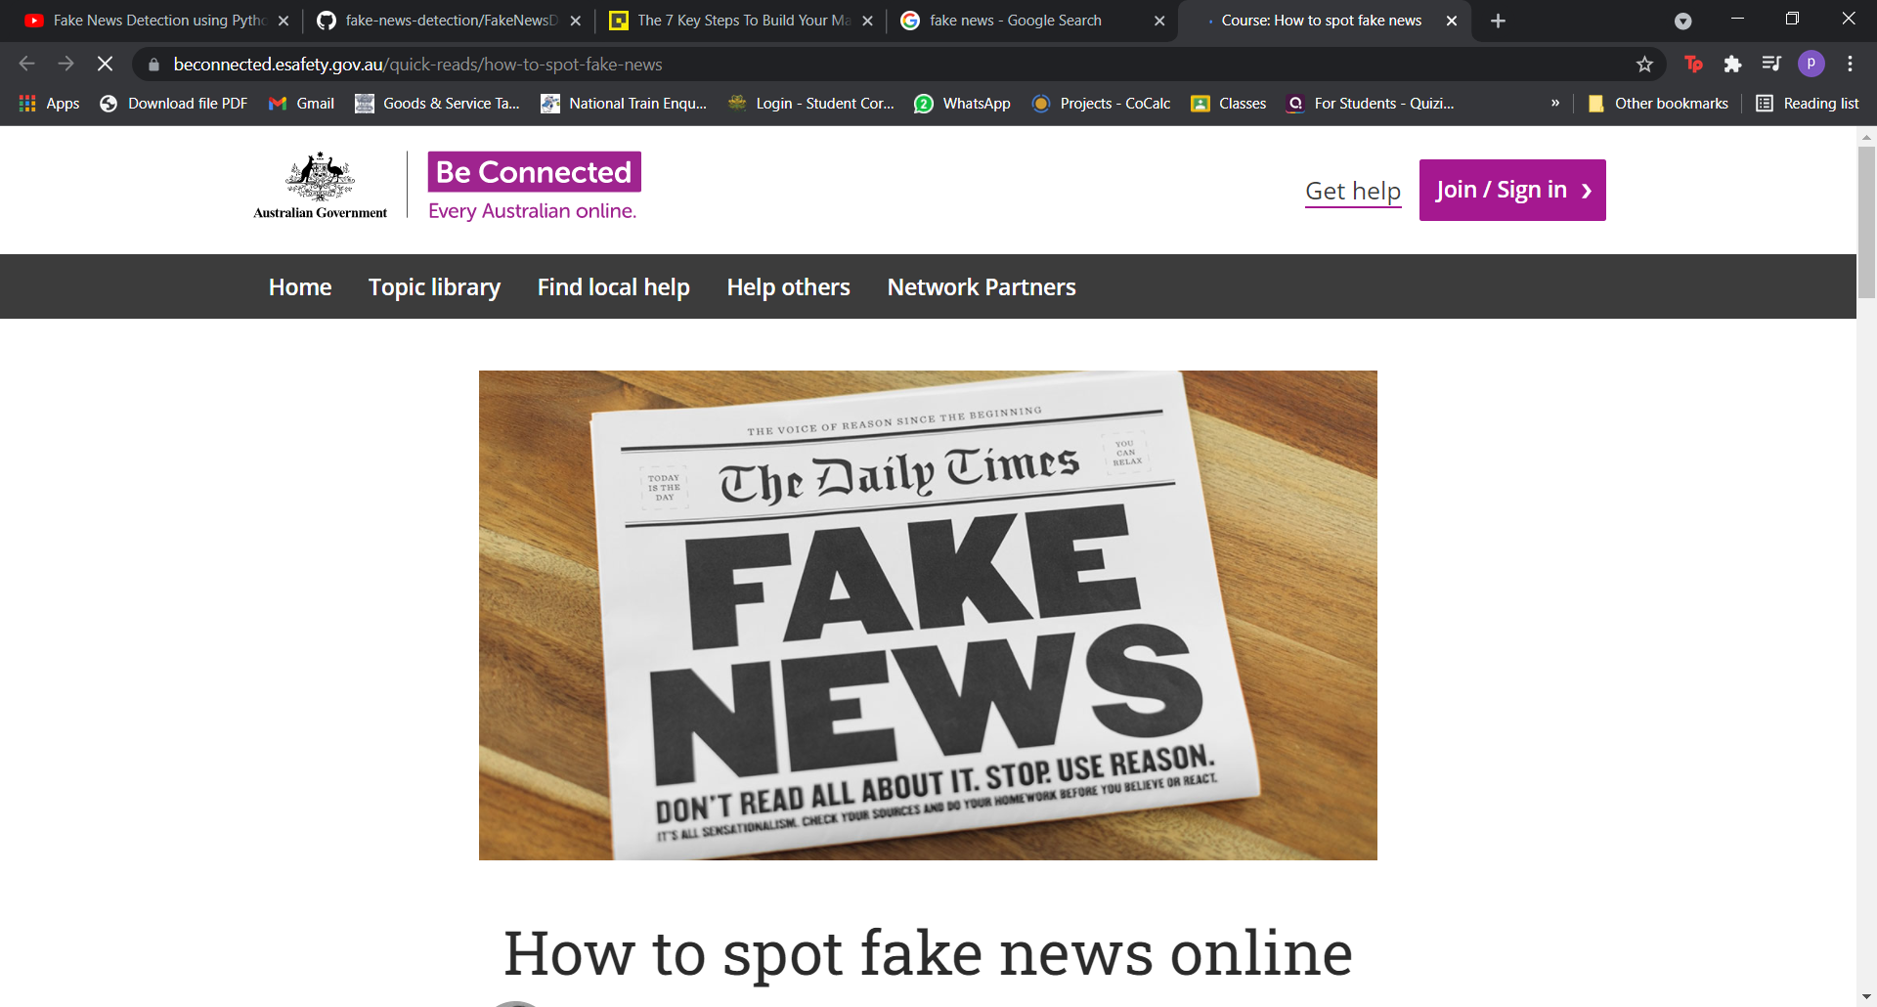
Fake News Detection Using Machine Learning
By Mounika Vishwanadhula

Slide 2


WHAT IS FAKE NEWS?
Fake news is news designed to deliberately spread hoaxes, propaganda and disinformation.

Slide 3

Project Goal and business problem
Fake News is one of the most popular phenomena that have considerable effects on our social life, especially in the political domain. Due to the increasing use of social media and the internet by people, spreading fake news is now relatively simple. Because of its difficulties, including the small number of benchmark datasets and the volume of news that is published every second, the identification of elusiveness news is thus a critical subject that requires careful consideration.
Detect and prevent the spread of false information in a range of industries.

Slide 4
Data Source
News Articles: Fake news detection in news articles from various sources. Obtained from online news platform such as RSS feeds and Web Scraping.
Social Media: Social media platforms like Twitter and Facebook is a great source. Few datasets are available to public.
❖ Data Source – Kaggle.
❖ DATA ITEMS - Title, Text, Subject, Date, Class.
❖ Label 1- Unreliable
❖ Label 0- Reliable

Slide 5
Dataset
There are two files, one for real news and one for fake news (both in English) with a total of 23481 "fake" tweets and 21417 "real" articles. https://www.kaggle.com/clmentbisaillon/fake-and-real-news-dataset

Slide 6
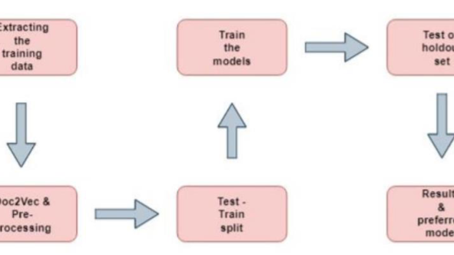
Data collection process
Data Collection: Based on the data source we can collected data using web scraping tools or API’s. Publicly available datasets can be used for training and developing the ML model. There are two files, one for real news and one for fake news (both in English) with a total of 23481 "fake" tweets and 21417 "real" articles.
Data Preprocessing: Cleaning the data i.e., filling or removing the missing values in the data attributes for accuracy and efficiency by using mean, mode, or regression method. Example- Removing duplicate articles and filtering irrelevant content.
Data Labeling: To train and develop ML model, labeling the data is particularly important and can be don’t manually or by using tools.
Libraries: Sklearn (scikit-learn), Numpy, and scipy.

Slide 7
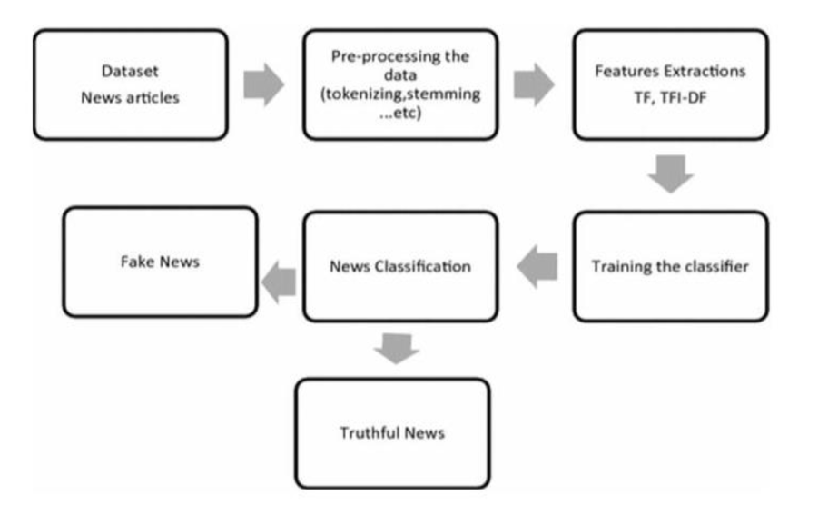

Slide 8

Implementation
STEP1: Start
STEP2: Input is collected from various sources and prepare a dataset.
STEP3: Preprocessing of data is done, and dataset is divided into 2 parts training and testing data.
STEP4: Count vectorization technique is used to convert the train data into numerical.
STEP5: Different algorithms are used to build the predictive model using the training data.
STEP6: Confusion Matrix is obtained.
STEP7: Accuracy is calculated.
STEP8: Comparison of different models.

Slide 9

Pre-existing model research
Detecting Fake News Using Machine Learning Techniques: A Case Study
Authors: S. Vinothini and R. Nithya
Journal: Journal of Computational and Theoretical Nanoscience
Dataset: 4,100 news articles (2,050 real and 2,050 fake)
Classifiers: Random Forest, Decision Tree, and Naive Bayes
Results: Random Forest performed the best (96.19% accuracy)
Feature analysis: Words related to politics, celebrity, and emotion were important
Conclusion: Machine learning can be useful in detecting fake news

Slide 10

Obtained Results

Slide 11
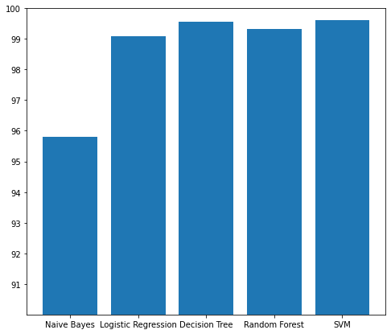
Results

Slide 12
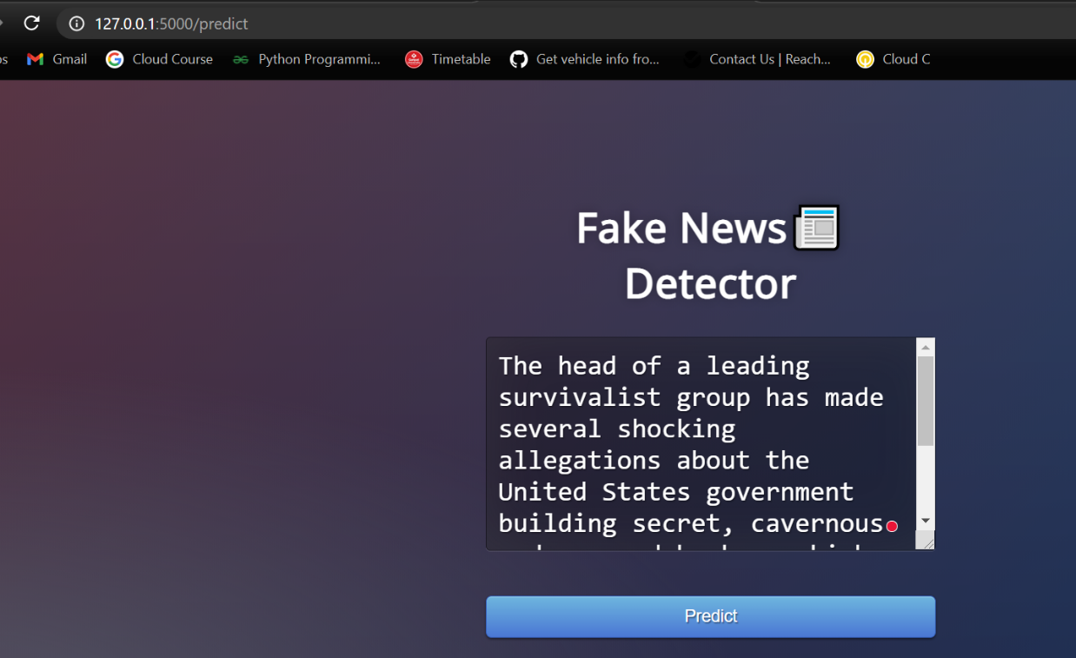
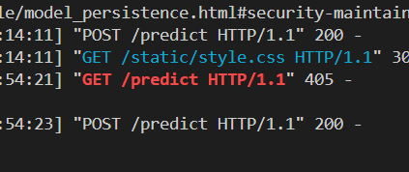
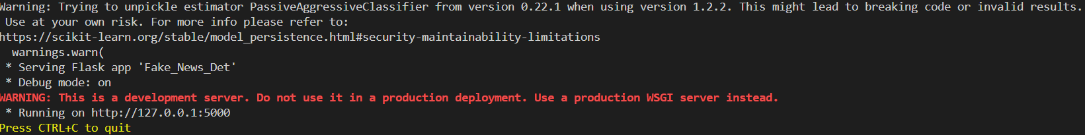
Results

Slide 13

Conclusion
To classify fake news articles using machine learning and ensemble techniques. Different textual features were extracted using an LIWC tool and performance metrics were used to compare results. Ensemble learners showed better scores than individual learners. Future research directions include identifying key sources of fake news and real-time identification of fake news in videos. Ethical and social implications should also be considered.

Slide 14
references:
Meesad, P. Thai Fake News Detection Based on Information Retrieval, Natural Language Processing and Machine Learning. SN COMPUT. SCI. 2, 425 (2021). https://doi.org/10.1007/s42979-021-00775-6.
N. F. Baarir and A. Djeffal, "Fake News detection Using Machine Learning," 2020 2nd International Workshop on Human-Centric Smart Environments for Health and Well-being (IHSH), Boumerdes, Algeria, 2021, pp. 125-130, Doi: 10.1109/IHSH51661.2021.9378748.
S. I. Manzoor, J. Singla and Nikita, "Fake News Detection Using Machine Learning approaches: A systematic Review," 2019 3rd International Conference on Trends in Electronics and Informatics (ICOEI), Tirunelveli, India, 2019, pp. 230-234, Doi: 10.1109/ICOEI.2019.8862770.
Detecting Fake News Using Machine Learning Techniques: A Case Study" by S. Vinothini and R. Nithya, published in the Journal of Computational and Theoretical Nanoscience

Slide 15
Thank you

