Slide 1

SAFE NEIGHBOURHOOD
MOUNIKA CHEERA(AP47176)

Slide 2
CONTENTS
Overview of dataset
Correlation Analysis
Temporal pattern of crime count from all geographical regions
Distribution of crime type aggregating from all geo-locations and all time periods
Crime type distributions according to count over different years ,months and days of the week.
Dynamic dashboard to explore spatial and temporal patterns of crime

Slide 3
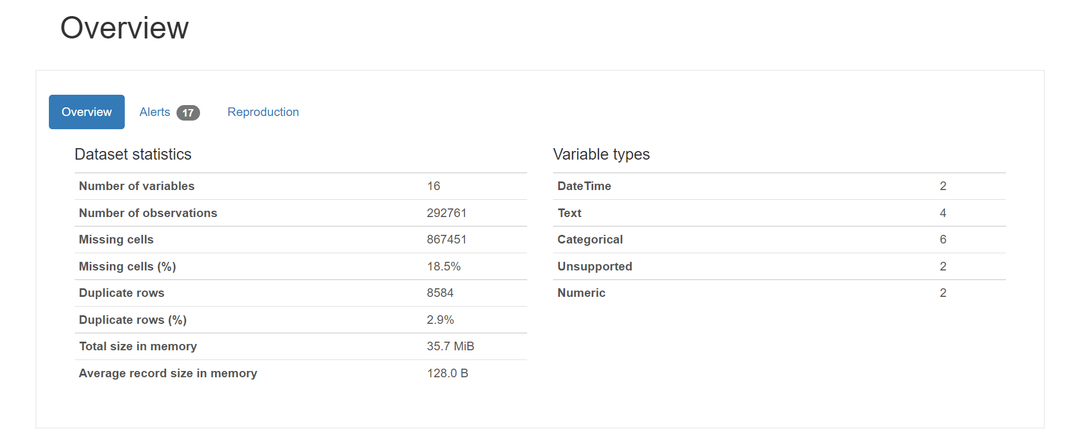
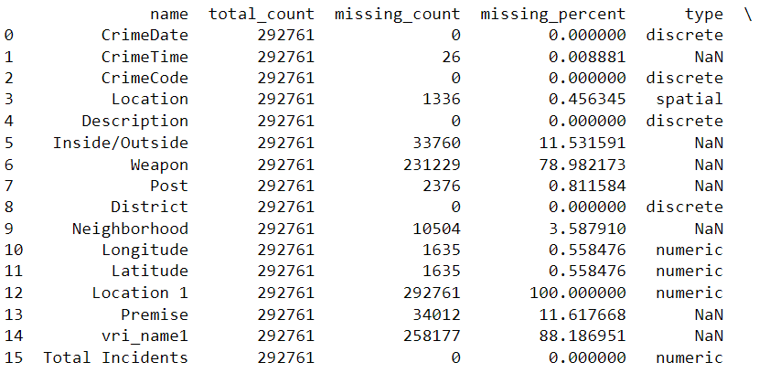
OVERVIEW OF DATASET

Slide 4
OVERVIEW OF DATASET
Numeric/Real/Continuous attributes:- Total Incidents
Symbolic/Discrete attributes:- CrimeTime, CrimeCode, Location,Description,Inside/Outside,Weapon,Post,District, Neighborhood, Premise, vri_name1, Location 1
Temporal attributes:Crimetime
Spatial attributes:Longitude, Latitude
For numeric attributes,
1.Total incidents –min(1),max(1),mean(1),median(1),std_dev(0)
For unique values for discrete attributes—
1.CrimeDate--2300
2.CrimeCode—81
3.Description—14
4.District—10

Slide 5
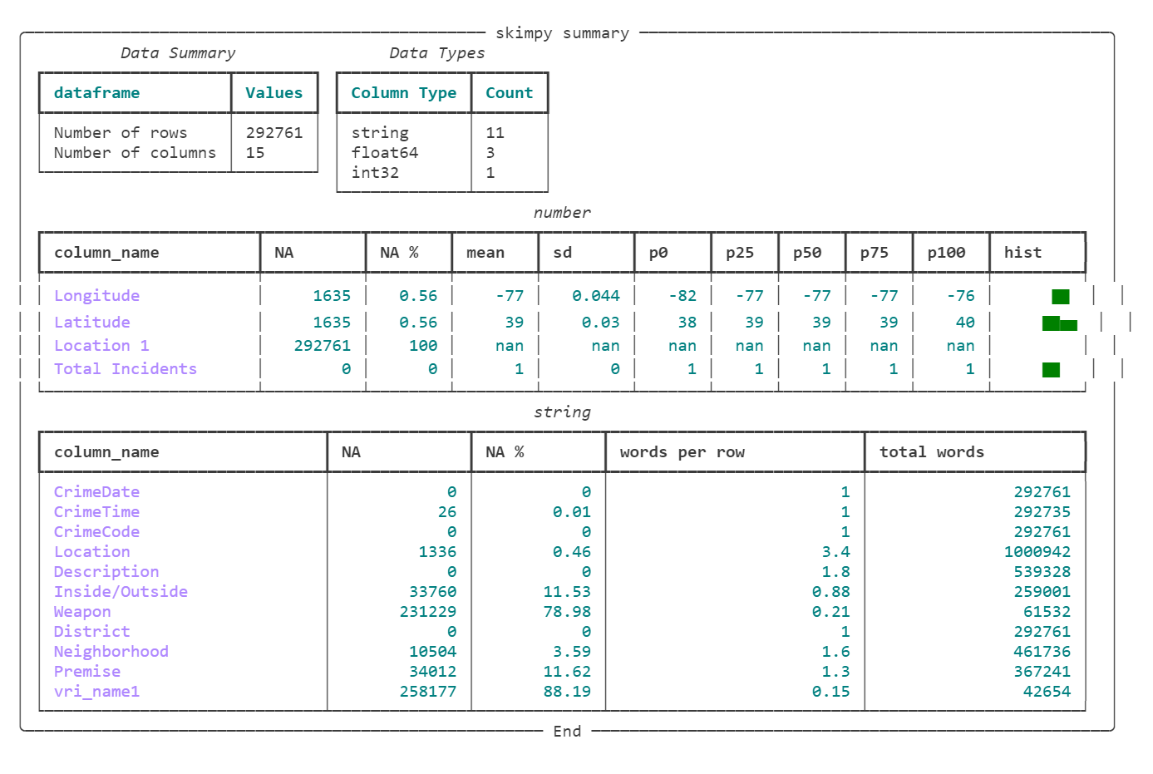
Using Skimpy – Dataset statistics
Skimpy is a tool that provides summary statistics about variables in data frames.

Slide 6
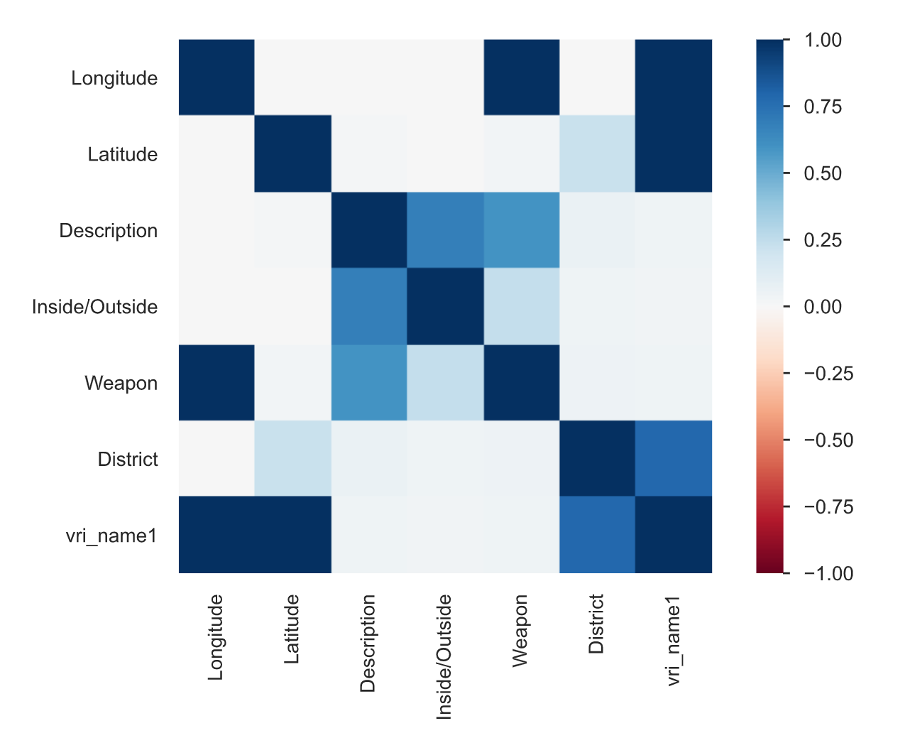
Correlation Analysis - Heat map
In a concise interpretation of the correlation matrix:
Longitude and Latitude have a very weak correlation, indicating they are largely independent.
Description and Inside/Outside are moderately correlated, suggesting that incident details may influence whether they occur indoors or outdoors.
Weapon and Inside/Outside have a weak correlation, suggesting that the presence of a weapon does not strongly determine the location of an incident.
District and vri_name1 exhibit a strong correlation, implying a significant association between the district and the vri_name1 category.

Slide 7
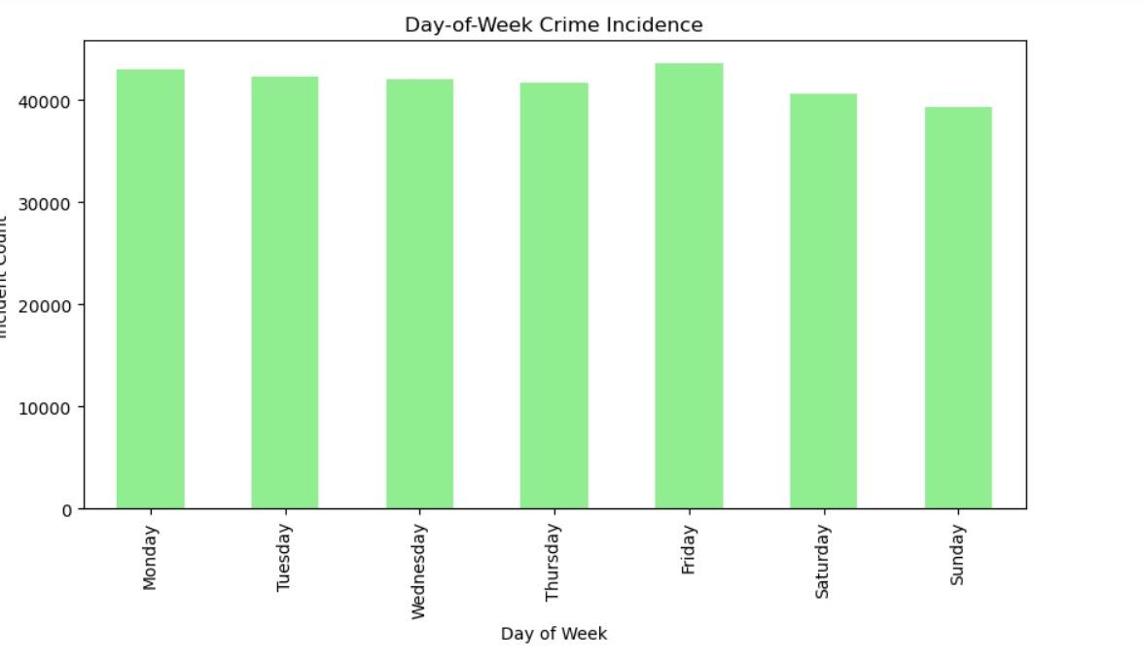
Crime count on different days of the week
It can be observed from the graph that Friday can be attributed as the day with highest crime incidence count

Slide 8
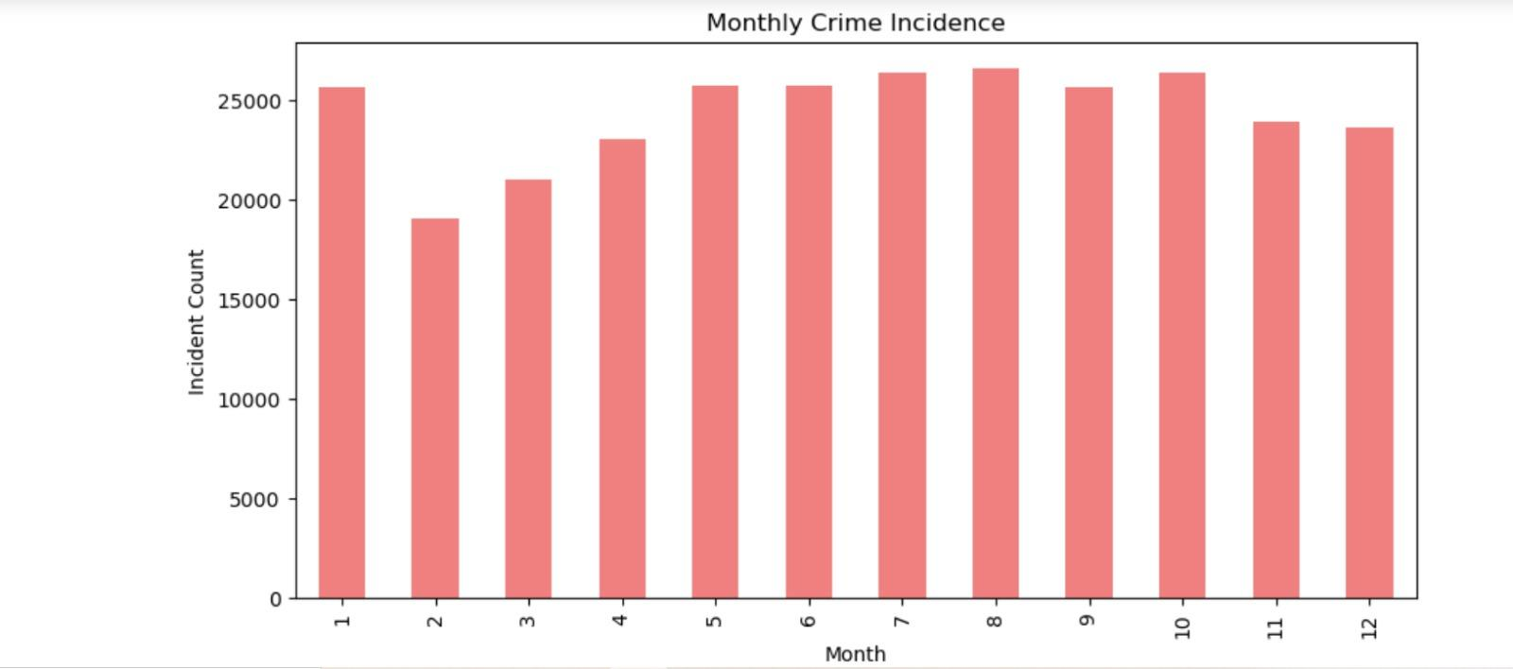
Crime count in different months
As we can observe from the graph may through august observed greater number of crime incidences and also January has greater number of crime incidences

Slide 9
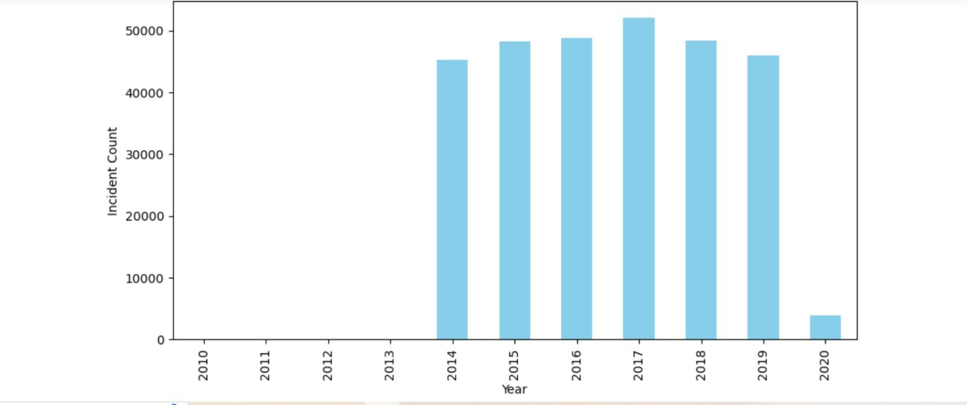
Crime count over the years
We observe that there has been a steady number of crime incidence over the years.

Slide 10
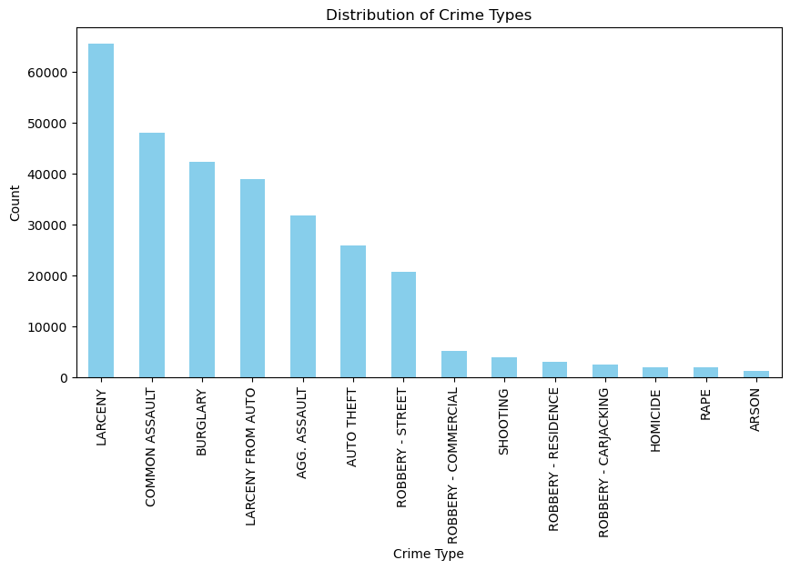
DISTRIBUTION OF CRIME TYPES
Over the year we see that from various locations larceny is the crime type with highest number of crime incidences(>60000)

Slide 11
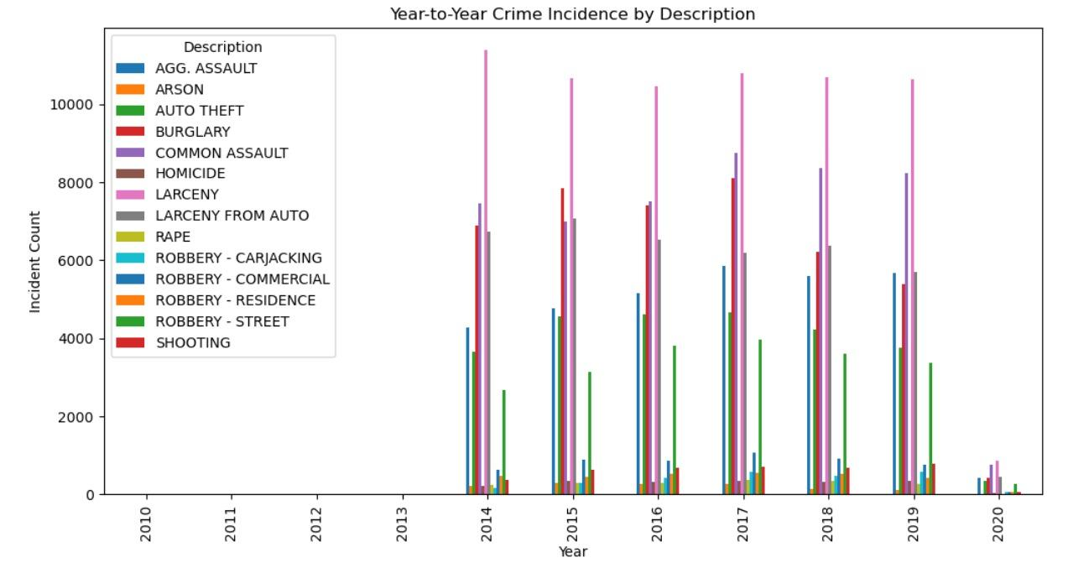
Crime distributions over the years
As we observe crime distribution over different years , through all years common assault is the most common crime.

Slide 12
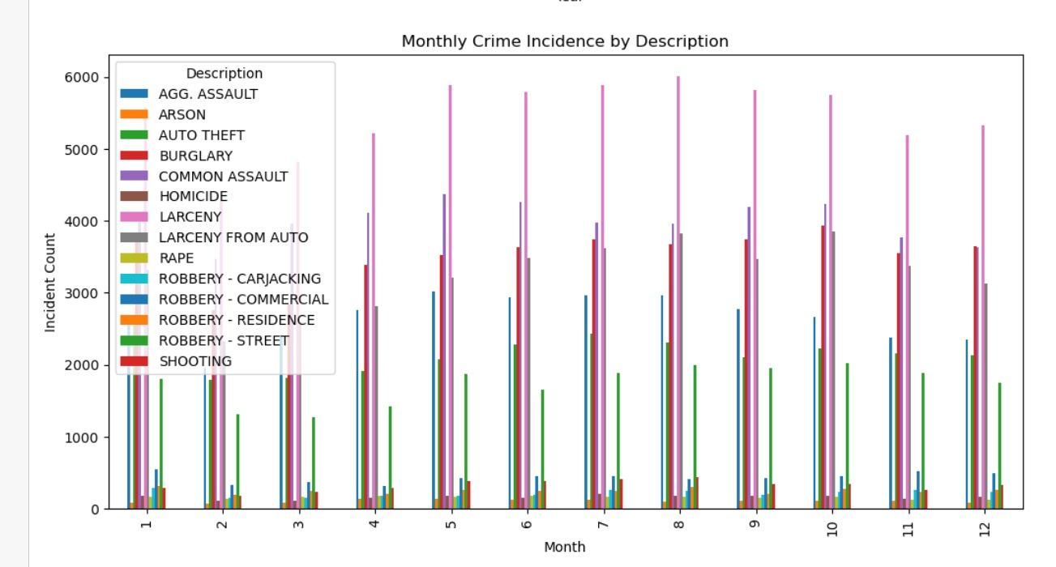
Crime distribution over different months of the year
In every month of the year we can see larceny being the most commonly committed crime.

Slide 13
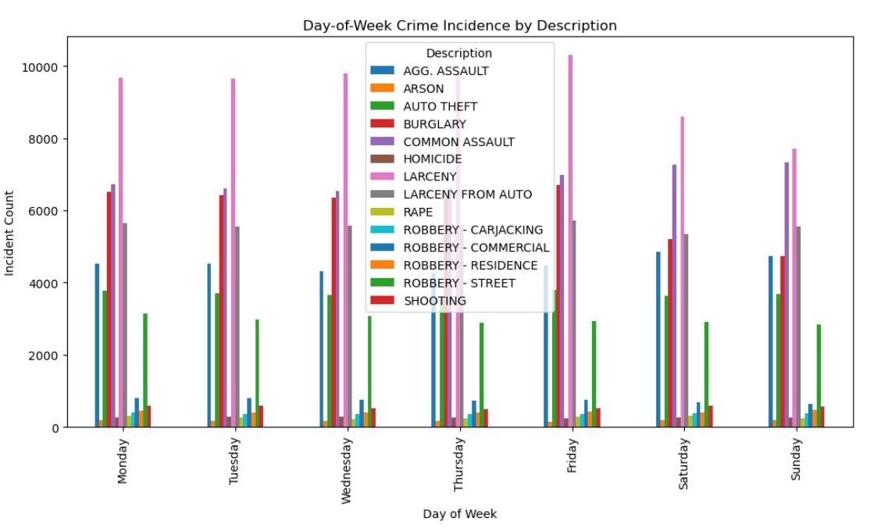
Crime distribution over different days of the week
Common assault and larceny can be attributed as the most commonly committed crime in any day of the week also , as we can see Friday observed the highest number of crimes being committed.

Slide 14
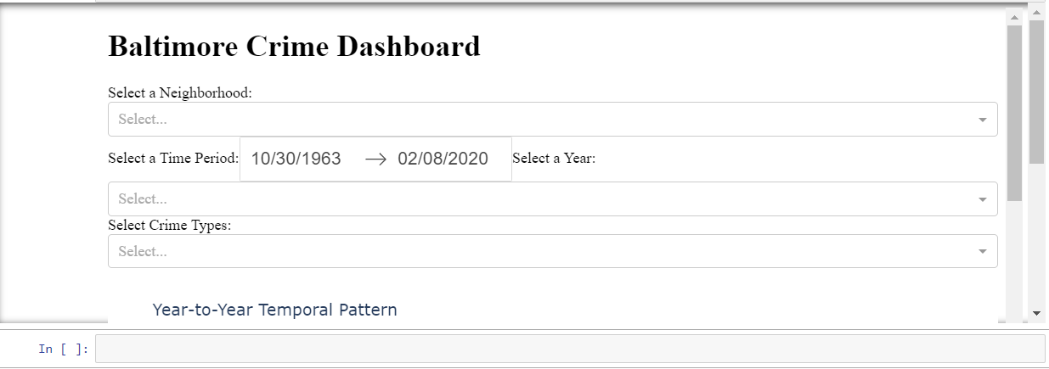

Slide 15
Thank You

