Slide 1

Spotting Road Accident Zones in Google Maps
BATCH-A11
B.Hemalatha (154G1A0530)
B.R.Aisha (154G1A0502) Project Guide:
Y.Nithin Kumar (154G1A0559) Mr.Y Ramesh _{M.Tech.}
L.Mounika (154G1A0550) Assistant Professor
Srinivasa Ramanujan Institute of Technology
Department of Computer Science & Engineering

Slide 2
Abstract
Everyone has a passion towards travelling but the main problem associated with it is absence of safety. Earlier systems lack of safety assurance systems, so that there is no information about accidents .This project is the web application, which identifies accident zones in route map and also displays level of risk factors.

Slide 3
Contents:
Problem Statement
Proposed System
Literature Survey
Modules
Design
Implementation
References

Slide 4
Problem Statement
Safety has become an essential aspect of everyday life. One way is, we can provide safety by enabling people with vital information on the safety aspects in the route they take during a travel from one place to another. This creates vigilance in traveller and precautionary measures could be taken to prevent any mishap.

Slide 5
Proposed System
We are building an Web application that will provide any possible safety lapse from source to a destination.
Given a route map (like Google maps), the security based profiling of various geographical routes traversed could be highlighted as red/yellow/green indicating high, medium and low risks zones along with deep curves.
This is an Internet web service, specifically Google APIs, which will offer geo-location for physical location name, map and map markers.
Using Google API, the coordinates can be presented and it displays the routes.

Slide 6
Comments
Review-1
Spotting danger zones and deep curves
Android Application
Review-2
Android Application

Slide 7
Literature Survey
Google Maps:
Displays path from source to destination.
Multiple Routes.
Shortest Path.
Street View.
Traffic analysis.
Discovering near by places.
Symbols to represent Geographic features.

Slide 8
Modules:
Admin
Login
Enter Admin user ID and Password
Perform Operations on Database

Slide 9
Continued....
User
Enter URL
Displays current location
Select Source and Destination from drop down list
It displays path along with risk spots and deep curves

Slide 10
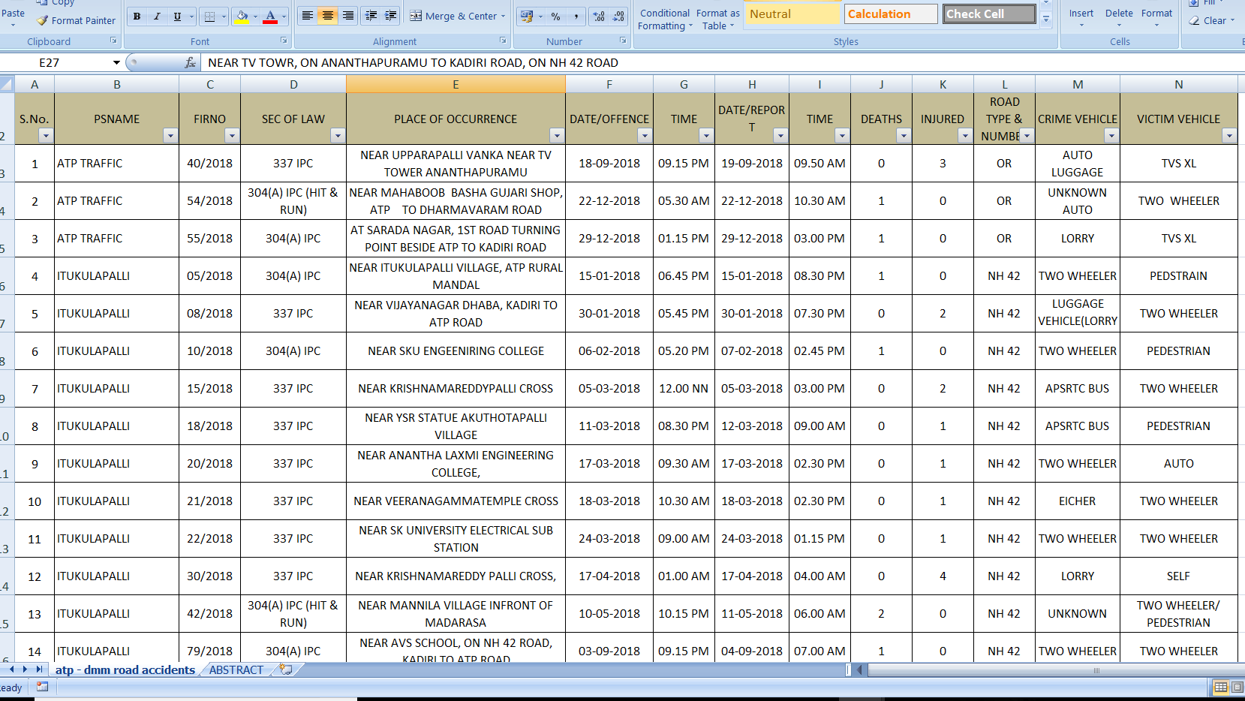
Database

Slide 11
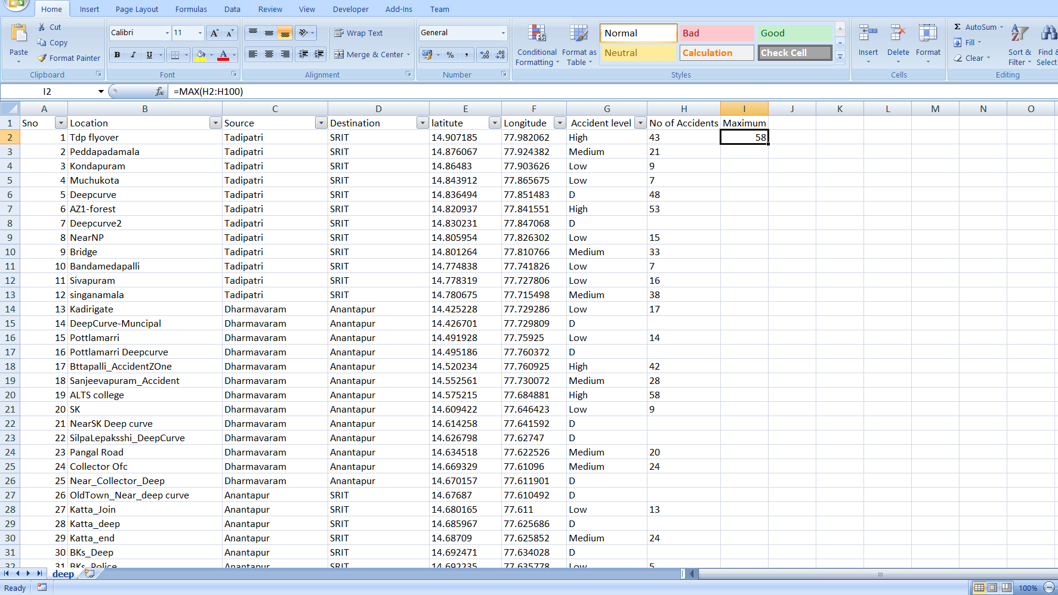
Continued..

Slide 12
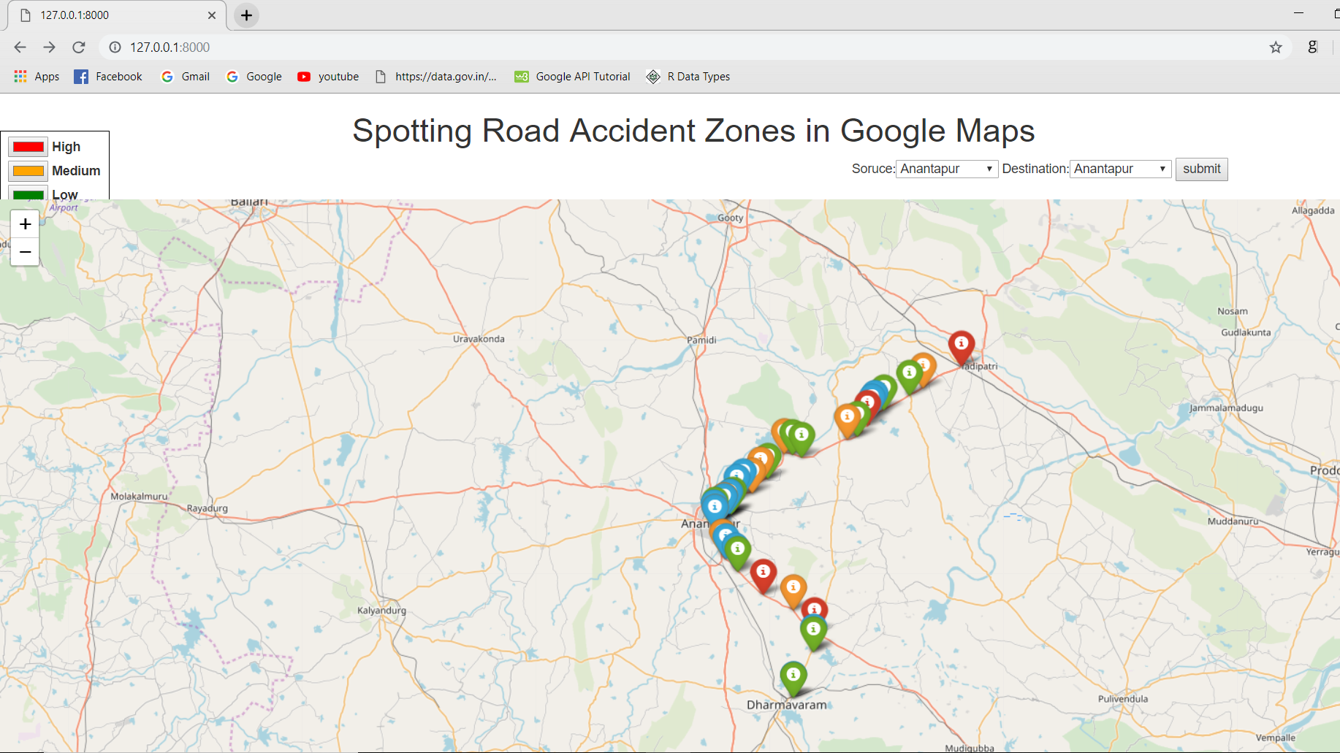
Design

Slide 13
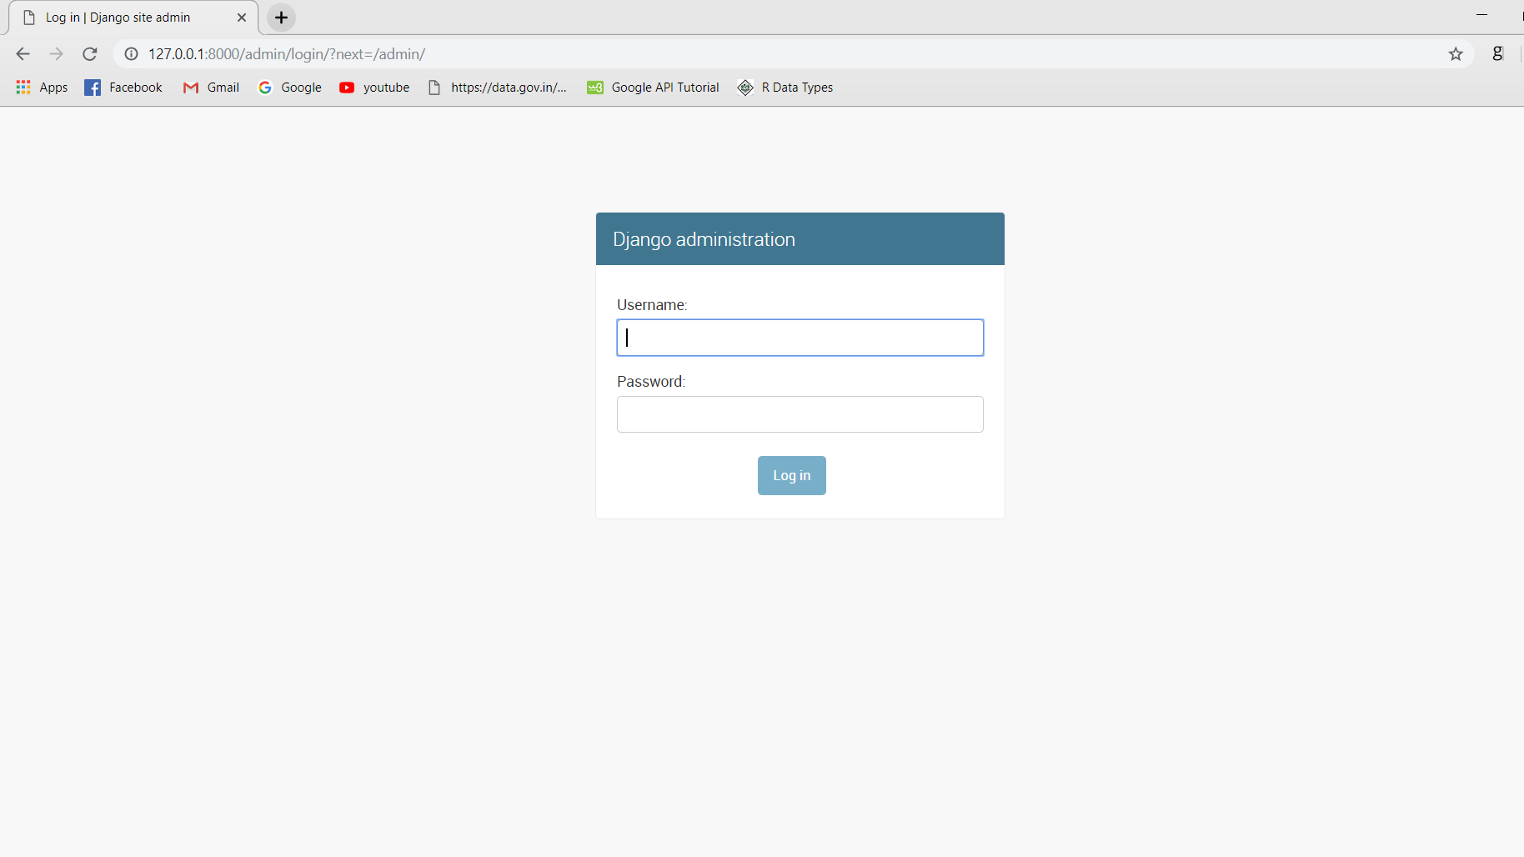
Continued..

Slide 14
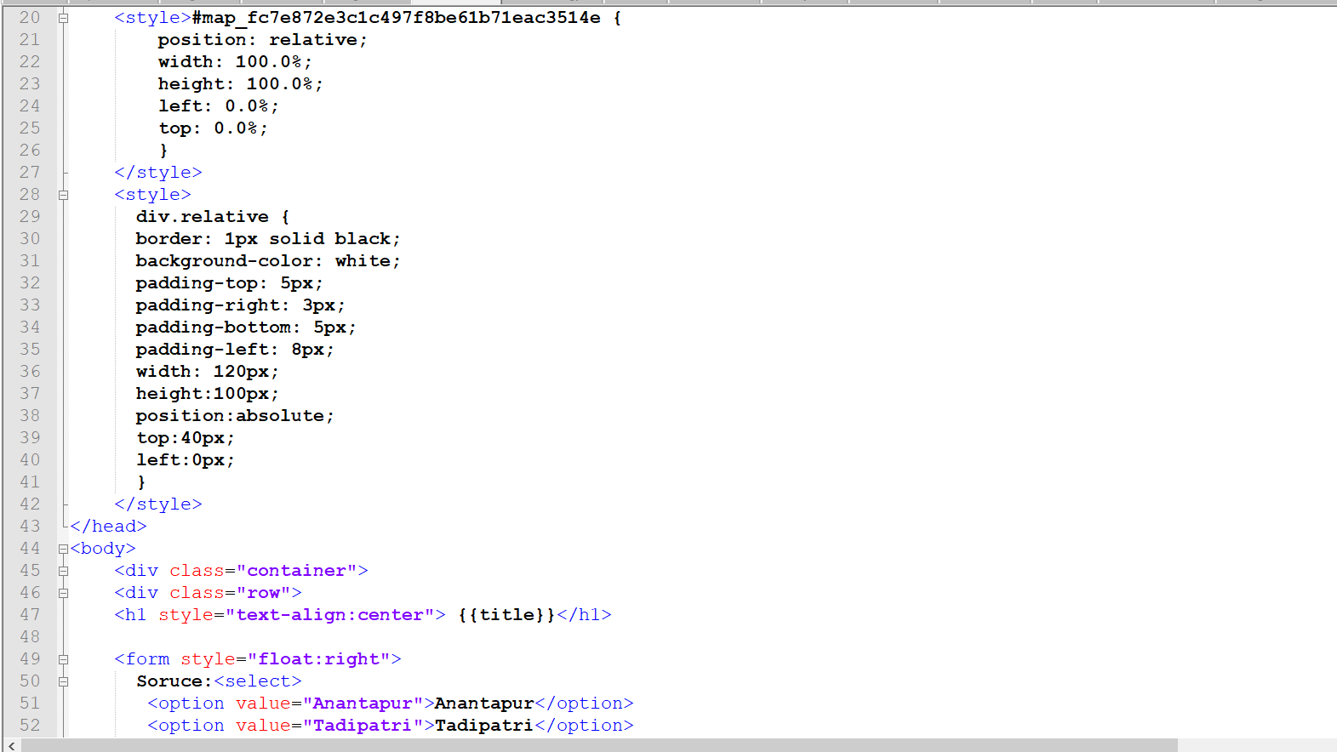
Implementation

Slide 15
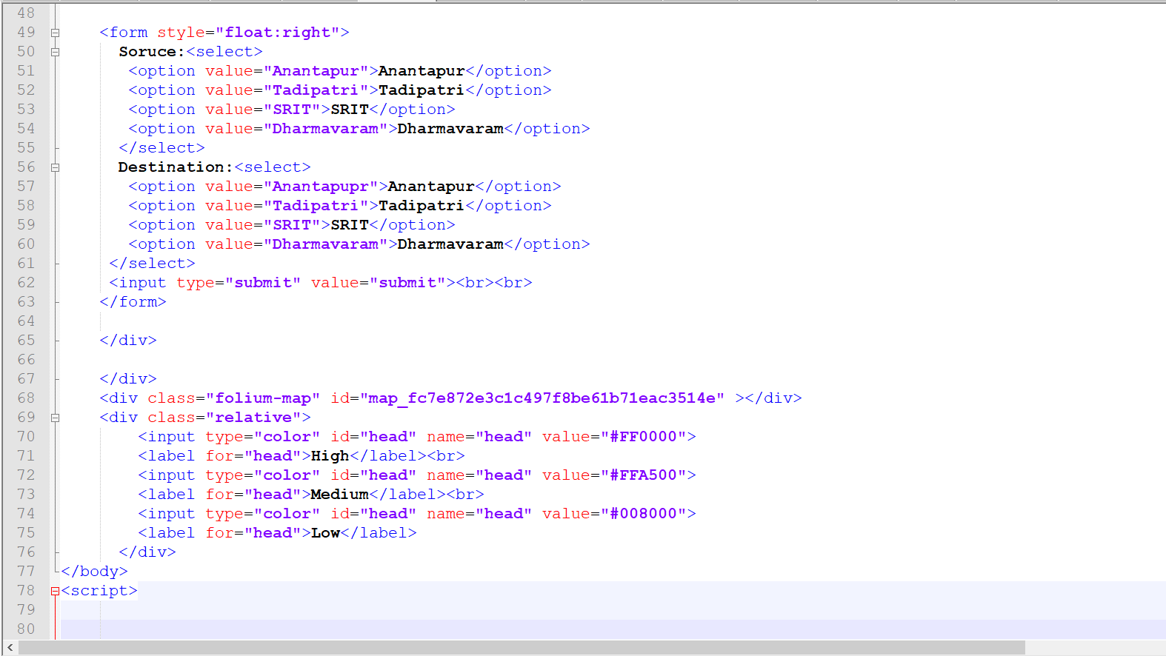

Slide 16
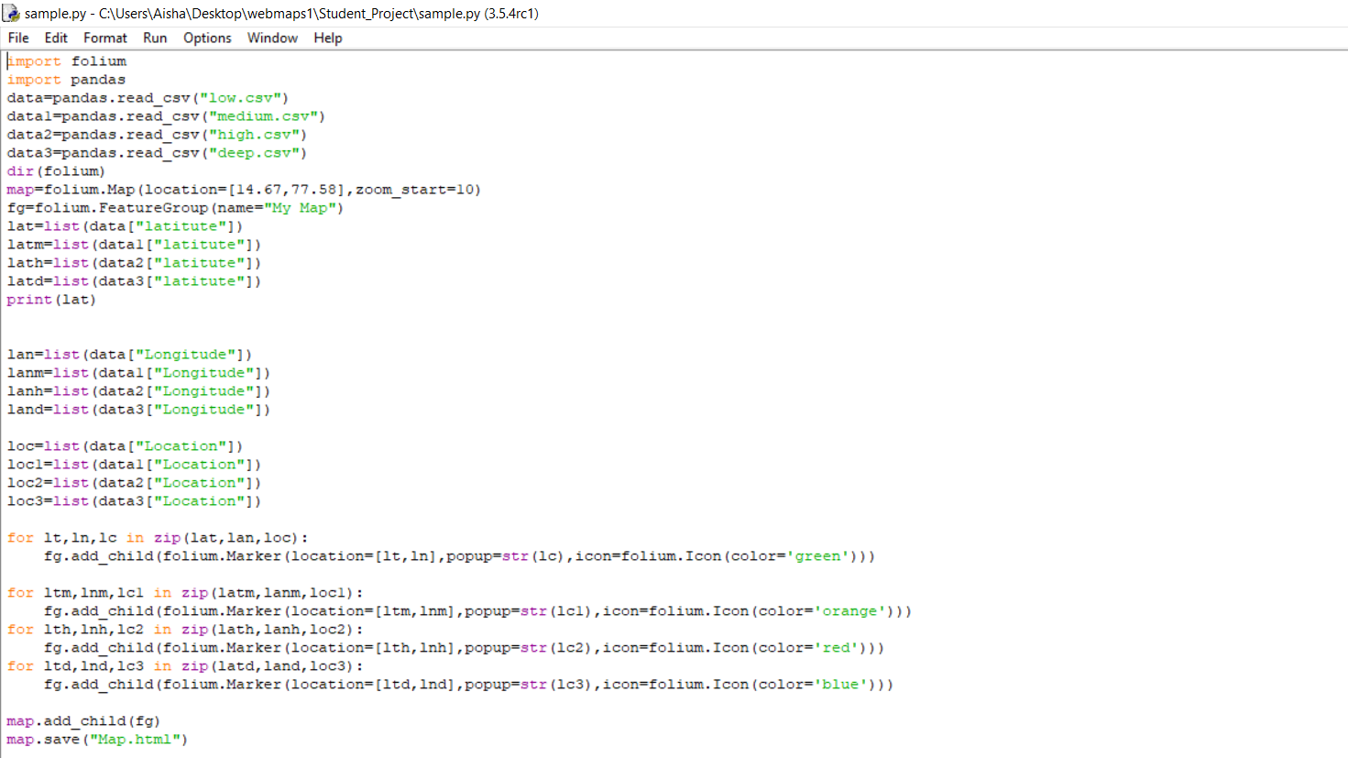

Slide 17
References
https://www.sih.gov.in/sih2019ProblemStatements/Ng==/QWxs/U2ltcGxl/QWxs/QWxs [1]
https://www.localguidesconnect.com/t5/Feedback-and-Feature-Requests/Accident-prone-area-alert-in-Google-Maps-Navigation/td-p/398701 [2]
https://ieeexplore.ieee.org/document/7055140 [3]

Slide 18
Thank you
Queries
?

