Slide 1

Spotting Road Accident Zones in Google Maps
B.Hemalatha (154G1A0530)
B.R.Aisha (154G1A0502) Project Guide:
Y.Nithin Kumar (154G1A0559) Mr.Y Ramesh _{M.Tech.}
L.Mounika (154G1A0550)
Assistant Professor
Srinivasa Ramanujan Institute of Technology
Department of Computer Science & Engineering

Slide 2
Abstract
Everyone has a passion towards travelling but the main problem associated with it is absence of safety. Earlier systems lack of safety assurance systems, so that there is no information about accidents .This project is the web application, which identifies accident zones in route map and also displays level of risk factors.

Slide 3
Contents:
Problem Statement
Planning
Literature Survey
Tools and Requirements
References

Slide 4
Problem Statement
Safety has become an essential aspect of everyday life. One way is, we can provide safety by enabling people with vital information on the safety aspects in the route they take during a travel from one place to another. This creates vigilance in traveller and precautionary measures could be taken to prevent any mishap.

Slide 5
Planning
Summary of Discussions | Period of Completion
Investigation of Problem, Abstract, Proposed and Existing System | 6 Days
Literature Survey | 4 Days
Study on Data base | 2 Day
Implementation | 10 Days
Conclusion and writing of project Documentation | 8 Days

Slide 6
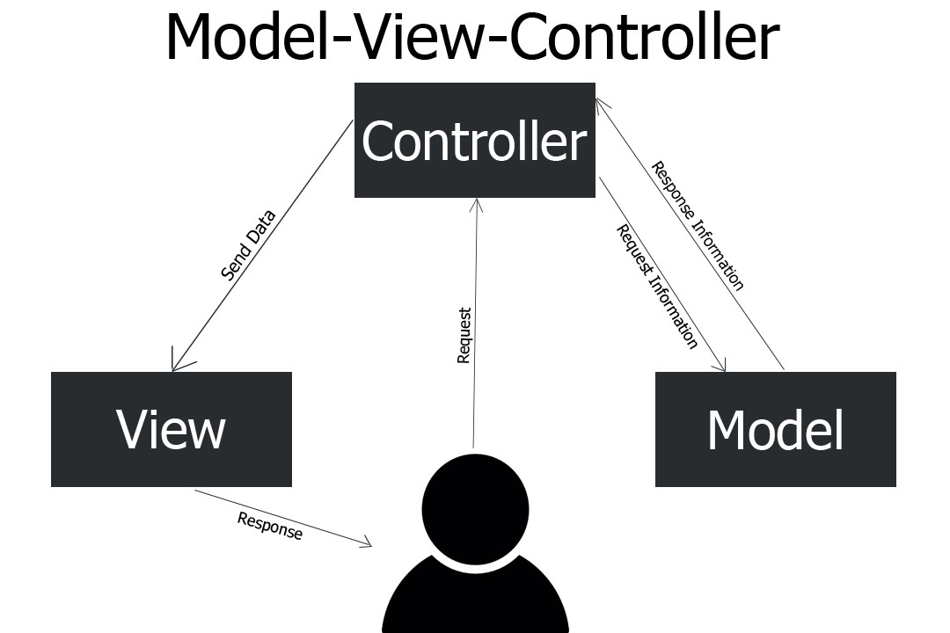
Continued....
4
3
2
1
5

Slide 7
Continued...
Modules:
Admin
Login
Enter Admin user ID and Password
Perform Operations on Database

Slide 8
Continued....
User
Enter URL
Displays current location
Select Source and Destination from drop down list
It displays path along with risk spots and deep curves

Slide 9
Literature Survey a. Existing Technology
Google Maps:
Displays path from source to destination.
Multiple Routes.
Shortest Path.
Street View.
Traffic analysis.
Discovering near by places.
Symbols to represent Geographic features.

Slide 10
Continued...
b.Limitations
G-Maps does not provide information regarding:
1.Accident zone areas.
2.Deep curves

Slide 11
Continued...
C. Proposed Solution
This is an Internet web service, specifically Google APIs, which will offer geo-location for physical location name, map and map markers.[3]
Using Google API, the coordinates can be presented using names of places and close range land marks.
We are building an Web application that will provide any possible safety lapse from source to a destination.
Given a route map (like Google maps), the security based profiling of various geographical routes traversed could be highlighted as red/yellow/green indicating high, medium and low risks zones along with deep curves.[1]

Slide 12
Tools and Requirements
Software Requirements:
Python 3
Sqlite 3
Sublime
Django
Operating System: Windows 7 and above.
Hardware Requirements:
RAM : 2GB and above
Processor : i3 and above
Hard Disk : 50GB and above

Slide 13
References:
https://www.sih.gov.in/sih2019ProblemStatements/Ng==/QWxs/U2ltcGxl/QWxs/QWxs [1]
https://www.localguidesconnect.com/t5/Feedback-and-Feature-Requests/Accident-prone-area-alert-in-Google-Maps-Navigation/td-p/398701 [2]
https://ieeexplore.ieee.org/document/7055140 [3]

Slide 14
Thank you
Queries
?

