Slide 1

Sreyas Institute of Engineering and Technology
An Autonomous Institution
Approved by AICTE, Affiliated to JNTUH
Accredited by NAAC-A Grade, NBA (CSE, ECE & ME) & ISO 9001:2015 Certified
PROJECT
On
REAL-TIME DRIVER ALERTNESS SYSTEM WITH ALARM
BACHELOR OF TECHNOLOGY
REVIEW
IN
COMPUTER SCIENCE AND ENGINEERING
BY
MUTHYAMAINA MOUNIKA 22VE1A05A1
ACADEMIC BATCH: (2022-2026)
Under the Guidance of
Guide Name – Mrs.P.VIJAYALAKSHMI

Slide 2
CONTENT
Abstract Test Cases
Existing System Screenshot
Drawbacks Limitations
Proposed System Future Scope
Advantages Conclusion
Requirements Queries
Architecture Diagram
Testing and Types

Slide 3
ABSTRACT:
REAL-TIME DRIVER ALERTNESS SYSTEM WITH ALARM is based on advanced facial landmarks analysis, focusing on eyelid blinking patterns to assess driver alertness accurately. This innovative system detects drowsiness and distractions, including mobile phone use and eating, in real-time. Upon detection, an alarm alerts the driver, promoting immediate precautionary measures or rest. Leveraging modules such as dlib, cv2, and yolov5, the system offers user-friendly and effective preventive measures against potential accidents caused by drowsy driving or distraction. Its proactive approach and simplicity make it an invaluable tool for enhancing driver safety and reducing road accidents.

Slide 4
EXISTING SYSTEMS
EyeSight by Omron: EyeSight employs camera-based technology to monitor driver behavior, detecting signs of drowsiness or distraction and issuing alerts to ensure safe driving.
1. Guardian by Seeing Machines: This system uses facial recognition and eye-tracking technology to detect driver fatigue and distraction, triggering alerts and interventions to prevent accidents.
2. EyeSight by Omron: EyeSight employs camera-based technology to monitor driver behavior, detecting signs of drowsiness or distraction and issuing alerts to ensure safe driving.
3. Driver Attention Monitor by Lexus: Lexus vehicles are equipped with a driver attention monitor system that uses steering inputs and facial recognition to detect signs of fatigue, prompting the driver to take breaks when necessary.
4. Fatigue Detection System by Bosch: Bosch's fatigue detection system uses steering angle sensors and vehicle data to monitor driver behavior and detect signs of drowsiness, alerting the driver to take corrective action.
5. DriveGuardian by Affectiva: DriveGuardian is an AI-powered system that monitors driver behavior through facial expression analysis, detecting signs of fatigue or distraction and providing real-time alerts to improve road safety.

Slide 5
DRAWBACKS
False Alarms: The system may occasionally trigger false alarms due to factors like sudden movements or changes in lighting conditions, potentially leading to driver annoyance and desensitization to alerts.
Dependency on Facial Recognition: Accuracy relies heavily on facial landmarks analysis, which may be less reliable in certain situations such as wearing glasses, obscured facial features, or variations in facial expressions.
Limited Effectiveness in Certain Conditions: The system may be less effective in extreme conditions like heavy rain, fog, or nighttime driving, where facial landmarks may be harder to detect accurately.
Dependency on Technology: Reliance on complex technology like cameras and AI algorithms makes the system susceptible to malfunctions, software bugs, and hardware failures, potentially compromising its reliability.
Privacy Concerns: Continuous monitoring of facial features raises privacy concerns, as drivers may feel uncomfortable with their behavior being constantly analyzed and recorded.

Slide 6
PROPOSED SYSTEM
Comprehensive Driver Alertness Monitoring: Our project utilizes both drowsiness detection through eye aspect ratio analysis and object detection to identify potential distractions, providing a thorough assessment of driver alertness and enhancing road safety.
Advanced Machine Learning Integration: Unlike traditional systems, our project leverages state-of-the-art machine learning models, including YOLOv5 for object detection and Dlib for facial landmark prediction, ensuring precise and adaptive monitoring of driver behavior in real-time.
Real-Time Audio Alerts and User-Friendly Interface: The system features an intuitive interface displaying real-time video feed with highlighted alerts, complemented by audio warnings through text-to-speech and alarm sounds, making it easy for users to stay aware of potential dangers while driving.

Slide 7
ADVANTAGES
Enhanced Safety: The system helps prevent accidents by alerting drivers when they show signs of drowsiness or distraction, thereby reducing the risk of collisions and improving road safety.
Increased Awareness: By continuously monitoring driver behavior, the system increases drivers' awareness of their own alertness levels and encourages them to stay focused and attentive while driving.
Reduced Costs: Fewer accidents result in lower costs for vehicle repairs, medical expenses, insurance premiums, and potential legal fees, leading to overall cost savings for fleet operators and transportation companies.
Improved Productivity: Alert drivers are more likely to maintain consistent driving performance and adhere to schedules, leading to improved productivity and efficiency in transportation operations.
Compliance and Liability Protection: Adopting a real-time driver alertness system demonstrates a commitment to safety and regulatory compliance, helping companies avoid legal liabilities and penalties associated with accidents caused by driver fatigue or distraction.

Slide 8
REQUIREMENTS
HARDWARE REQUIREMENTS
Mordern multicore CPU
Atleast 8GB of RAM
Solid-state drive(SSD) for storage
Onboard camera
Onboard screen
SOFTWARE REQUIREMENTS
Operating system: Windows,MACOS or Linux
Python
Developing environment: python idle

Slide 9
ARCHITECTURE DIAGRAM
DATA PROCESSING
(IMAGE PROCESSING)
DATA ANALYSING
ALERT MANAGEMENT
INCIDENT REPORTING
DRIVER INTERFACE
ALERT AGGREGATION

Slide 10
PROJECT MODULES
ADMIN MODULE:
View alert logs: Display all alert logs with filters for date, time, and type of alert.
Configure system settings: Adjust thresholds and parameters for drowsiness and distraction detection.
USER (DRIVER) MODULE:
Update profile: Allow drivers to update personal information.
Start/stop monitoring session: Enable drivers to start or stop the alertness monitoring process.
View personal alert logs: Display a log of alerts specific to the driver.

Slide 11
PROJECT MODULES
DROWSINESS DETECTION MODULE:
Capture real-time video stream: Use OpenCV to capture video from the webcam.
Detect faces and eyes using dlib: Utilize dlib's face detector and facial landmark predictor.
Calculate Eye Aspect Ratio (EAR): Compute EAR for both eyes to monitor for drowsiness.
Trigger alarm if drowsiness is detected: Play an alarm and provide a text-to-speech warning.
Log incident in the database with timestamp: Automatically record the drowsiness event in the database.

Slide 12
PROJECT MODULES
DISTRACTION DETECTION MODULE:
Capture real-time video stream: Use OpenCV to capture video from the webcam.
Detect objects using YOLOv5: Load the YOLOv5 model and perform object detection.
Identify predefined distraction objects: Filter detected objects for predefined distraction classes.
Trigger alert and log incident in the database: Provide a text-to-speech warning and log the distraction event with a timestamp.
ALARM MODULE:

Slide 13
PROJECT MODULES
ALARM MODULE:
Play alarm sound: Use Pygame mixer to play an alarm sound when an alert is triggered.
Provide text-to-speech alerts: Use pyttsx3 for text-to-speech notifications of alerts.
DATABASE MODULE:
Store alert details: Insert alert information into the database with details about the type and time of the alert.
Maintain logs for review: Ensure all alerts are logged and can be retrieved for review.
Ensure data security and integrity: Implement measures to protect the data from unauthorized access.
Provide reports for analysis: Generate reports summarizing alert incidents over a specified period.

Slide 14
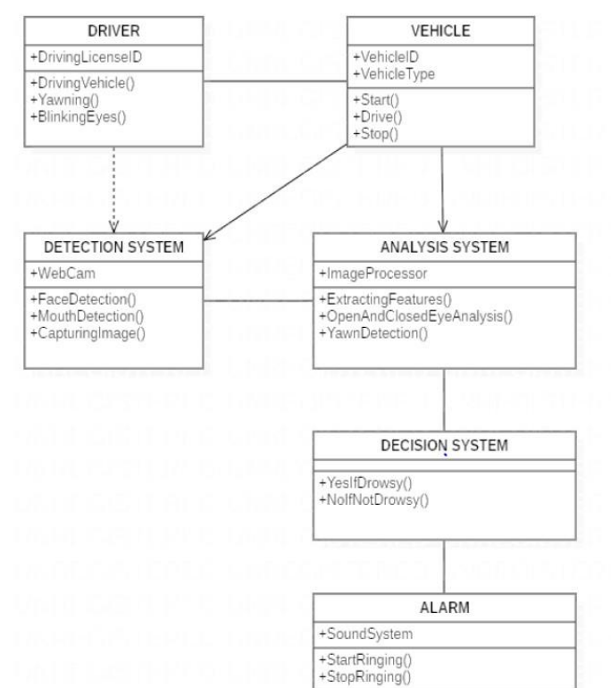
CLASS DIAGRAM

Slide 15
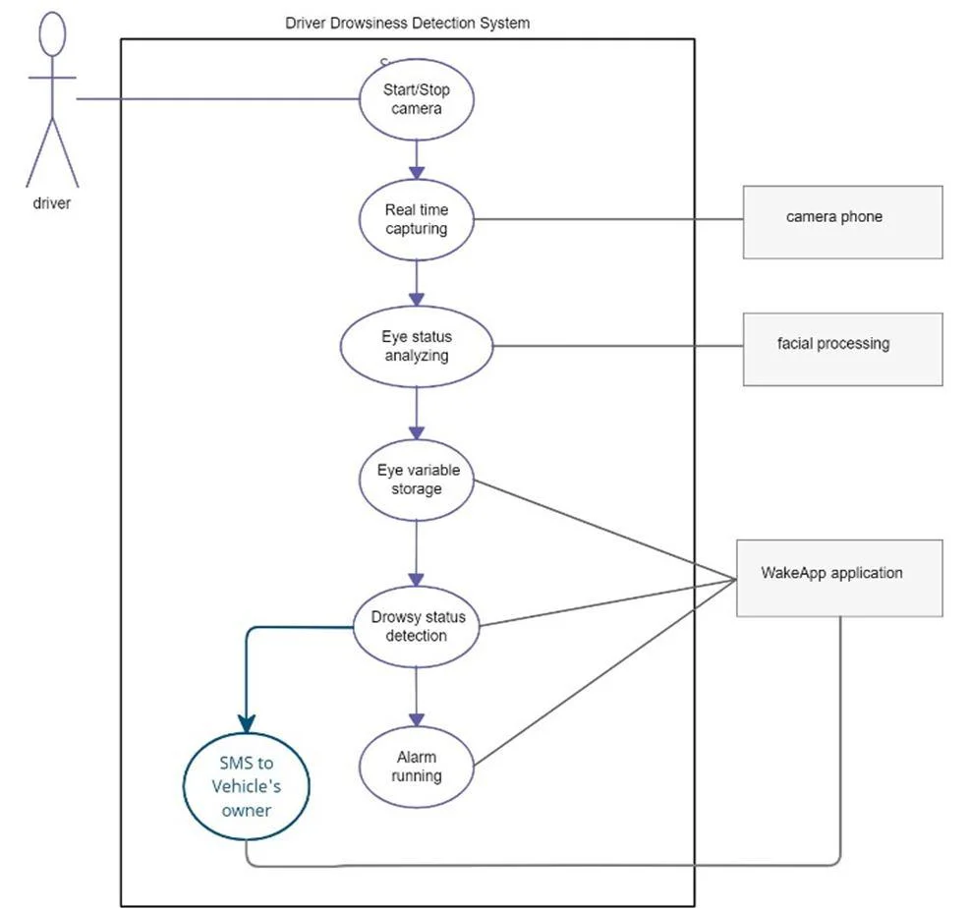
USE CASE DIAGRAM

Slide 16
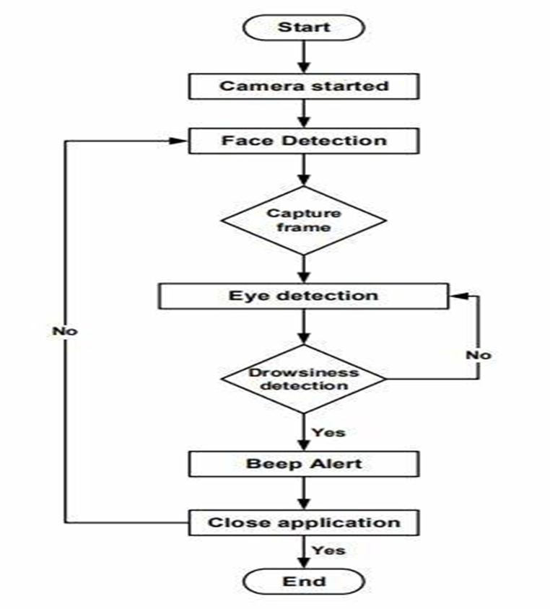

ACTIVITY DIAGRAM

Slide 17
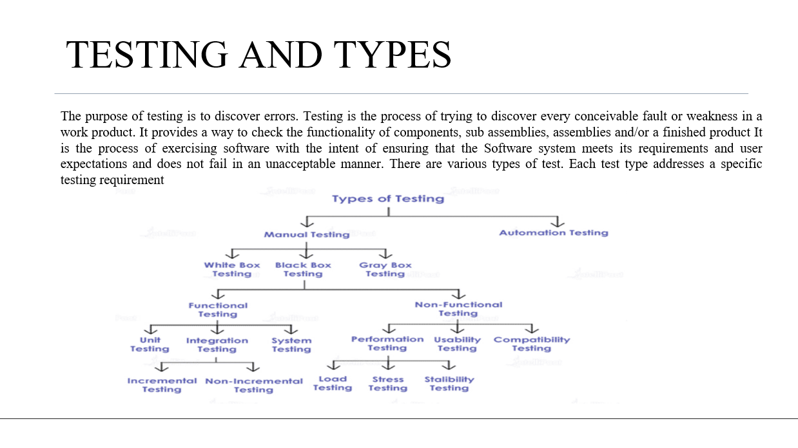

Slide 18
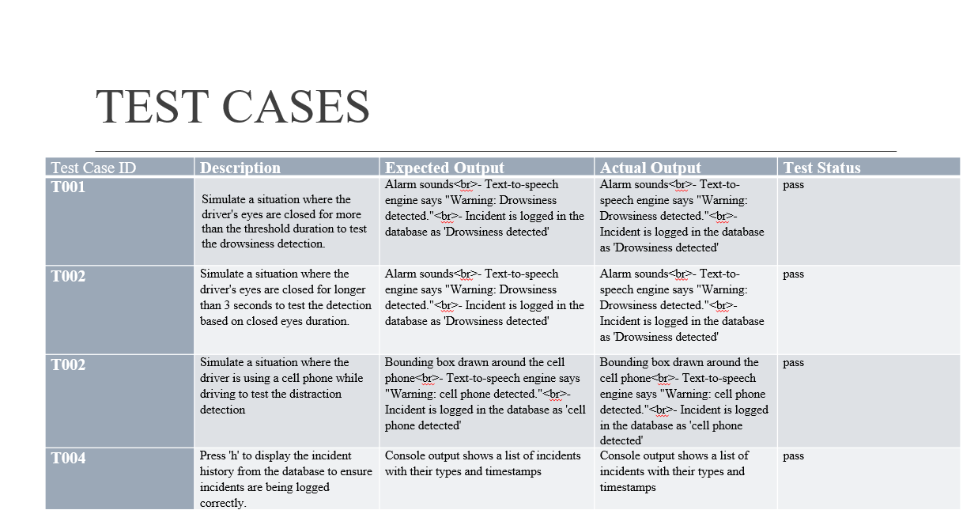

Slide 19
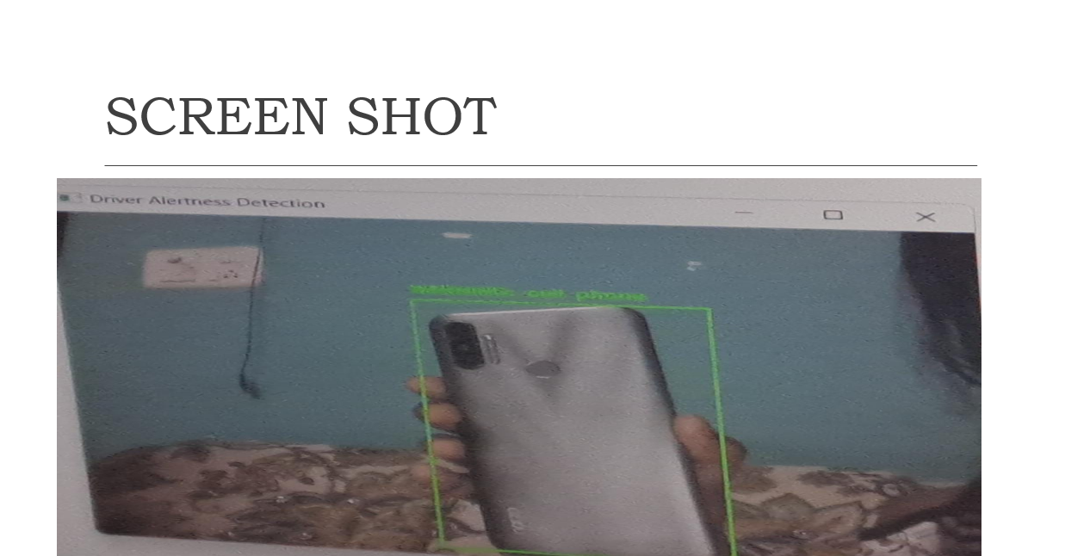

Slide 20
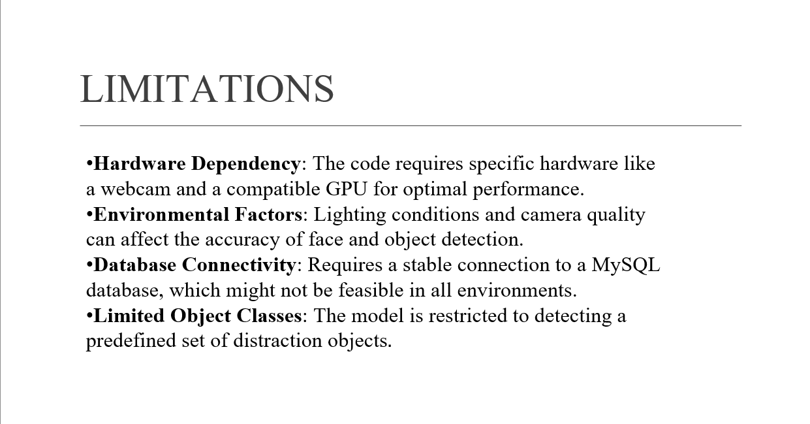

Slide 21
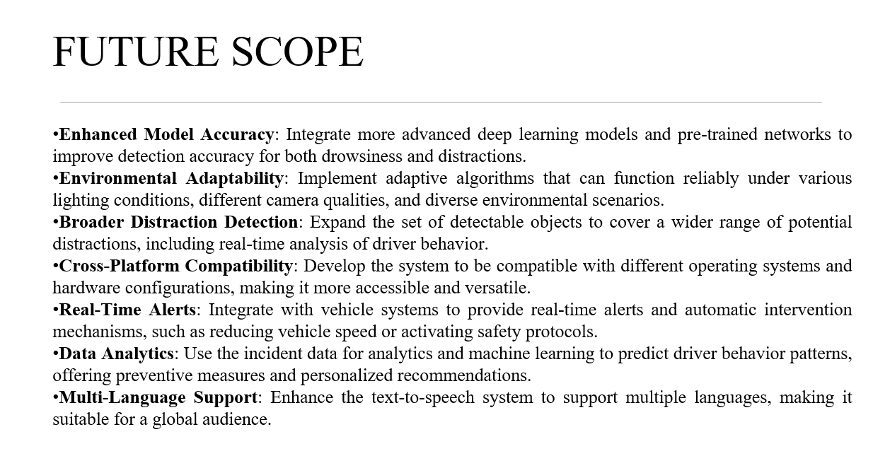

Slide 22
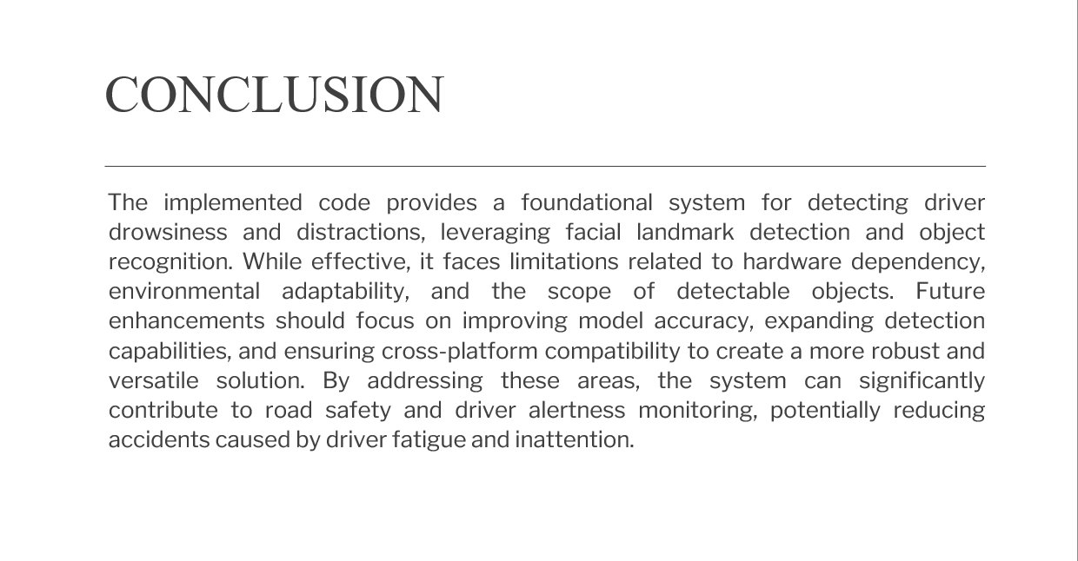

Slide 23
QUERIES ??

