Slide 1

Touch Screen Technology
By
B.Mounika roshan
1210314012
Class B-10

Slide 2
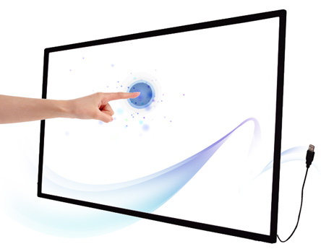
What is a touch screen?
An electronic visual display that locates the coordinates of a users touch within display area
Works independently of what is being
displayed on screen
[7]

Slide 3
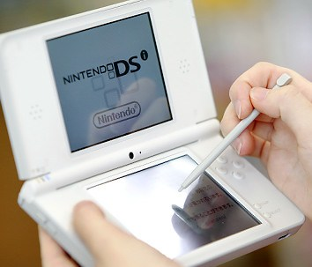
When is it Applicable?
It allows users to interact directly with what is being displayed, rather than indirectly using a mouse or keyboard
Can be used without any intermediate device
Found in modern smartphones, video games, kiosks, navigation systems, etc. . .
[1]

Slide 4
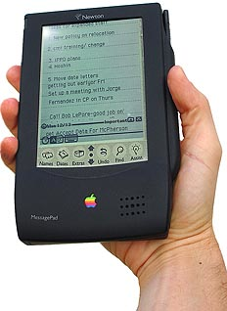
Brief History
Invented by E.A. Johnson (Royal Radar Est.) around 1965 for air traffic control
HP-150 home computer using infrared technology in 1983
1993 Apple’s Newton and
IBM’s Simon
2002 Microsoft’s Windows XP Tablet
2007 Apple’s iPhone (Multi-touch)
[6]

Slide 5
Touch Screen Technology
Four different technologies used to make touch screens today:
    Resistive
    Capacitive
    Surface Acoustic Wave (SAW)
    Infrared LED or Optical

Slide 6
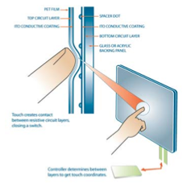
Resistive Touch Screens
Two layers of conductive material
Touch creates contact between resistive layers completing circuit
[2]

Slide 7
Resistive Touch Screens
Voltage in circuit changes based on position
Controller determines location based on voltages
Any material can trigger sensors
[2]

Slide 8
Why Resistive?
Advantages:
  Cost-effective and low power Requirements
  Activated by any object
  Accurate
Disadvantages:
  Polyester surface can be damaged
  Only 75% light transmission
  Lower endurance (~35 million touches)

Slide 9
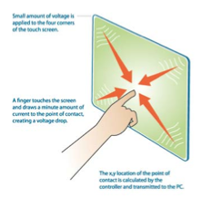
Capacitive Touch Screens
Glass panel with conductive layer (Indium Tin Oxide)
Small amount of voltage applied to four corners of touch screen
[2]

Slide 10
Capacitive Touch Screens
Touch draws minute
amount of current creating voltage drop
Coordinates of point of contact calculated by controller
[2]

Slide 11
Why Capacitive?
Advantages:
  Durable surface material
  High endurance (~255 million touches)
  Very accurate
  Good optical quality
Disadvantages:
  Triggered only by bare finger or active stylus

Slide 12
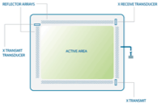
Surface Acoustic Wave Touch Screens
[2]
Surface consists of glass overlay with transmitting and receiving transducers

Slide 13
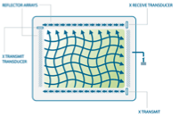
Surface Acoustic Wave Touch Screens
[2]
Electrical signals sent to the transmitting transducers converts to ultrasonic waves
Waves are directed across screen by reflectors then directed to receiving transducers

Slide 14
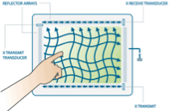
Surface Acoustic Wave Touch Screens
[2]
When finger touches screen it absorbs waves
Received values are compared to stored digital maps to calculate x and y coordinates

Slide 15
Why SAW?
Advantages:
  Best optical quality
  High surface durability and seal
  Activated by multiple sources
Disadvantages:
  Expensive
  Contaminates on screen can cause false-touches

Slide 16
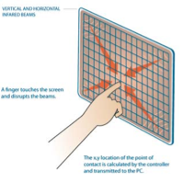
Infrared/Optical
Touch Screens
Uses infrared LEDs and matching photodetectors
Touching screen interrupts LEDs
[2]

Slide 17
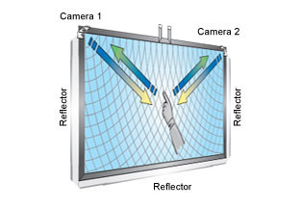
Infrared/Optical
Touch Screens
[8]
Cameras detect reflected LED caused by touch
Controller able to calculate coordinates from camera data

Slide 18
Infrared/Optical
Touch Screens
  Advantages:
    High optical clarity
    Durable surface
    Supports multi-touch
    Can scale to large sizes
  Disadvantages:
    Expensive
    Cameras can get out of alignment

Slide 19
Thank you

