Slide 1

Mini Project – MySQL Demonstration
By
Mounika Seelam On August 2025

Slide 2
What is MySQL?
MySQL is an open-source relational database management system (RDBMS).
Uses SQL (Structured Query Language) for managing and querying data.
Popular for web applications, data storage, and analytics.

Slide 3
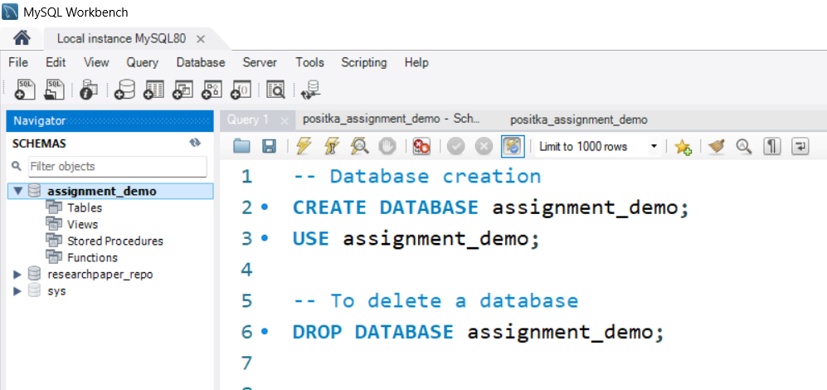
Creating a Database
Command: CREATE DATABASE database_name;
Creates a new database named assignment_demo.

Slide 4
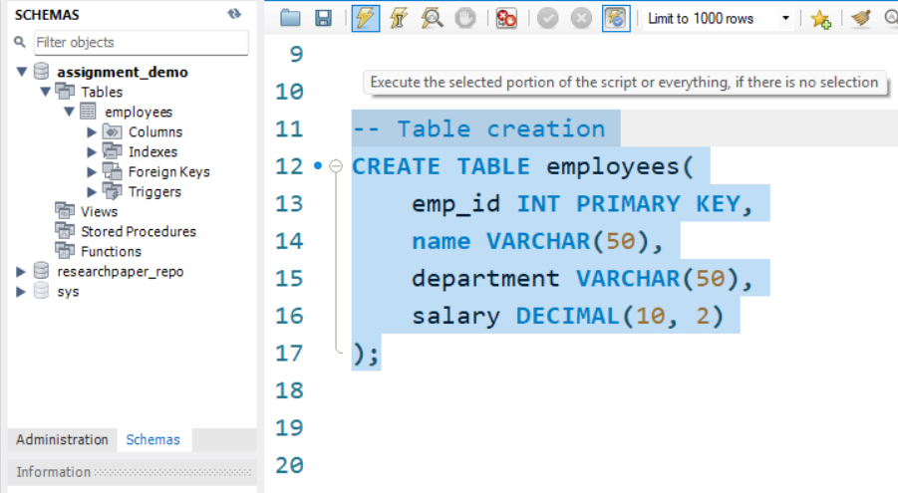
Creating Tables
Example Table: Employees
CREATE TABLE Employees (columns);

Slide 5
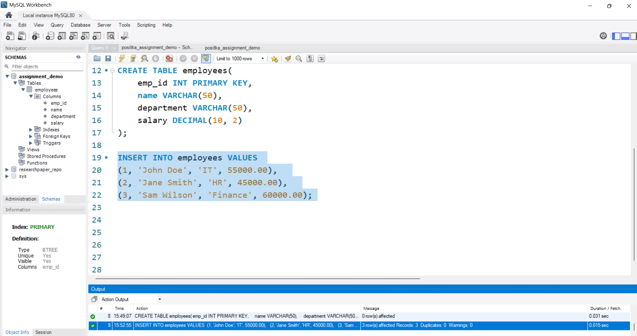
Inserting Sample Data
INSERT INTO Employees VALUES (rows)

Slide 6
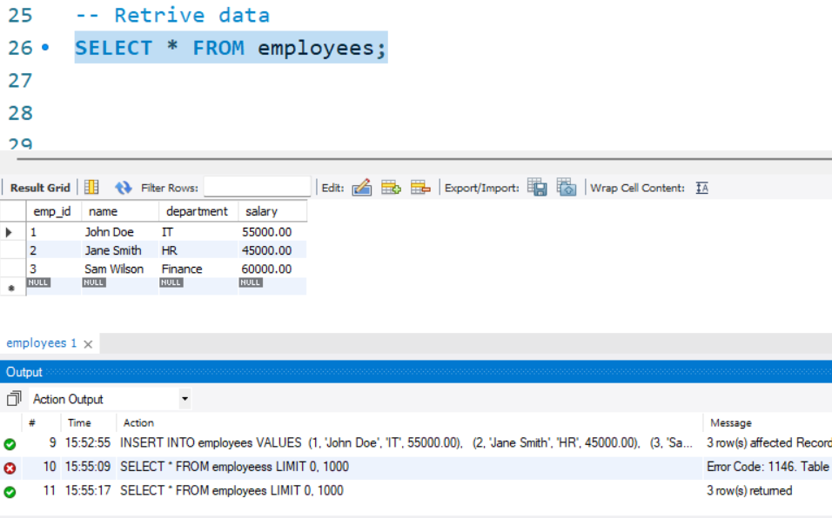
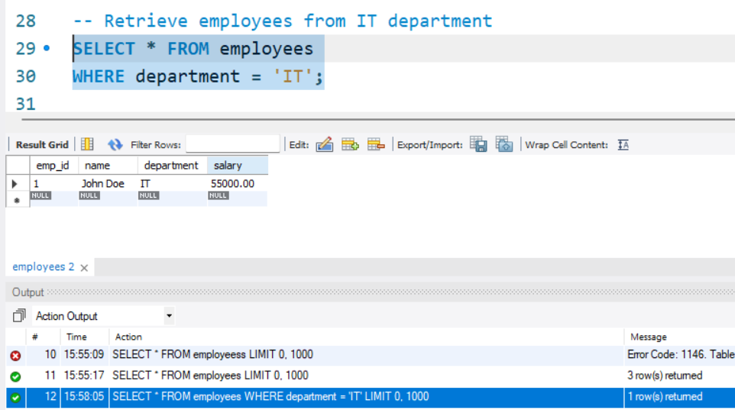
Querying Data
Retrieve all employees: SELECT * FROM Employees;
Retrieve employees from IT department:
SELECT * FROM Employees WHERE Department = 'IT';

Slide 7
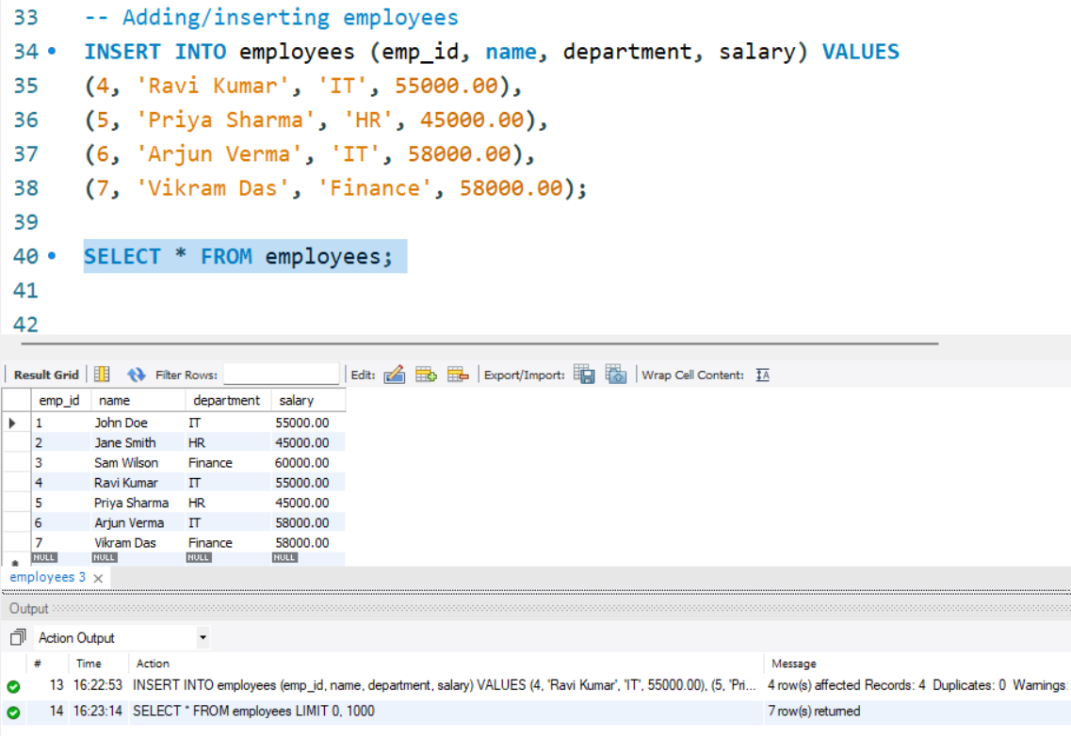
Insert More Employees
Query: INSERT INTO employees (...) VALUES (...)

Slide 8
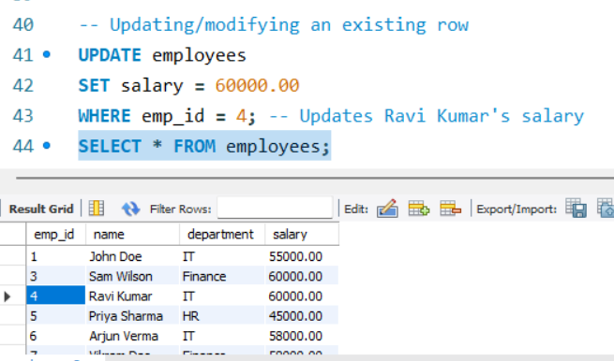
Update Query
Query: UPDATE employees SET salary = ... WHERE emp_id = ...;

Slide 9
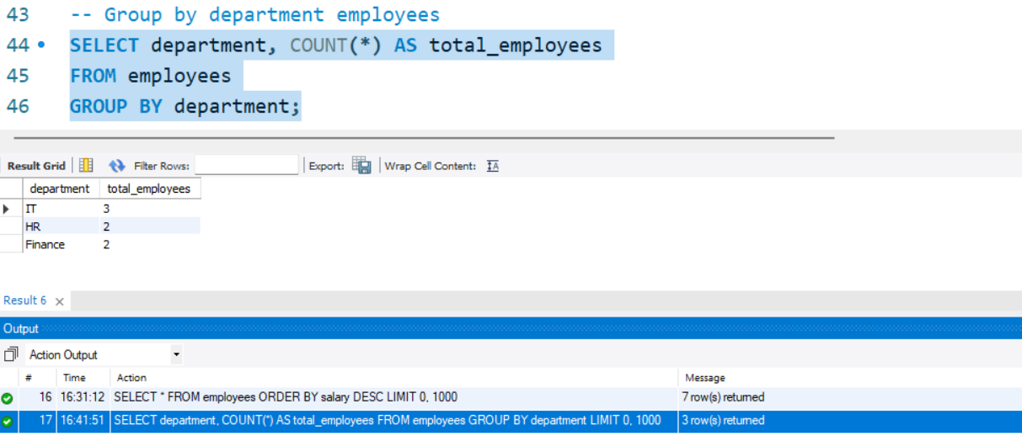
Group By
Query: SELECT department, COUNT(*) FROM employees GROUP BY department;

Slide 10
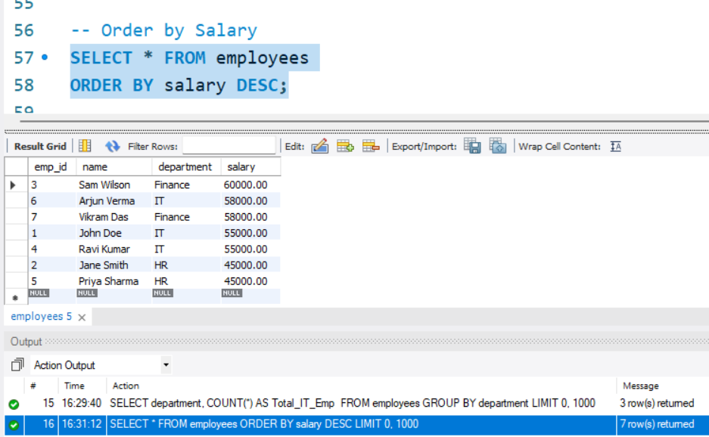
Order By
Query: SELECT * FROM employees ORDER BY salary DESC;

Slide 11
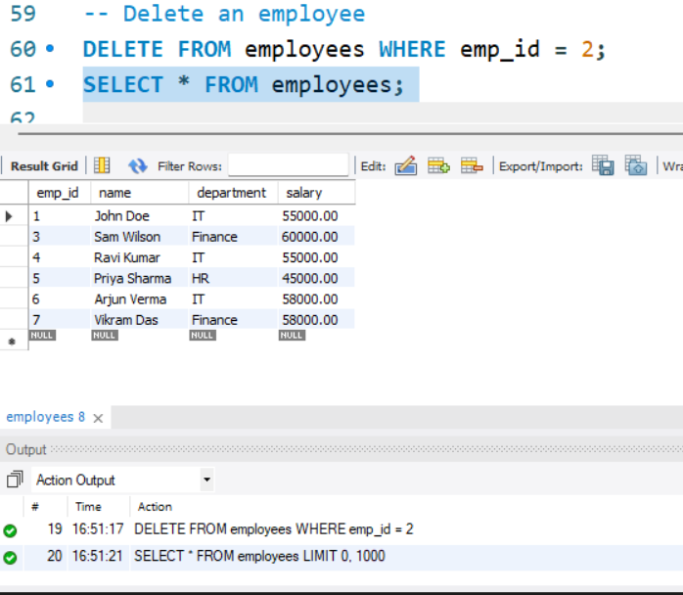
Delete Employee
Query: DELETE FROM employees WHERE emp_id = ...;

Slide 12
Backup/Save file
Command: mysqldump -u root -p CompanyDB > companydb_backup.sql
This creates a backup file of the database
Or Save manually by file -> save

Slide 13
Real-life Applications of MySQL
Used in web applications like WordPress, Facebook, Twitter.
Helps manage user data, posts, and interactions.
Common in enterprise applications for HR, Sales, and Finance data.

Slide 14
Conclusion
MySQL is widely used for managing relational databases.
Easy to use, efficient, and reliable.
Supports data backup, retrieval, and secure storage.
Created and managed a MySQL database (assignment_demo).
Demonstrated SQL operations: Create, Insert, Update, Delete, Group By, and Order By.
Showed how to back up the database using mysqldump.
Highlighted practical knowledge of relational databases.
This project demonstrates my foundational database skills and problem-solving approach.

Slide 15
Thank You
Prepared By
- Mounika Seelam

