Slide 1
Selenium Training

Slide 2
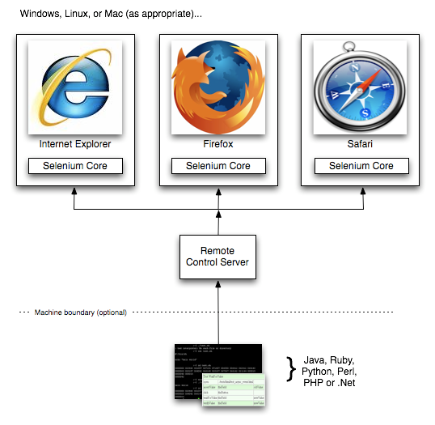
Selenium IDE,RC and WebDriver
There are 3 Components in Selenium:
1. Selenium IDE: Selenium IDE is a Firefox plugin which records and plays back user interactions with the browser.
So its just a record and play back tool and it will work only in Firefox browser.
2. Selenium RC:Selenium Remote Control (RC) is a test tool that allows you to write automated web application UI tests in any programming language against any HTTP website using any mainstream JavaScript-enabled browser.
3.WebDriver:Selenium-WebDriver makes direct calls to the browser using each browser’s native support for automation. How these direct calls are made, and the features they support depends on the browser you are using

Slide 3
Selenium– Environment Setup
Java
Eclipse
Selenium Jars (http://www.seleniumhq.org/download/)
Firefox Plugins –
Firebug - https://addons.mozilla.org/en-US/firefox/addon/firebug/
Selenium IDE- https://addons.mozilla.org/en-US/firefox/addon/selenium-ide/
Firepath - https://addons.mozilla.org/en-US/firefox/addon/firepath/

Slide 4
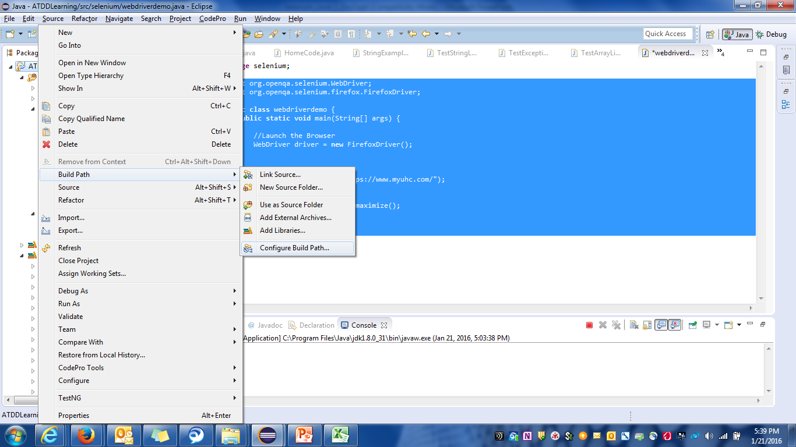
Selenium : Environment Setup

Slide 5
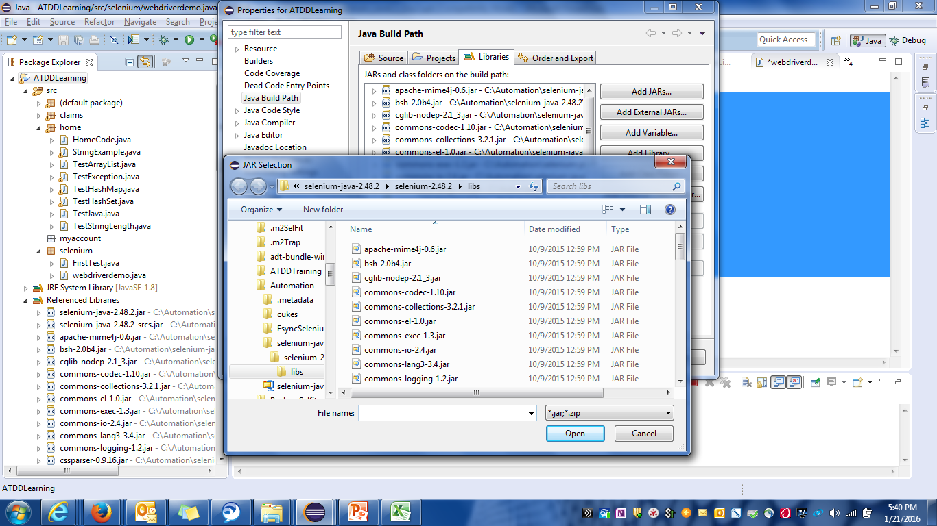
Selenium : Environment Setup

Slide 6
Selenium WebDriver - Introduction
WebDriver is a web automation framework that allows you to execute your tests against different browsers, not just Firefox.
WebDriver supports following languages :
Java, C #, Python , Ruby , PHP , HTML
WebDriver supports different Browsers :
Mozilla Firefox, Internet Explorer, HtmlUnit Driver , Chrome , Opera
WebDriver is implemented through a browser-specific browser driver, which sends commands to a browser, and retrieves results

Slide 7
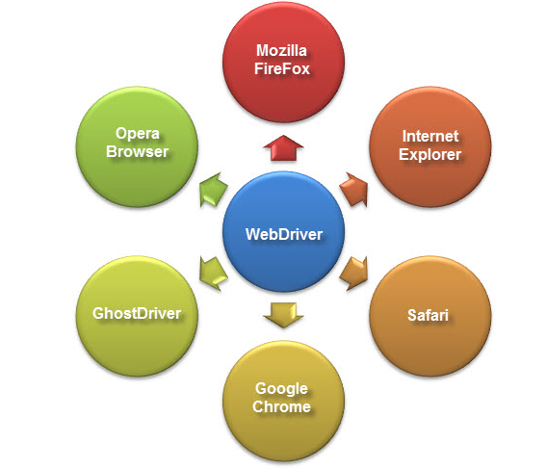
Selenium WebDriver - Introduction

Slide 8
Various Web Drivers
IE Driver Executable: http://code.google.com/p/selenium/downloads/list
Chrome Driver Executable: http://code.google.com/p/chromium/downloads/list
Opera Driver Executable: https://github.com/operasoftware/operadriver/downloads
‹Firefox Driver does not require a download as it is bundled with the Java client bindings

Slide 9
WebDriver
import org.openqa.selenium.WebDriver;
import org.openqa.selenium.firefox.FirefoxDriver;
public class webdriverdemo {
public static void main(String[] args) {
//Launch the Browser
WebDriver driver = new FirefoxDriver();
//Launch website
driver.navigate().to("https://www.myuhc.com/");
//Maximize the browser
driver.manage().window().maximize();
}
}

Slide 10
Webdriver API

Slide 11
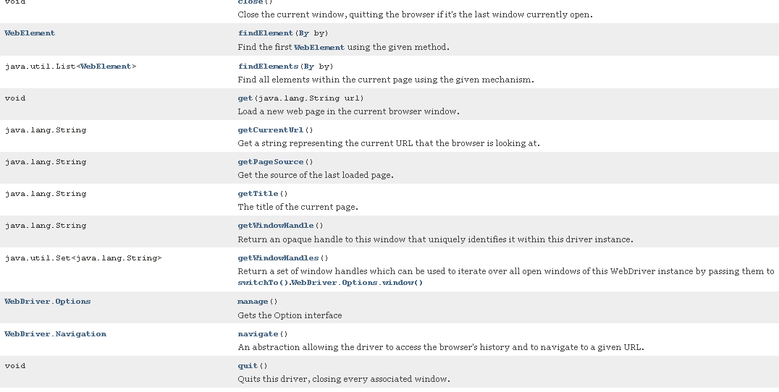
WebDriver API

Slide 12
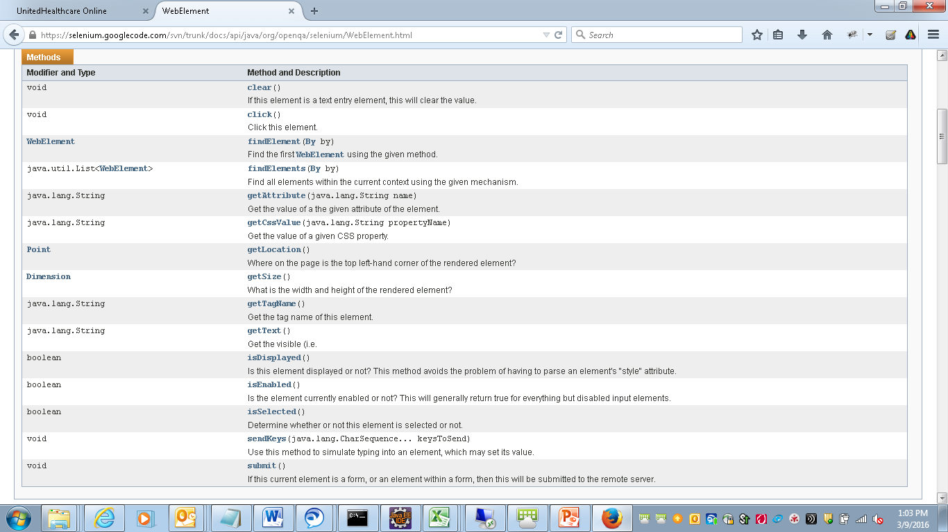
WebElement API

Slide 13
Thank You

