Slide 1
Selenium Training

Slide 2
Selenium– Environment Setup
Java
Eclipse
Selenium Jars (http://www.seleniumhq.org/download/)
Firefox Plugin –
Firebug - https://addons.mozilla.org/en-US/firefox/addon/firebug/
Firepath - https://addons.mozilla.org/en-US/firefox/addon/firepath/

Slide 3
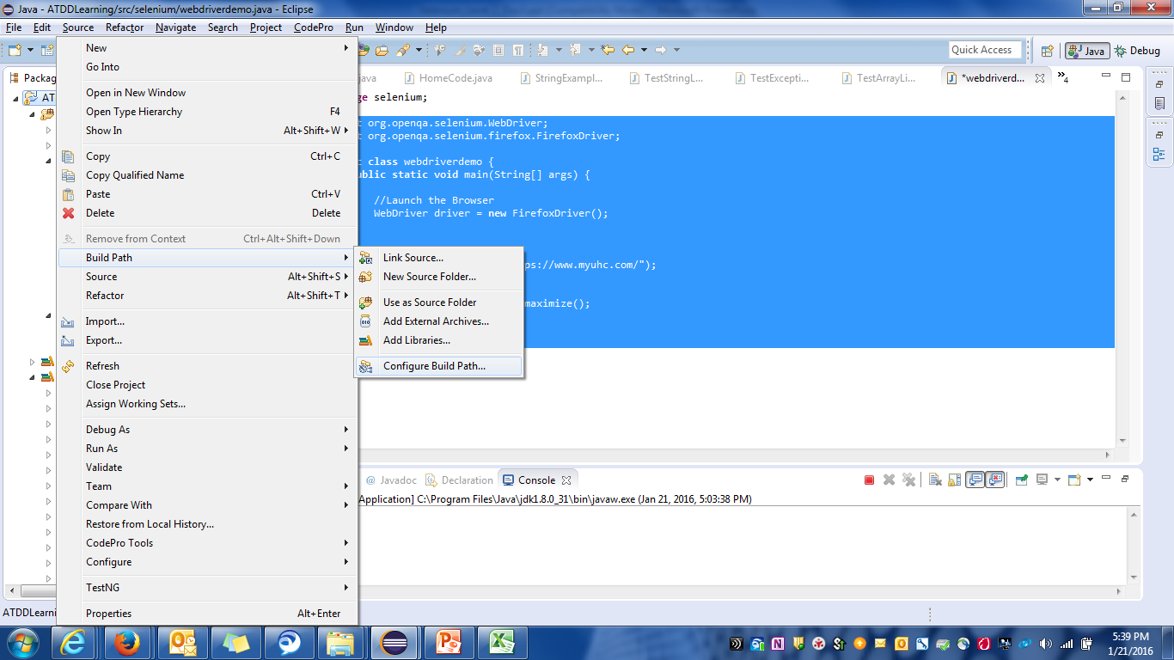
Selenium : Environment Setup

Slide 4
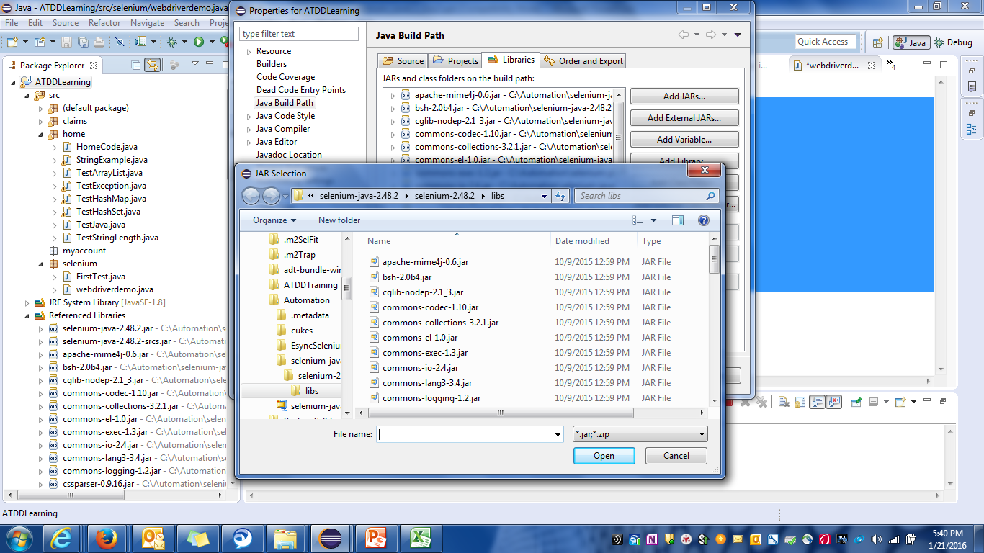
Selenium : Environment Setup

Slide 5
Selenium WebDriver - Introduction
WebDriver is a web automation framework that allows you to execute your tests against different browsers, not just Firefox.
WebDriver supports following languages :
Java, C #, Python , Ruby , PHP , HTML
WebDriver supports different Browsers :
Mozilla Firefox, Internet Explorer, HtmlUnit Driver , Chrome , Opera
WebDriver is implemented through a browser-specific browser driver, which sends commands to a browser, and retrieves results

Slide 6
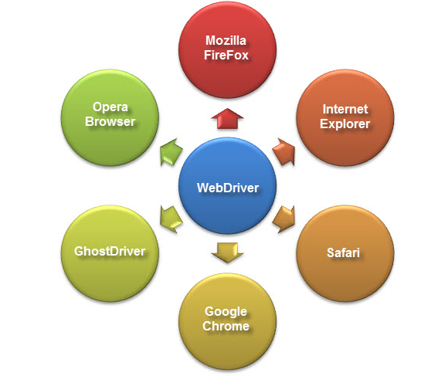
Selenium WebDriver - Introduction

Slide 7
Various Web Drivers
IE Driver Executable: http://code.google.com/p/selenium/downloads/list
Chrome Driver Executable: http://code.google.com/p/chromium/downloads/list
Opera Driver Executable: https://github.com/operasoftware/operadriver/downloads
‹Firefox Driver does not require a download as it is bundled with the Java client bindings

Slide 8
WebDriver
import org.openqa.selenium.WebDriver;
import org.openqa.selenium.firefox.FirefoxDriver;
public class webdriverdemo {
public static void main(String[] args) {
//Launch the Browser
WebDriver driver = new FirefoxDriver();
//Launch website
driver.navigate().to("https://www.myuhc.com/");
//Maximize the browser
driver.manage().window().maximize();
}
}

Slide 9
Webdriver API

Slide 10
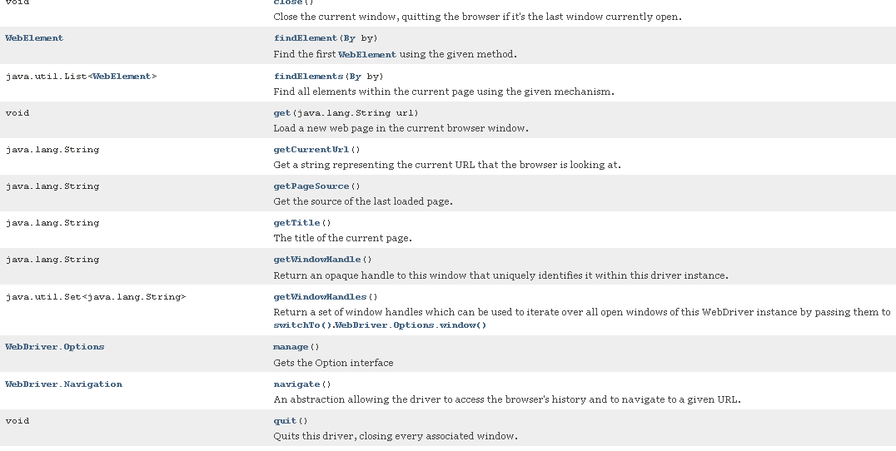
WebDriver API

Slide 11
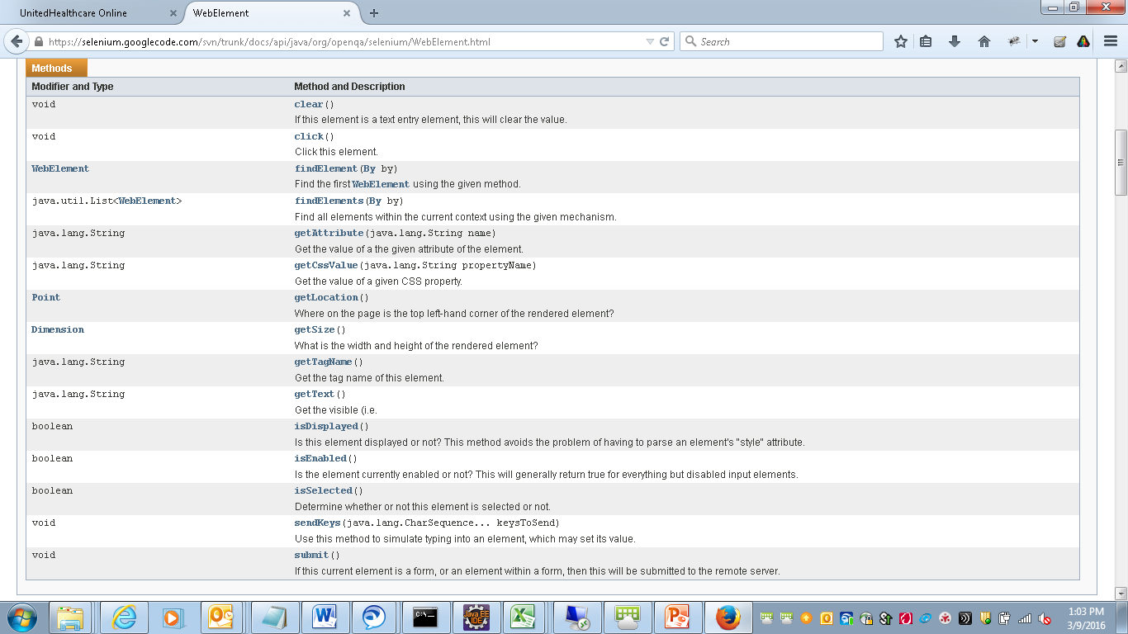
WebElement API

Slide 12
Thank You

