Slide 1
Selenium Training

Slide 2
WebDriver - Navigate
Navigate To Command
to(String arg0) : void – This method Loads a new web page in the current browser window. It accepts a String parameter and returns nothing.
Command -driver.navigate().to("http://www.myuhc.com");
Forward Command
forward() : void – This method does the same operation as clicking on the Forward Button of any browser. It neither accepts nor returns anything.
Command - driver.navigate().forward();
Back Command
back() : void – This method does the same operation as clicking on the Back Button of any browser. It neither accepts nor returns anything.
Command - driver.navigate().back();
Refresh Command
refresh() : void – This method Refresh the current page. It neither accepts nor returns anything.
Command - driver.navigate().refresh();

Slide 3
WebDriver – WebElement Commands
What is WebElement?
  WebElement represents an HTML element. HTML documents are made up by HTML elements. HTML elements are written with a start tag, with an end tag, with the content in between: <tagname> content </tagname>
The HTML element is everything from the start tag to the end tag: <p> My first HTML paragraph. </p>
Clear Command
clear( ) : void - If this element is a text entry element, this will clear the value. This method accepts nothing as a parameter and returns nothing.
Command - element.clear();
SendKeys Command
sendKeys(CharSequence… keysToSend ) : void - This simulate typing into an element, which may set its value. This method accepts CharSequence as a parameter and returns nothing.
Command - element.sendKeys(“text”);

Slide 4
WebDriver – WebElement Commands
Click Command
click( ) : void - This simulates the clicking of any element. Accepts nothing as a parameter and returns nothing.
Command - element.click();
IsDisplayed Command
isDisplayed( ) : boolean - This method determines if an element is currently being displayed or not. This accepts nothing as a parameter but returns boolean value(true/false).
Command - element.isDisplayed();
IsSelected Command
isSelected( ) : boolean - Determine whether or not this element is selected or not. This accepts nothing as a parameter but returns boolean value(true/false).
Command - element.isSelected();

Slide 5
WebDriver – WebElement Commands
GetText Command
getText( ) : String- This method will fetch the visible (i.e. not hidden by CSS) innerText of the element. This accepts nothing as a parameter but returns a String value.
  Command - element.getText ();

Slide 6
WebDriver – Switch Window
Some web applications have many frames or multiple windows. Selenium WebDriver assigns an
alphanumeric id to each window as soon as the WebDriver object is instantiated. This unique
alphanumeric id is called window handle. Selenium uses this unique id to switch control among
several windows. In simple terms, each unique window has a unique ID, so that Selenium can
differentiate when it is switching controls from one window to the other.
GetWindowHandle Command
String handle= driver.getWindowHandle();//Return a string of alphanumeric window handle
GetWindowHandles Command
Set<String> handle= driver.getWindowHandles();//Return a set of window handle
SwitchTo Window Command
driver.switchTo().window("windowName");
for (String handle : driver.getWindowHandles()) {
driver.switchTo().window(handle);}

Slide 7
WebDriver – Switch To Frame
SwitchTo Frame Command
driver.switchTo().frame("frameName");

Slide 8
WebDriver – Switch To Alert
SwitchTo PopUp Command
Alert alert = driver.switchTo().alert();
alert.accept();
alert.dismiss();

Slide 9
Implicit and Explicit Wait
Waiting is having the automated task execution elapse a certain amount of time before continuing with
the next step.
Implicit Waits
An implicit wait is to tell WebDriver to poll the DOM for a certain amount of time when trying to find an element or elements if they are not immediately available. The default setting is 0. Once set, the implicit wait is set for the life of the WebDriver object instance.
Example:
  WebDriver driver = new FirefoxDriver();
  driver.manage().timeouts().implicitlyWait(10, TimeUnit.SECONDS
Explicit Waits
An explicit waits is code you define to wait for a certain condition to occur before proceeding further in the code. The worst case of this is Thread.sleep(), which sets the condition to an exact time period to wait. There are some convenience methods provided that help you write code that will wait only as long as required. WebDriverWait in combination with ExpectedCondition is one way this can be
accomplished.
Example:
driver.get( "http://somedomain/url_that_delays_loading" );
WebElement myDynamicElement = (new WebDriverWait(driver, 10))
.until(new ExpectedCondition<WebElement>()

Slide 10
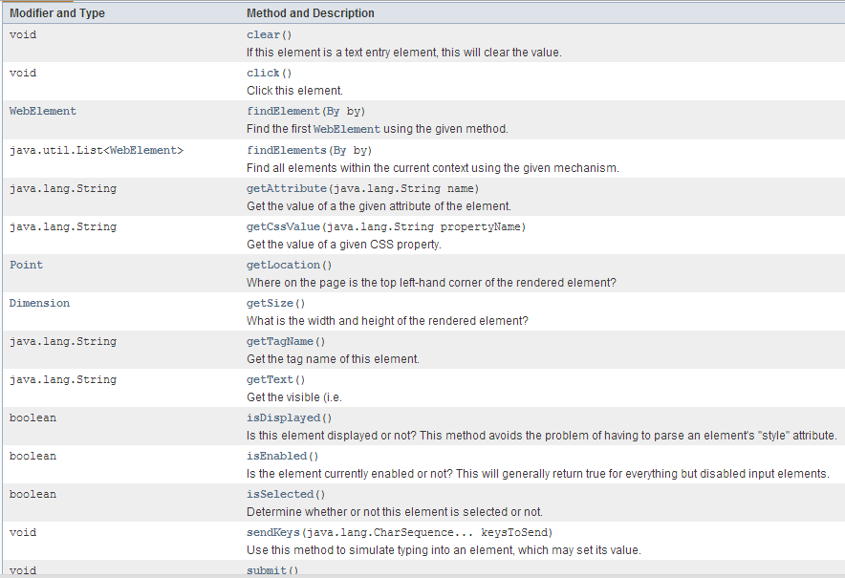
WebElement

Slide 11
Thank You

