Slide 1
FoodWise

Slide 2
1/3 food wasted
$1 Trillion+ loss
3.3 Billion kg CO₂
820 Million hungry

Slide 3
FoodWise is a smart food waste management platform that helps households and restaurants track inventory, log waste, and generate AI-powered recipes.
Household Users
Restaurant Owners
Admin Dashboard

Slide 4
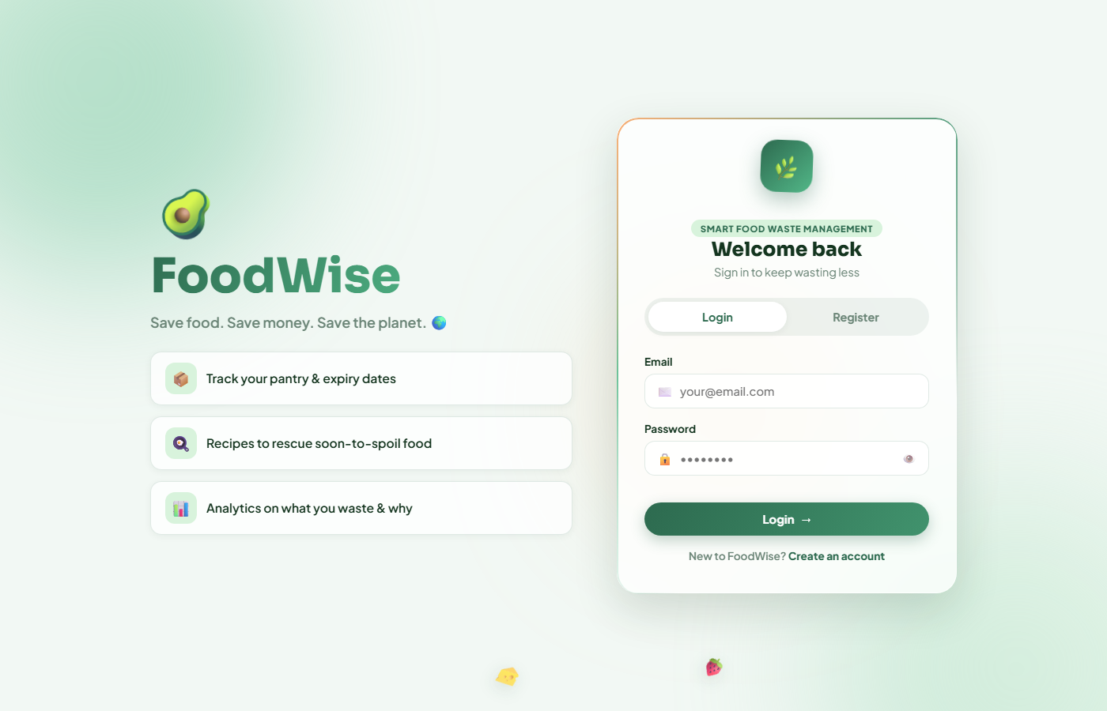
Login & Register

Slide 5
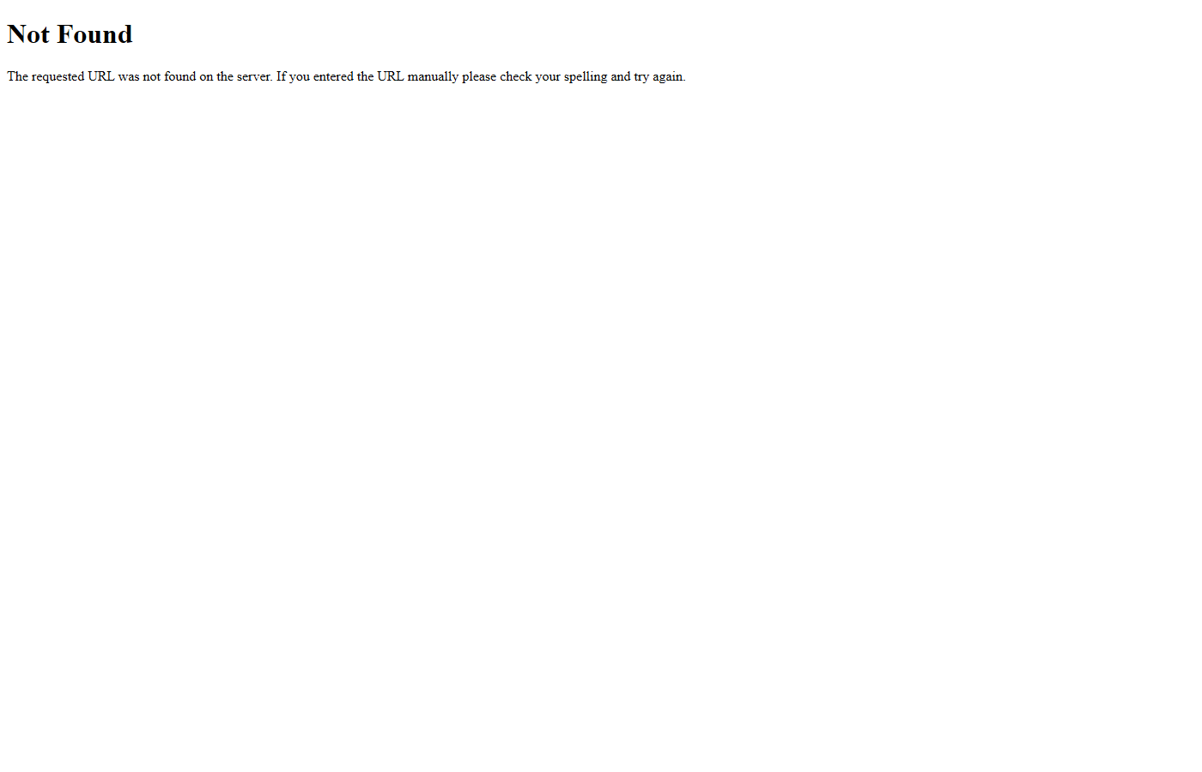
Smart Pantry + Status Badges

Slide 6
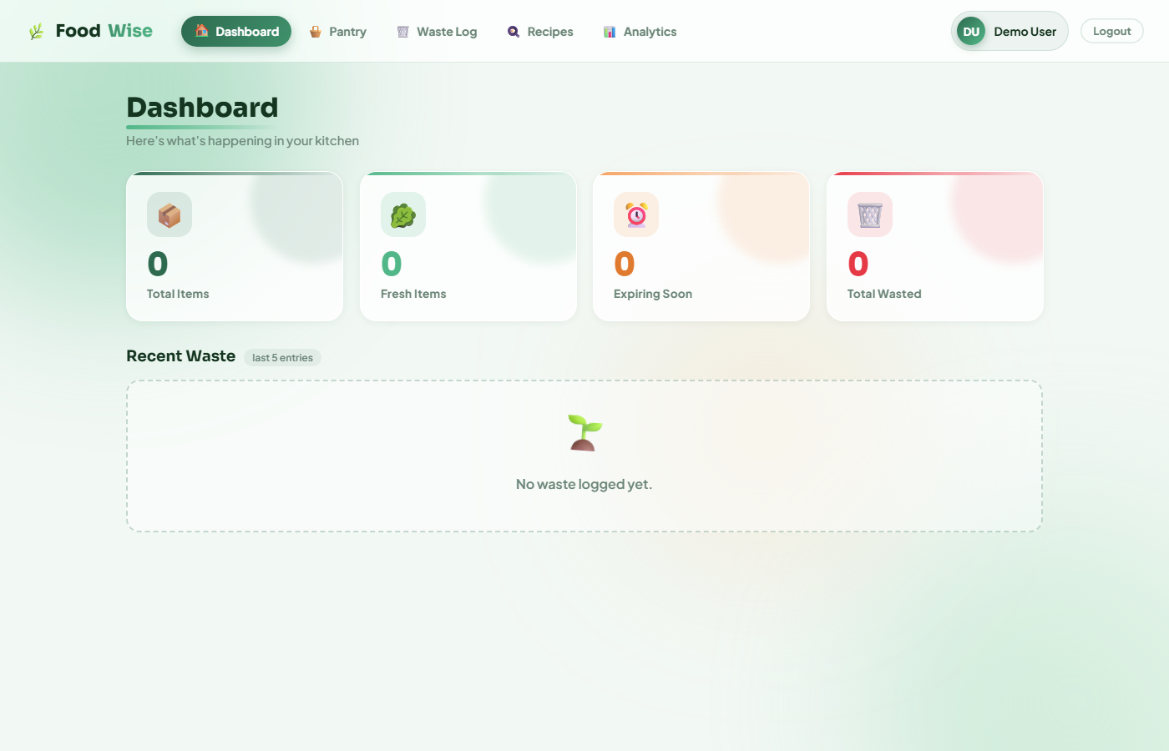
Live Dashboard

Slide 7
Waste Logging

Slide 8
Analytics Bento Dashboard

Slide 9
AI Recipe Generation

Slide 10
Tech Stack
Flask
Python web framework
SQLite
Embedded database
JWT
Secure auth tokens
HTML+JS
Vanilla frontend
SVG Charts
Bento analytics

Slide 11
Architecture: Browser → Flask → Routes → SQLite

Slide 12
Database Schema: users, food_items, waste_log, recipes
users (id, name, email, password, role)
food_items (id, user_id, name, category, quantity, expiry)
waste_log (id, item_name, quantity, reason, date)
recipes (id, name, ingredients, instructions)

Slide 13
Email expiry alerts
Barcode scanning
ML waste prediction
Community food sharing
Export reports
Mobile app

Slide 14
Thank You!

