Slide 1
IBM University Engagement Project Submission
“Exploring the Power of Agentic AI with IBM Granite and IBM Bob”

Slide 2
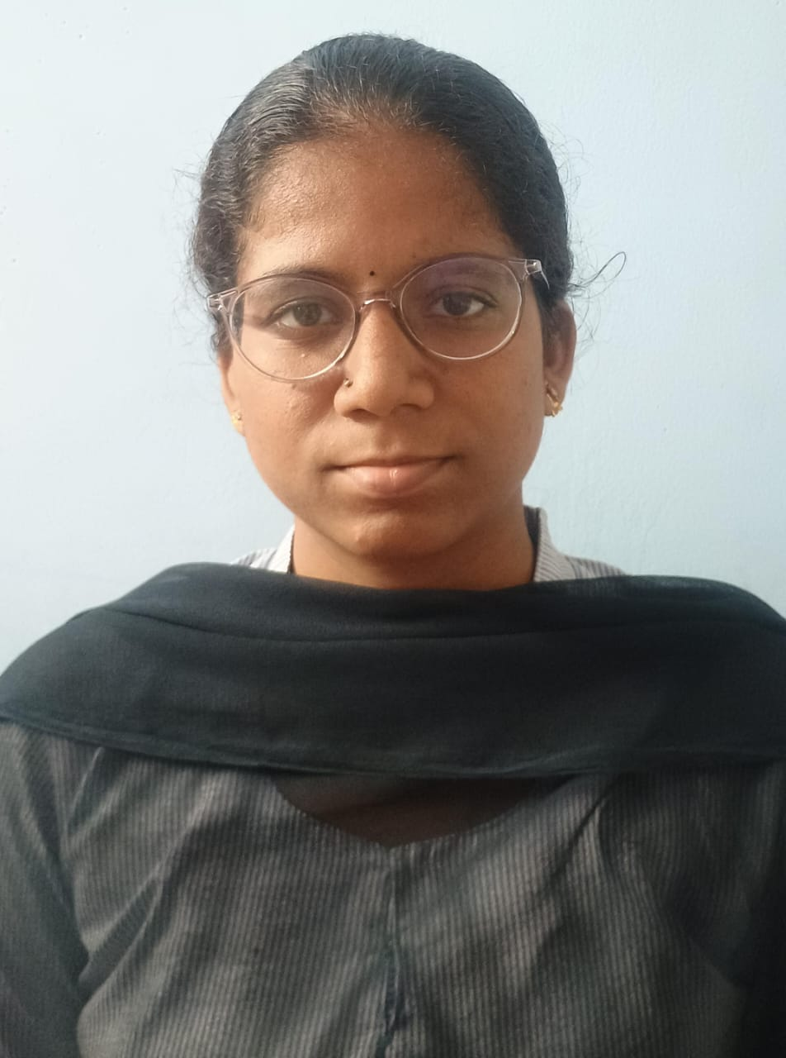
Project Tile – Improved Source of Drinking Water
Domain of Project –Data Analytics
Student Name | Recent Passport Photo | Email ID | Mobile number [WhatsApp]
RAJALA VENKATA LAKSHMI MOUNIKA |  | rajalavenkatalakshmimounika@gmail.com | 6302699182

Slide 3
Problem Statement -
Problem Statement : Improved Source of Drinking Water
The Challenge -
To analyse the availability and improvement of drinking water sources across rural and urban areas of India using historical data, and identify regional differences, trends, and factors associated with access to improved drinking water.
The Objective -
To develop a data analytics solution that analyses drinking water source availability and improvement across different regions of India. The solution should:
Water Access Analysis – Analyse access to improved sources of drinking water across different states and regions.
• Rural & Urban Comparison – Compare drinking water access between rural and urban areas.
• Trend Analysis – Identify changes and trends in drinking water access over different years.
• Regional Analysis – Identify regional variations and differences in drinking water availability.
• Socioeconomic Analysis – Analyse the relationship between water access and factors such as literacy, income, sanitation, and clean fuel.
• State-Level Insights – Identify states with higher and lower drinking water access and areas requiring improvement.
• Visualization Dashboard – Present key findings, trends, comparisons, and relationships using charts and visualizations.

Slide 4
Proposed Solution -
Proposed Solution: Improved Source of Drinking Water Analysis
The proposed solution is a data analytics-based drinking water analysis system developed using Python, Pandas, NumPy, Matplotlib, Seaborn, IBM Bob, and IBM watsonx.ai Runtime to analyse drinking water access and improvement across different regions of India. The system addresses challenges in understanding regional variations, rural–urban gaps, trends, and socioeconomic factors affecting access to improved drinking water.
At its core, the solution uses an Exploratory Data Analysis (EDA) pipeline to clean, process, analyse, and visualize drinking water data collected across different states, districts, years, and rural–urban categories. The system generates meaningful insights from the dataset and presents them through statistical analysis and visualizations.
The solution consists of the following key analysis components:
Water Access Analysis analyses the availability of improved drinking water sources across different states and regions.
Rural & Urban Comparison compares drinking water access between rural and urban areas and identifies the existing accessibility gap.
Trend Analysis examines changes in drinking water access over different years to identify improvement patterns.
Regional & State Analysis compares states and regions to identify areas with higher and lower levels of improved drinking water access.
Socioeconomic Analysis studies relationships between drinking water access and factors such as literacy, income, sanitation, and clean fuel availability.
Improvement Analysis identifies states and regions that show significant improvement or require further attention in providing improved drinking water sources.
The solution includes a visualization dashboard built using Streamlet that presents key findings, trends, state-level comparisons, rural–urban differences, and socioeconomic relationships through interactive charts and graphs.
IBM Bob is used to assist in project development, code generation, debugging, documentation, analysis, and validation. IBM watsonx.ai Runtime is used to connect the project with IBM Cloud resources and support the cloud-based project workflow.

Slide 5
Technology Used
• IBM Bob Platform – For assisting in project development, generating analysis code, debugging, documentation, and validating the data analytics workflow.
• Python – For data processing, statistical analysis, and implementation of the overall data analytics workflow.
• Pandas & NumPy – For data cleaning, preprocessing, manipulation, and numerical analysis of the drinking water dataset.
• Matplotlib & Seaborn – For creating charts, graphs, comparisons, and visualizing drinking water trends and patterns.
• IBM Cloud – Provides the cloud environment and IBM services required to connect and support the project workflow.
• IBM watsonx.ai Runtime – Used to connect the project with IBM Cloud and support the cloud-based AI/data analytics workflow.
• Stream lit – Used to develop an interactive visualization dashboard for presenting key findings, trends, state comparisons, and rural–urban differences.
• CSV Dataset – Used as the primary data source containing drinking water access information across states, districts, years, and rural/urban categories.

Slide 6
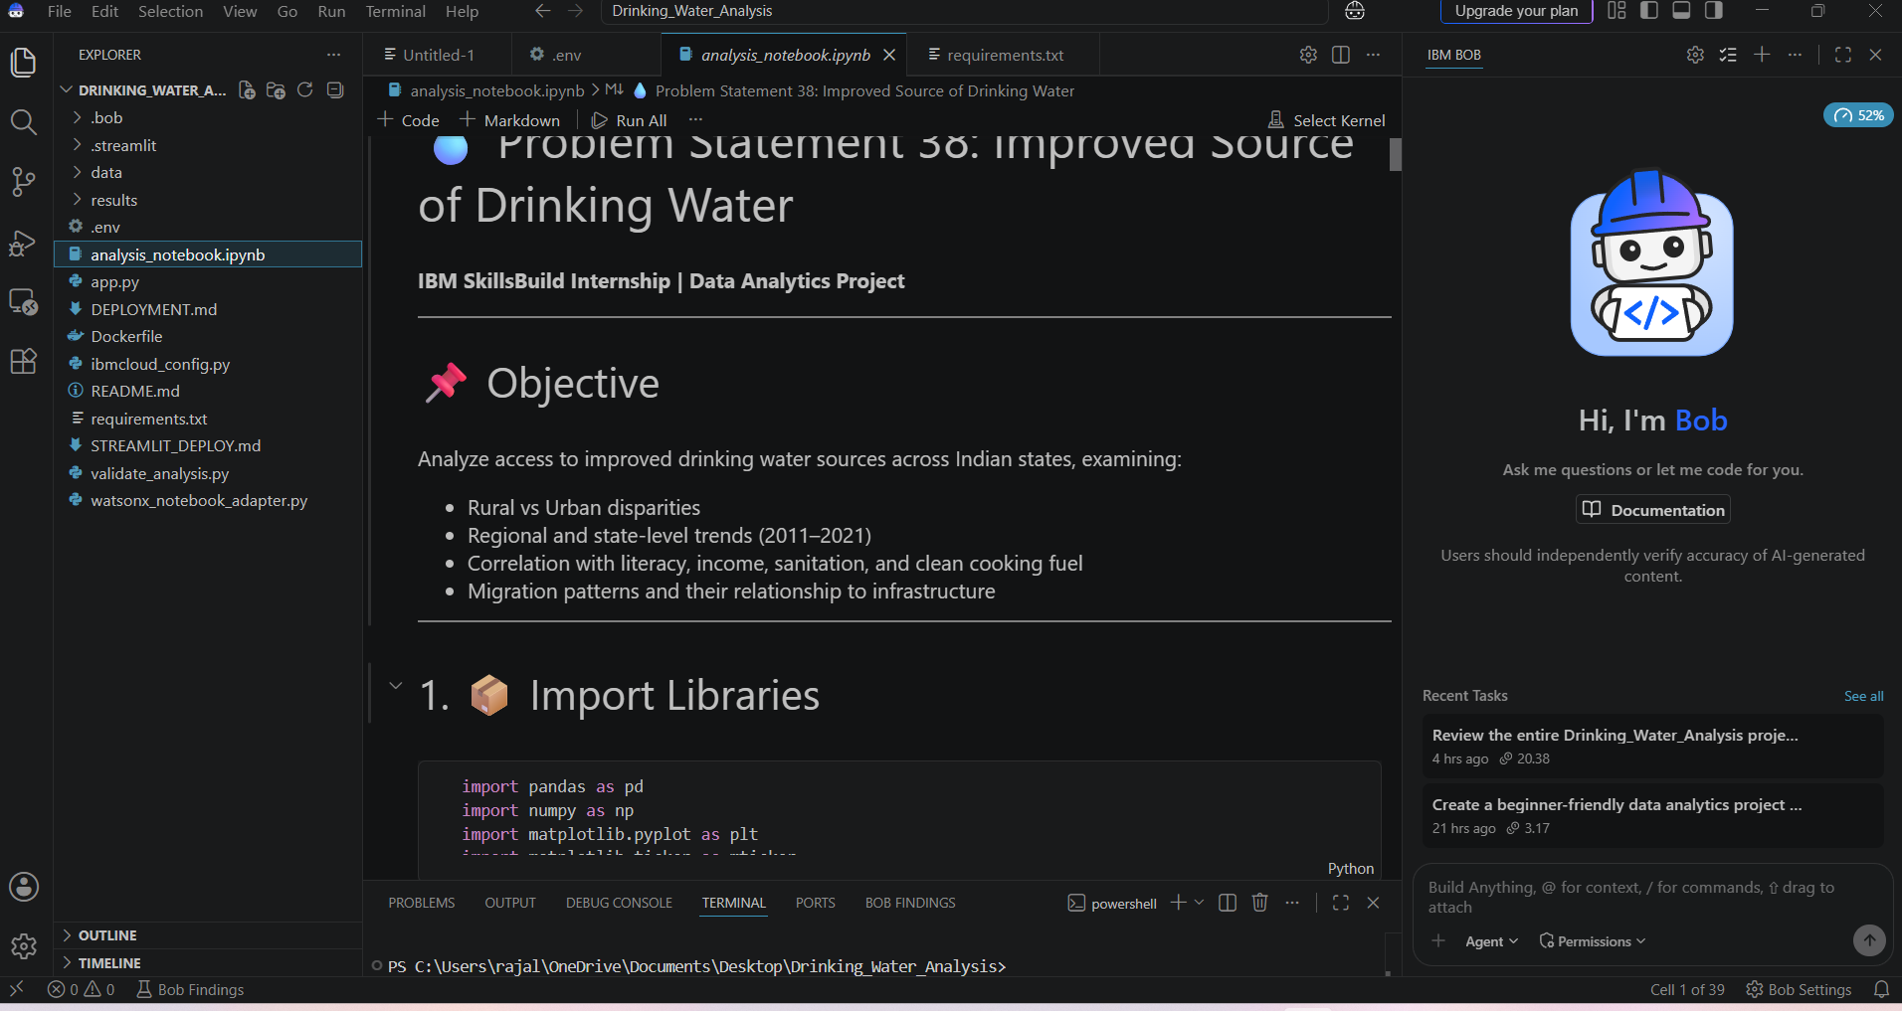
Required Files created using IBM bob -

Slide 7
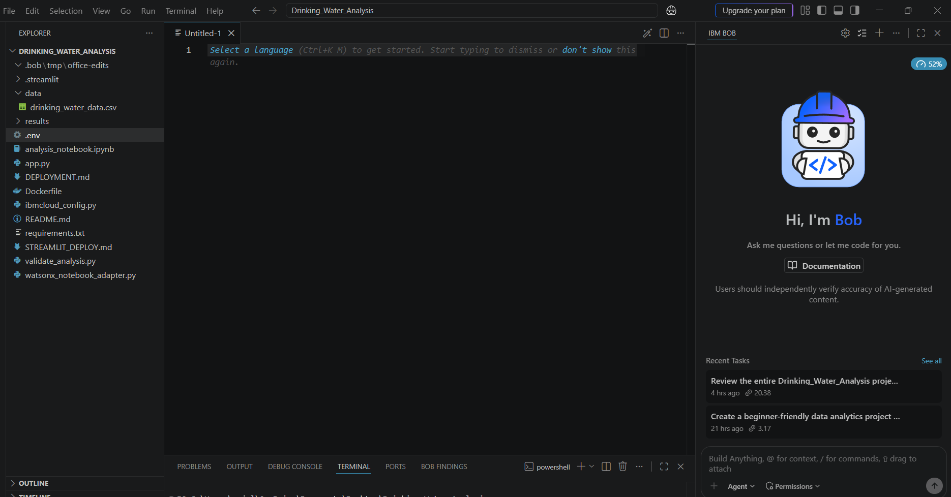
IBM Bob Screenshots:

Slide 8
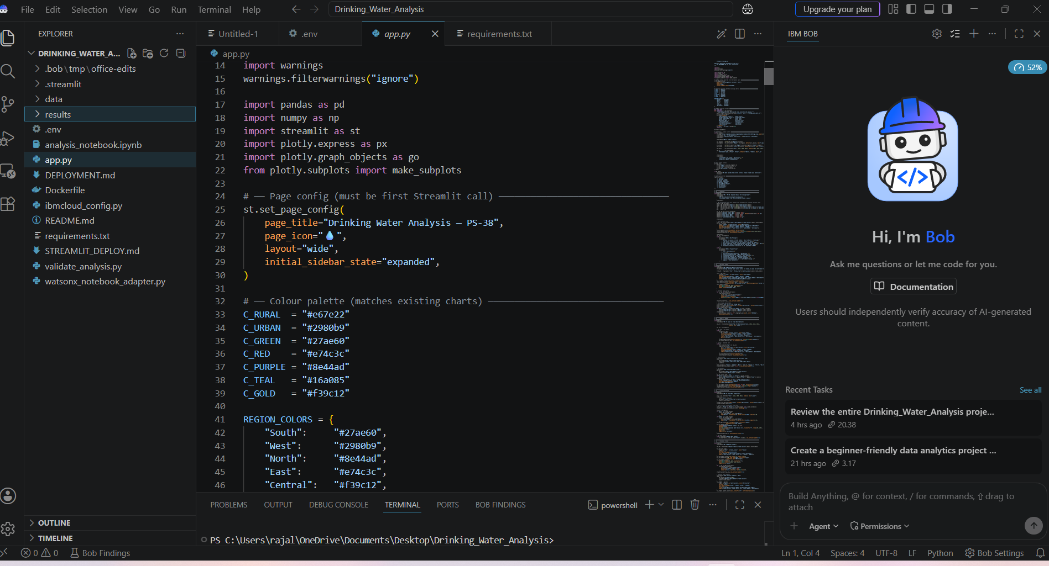
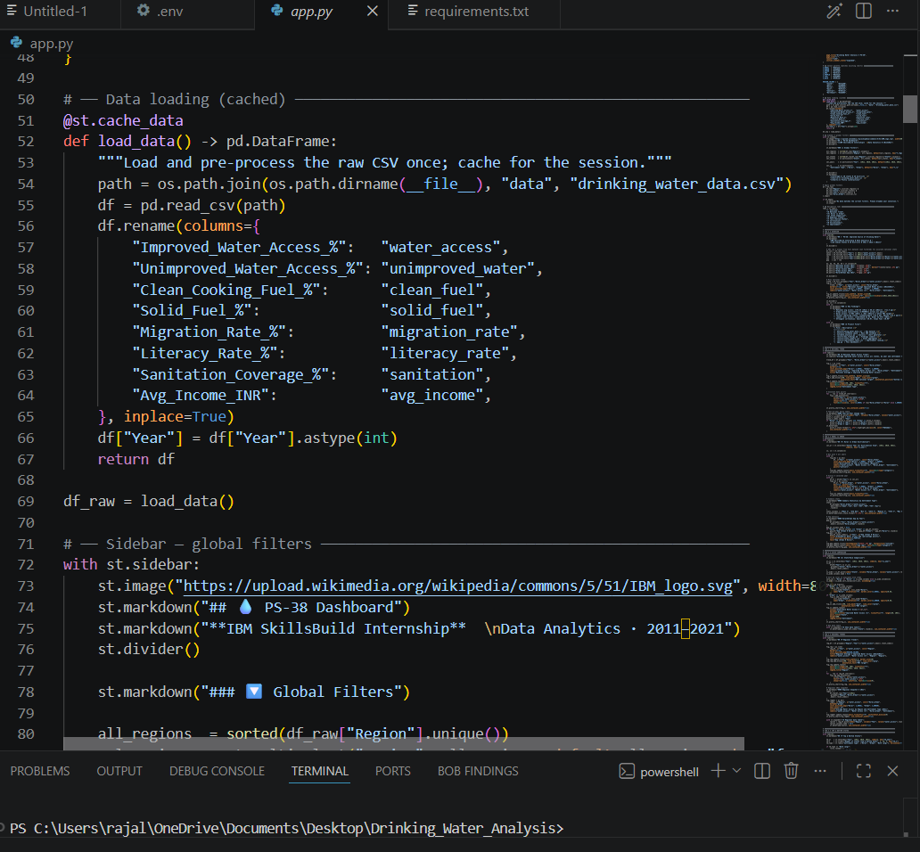

Slide 9
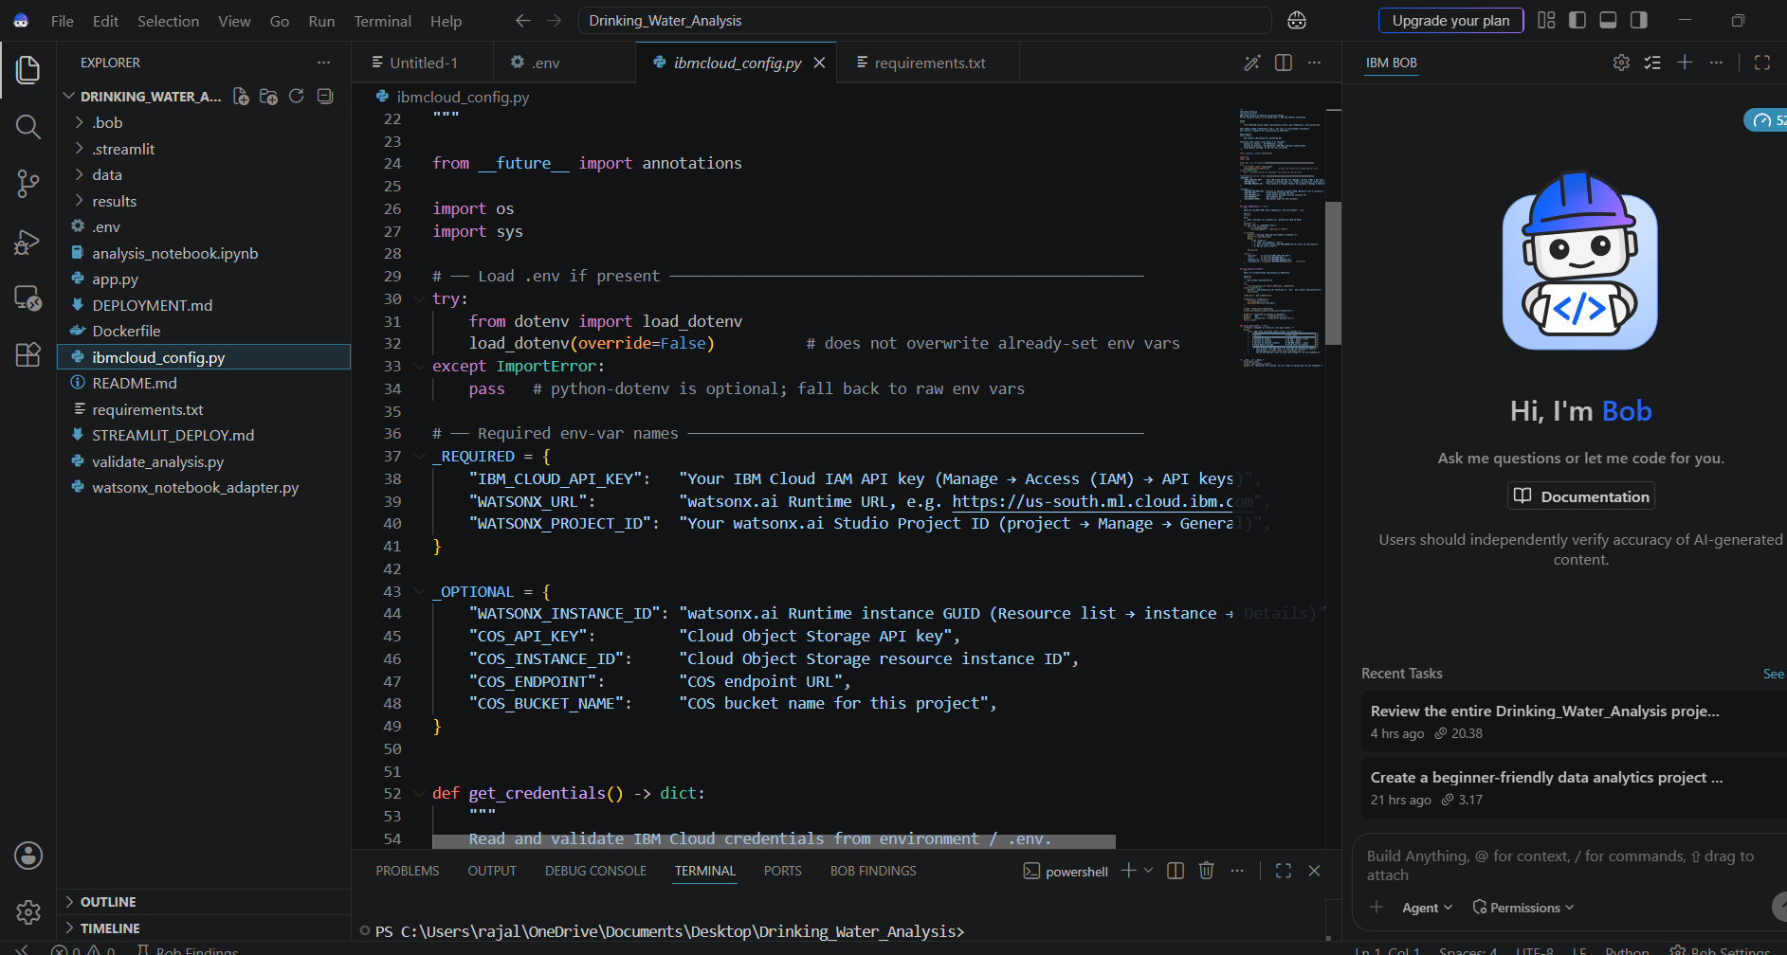
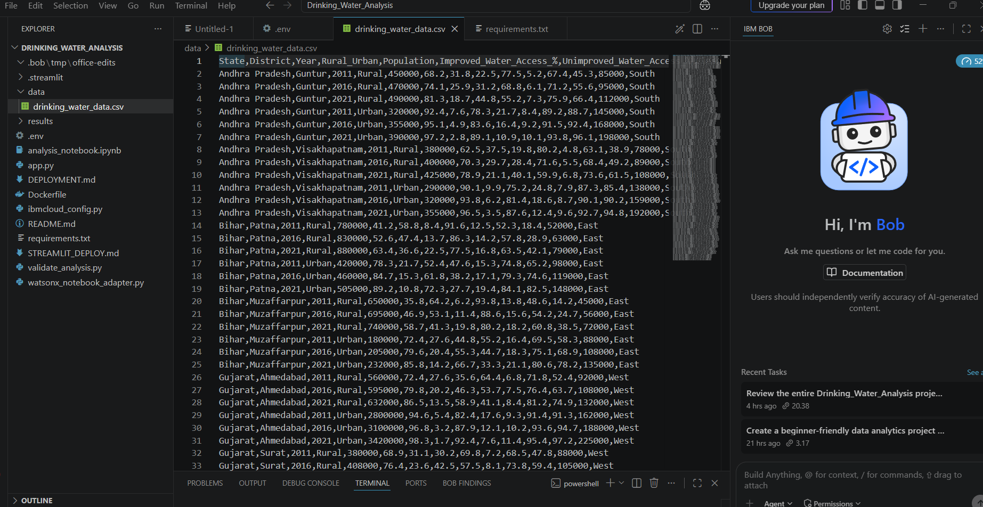

Slide 10
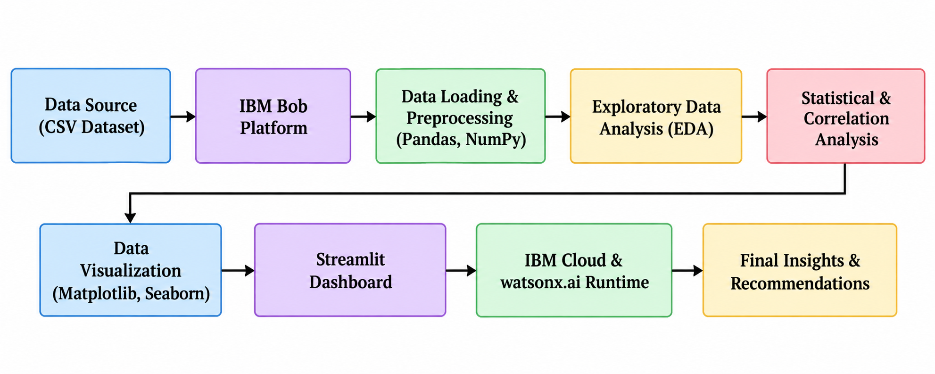
Architecture blueprint for IBM bob:

Slide 11

Role of Agentic AI in the solution
Role of Agentic AI in Improved Source of Drinking Water
Agentic AI enables the project development process to be more intelligent and efficient by assisting with data analysis, code generation, debugging, validation, and documentation. IBM Bob acts as an intelligent development assistant that supports different stages of the drinking water analysis workflow.
IBM Bob helps in data analysis and processing by generating Python code for loading, cleaning, transforming, and analyzing the drinking water dataset.
It supports automated problem solving and debugging, helping identify coding errors and suggesting appropriate solutions during project development.
Agentic assistance is also used for exploratory data analysis, including rural–urban comparison, state-level analysis, trend identification, and correlation analysis.
The system uses context-aware assistance to understand the project requirements and generate relevant analysis, visualizations, documentation, and project files.
Agentic AI also supports workflow efficiency, allowing different project tasks such as analysis, visualization, validation, and documentation to be completed systematically.
Overall, the use of IBM Bob and agentic assistance makes the solution more efficient, structured, and goal-oriented, helping transform raw drinking water data into meaningful insights and data-driven recommendations.

Slide 12
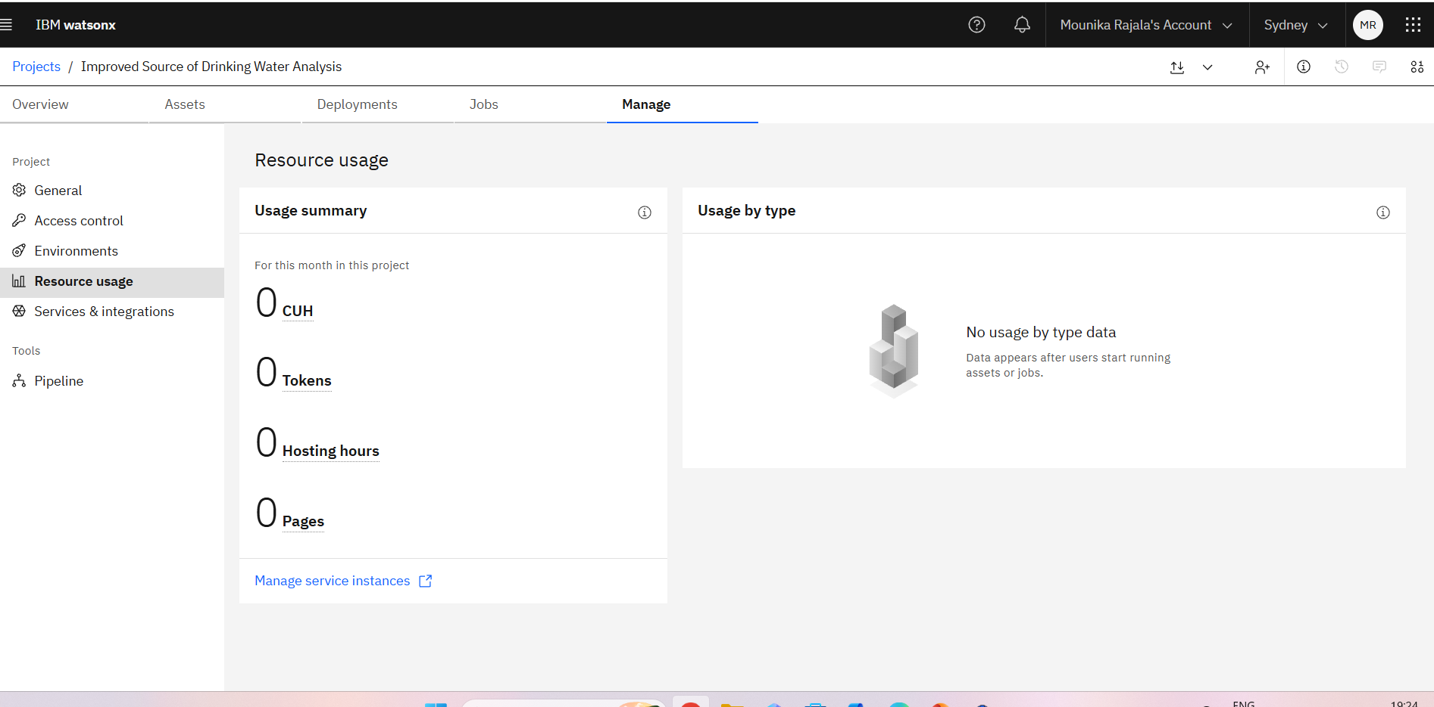
Token Usage
11,761 token are used
Before Prompt
After the Prompt
·
·
·

Slide 13
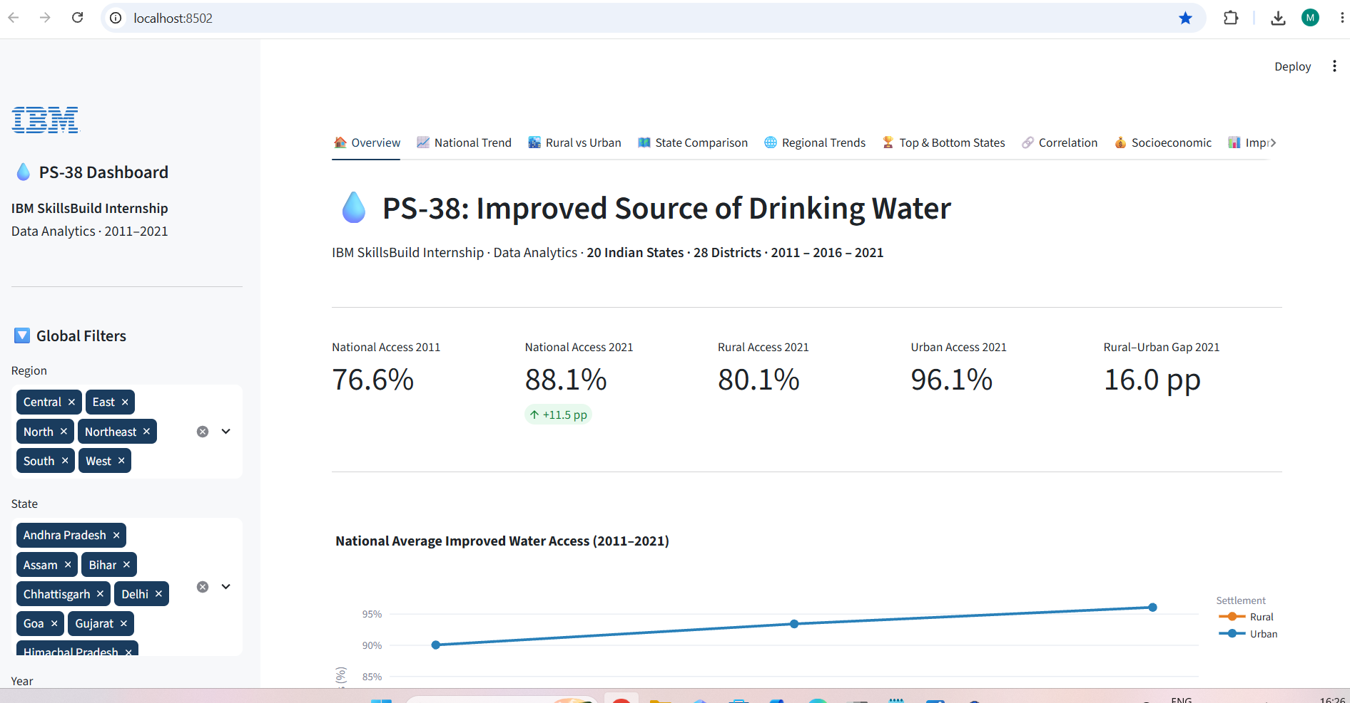
Project Output Screenshot
·
·
·

Slide 14
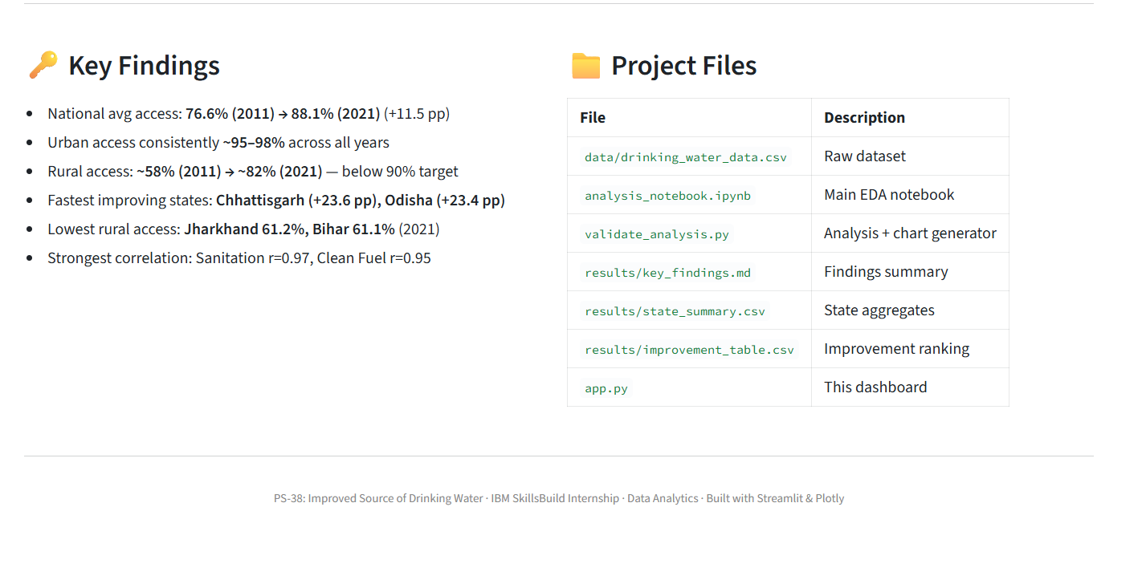
Project Output Screenshot
Please put IBM Bob output screenshots with 2-3 prompts.
You can take 2-3 more slides for each screenshot
·
·
·

Slide 15
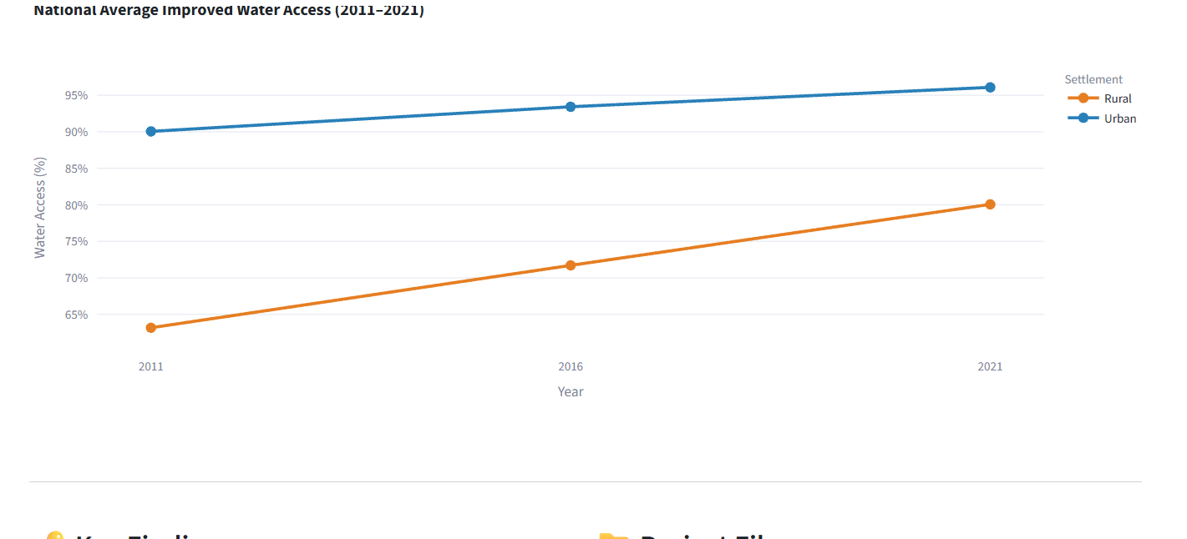
Project Output Screenshot
Please put IBM Bob output screenshots with 2-3 prompts.
You can take 2-3 more slides for each screenshot
·
·
·

Slide 16
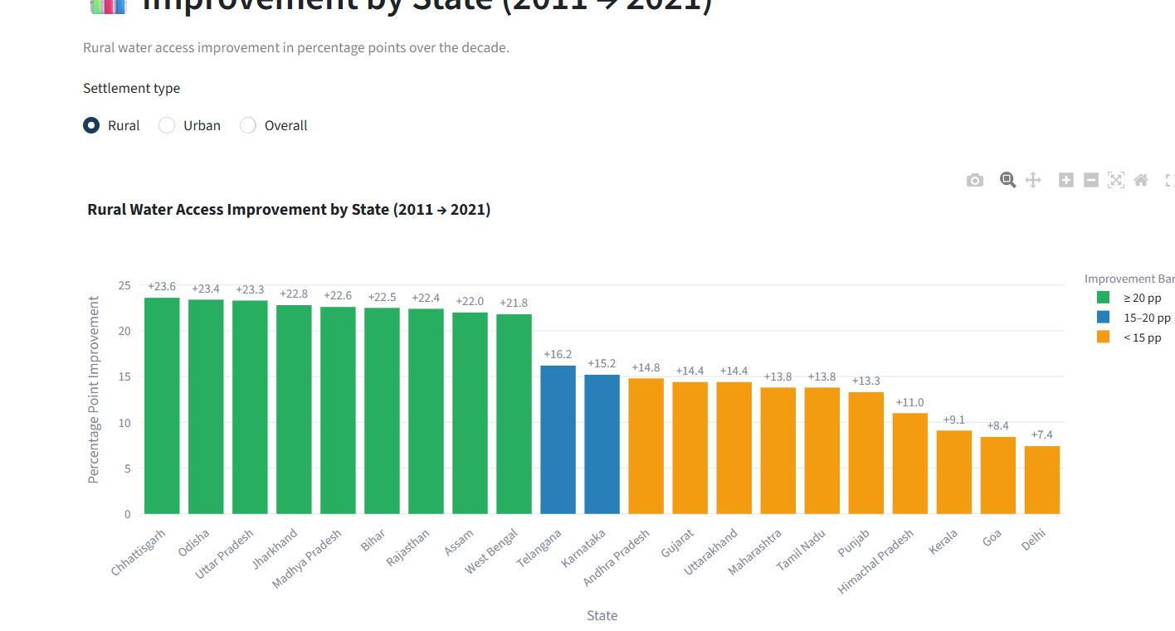

Slide 17
Novelty and Uniqueness-
The proposed Improved Source of Drinking Water Analysis stands out by combining comprehensive data analytics, regional comparison, trend analysis, and socioeconomic insights into a single analytical solution.
Multi-Dimensional Analysis – Analyses drinking water access from multiple perspectives, including state, district, rural–urban, regional, and year-wise comparisons.
Rural–Urban Gap Analysis – Identifies differences in drinking water access between rural and urban populations and highlights accessibility gaps.
Trend-Based Insights – Examines changes across different years to identify improvement patterns in access to improved drinking water sources.
Socioeconomic Relationship Analysis – Studies relationships between water access and factors such as literacy, income, sanitation, and clean fuel availability.
State-Level Comparison – Identifies high-performing and low-performing states and helps highlight regions requiring further improvement.
Interactive Visualization – Presents complex analytical results through charts and an interactive Stream lit dashboard, making insights easier to understand.
AI-Assisted Development – Uses IBM Bob for code generation, debugging, analysis assistance, validation, and documentation.
Cloud Integration – Connects the project with IBM watsonx.ai Runtime and IBM Cloud, providing a foundation for future cloud-based enhancements.
This makes the solution a data-driven, interactive, and scalable drinking water analysis system, rather than a simple static statistical report.

Slide 18
Git Hub Link-
https://github.com/mounika26-prog/Improved-Source-of-Drinking-Water
·
·
·

Slide 19
Future Scope
1. Real-Time Government & Public Data Integration –
The system can be integrated with updated government and public datasets to continuously monitor drinking water access and identify newly emerging regional gaps. This will help provide more current and reliable insights for planning and decision-making.
2. AI-Powered Predictive Analysis –
The system can be enhanced with machine learning and AI techniques to predict future drinking water access trends and identify regions that may require additional attention or resources.
3. GIS & Location-Based Visualization –
Integration with GIS and interactive maps can help visualize drinking water accessibility at state, district, and local levels, making it easier to identify underserved regions geographically.
4. Multilingual & Voice-Based Access –
Adding multilingual and voice-based interaction can make the system more accessible to users and decision-makers from different linguistic backgrounds.
·
·
·

Slide 20
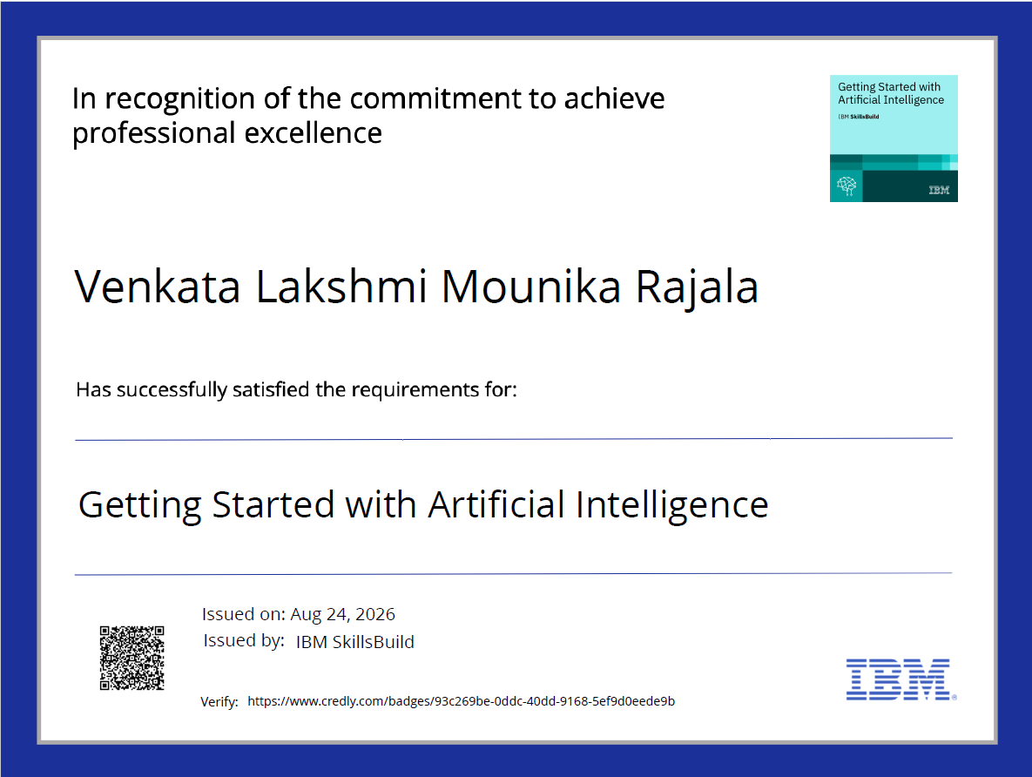
Certificates Earned:
Getting Started with Artificial Intelligence

Slide 21
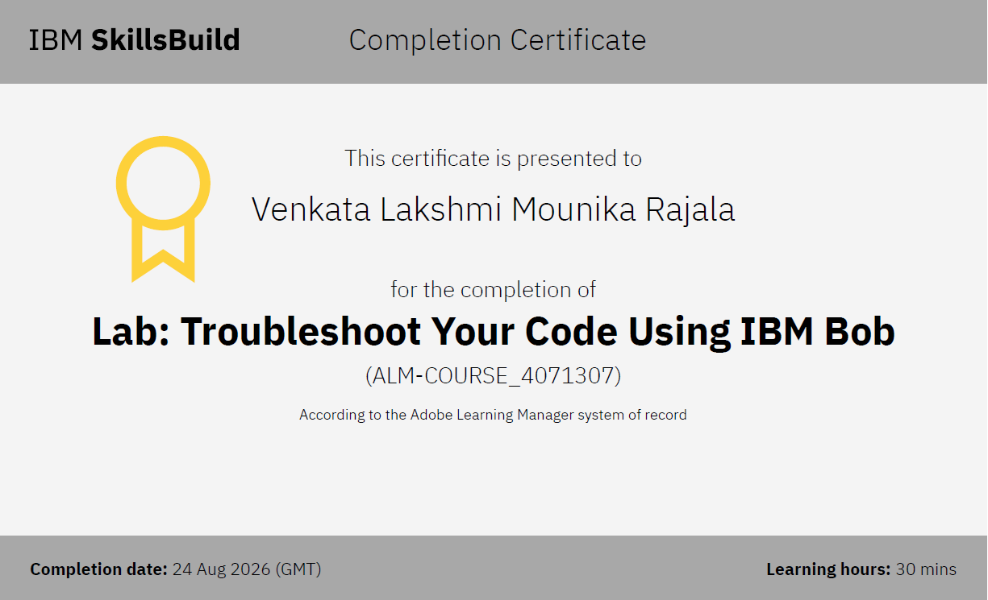
Certificates Earned:​
IBM BOB Certificate

Slide 22


