Slide 1
Sales Dashboard Summary
Interactive Dashboard Insights

Slide 2
Key Metrics
• Total Sales: 2.33M
• Maximum Profit: 8.40K
• Average Discount: 0.16
• Total Quantity Sold: 39K

Slide 3
Sales Breakdown
• Sales by Sub-Category and Year (2020–2023 trend observed).
• Sales by Category: Furniture (32.44%), Office Supplies (31.46%), Technology (36.1%).

Slide 4
Customer Insights
• Top Customers by Sales:
- Adrian Barton - 14.47
- Christopher Conant - 12.12
- Hunter Lopez - 12.87
- Ken Lonsdale - 14.17
- Raymond Buch - 15.11
- Carlos Cloud - 15.07

Slide 5
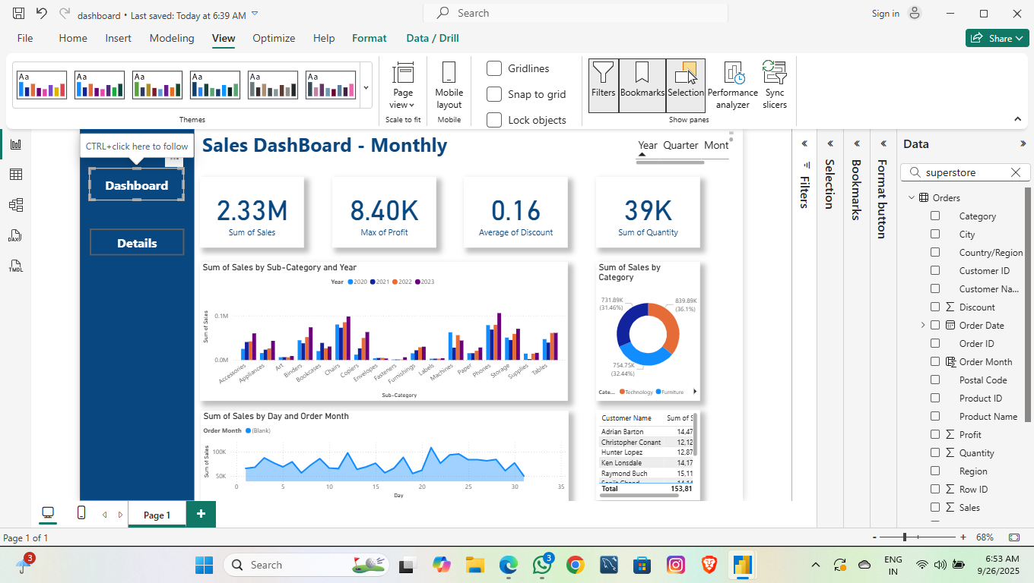
Interactive Dashboard View

Slide 6
Visual Metrics Overview
2.33M
8.40K
0.16
39K
Total Sales
Max Profit
Avg Discount
Quantity Sold

