Slide 1
AI-Based Customer Recommendation System
Hackathon 2025 Solution Overview

Slide 2

Problem Statement
• Analyze customer demographics, transactions & social media.
• Generate personalized product/service suggestions.
• Support new and existing customers.
• Enable multimodal (voice, image) input-based Q&A.

Slide 3
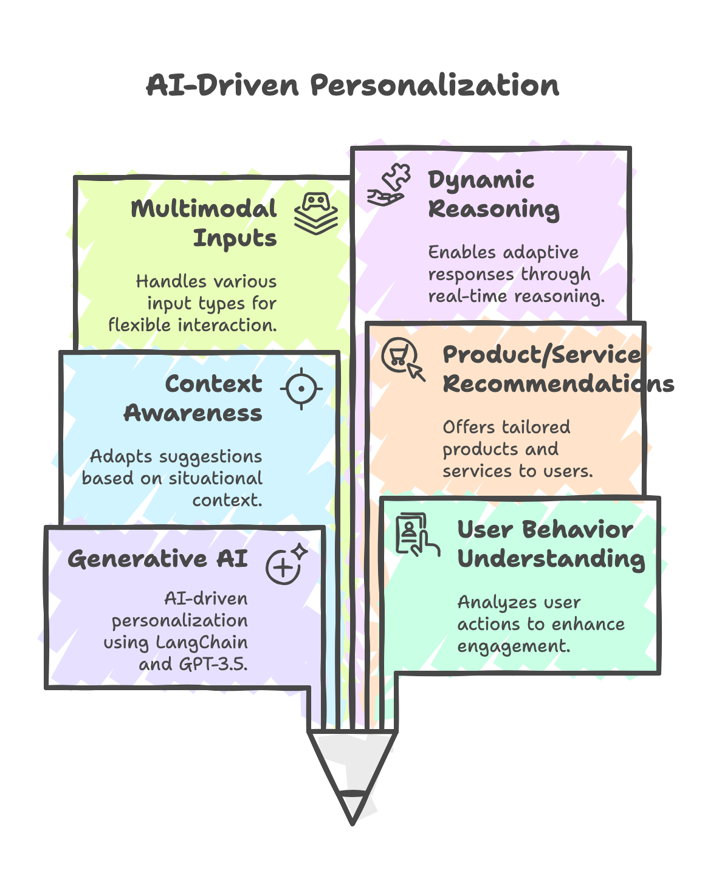
Solution Overview
• Built using Generative AI (LangChain + GPT-3.5).
• Understands user behavior & context.
• Suggests relevant products/services & content.
• Supports multimodal inputs and dynamic reasoning.

Slide 4
Tech Stack
Layer | Tools Used
LLM Integration | LangChain, OpenAI GPT-3.5
UI | Streamlit
Data Processing | Pandas, JSON, Sentence Transformers
Audio Input | SpeechRecognition, SoundDevice
OCR Input | PaddleOCR

Slide 5
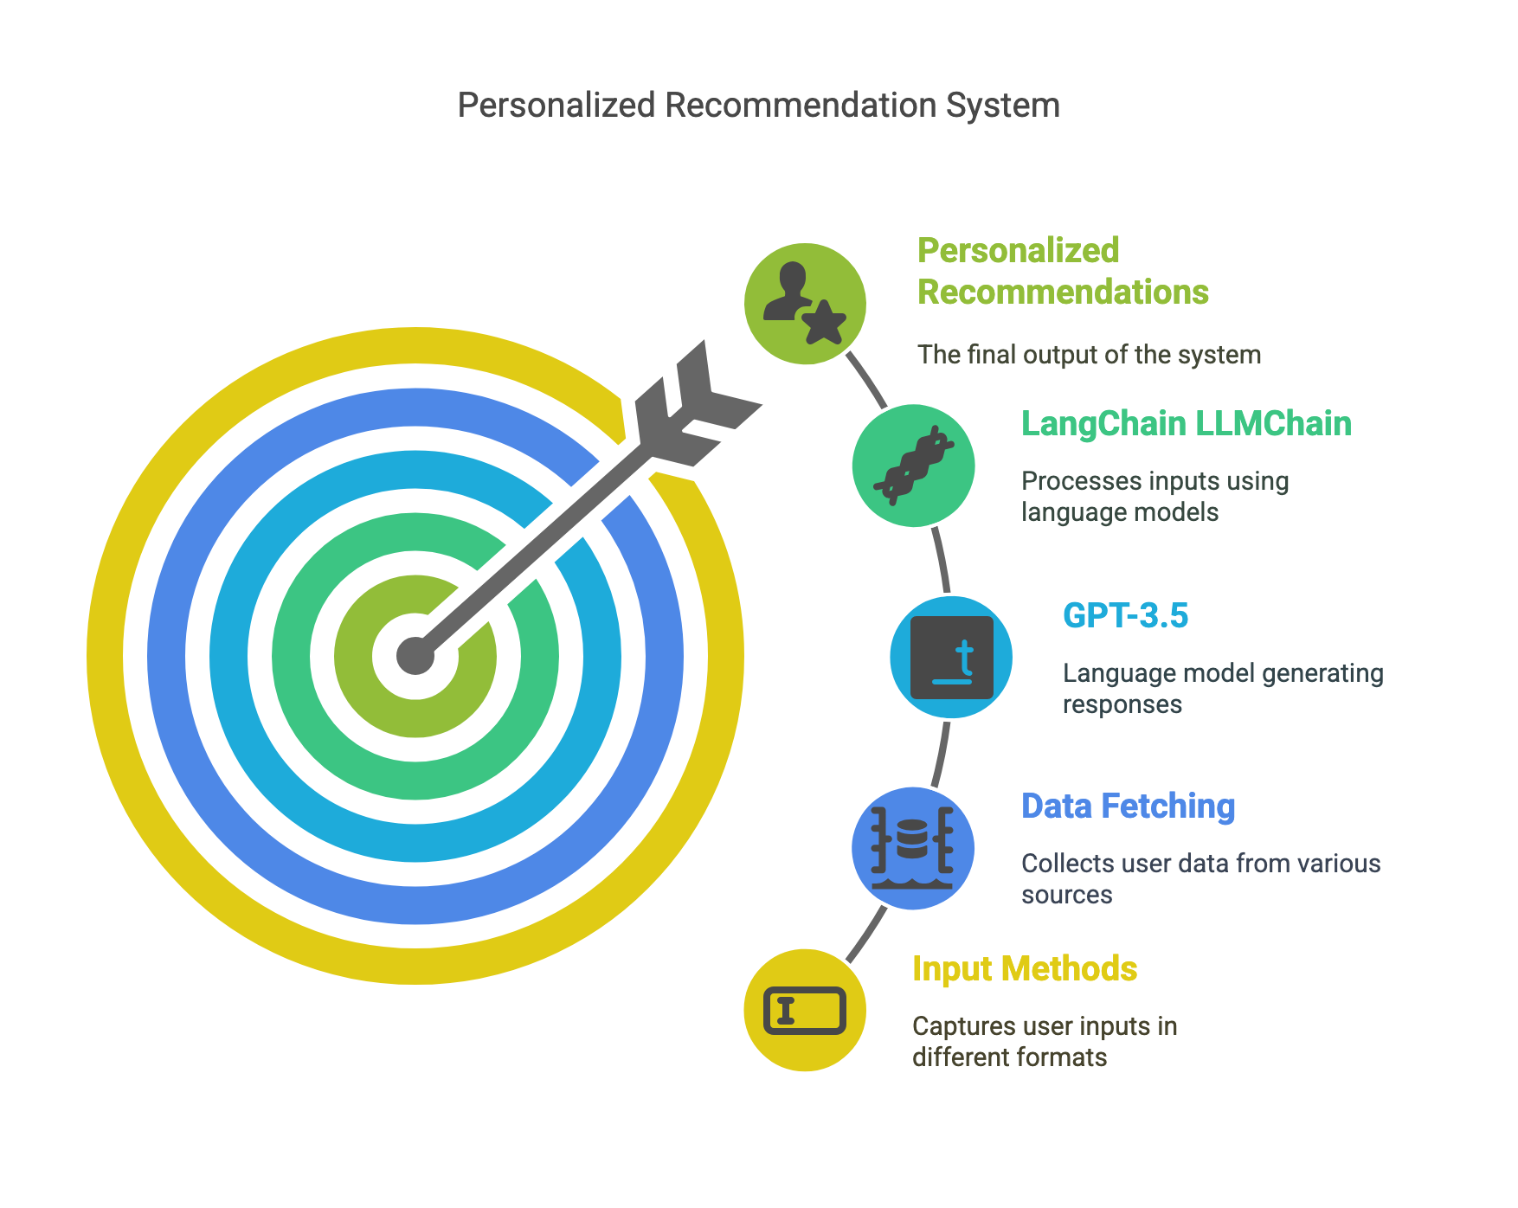
How it works ?
Architecture Diagram - visual selection.png

Slide 6
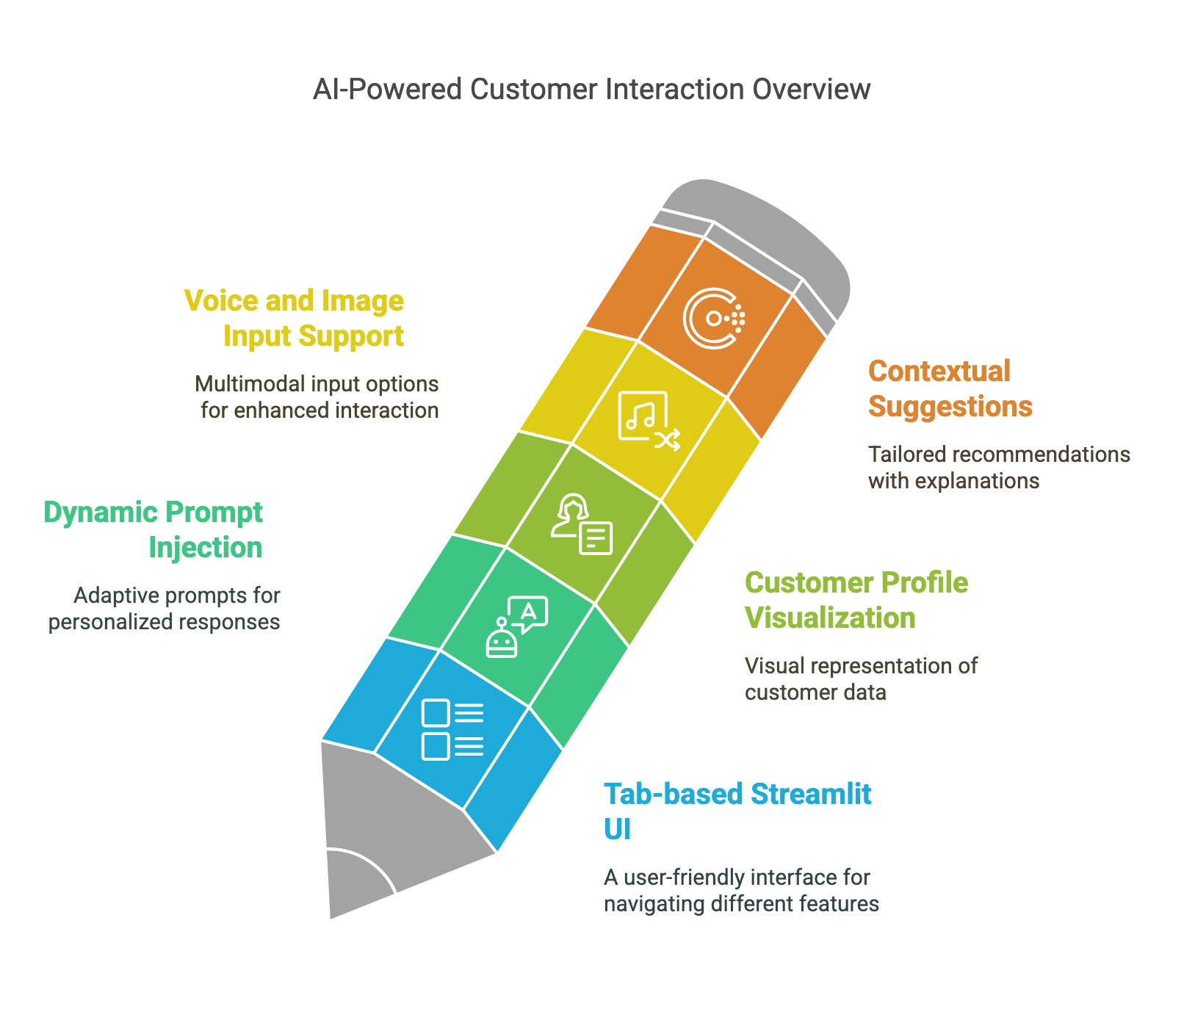
Key Features

Slide 7
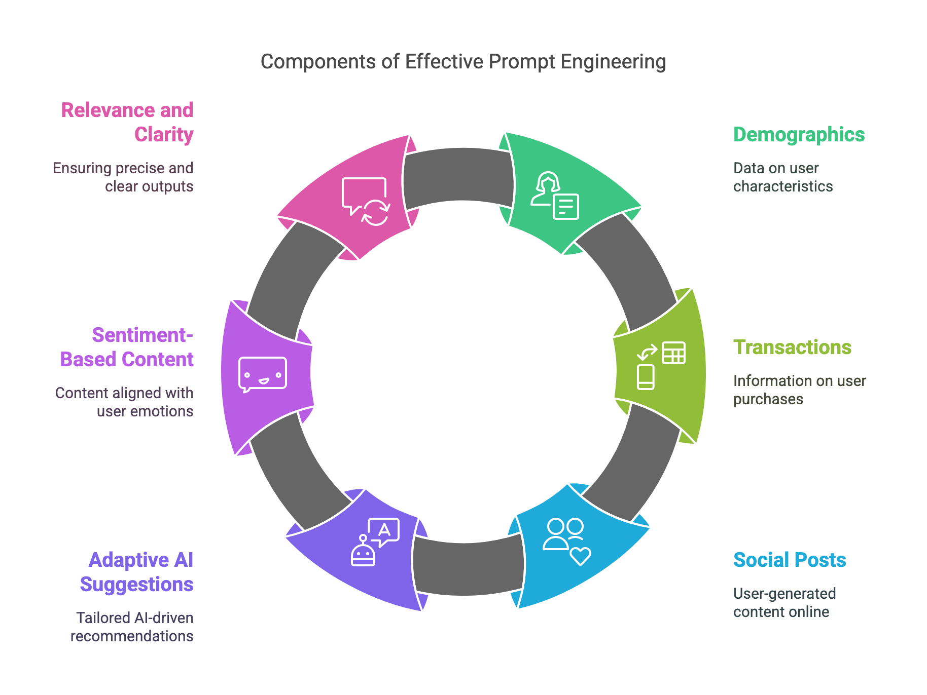
Prompt Engineering
• Combined demographics, transactions, and social posts.
• Structured output: Adaptive, AI suggestions, sentiment-based content.
• Prompt format ensured relevance and clarity in recommendations.

Slide 8
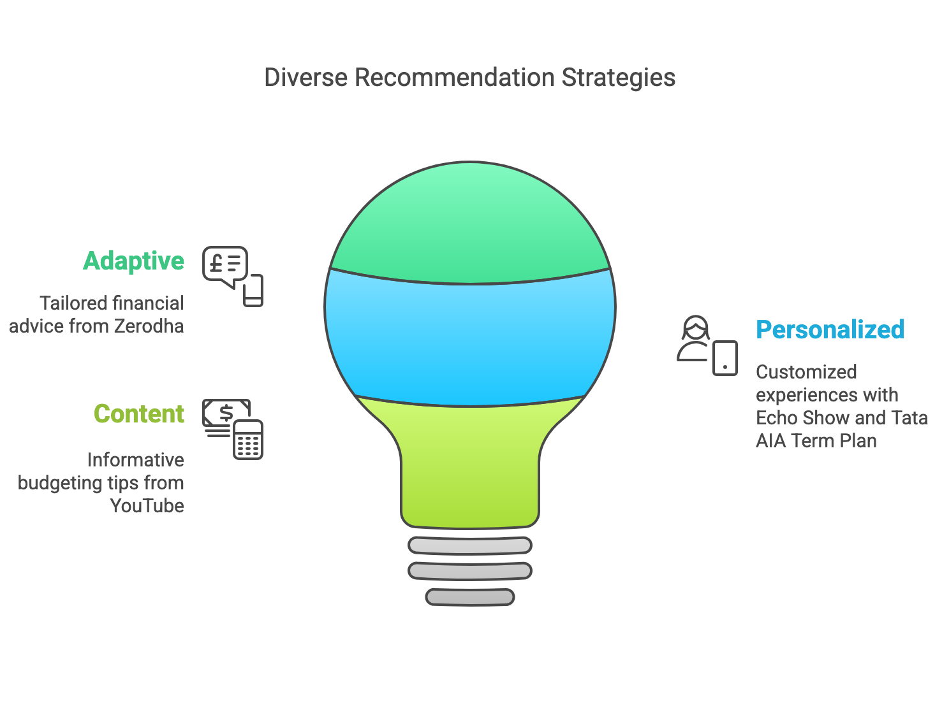
Sample Recommendations

Slide 9
Challenges & Solutions
Challenge | Solution
Prompt tuning | Structured LangChain template
Structured rendering | Markdown + HTML in Streamlit
Voice & OCR input | Used SpeechRecognition & PaddleOCR
Token limits | Summarized fields and reduced payload

Slide 10
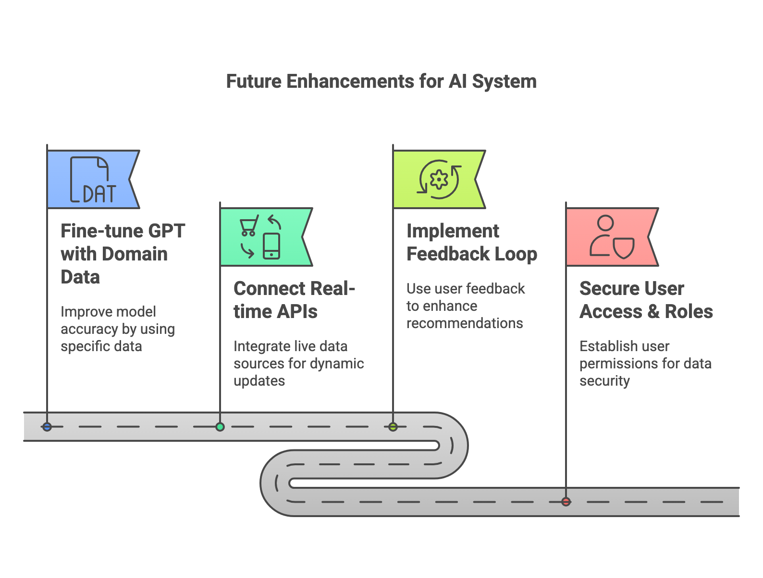
Future Enhancements
• Fine-tune GPT with domain data
• Connect real-time APIs (e.g., e-commerce)
• Feedback loop for improving recommendations
• Secure user access & roles

