Slide 1

AI-Driven Campus Placement Registration and Resume Matching Platform with Job Recommendation Engine
Automating student registration, resume analysis, candidate-job matching, and personalized job recommendations through Artificial Intelligence and Machine Learning
Student Registration
Resume Analysis
Automated onboarding and profile capture
AI-driven parsing and skill extraction
Candidate-Job Matching
Job Recommendation Engine
Intelligent fit scoring and ranking
Personalized role suggestions for students
DANDI MOUNIKA 324129510015

Slide 2

Introduction: Campus Placement Management
What is Campus Placement?
Why Automation Matters
A structured process connecting students with recruiters through registration, resume screening, eligibility verification, and job matching — coordinated by institutional placement cells.
Manual processes are time-consuming, human-dependent, and inconsistent. AI and NLP enable automated resume parsing, skill extraction, eligibility verification, and intelligent job recommendations at scale.
Student Registration
Resume Screening
Tracks placement participation and maintains centralized candidate information across departments.
Identifies relevant skills, qualifications, and experience from candidate profiles systematically.
Eligibility Verification
Job Matching
Ensures candidates meet academic and professional requirements specified by recruiters.
Aligns student capabilities with recruiter requirements to identify suitable opportunities.
The Role of AI and NLP: Automate resume parsing, extract skills, verify eligibility, and provide intelligent job recommendations at scale — overcoming the core limitations of manual placement processes.

Slide 3
Problem Identification: Challenges in Traditional Placement
Registration & Screening Bottlenecks
Generic Recommendations
Manual student registration is time-consuming and error-prone. Resume screening requires significant manual effort for large candidate pools, making it impractical without automated support.
Job recommendations are generic rather than personalized. Traditional placement systems offer limited personalization, reducing the quality of opportunity discovery for students.
Inconsistent Evaluation
Decentralized Information
Manual eligibility verification is repetitive and inconsistent. Identifying suitable candidates manually is inefficient and subjective, leading to unreliable shortlisting outcomes.
Centralized placement information is difficult to maintain across departments, leading to fragmented records and coordination challenges for placement officers.
Skill Comparison Difficulty
Limited Analytics
Comparing student skills with job requirements efficiently is difficult without structured data. Relevant skills are buried in unstructured resume text with no automated extraction.
Traditional systems provide limited analytics for data-driven placement decision-making, preventing institutions from identifying trends or improving placement outcomes systematically.

Slide 4

Existing System: Traditional Campus Placement Process
Resume Collection
Eligibility Check
Manual Registration
Manual Screening
The conventional placement workflow relies entirely on human effort at every stage — from collecting paper or email-based resumes to manually verifying eligibility criteria and maintaining spreadsheet records.
Time-Intensive
Human-Dependent
Volume Constraints
No Personalization
Labor-intensive processes at every stage slow down placement cycles significantly.
Evaluation quality varies by reviewer, introducing inconsistency in candidate assessment.
Processing large resume volumes efficiently is not feasible without automated tooling.
Limited personalized job recommendations; candidates receive generic opportunity lists.
Fragmented Data
No Real-Time Insights
Recruitment information is decentralized across multiple systems and departments.
Limited real-time placement analytics prevents data-driven institutional decision-making.

Slide 5
Proposed System: AI-Driven Placement Platform
Core Advantage: A centralized, intelligent platform automating the entire placement workflow — from student registration through personalized job recommendations — serving students, placement officers, and recruiters through role-specific dashboards.
Student-Facing Components
Institutional & Recruiter Components
Automated student registration and profile creation
Resume upload and automated parsing
NLP-based text processing and skill extraction
Academic information and certification analysis
Project experience analysis
Personalized job recommendation engine
Recruiter requirement analysis and job posting
Automated eligibility verification
Resume-job matching with matching score generation
Interactive dashboards for all stakeholder roles
Comprehensive placement and recruitment analytics
1
2
Register
Parse
Student registers and creates profile
Resume uploaded and parsed via NLP
3
4
Match
Recommend
Skills matched against job requirements
Personalized job recommendations delivered

Slide 6
System Architecture and Data Flow
Complete Processing Pipeline: Each stage processes student and job data to create structured candidate profiles, compare them with job requirements, generate matching scores, and deliver personalized recommendations through role-specific dashboards.
01
02
Student Registration → Profile Creation
Resume Upload → Resume Parsing
Student submits registration details; system creates a structured candidate profile for downstream processing.
Student uploads resume document; parser extracts raw text content for NLP processing.
03
04
NLP Text Processing → Skill & Qualification Extraction
Eligibility Verification
Natural Language Processing converts unstructured resume text into structured skill, certification, and experience data.
Extracted academic and qualification data is compared against recruiter-defined eligibility criteria automatically.
05
06
Recruiter Job Requirements Analysis
Candidate-Job Matching → Score Generation
Recruiter-submitted job descriptions are analyzed to identify required skills, qualifications, and experience levels.
Matching algorithm compares candidate profiles with job requirements and generates a numerical matching score.
07
08
Job Recommendation Engine
Interactive Dashboards & Analytics
Recommendation engine ranks and presents personalized job opportunities based on candidate profile alignment.
Role-specific dashboards for students, placement officers, and recruiters; comprehensive placement analytics and reporting.

Slide 7

Resume Processing and Skill Extraction
1
Resume Upload and Parsing
1
Academic and Certification Analysis
Students upload resumes; the system extracts text and processes content automatically to identify skills, certifications, and project experience without manual intervention.
Analyzes student academic information, certifications, and qualifications extracted from resumes. Compares these structured records with job eligibility requirements defined by recruiters.
2
Natural Language Processing
2
Eligibility Verification
Processes unstructured resume text to identify relevant words, phrases, technical skills, project experience, and certifications. Converts resume content into structured, queryable information.
Analyzes student academic information and compares relevant qualifications with job requirements to identify potentially eligible opportunities — replacing repetitive manual verification steps.
3
Skill Extraction
3
Structured Profile Output
Identifies skills mentioned in resumes, organizes them into structured profiles, and compares with recruiter requirements to identify both matching and missing skills for each candidate.
All extracted data — skills, certifications, academic records, project experience — is consolidated into a structured candidate profile used by the matching and recommendation engine.
NLP is the core enabling technology: it bridges the gap between unstructured resume text and the structured data required for automated matching and recommendation.

Slide 8

Candidate-Job Matching and Recommendation Engine
The matching and recommendation subsystem is the intelligence core of the platform, combining structured candidate profiles with job requirement data to generate scores and ranked recommendations.
Matching Process
Job Recommendation Engine
Combines student resume, profile, extracted skills, academic information, certifications, and project experience into a unified candidate profile. Compares this profile with job requirements using a matching algorithm to produce a Matching Score — a numerical representation of the degree of similarity between candidate and job requirement.
Higher scores indicate stronger alignment. Matching scores help students identify suitable opportunities and help recruiters identify the most relevant candidates efficiently.
Analyzes student profiles, extracted skills, academic qualifications, certifications, and project experience. Compares these against available job opportunities and ranks them to present personalized job recommendations ordered by relevance.
Machine Learning Approach
Analyzes relationships between student profiles and job requirements; improves matching accuracy over time; supports recommendation ranking; identifies patterns in placement data.
Classification Algorithms
Similarity-Based Matching
Recommendation Algorithms
Clustering Techniques
Possible technique for eligibility and suitability classification
Possible technique for profile-to-job comparison
Possible technique for personalized job ranking
Possible technique for grouping similar profiles or jobs
Important: Recommendations support placement decisions but do not guarantee job placement. The system is a decision-support tool, not a placement guarantee mechanism.

Slide 9
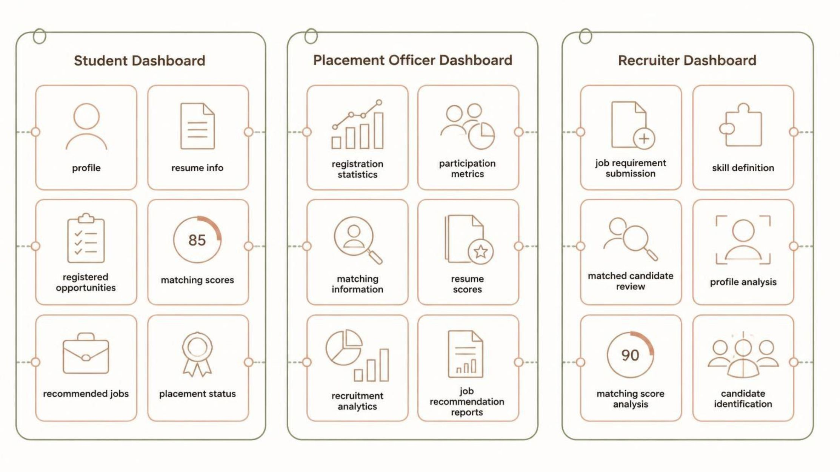
System Users and Dashboards
👨‍🎓 Students
🏫 Placement Officers
🏢 Recruiters
Register for placement and create profiles
Upload resumes for automated parsing
View matching scores for applied opportunities
Receive personalized job recommendations
View suitable opportunities and job requirements
Track placement registration status
Manage student registrations centrally
Monitor placement activities and participation
View placement statistics and analytics
Analyze candidate-job matching outcomes
Monitor recruitment analytics and reports
Support placement coordination across departments
Submit job requirements and define required skills
Review matched candidates automatically surfaced
View and analyze candidate profiles
Analyze matching scores for shortlisting
Identify suitable candidates efficiently

Slide 10
Advantages, Applications, and Future Scope
Key Advantages
Applications
Automation: Automated registration, resume parsing, eligibility verification, and matching reduce manual effort significantly
Colleges and universities
Institutional placement cells
Recruitment agencies
Corporate recruitment organizations
Intelligence: NLP-based analysis, skill extraction, and ML-driven matching improve accuracy and consistency
Expected Outcomes
Personalization: Personalized job recommendations replace generic opportunity lists
Faster registration and reduced manual screening
Improved matching accuracy and better recommendations
Improved coordination and enhanced analytics
Easier candidate identification and opportunity discovery
Centralization: Unified platform for all placement data, analytics, and coordination
Scalability: Architecture supports multiple institutions and increasing job volumes
Future Enhancements
Advanced Semantic Matching
Skill-Gap Analysis
Interview Preparation
Recruiter Chatbot
Transformer-based NLP for deeper semantic understanding of resumes and job descriptions
Identify missing skills and provide targeted learning recommendations to candidates
Personalized interview preparation recommendations based on matched job requirements
Conversational interface for recruiters to query candidate pools and placement data
Job Market Trends
Platform Integration
Job market trend analysis and multi-language support for broader institutional reach
Integration with professional job platforms for expanded opportunity discovery

Slide 11
Conclusion: Intelligent Campus Placement Management
The AI-Driven Campus Placement Registration and Resume Matching Platform provides a modern, intelligent solution to campus placement challenges by integrating six core capabilities into a unified system:
Automated Registration
Resume Parsing & NLP
Student registration and profile management
Automated parsing and natural language processing
Skill Extraction
ML-Based Matching
Intelligent skill extraction and eligibility verification
Machine learning candidate-job matching with scores
Recommendation Engine
Analytics
Personalized job recommendation engine
Comprehensive placement and recruitment analytics
Overall Impact
Result
The system improves resume matching accuracy, enhances recruitment efficiency, supports personalized job recommendations, and enables data-driven placement decision-making. By automating manual processes and providing intelligent insights, the platform helps students discover suitable opportunities, assists recruiters in identifying relevant candidates, and enables placement officers to manage placement activities more efficiently.
A secure, scalable, and intelligent placement management solution suitable for educational institutions, recruitment agencies, and corporate organizations.
The platform represents a meaningful advancement over traditional manual placement processes — bringing consistency, personalization, and analytical depth to campus recruitment at scale.
ACADEMIC CAPSTONE PROJECT
AI & MACHINE LEARNING
NLP-DRIVEN

