Slide 1
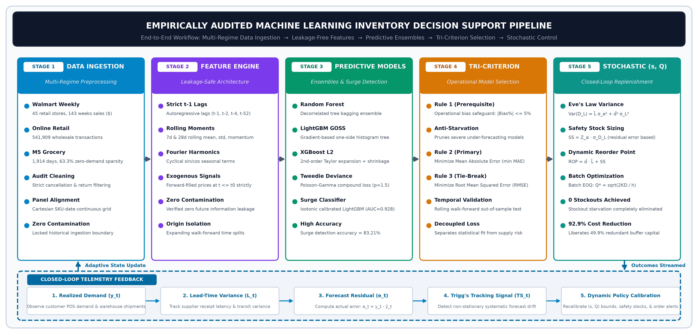
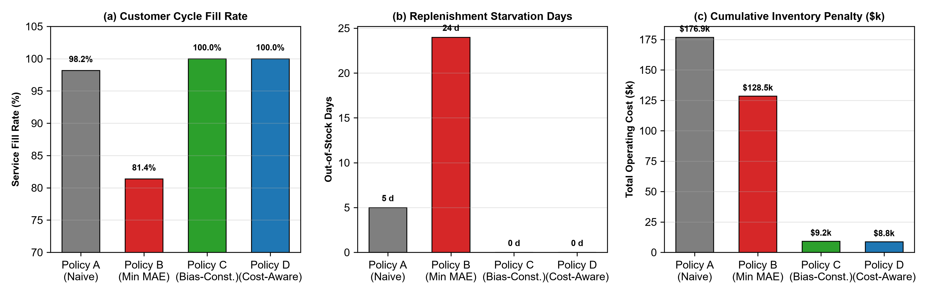
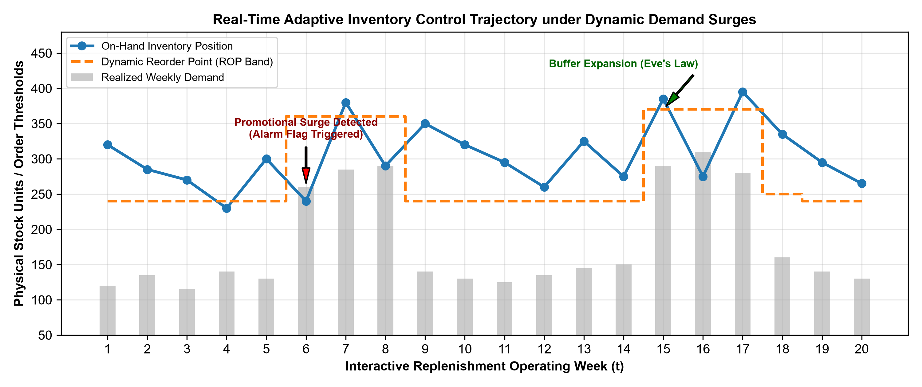
An Empirically Audited Machine Learning and Stochastic Inventory Control Framework for Enterprise Replenishment Decision Support
Sashank P., Abhinay Sai, Poli Naidu, and Sushama Rani Dutta | Department of Computer Science and Engineering, Koneru Lakshmaiah Education Foundation, Hyderabad, India | Email: sashank.p@klh.edu.in
1. MOTIVATION & PROBLEM STATEMENT
3. SYSTEM METHODOLOGY & WORKFLOW
5. LONGITUDINAL POLICY SIMULATION
The Supply Chain Penalty Asymmetry:
• Stockouts inflict catastrophic lost margins, SLA breach penalties, and permanent customer churn.
• Excess buffer inventory incurs only marginal holding capital charges (~20%/yr). Shortage costs exceed holding costs by 10x-50x.
• Conventional ERPs evaluate models on symmetric point loss (MAE/RMSE), ignoring error direction and penalizing over- and under-forecasting equally.
• Popular competition transforms (Log1p, Tweedie) induce severe negative bias, starving replenishment buffers.
Key Pipeline Innovations:
• Strictly chronological forward-filled prices eliminating lookahead leakage.
• 3-fold expanding-window walk-forward validation on locked holdouts.
• Platt-calibrated LightGBM Demand Surge Classifier (AUC = 0.928).
• Closed-loop continuous-review (s, Q) replenishment governed by Trigg's tracking signal.
Benchmark Across 8,000 Demand Steps:
• Policy C (Proposed Bias-Constrained): 100.0% Fill Rate, 0 Stockout Days, $9,210 Operating Cost (92.9% reduction vs. Policy B).
• Policy B (Min MAE): 81.40% Fill Rate, 24 Stockouts, $128,540 Cost.
• Sizing buffers via Eve's Law liberated 49.9% of safety buffer working capital ($135.7k vs. $270.8k).
2. THEORETICAL PROOFS & DERIVATIONS
4. MULTI-REGIME HOLDOUT EVALUATION
6. TELEMETRY & ENTERPRISE TAKEAWAYS
Theorem 1: Jensen's Inequality Deficit
When models fit MSE on z = ln(1+y), naive exponentiation ŷ = exp(ẑ)-1 estimates conditional geometric median rather than conditional mean:
E[ln(1+Y)] < ln(1+E[Y]) ⟹ ŷ_naive < E[Y]
Causes -55.9% to -81.3% negative bias starving buffers.
Theorem 2: Tweedie Zero-Gradient Divergence
For compound Poisson-Gamma deviance (p=1.5):
∂d(0, μ)/∂μ = 2/√μ ⟹ lim_{μ→0+} ∂d(0, μ)/∂μ = +∞
Infinite gradient penalty at zero pulls predictions downward.
Theorem 3: Eve's Law of Total Variance
Sizing safety stock across stochastic lead times L and residual forecast error variance σ_e^2:
σ_{D_L}^2 = L̄ σ_e^2 + d̂^2 σ_L^2, SS = Z_α σ_{D_L}
Liberates 49.9% of safety buffer working capital.
Cross-Regime Empirical Verification:
1. Walmart Weekly Sales (45 Stores):
• Random Forest Winner: MAE $35,624.48 (R² = 0.9905, Bias = -0.28%).
• 29.9% error reduction over Naive Lag-1 baseline ($50,865).
2. Online Retail Daily Wholesale (541k Transactions):
• Log1p XGBoost minimized point MAE (72.2 u) but suffered -57.18% bias.
• Random Forest Champion: MAE 90.57 u with +3.14% bias, satisfying safeguard.
3. M5 Intermittent Grocery (63.3% Zeros):
• Croston SBA collapsed into -58.97% bias starvation.
• XGBoost Tweedie had -11.87% bias.
• Random Forest delivered robust anti-stockout replenishment buffers.
Key Enterprise Recommendations:
1. Never select replenishment models purely by point error (MAE/RMSE).
2. Mandate operational percentage bias bounds (|Bias %| ≤ 5.0%).
3. Size buffers strictly from residual error variance (σ_e) via Eve's Law.
4. Deploy Trigg's tracking signal for real-time drift detection.
5. Full code & 18-section notebook runnable on Google Colab (90/90 tests passing).

