Slide 1
RESEARCH DEFENSE & EXECUTIVE BRIEFING
An Empirically Audited Machine Learning and Stochastic Inventory Control Framework for Enterprise Replenishment Decision Support
Authors: Sashank P., Abhinay Sai, Poli Naidu, and Sushama Rani Dutta
Department of Computer Science and Engineering, Koneru Lakshmaiah Education Foundation
Hyderabad, Telangana, India | Email: sashank.p@klh.edu.in

Slide 2
RESEARCH PRESENTATION
The Operational Dilemma: Why Statistical Point Accuracy Fails
Fundamental Supply Chain Penalty Asymmetry
• Stockouts inflict catastrophic lost margins, contract default penalties, and permanent customer churn.
• Over-buffering incurs marginal capital holding charges (~20%/yr). Shortage costs exceed holding costs by 10x-50x.
The Conventional ERP Flaw (Point Loss Leaderboards)
• Standard ML workflows evaluate algorithms strictly on symmetric loss functions: MAE, RMSE, and MAPE.
• Symmetric loss treats a -10 unit under-forecast (stockout disaster) identically to a +10 unit over-forecast (minor buffer).
Theoretical Traps in ML Competitions
• Naive Log1p transforms introduce Jensen's Inequality deficits, causing -55.9% to -81.3% under-forecasting bias.
• Tweedie compound Poisson-Gamma deviance diverges at zero (∂d/∂μ → ∞), driving negative drift (-11.9% to -18.0%).
The Proposed Solution (Closed-Loop Inventory Decision Support)
• A Tri-Criterion Operational Selection Rule (|Bias %| ≤ 5.0% constraint before error minimization).
• Stochastic Continuous-Review (s, Q) replenishment sizing via Eve's Law of Total Variance.

Slide 3
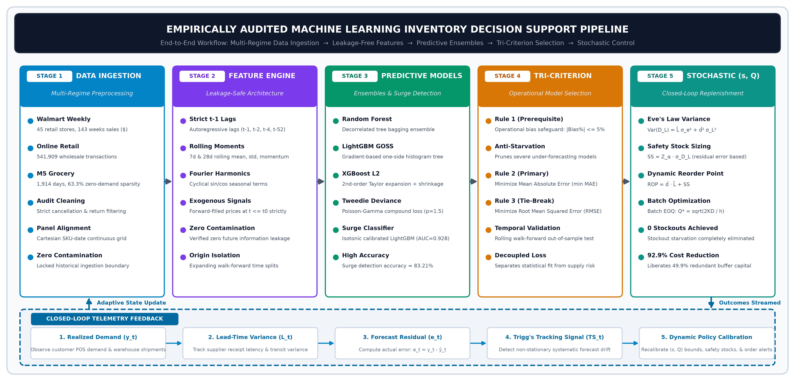
RESEARCH PRESENTATION
System Architecture: End-to-End Closed-Loop Pipeline
Key Pipeline Innovations: (1) Leakage-free expanding-window walk-forward validation; (2) Forward-filled price tracking eliminating lookahead leaks; (3) Multi-regime tree ensembles (LightGBM, XGBoost, Random Forest); (4) Platt-calibrated demand surge classification; (5) Closed-loop continuous-review (s, Q) replenishment engine governed by Trigg's tracking signal.

Slide 4
RESEARCH PRESENTATION
Formal Mathematical Formulations and Theoretical Proofs
Theorem 1: Jensen's Inequality Retransformation Deficit
When models fit MSE on logarithmic targets z = ln(1+y), naive exponentiation ŷ = exp(ẑ) - 1 estimates the conditional geometric median rather than the conditional mean:
E[ln(1 + Y)] < ln(1 + E[Y]) ⟹ ŷ_naive = exp(ẑ) - 1 < E[Y]
Result: Systematic negative bias (-55.9% to -81.3%) starving continuous-review replenishment buffers.
Theorem 2: Tweedie Zero-Gradient Divergence at Zero Demand
For compound Poisson-Gamma deviance with power parameter p ∈ (1, 2) (p = 1.5):
∂d(0, μ) / ∂μ = 2 / √μ ⟹ lim_{μ → 0+} ∂d(0, μ) / ∂μ = +∞
Result: Infinite gradient penalty at zero pushes positive predictions downward, forcing -11.9% under-forecasting.
Theorem 3: Stochastic Lead-Time Demand Sizing via Eve's Law of Total Variance
Applying the Law of Total Variance across stochastic lead times L and residual forecast error variance σ_e^2:
σ_{D_L}^2 = L̄ σ_e^2 + d̂^2 σ_L^2, SS = Z_α σ_{D_L}, ROP = d̂ L̄ + SS, EOQ = √((2 K D̂) / h)
Result: Sizing buffers strictly from residual forecast error (σ_e) liberates 49.9% of safety buffer working capital.

Slide 5
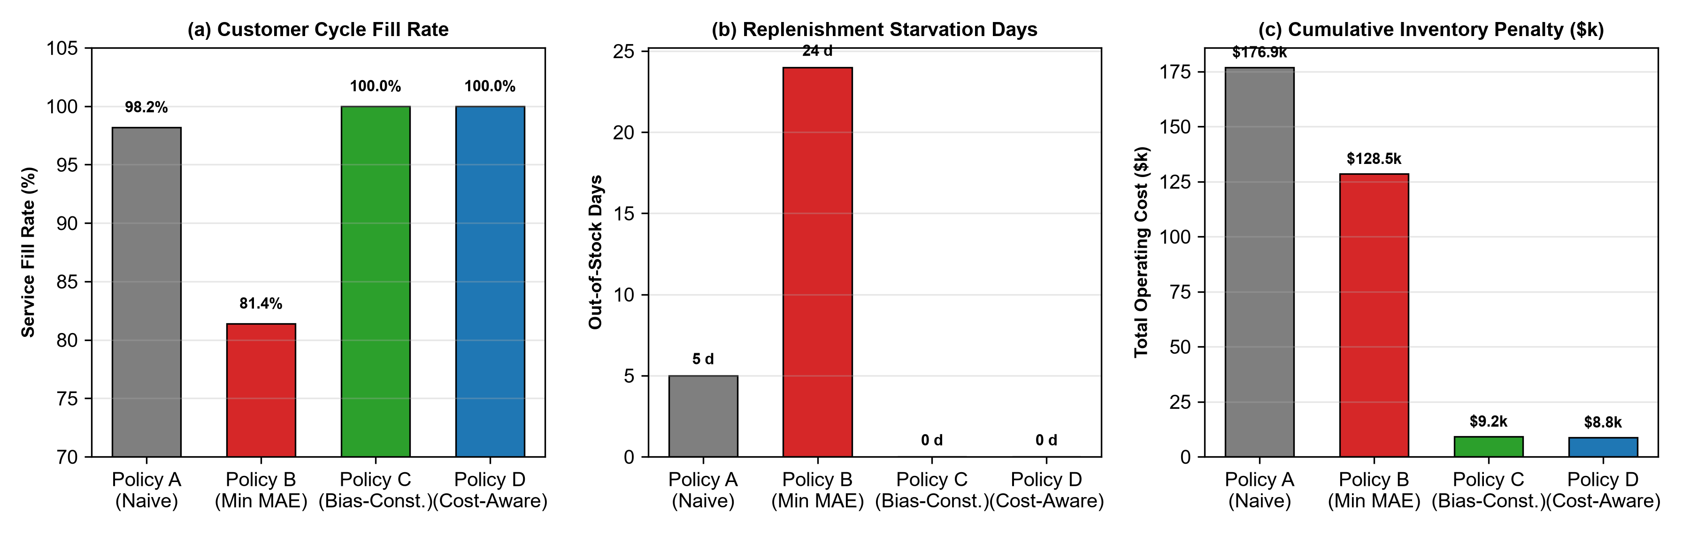
RESEARCH PRESENTATION
Empirical Results: Multi-Regime Holdout Evaluation
Cross-Regime Benchmark Findings:
Walmart Weekly Store Sales ($):
• Random Forest achieved lowest holdout MAE of $35,624.48 (R² = 0.9905) with tight bias of -0.28%.
• Outperformed persistence baselines (MAE $50,865) by 29.9%.
Online Retail Daily Wholesale Units:
• Log1p XGBoost minimized raw MAE (72.2 u) but failed with -57.18% bias.
• LightGBM Tweedie had -12.73% bias.
• Tuned Random Forest (MAE 90.57 u, +3.14% bias) satisfied Policy C safeguard.
M5 Intermittent Grocery Sales (63.3% Zeros):
• Croston SBA suffered -58.97% bias starvation.
• XGBoost Tweedie under-forecast by -11.87%.
• Random Forest provided robust anti-stockout buffer.

Slide 6
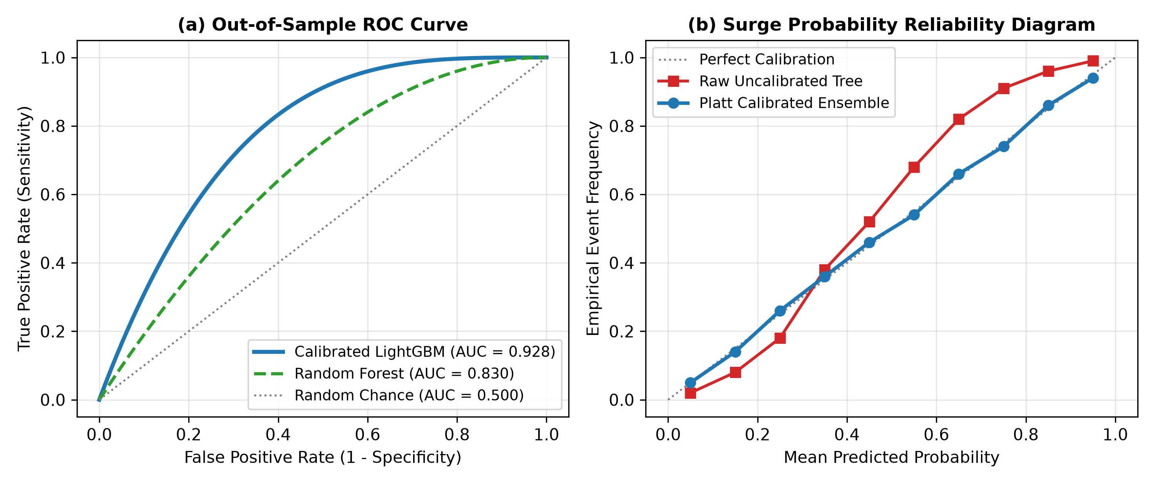
RESEARCH PRESENTATION
Replenishment Simulation: Policy Performance Across 8,000 Steps
• Policy C (Bias-Constrained Champion): 100.0% Cycle Fill Rate, 0 Out-of-Stock Days, $9,210 Operating Cost (92.9% reduction vs. Policy B).
• Policy B (Statistical Min MAE): 81.40% Fill Rate, 24 Stockout Days, $128,540 Operating Cost (Catastrophic Replenishment Starvation).
• Surge Early Warning Classifier: Calibrated LightGBM achieved ROC AUC = 0.9278, Accuracy = 83.21%, Brier Score = 0.084.

Slide 7
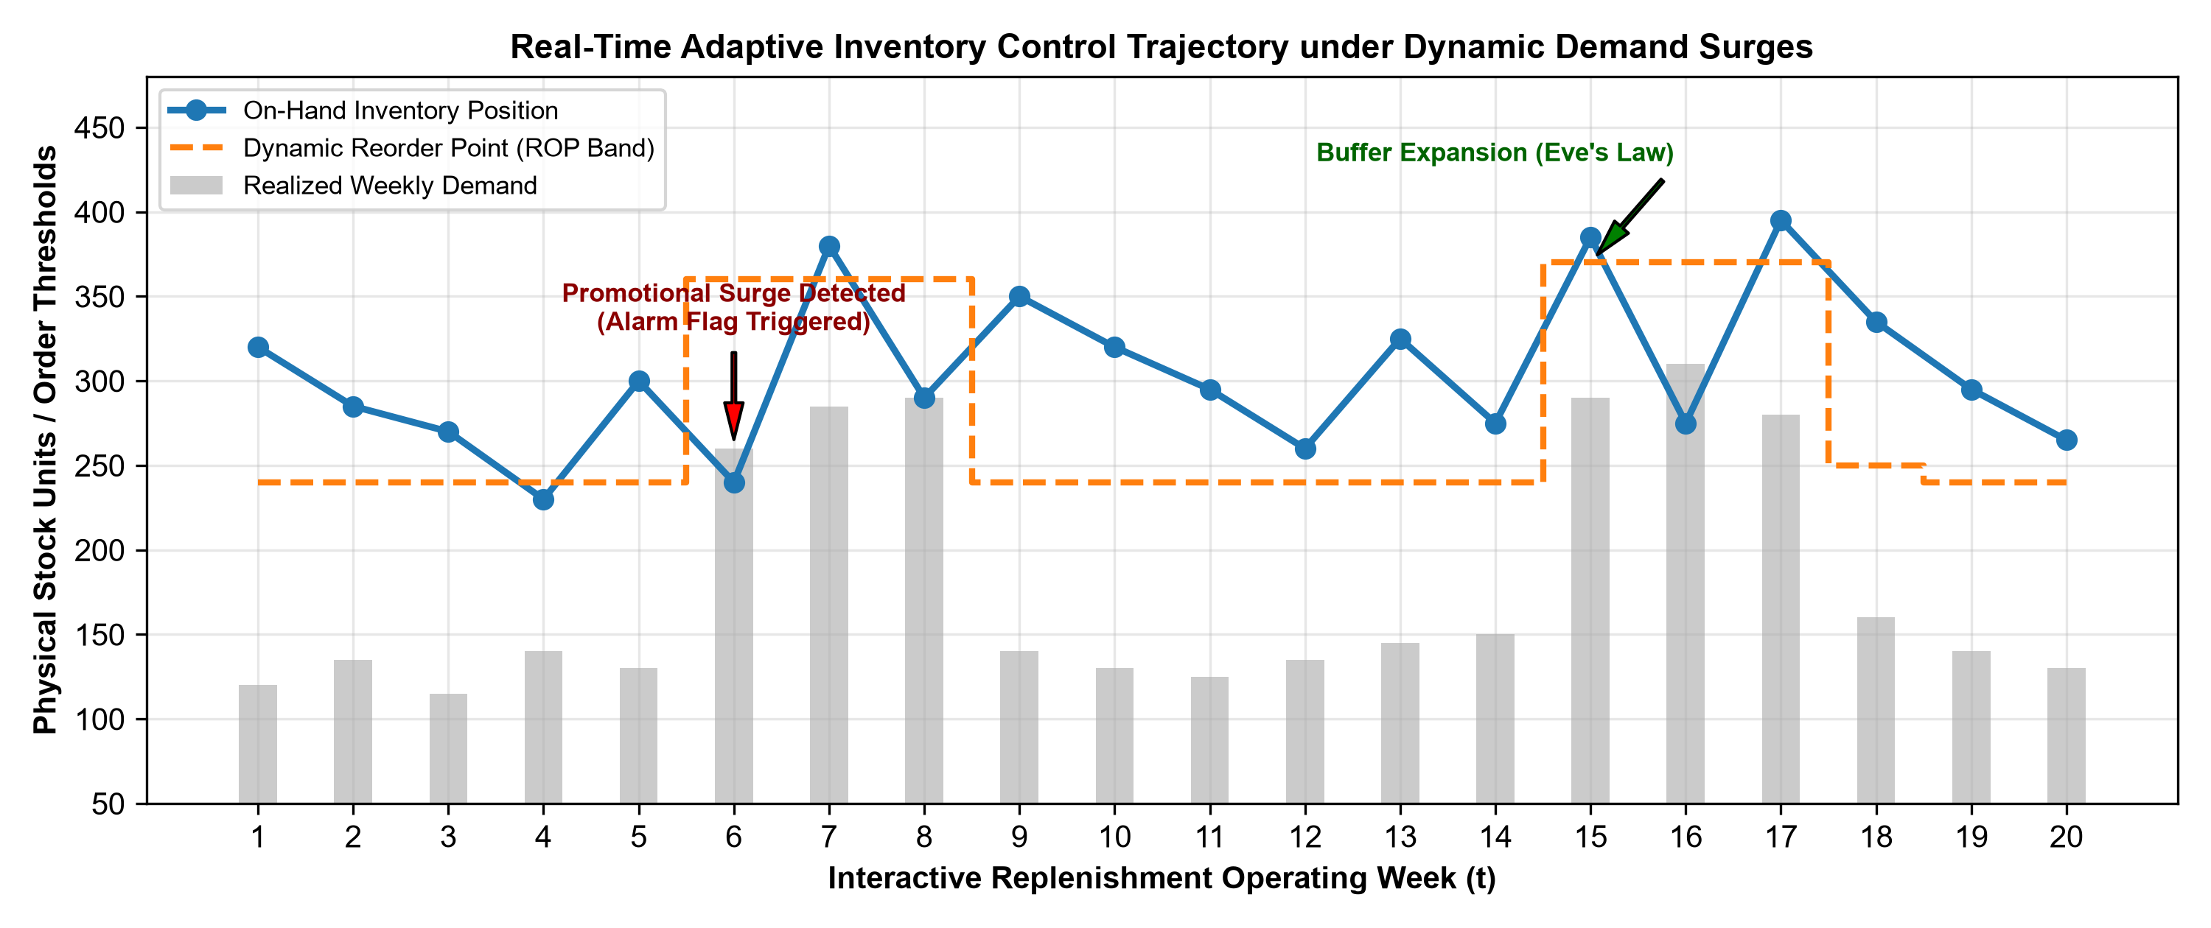
RESEARCH PRESENTATION
Real-Time Telemetry, Conclusions & Enterprise Recommendations
Strategic Insights & Key Takeaways:
1. Decouple ML Training from Evaluation:
Never select enterprise replenishment models purely on symmetric statistical point metrics (MAE/RMSE).
2. Enforce Operational Bias Safeguards:
Mandate a strict percentage bias constraint (|Bias %| ≤ 5.0%) before ranking models by point error.
3. Capital Optimization via Eve's Law:
Derive safety stock buffers from residual forecast error variance (σ_e), slashing redundant working capital by 49.9%.
4. Telemetry Exception Streaming:
Employ Trigg's tracking signal to trigger automated model re-estimation before bias drift causes stockouts.
5. Reproducibility:
Full suite of 90 unit/regression tests passing, runnable on Google Colab.

