Slide 1
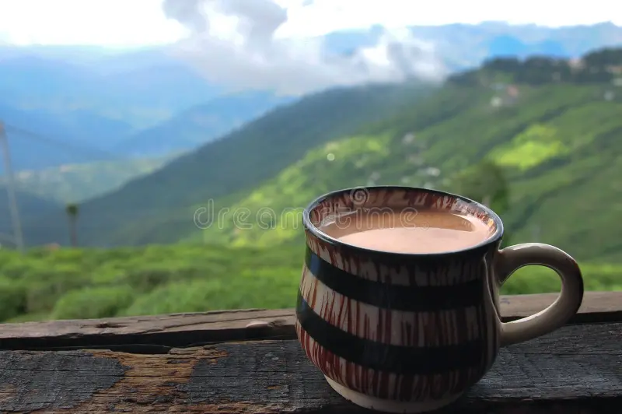
Welcome
to
Darjeeling…..

