Slide 1

EDA for IPL - Mounika Prasad K

Slide 2
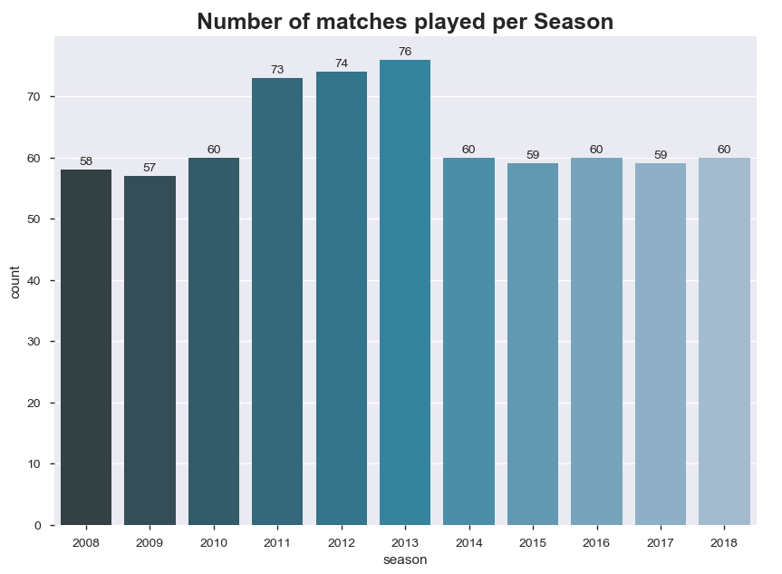
Average number of matches played per season - 63

Slide 3
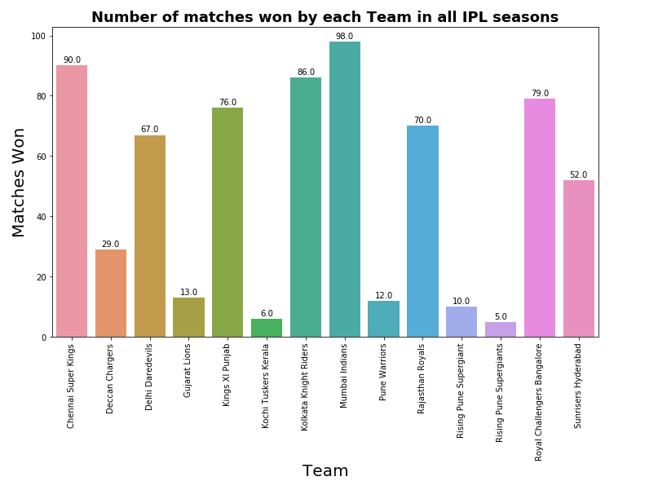
The most consistent team in IPL – Mumbai Indians

Slide 4
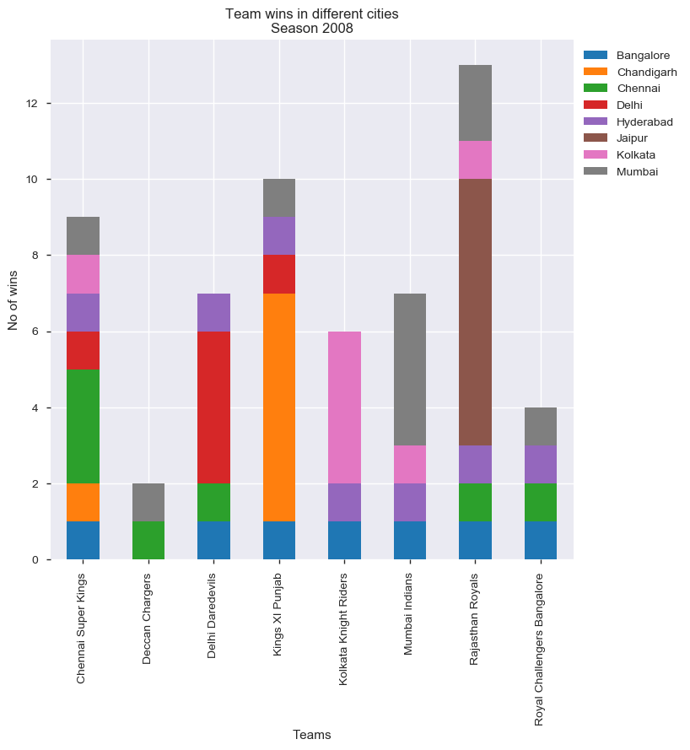
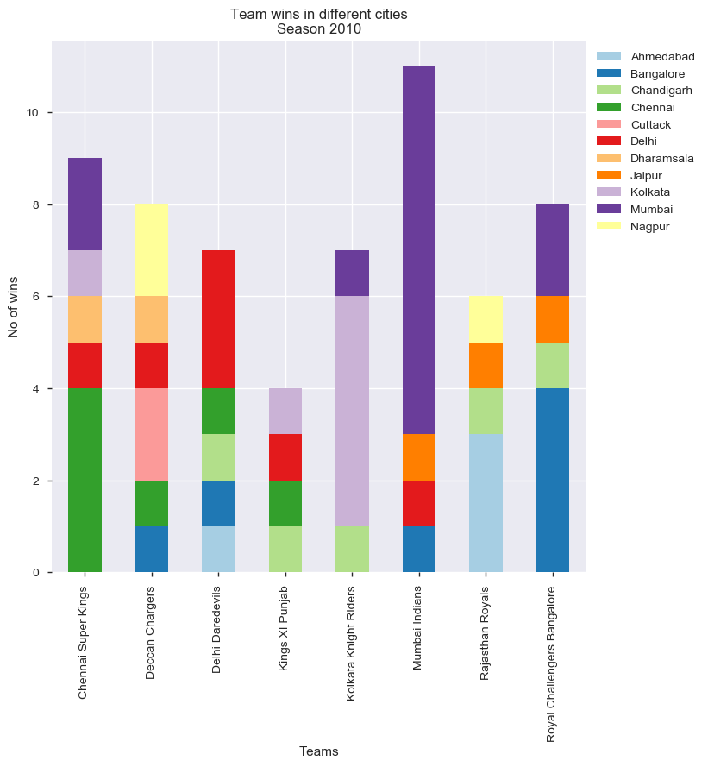
Did the teams have home ground advantage ?

Slide 5
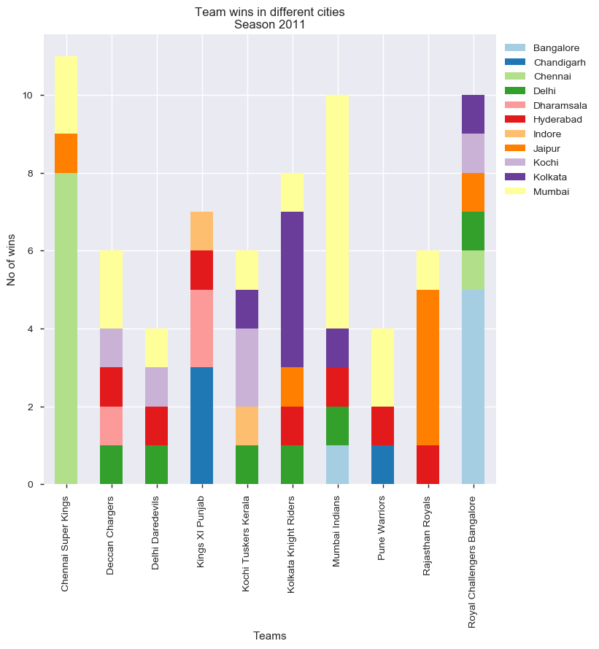
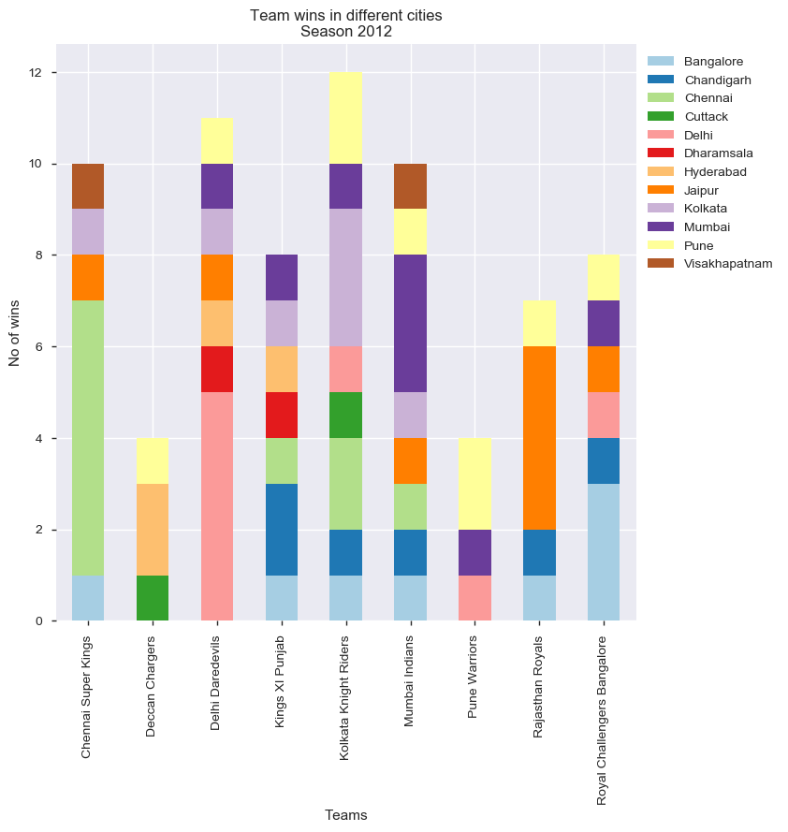
Did the teams have home ground advantage ? Contd…

Slide 6
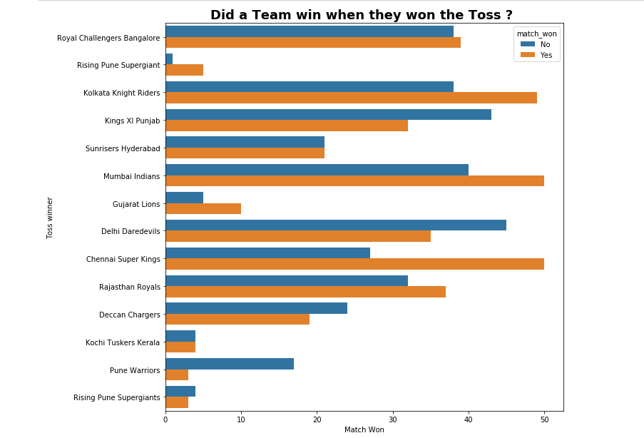
Did toss play a role in winning the match?

Slide 7
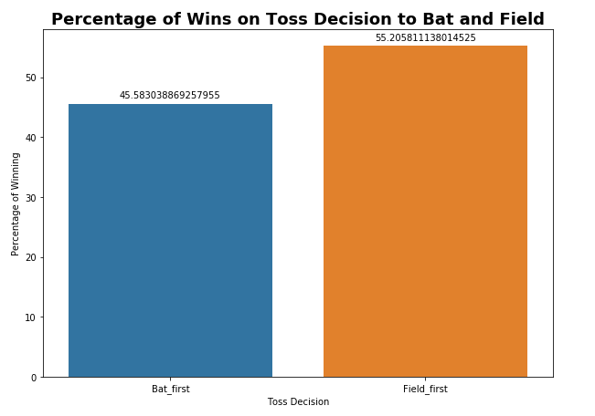
Did the Toss Decision to bat / field impact the result ?

Slide 8
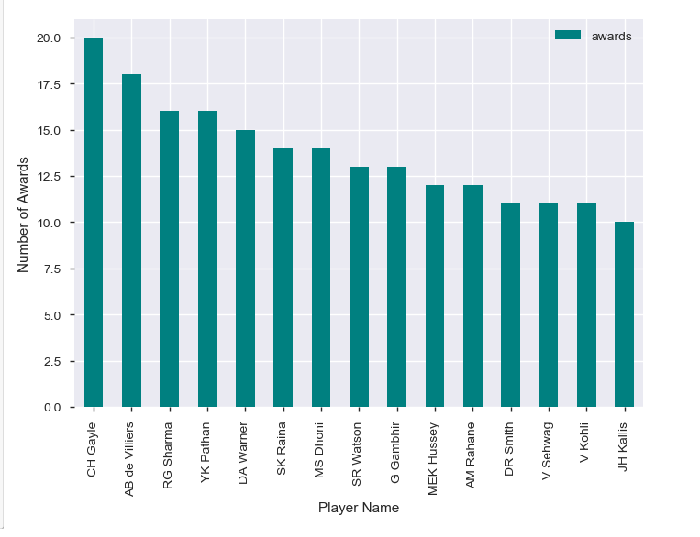
Top 15 IPL ‘Players of the Match’

Slide 9
Thankyou..

