Slide 1
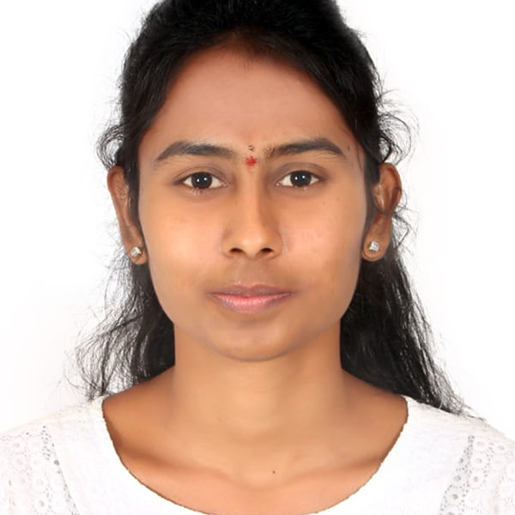
MounikaRapelly
Mater of computer application
:2018-2021
Analyst/Software Engineer
Skills
Hyderabad
Java | Basics of java,core java ,oops concepts..
Spring core | IOC & Dependency Injection, Autowire
Spring REST | REST controllers, Implementation of GET, POST, PUT & DELETE, Bean Validation & Exception Handling, Testing Services, Controller & Repository layer
Spring Boot Microservices |  | Spring Boot Starters, annotations, Messaging Service, Sync/Async comms, Swagger API documents
React | Components, Hooks, Event handling, Redux..
Database | MongoDB No Sql Basics My SQL RDS Basics
UI Tech | HTML 5 & CSS ,JavaScript, ES6 & TypeScript Reusable templates, Optimized UI Designed
Tools | Git, Postman, Maven, IDE
Ides | Spring Tool ,Visual Studio 2019, Visual Studio code, Swagger, ,Intellij, eclipse
Add On skills | Communications, Team management. Peer learning
Mounika.Rapelly@capgemini.com
+91 7032468411
A4
Hands on experience in creating Web Application with Spring Boot
Hands on experience in creating microservices with Springboot, Spring Rest API, API Gateway, Eureka server.
Good knowledge in Microservices
Knowledge in databases like sql, mongodb
Proficient in JAVA and OOPs concepts.
Hands on experience in developing web pages using HTML5, CSS3, Object Oriented Programming.
Practical understanding of rendering REST API.
Implemented Web API and React Js in case study and up skilling this knowledge continuously.
Uniﬁed Developer Tool Set
Uniﬁed Developer Tool Set is a multi tenant IDE Conﬁguration and
management tool clubbed with various external AI Tools such as Diﬀblue, Tabnine, Ponicode ,snyk, etc,.,.
to reduce developer's eﬀort,time,cost
ONLINE RAILWAY RESERVATION SYSTEM
Working on end to end case study Online railway reservation system Application along with Eureka, Swagger and React Js used for user interface.
Java Full Stack Developer in Degreed Platform
Completed this course with optimal Knowledge of MVC ,Web API , RESTful services , Components.
• Awarded with AWS Cloud Practitioner Certificate by Amazon.
railway Reservation.webm
Check out my work Video Profile

