Slide 1
Algorithm Used in Pneumonia Detection
Intern: Soyam Mounika (N200863)

Slide 2
Why Convolutional Neural Networks (CNN)?
- Specifically designed for image classification tasks
- Automatically extracts important image features
- Preserves spatial structure through convolution
- High accuracy in medical image detection

Slide 3
How CNN Works
- Input image → Convolution layers → Pooling layers → Fully connected layers → Output
- Convolution detects edges, patterns
- Pooling reduces dimensions
- Dense layer classifies as Normal or Pneumonia

Slide 4
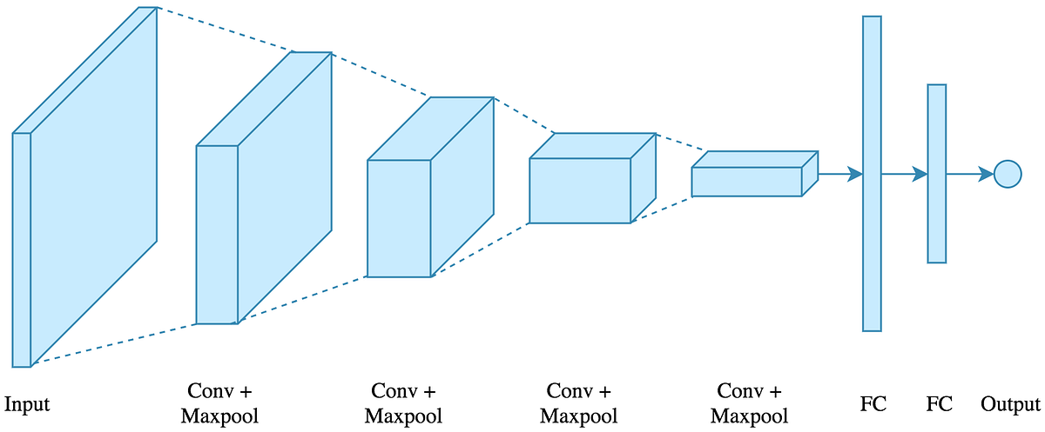
Woking of CNN

Slide 5
Model Architecture Used
Input: 150x150 grayscale image
3 Convolutional Layers + MaxPooling
Flatten → Dense Layer → Output (Sigmoid)
Binary Classification: Pneumonia or Normal

Slide 6
CNN vs Other Algorithms
- Logistic Regression/SVM: Not suitable for images
- Naive Bayes: Assumes feature independence
- KNN: Too slow for large image datasets
- Random Forests: Require manual feature extraction
- CNN: Learns features directly from image pixels

Slide 7
Conclusion
CNN is ideal for pneumonia detection from X-rays
High accuracy, feature learning, and visual explanations
Outperforms traditional ML methods in image tasks

