Slide 1
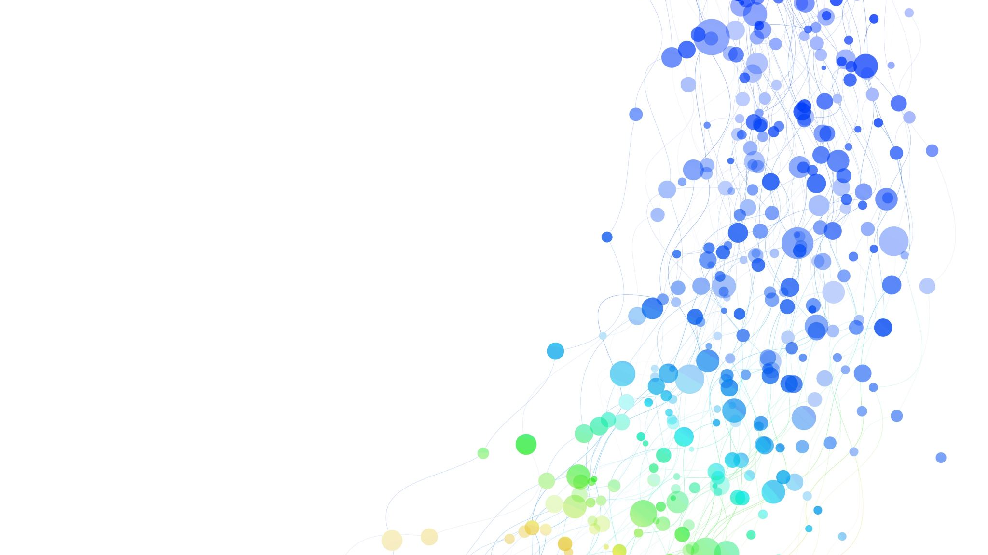
Deep Learning for Business: Customer Shopping Preferences
Term Project: Mounika Thatipamula 06/15/2024

Slide 2

Introduction and Business Problem
Business Problem: Understanding and predicting customer shopping preferences to enhance business decision-making.
Significance: Helps businesses tailor products, marketing strategies, and overall customer experience to better meet customer needs.
Goals and Objectives:
Preprocess the data to handle missing values, encode categorical variables, and scale numerical features.
Experiment with various deep learning architectures, including RNN, CNN, Bidirectional RNNs, and pretrained-inspired models.
Fine-tune the models to optimize their performance.
Evaluate the models using appropriate metrics.
Benefits to the Business:
Optimize inventory management to reduce overstock and stockouts.
Improve personalized marketing strategies, resulting in higher customer engagement and conversion rates.
Enhance customer relationship management by understanding customer preferences and providing tailored experiences.
Implications on Decision-Making:
Inventory Management: Adjust inventory levels based on predicted demand.
Marketing Strategies: Design more effective marketing campaigns.
Customer Relationship Management: Personalize interactions for increased loyalty and satisfaction.

Slide 3

Dataset Source
Dataset Source:
Source: The dataset used in this project is sourced from Kaggle, titled "Customer Shopping Trends Dataset" provided by Sourav Banerjee.
Description: Dataset contains updated information on customer shopping trends, including various attributes related to customer demographics, purchase behaviors, and product details.
Relevance: This dataset is essential for developing and training predictive models to understand shopping preferences and trends, helping businesses tailor their strategies to meet customer needs better.

Slide 4
Data Description
Input Variables: Age, Gender, Item Purchased, Category, Location, Size, Color, Season, Review Rating, Subscription Status, Payment Method, Shipping Type, Discount Applied, Promo Code Used, Previous Purchases, Preferred Payment Method, Frequency of Purchases.
Output Variable: Purchase Amount (USD).
Dataset Dimensions: 3900 rows, 19 columns.
Missing Values: None.
Descriptive Statistics: Summary of key statistics for numerical and categorical variables.

Slide 5
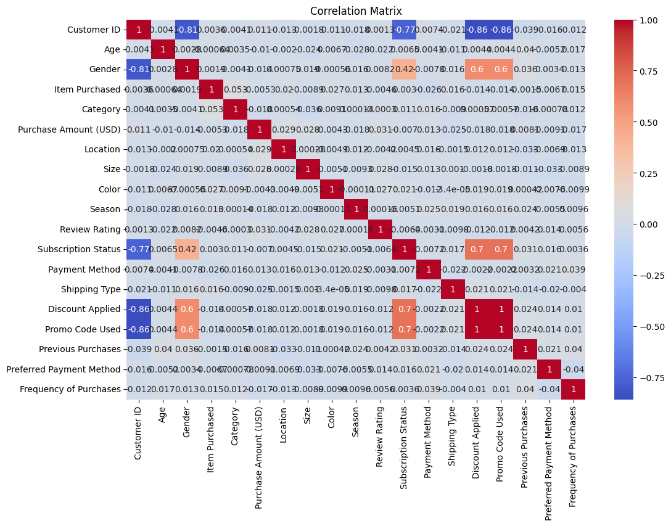
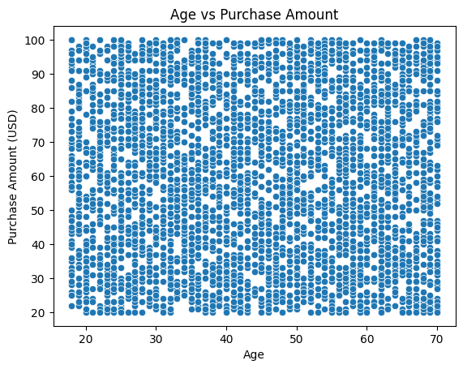
Describing Dataset
Scatter Plot: Age vs Purchase Amount
Correlations: Heatmap of correlation between variables

Slide 6
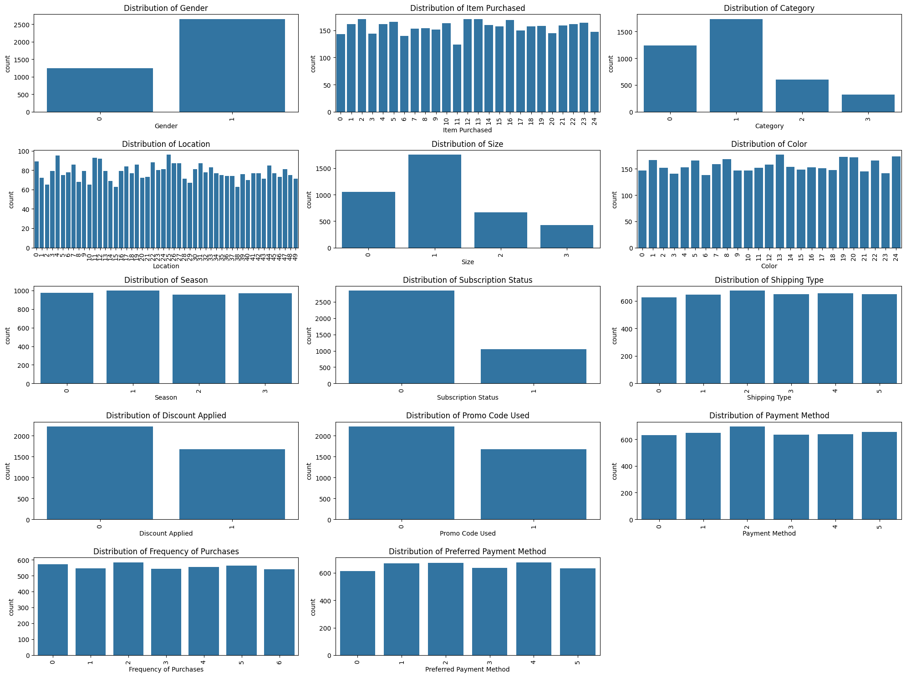
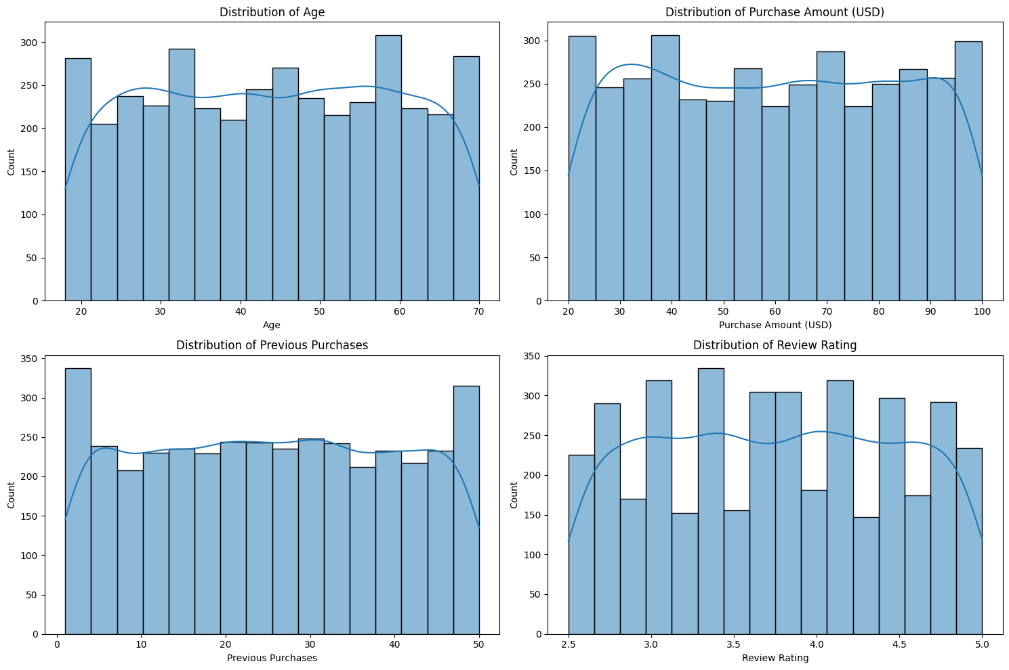
Describing Dataset (Visualization)
Bar Plots: Distribution of categorical features
Distribution Plots: Histograms for numerical features

Slide 7
Exploratory Data Analysis
Central Tendencies: Mean, Median, Mode.
Correlations: Heatmap of correlation between variables.
Variance and Outliers: Visualized using box plots.
Visualizations:
Scatter Plot: Age vs Purchase Amount.
Correlation Matrix: Heatmap.
Bar Plots: Distribution of categorical features.
Distribution Plots: Histograms for numerical features.
Box Plots: Identifying outliers in numerical features.

Slide 8
Data Preprocessing
Handling Missing Values:
Applied forward fill method to handle any missing values in the dataset.
Encoding Categorical Variables:
Utilized LabelEncoder to transform categorical variables into numerical values for model compatibility.
Feature Scaling:
Used StandardScaler to scale numerical features, ensuring they are on a similar scale for better model performance.
Preparation of Numerical Features:
X_numerical: Contains scaled values of 'Age', 'Purchase Amount (USD)', and 'Previous Purchases'.
y: The target variable 'Review Rating'.

Slide 9
Fitting Different Deep Learning Architectures
Deep Learning Models:
Simple Neural Network with Embeddings.
Recurrent Neural Network (RNN) with Embeddings.
Convolutional Neural Network (CNN) with Embeddings.
Bidirectional RNN with Embeddings.
Pretrained-Inspired Model.
Evaluation:
Performance metrics: Mean Absolute Percentage Error (MAPE).

Slide 10
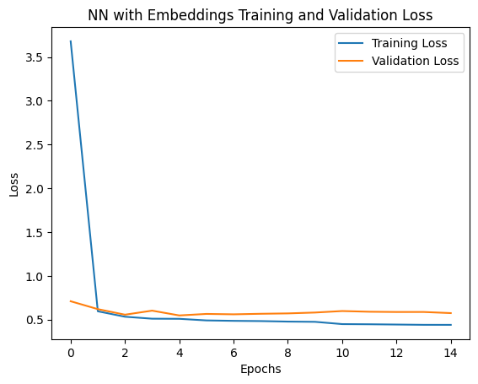
Simple Neural Network with Embeddings.
Model Structure:
The model was trained for 15 epochs, with early stopping applied to avoid overfitting.
Compiling the Model: Optimizer: Adam
Loss Function: Mean Squared Error (MSE)
Metrics: Mean Absolute Percentage Error (MAPE)
Fit Method: Trains with a 20% validation split, using 50 epochs and a batch size of 32.
Assessment: Evaluates performance on test data, achieving a MAPE of 17.98.

Slide 11
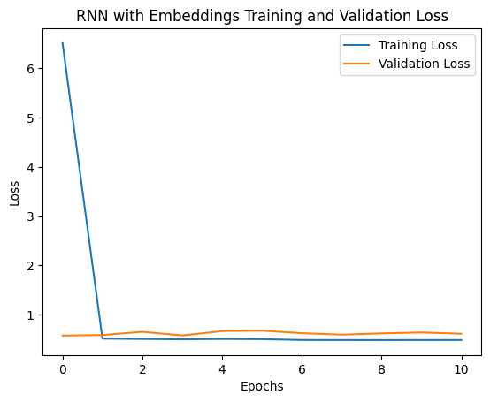
Recurrent Neural Network (RNN) with Embeddings
LSTM Layers: Effectively capture sequential dependencies in data, enhancing model performance.
Embedding Layers: Transform categorical features into continuous vectors, improving data representation.
Early Stopping & Learning Rate Reduction: Prevent overfitting and improve training efficiency.
Performance: Achieved a Mean Absolute Percentage Error (MAPE) of 17.64, indicating reliable predictive capability.

Slide 12
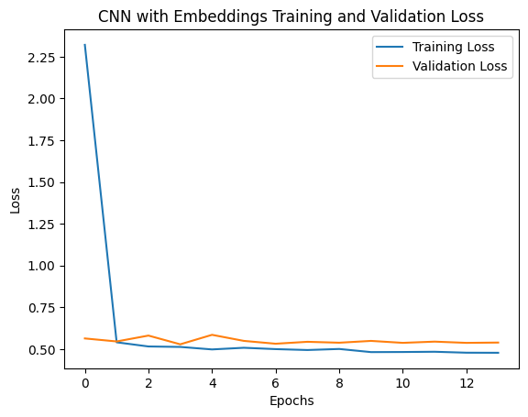
Convolutional Neural Network (CNN) with Embeddings
Conv1D Layers: Effectively capture spatial relationships in sequential data, enhancing feature extraction.
Embedding Layers: Transform categorical features into continuous vectors, improving data representation.
Pooling Layers: Reduce dimensionality, control overfitting, and capture important features.
Early Stopping & Learning Rate Reduction: Prevent overfitting and improve training efficiency.
Performance: Achieved a Mean Absolute Percentage Error (MAPE) of 18.38, indicating competitive predictive capability.

Slide 13
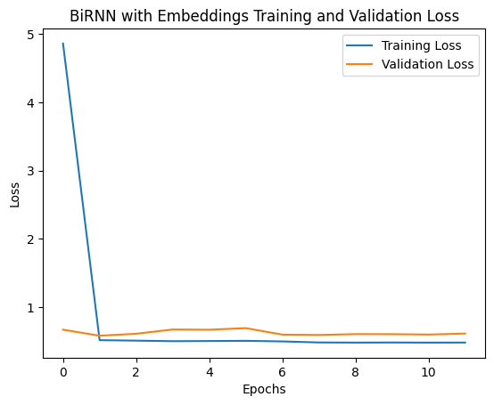
Bidirectional Recurrent Neural Network (BiRNN) with Embeddings
Bidirectional LSTM Layers: Capture dependencies in both forward and backward directions, enhancing context understanding.
Embedding Layers: Transform categorical features into meaningful continuous vectors.
Dense Layers: Learn complex patterns in the data.
Early Stopping & Learning Rate Reduction: Improve training efficiency and prevent overfitting.
Performance: Achieved a Mean Absolute Percentage Error (MAPE) of 17.54, indicating strong predictive performance.

Slide 14
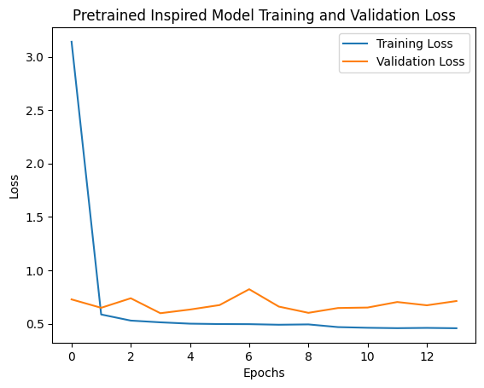
Pretrained DL Models
Embedding Layers: Converts categorical features into continuous vectors for better representation.
Dense Layers: Multiple dense layers with different units (128, 64, 32, 16) to capture intricate patterns in the data.
Optimizer & Metrics: Uses Adam optimizer and Mean Absolute Percentage Error (MAPE) as the evaluation metric.
Early Stopping & Learning Rate Reduction: Early stopping to prevent overfitting and learning rate reduction for improved training efficiency.
Performance: Achieved a final test MAPE of approximately 17.72%, demonstrating effective predictive capability.

Slide 15

Model Training and Evaluation
Training Process: Implemented various architectures (RNN, CNN, BiRNN, Pretrained-inspired) to train the models effectively. Early stopping and learning rate reduction.
Evaluation Metrics: Mean Absolute Percentage Error (MAPE).
Results:
NN with Embeddings MAPE: 17.98%
RNN with Embeddings MAPE: 17.64%
CNN with Embeddings MAPE: 18.38%
BiRNN with Embeddings MAPE: 17.54%
Pretrained-Inspired Model MAPE: 17.72%
Fine-Tuning: Adjusting hyperparameters to optimize model performance.

Slide 16
Conclusion
Embeddings: Efficiently captured relationships in categorical data, enhancing model performance.
Early Stopping & Learning Rate Reduction: Crucial techniques to prevent overfitting and improve training efficiency.
Performance: Achieved competitive MAPE scores across various architectures, demonstrating the effectiveness of the models.
Future Work: Further hyperparameter tuning and exploration of additional deep learning architectures to enhance predictive accuracy.

Slide 17

Thank you

