Slide 1
SMART HOME ENERGY MANAGEMENT SYSTEM
-Team2

Slide 2
Team Members:
Team Lead - S Jayanth
Technical Lead - Kavya
Developer Core- Mounika
Developer Supporting – Dibya
Tester/Quality Analyst – Swetha
Documentation-

Slide 3
The Smart Home Energy Management System addresses the growing challenge of rising energy consumption and inefficient resource utilization within modern households. As homes become increasingly equipped with electronic appliances and smart devices, monitoring and controlling overall power usage manually becomes complex and impractical.
The Smart Home Energy Management System is an intelligent Java-based solution engineered to enhance residential energy efficiency through automated control and data-driven decision-making.
The platform enables real-time monitoring of power usage, predictive appliance scheduling, and optimized resource utilization.
By integrating smart automation with user-centric insights, the system supports sustainable living while reducing operational energy costs.

Slide 4
Solution Overview:
A Java-based Smart Home Energy Management System designed to optimize energy usage, automate device control, and provide intelligent consumption insights.
Functional Modules:
Authentication & Role Management🔐
Secure login and role-based access control.
Differentiated permissions for admin and user roles.
Device Management⚙️
Add, remove, and configure smart home devices.

Slide 5
Real-Time Energy Tracking📊
Live monitoring of appliance-level power consumption.
Analytics Dashboard📈
Visual reports, trends, and consumption summaries.
Data-driven insights to support energy optimization
Scheduling & Automation⏱
Smart rules based on time, usage patterns, or energy goals.

Slide 6
Tech Stack
Front End:Html/CSS/Bootstrap
Back End:
  Java 17 or higher 🡪Stable version
  Spring Boot 🡪Auto configures project and helps to build REST API
  JDBC 🡪 Connects java to database
  Hibernate 🡪 for ORM
  REST API 🡪 Enables easy communication
Data Base:
  MySql 🡪 table format and structured / Relational Databses
Version Control: Git & Git Hub
IDE: IntelliJ/Vs code

Slide 7
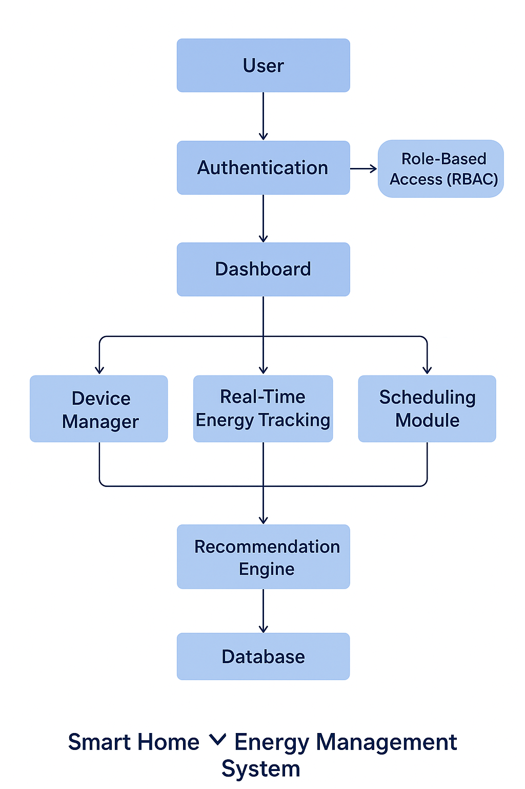
System Architechture

Slide 8
Module -1
Authentication and role management
The Authentication and Role Management module is responsible for validating user credentials and assigning appropriate access privileges within the system. When a user attempts to log in, the system verifies the provided username and password against securely stored credentials in the database. Passwords are stored in an encrypted format to ensure data privacy and protection.
Admins have extended control, including managing users, viewing system-wide energy data, and configuring devices.
Standard Users are provided access to personal dashboards with device control, energy tracking, scheduling, and usage tips.

Slide 9
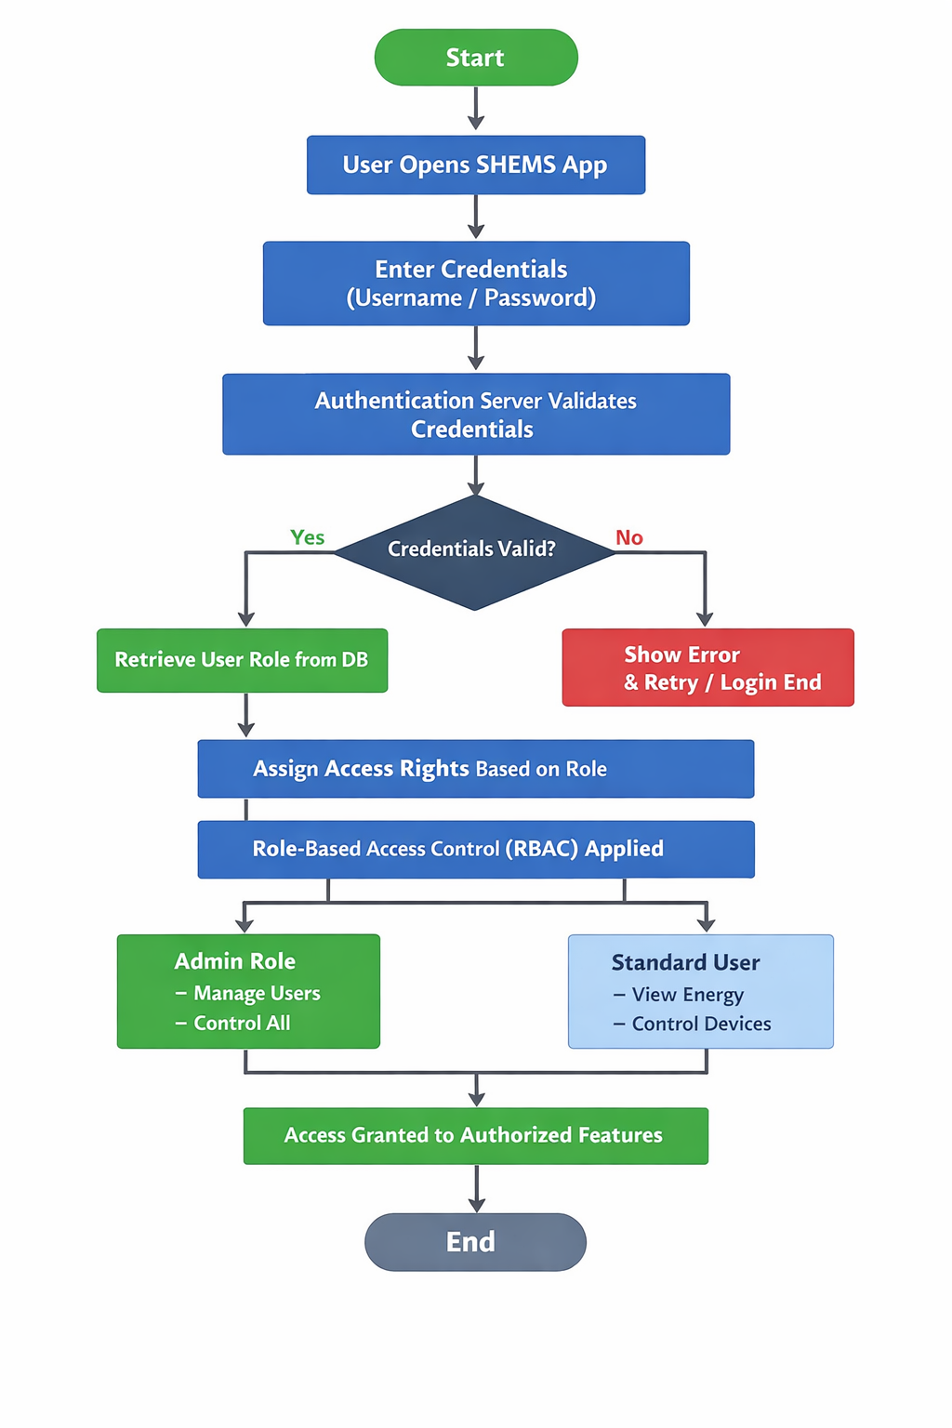

Slide 10
Testing Strategy
Tested the Smart Home Energy Management System for functionality, security, and role-based access
Focused on:
  Login & Authentication
  Role-Based Dashboards
  Device Control
  Analytics Page
Verified system behavior for different user roles:
  Owner, Child, Guest, Servant
Ensured restricted users cannot access unauthorized features

Slide 11
Test Cases and Results
Login tested with valid and invalid credentials
Role-based access verified for all user types
Device ON/OFF and status update tested successfully
Device addition tested for Owner role only
Analytics access and chart loading verified
Result: All test cases passed, system works as expected

