Slide 1

Smart Home Energy Management System
Mounika
under the guidance of
Dr.T.Premalatha

Slide 2
Meaning of the Title
A Smart Home Energy Management System is an intelligent system that monitors and controls electricity usage in a home.
It uses sensors, smart devices, and automation to track real-time power consumption.
Helps to reduce energy waste and improve overall efficiency.
Supports cost savings by lowering electricity bills.
Promotes sustainable living through optimized energy usage.

Slide 3
Problems in Existing System
No automatic monitoring of electricity usage.
High power wastage due to manual control.
Users cannot track real-time energy consumption.
Difficulty in identifying which appliances consume more power.
Higher electricity bills due to inefficient usage.
No alerts or notifications for over-usage or faults.
Lack of integration between home appliances and control systems.

Slide 4
Proposed System
The proposed system is a Smart Home Energy Management System designed to automatically monitor, control, and optimise energy usage in homes.
Helps reduce electricity wastage and lower energy bills.
Provides automation and intelligent control of home appliances.
Offers alerts, notifications, and reports to improve efficiency and sustainability.

Slide 5
System Configuration
Front-End(JavaScript/React):
Users control appliances via interactive dashboard and view real-time power usage with charts
e.g.,fetch(‘/api/power’)for data.
Displays energy usage graphs, and device control options.
Back-End(Java/Spring Boot):
Receives user requests,processes logic like device commands
e.g.,if (user.role==’admin’{
turnOn(device);
}
Handles authentication, automation logic, alerts, notifications, and data storage.
Device & Sensor Configuration
Smart meters, sensors, and appliances installed in the home.
Collect real-time energy consumption data and send it to the backend.

Slide 6
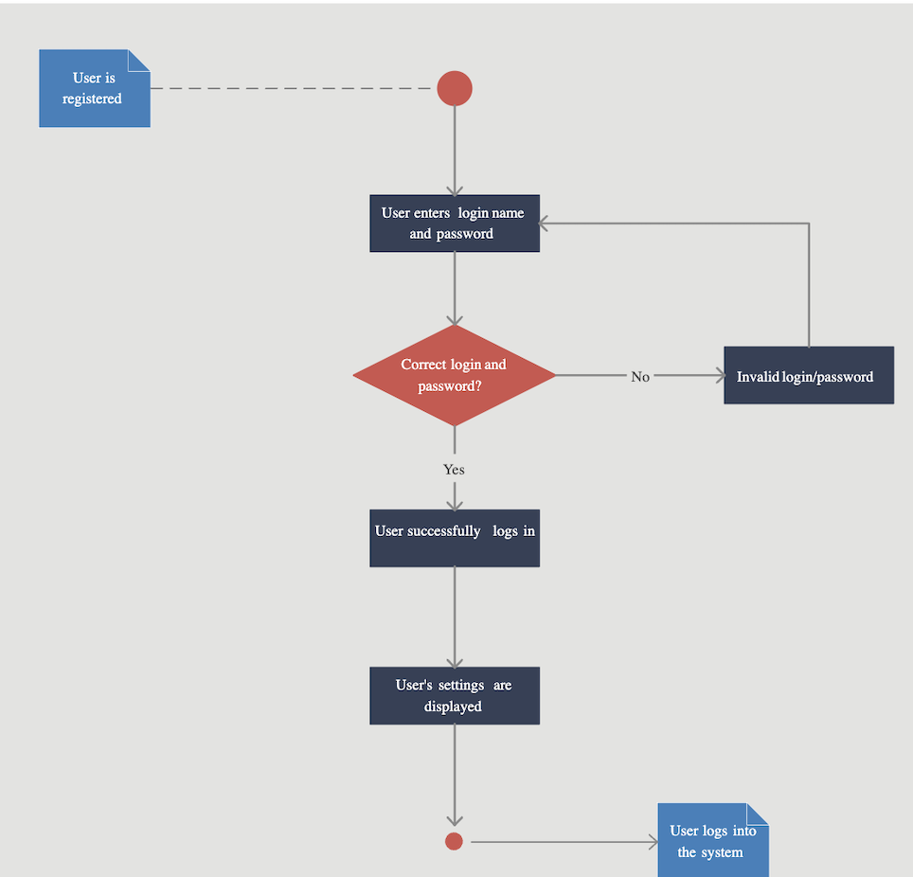
Module 1 – User Login & Role-Based access
Job of Module 1
Provides secure login for users.
Controls access based on user roles (Admin, User, Guest).
Activities Performed
User enters username & password.
System verifies credentials.
Assigns a role after successful login.
Grants access only to permitted features.
Activity Diagram:
Caption

Slide 7
Classes for Login + Role-Based Access
classDiagram
class AuthController {
+ login()
+ logout()
}
class AuthService {
+ validateUser()
+ authenticate()
}
class UserRepository {
+ getUserByUsername()
+ saveUser()
}
class Database {
+ users table
+ login_logs table
}
class User {
username
password
role
email
}
1.User
Model class representing a user.
Contains: username, password, role, email, status.
2. AuthController
Receives login request from UI (front end).
Sends username/password to AuthService,Returns login success/failure response.
3. AuthService
Main login logic.
Validates username + password.Calls UserRepository to fetch user data.
4. UserRepository
Communicates with the database.
Fetches user by username.Saves user info when needed.
5. Database Table (Users Table)
Stores user credentials.
Stores user roles.
Example columns: id, username, password, role.

Slide 8
Class Diagram (With Properties & Methods)
✅ 1. User Class
Properties:
userId
username
password
email
role (Admin / User / Guest)
Methods:
getRole()
validatePassword()
✅ 2. AuthController Class
Properties:
None (controller layer)
Methods:
login()
logout()
handleInvalidLogin()
✅ 3. AuthService Class
Properties:
userRepository (object reference)
Methods:
validateUser(username, password)
authenticate(user)
assignRole(user)
✅ 4. UserRepository Class
Properties:
databaseConnection
Methods:
getUserByUsername(username)
saveUser(user)
logLoginAttempt(user, status)
✅ 5. Database Class
Tables (Properties):
users(username, password, role, email)
login_logs(userId, timestamp, status)
Methods:
insert()
select()
update()

Slide 9
Database Schema: Module 1
CREATE TABLE Users (
userId INT PRIMARY KEY AUTO_INCREMENT,
userName VARCHAR(50) NOT NULL,
email VARCHAR(100) UNIQUE NOT NULL,
password VARCHAR(255) NOT NULL
);
-- 2. ROLES Table (Role definitions)
CREATE TABLE Roles (
roleId INT PRIMARY KEY AUTO_INCREMENT,
roleName VARCHAR(20) NOT NULL -- 'admin', 'user'
);
-- 3. USER_ROLES Table (Many-to-Many Link)
CREATE TABLE User_Roles (
userId INT,
roleId INT,
PRIMARY KEY (userId, roleId),
FOREIGN KEY (userId) REFERENCES Users(userId),
FOREIGN KEY (roleId) REFERENCES Roles(roleId)
);
1. Tables Overview
We need 3 tables for better organization:
Users – Stores user login info.
Roles – Stores role types.
User_Roles (optional, if a user can have multiple roles) – Maps users to roles.

Slide 10
🟦 Module 1-
Authentication Module
🔹 User (User Details Holder)
CLASS User
userId
fullName
email Id
username
password
userRole
END CLASS
Purpose:
Stores user information such as credentials and role
(No business logic here)
🔹 AuthController (Handles User Requests)
CLASS AuthController
FUNCTION registerUser(userInfo)
call AuthService.register(userInfo)
END FUNCTION
FUNCTION loginUser(loginInfo)
call AuthService.login(loginInfo)
END FUNCTION
FUNCTION resetPassword(email)
call AuthService.resetPassword(email)
END FUNCTION
END CLASS
Purpose:
Receives requests from user interface
Forwards them to service layer

Slide 11
🔹 AuthService (Authentication Logic)
CLASS AuthService
FUNCTION register(userInfo)
IF user already exists THEN
display "User already registered"
ELSE
save user details
display "Registration successful"
END IF
END FUNCTION
FUNCTION login(loginInfo)
IF credentials are valid THEN
create session
grant access based on role
ELSE
display "Login failed"
END IF
END FUNCTION
FUNCTION resetPassword(email)
IF email exists THEN
send password reset link
ELSE
display "Email not found"
END IF
END FUNCTION
END CLASS
Purpose:
Contains core authentication and security logic
🔹 UserRepository (Database Interaction)
CLASS UserRepository
FUNCTION saveUser(user)
store user data in database
END FUNCTION
FUNCTION getUser(username)
retrieve user from database
END FUNCTION
END CLASS
Purpose:
Handles only database operations
No business logic

Slide 12


