Slide 1
AI-Powered-tattoo-design-generator-main
by Mounika V
T & P
empId:112021

Slide 2
Introduction
AI Tattoo Generator** is a creative application that generates unique tattoo designs using two powerful AI models:
- **ChatGroq (LLaMA-3.1)** to enhance your basic tattoo idea into a detailed and artistic prompt.
- **Gemini (Google Generative AI)** to create realistic tattoo image outputs from your enhanced description.
The app is built using **Streamlit** to offer a clean, no-code interface for all users.

Slide 3
Problem Statement
An AI tattoo generator's problem statement centers on bridging the gap between a client's vague idea and a high-quality, "tattooable" design, all while navigating significant ethical and practical challenges. It seeks to provide a collaborative tool for inspiration and visualization, not a complete replacement for human artistry.

Slide 4
Objectives
Potential tattoo clients often struggle to articulate and visualize their ideas, leading to uncertainty and an inefficient consultation process with their artist. The AI tattoo generator aims to solve this by providing a digital tool for exploration and concept generation before the client commits to the permanent artwork.

Slide 5
System Architecture
1. Text Input → 2. Preprocessing → 3. Visualization Output

Slide 6
Model
Model: gemini-2.0-flash-exp-image-generation

Slide 7
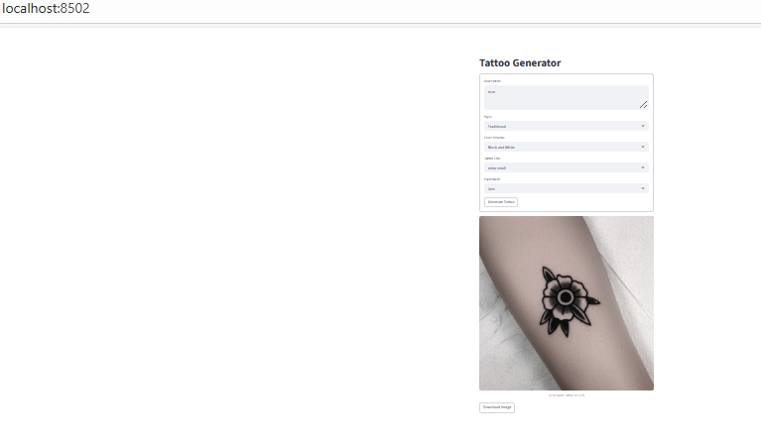
Results / Output

Slide 8
Conclusion & GitHub Showcase
GitHub: https://github.com/mounikav-source/AI-Powered-tattoo-design-generator-main
Streamlit : https://ai-powered-tattoo-design-generator-main-cdaa57dlrmplrrdrutqfhb.streamlit.app/#tattoo-generator
Thank You

