Slide 1
JEWELLERY SHOP WEBSITE DESIGN USING FRONT END TECHNOLOGIES
Presented By:
Y.Mounika

Slide 2
Contents:
FRONT END TECHNOLOGIES
HTML
CSS
ANGULAR
BOOTSTRAP
Sample code
Sample output

Slide 3
HTML:
HTML(Hyper text markup language) is used to define how text should be displayed in a browser.
Structure of HTML document includes tags , attributes and elements.
HTML tags are hidden keywords within a webpage that define how your web browser must format and display the content . Ex:<B> for bold.
Attribute should follow some key terms i.e.,
A space between it and the element name.
The attribute name followed by an equal sign.
The attribute value wrapped by opening and closing tags
Ex:<p class=“nice”>Hello World!</p>
In this <p> </p> represents element , class=“nice” represents attribute.

Slide 4
CSS:
CSS stands for Cascading Style Sheets and provides HTML with layout and design.
CSS is the language we use to style an HTML document.
CSS describes how HTML elements should be displayed.
Some of the most important CSS properties are:
Color - specifying text color.
Font-family - specifying font type.
Font-size - specifying font size.
Text-decoration - specifying text decorations, such as underline.
Font-style - specifying font styling, such as italics.
Font-weight - specifying font weight, such as bold.

Slide 5
ANGULAR:
Angular is a platform and framework for building single-page client applications using HTML and TypeScript. Angular is written in TypeScript. It implements core and optional functionality as a set of TypeScript libraries that you import into your applications.
The basic building blocks of the Angular framework are Angular components that are organized into NgModules. NgModules collect related code into functional sets; an Angular application is defined by a set of NgModules. An application always has at least a root module that enables bootstrapping, and typically has many more feature modules.
Modules, components and services are classes that use decorators. These decorators mark their type and provide metadata that tells Angular how to use them.
Angular is a complete rewrite from the same team that built AngularJS.

Slide 6
BOOTSTRP:
Bootstrap is a free front-end framework for faster and easier web development.
It includes HTML,CSS based design templates for typography,forms,buttons,tables,navigat-ion,modals,image carousals and many other as well as optional IS plugins.
Advantages:
Easy to use and responsive features.
Mobile first approach,Browser compatibility.

Slide 7
Sample code:
<nav class="navbar navbar-expand-lg navbar-red bg-black">
<div class="container-fluid">
<a id="b" class="navbar-brand" href="#Necklace1"><b><h1>JEWELLERY-SHOP</h1></b></a>
<button class="navbar-toggler" type="button" data-bs-toggle="collapse" data-bs-target="#navbarNavDropdown" aria-controls="navbarNavDropdown" aria-expanded="false" aria-label="Toggle navigation">
<span class="navbar-toggler-icon"></span>
</button>
<div class="collapse navbar-collapse" id="navbarNavDropdown">
<div class="column">
<ul id="nav-item" class="navbar-nav-item" >
<li class="nav-inline-item">
<a class="nav-link active" aria-current="page" href="#sect1"><b>Home</b></a>
</li>
</div>
</nav>

Slide 8
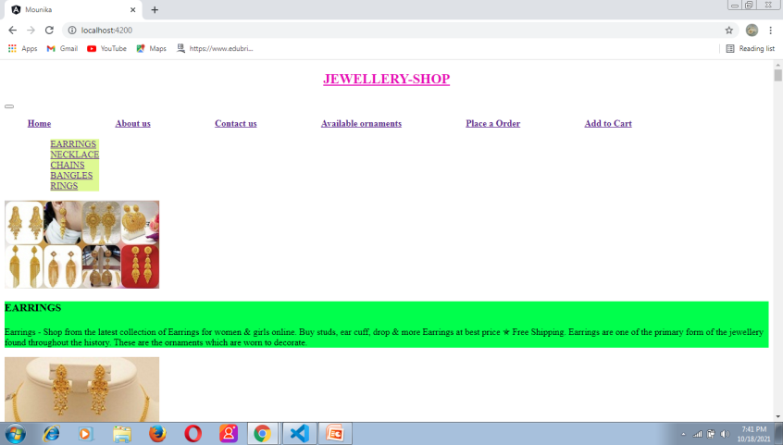
Sample output:

Slide 9
THANK YOU

